Slide 1

UNIT 6
SOCIAL AND CULTURAL ENVIRONMENT

Slide 2
Relationship between society and environment
The relation between human society and environment are constantly changing but the environment is highly valued by a wide variety of people with different interest and values.
Difficulties remain on how to ensure the protection of our present environment and natural resources.
However, a well managed Environment can provide goods and services which are both essential for our well-being as well as for continued economic prosperity.

Slide 3
Contd….
Research and teaching in this area emphasizes that the human relationship to the environment can be biological, economic, political, physical, cultural, chemical and social.

Slide 4
Illustrations:
Natural disasters are not necessarily natural.
Events such as Hurricane Katrina are shaped by physical processes such as climate change, the weather, and hydrology.
Social processes such as land-use decisions, racial inequality and poverty, and political decision-making can transform a large storm into a disaster.
In addition, bio-geophysical and social processes are closely linked and constantly influencing each other.

Slide 5
Society and environment: Issues
Global challenges
  Deforestation
  Global climate change
  Pollution
  Ozone depletion
  Desertification
Law and policy issues
  Environmental management
  Legislation
  Conservation
  Socioeconomics

Slide 6
Contd….
Ecological systems (human-environmental impact)
  Soil degradation
  Landform change
  Hydrology (Water cycle)
  Plant distribution
  Climatology (study of climate)

Slide 7
Concept of culture of human civilization
Culture is the “key” to understanding human life and death.
Culture is a group phenomenon.
Cultures evolve from the interaction of person with others, and a person’s belief or behavior becomes part of the culture when it is externalized and objectified.
When it is understood , the concept of the way human life is organized.

Slide 8
CIVILIZATION
Group of people living and working together for the purpose of creating an organized society.
“The highest cultural grouping of people which distinguishes humans from other species”
“Complex systems or network of cities that emerge from pre-urban culture”

Slide 9
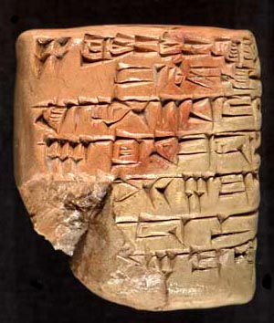
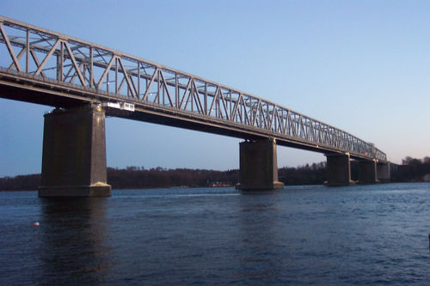
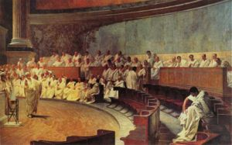
EIGHT BASIC FEATURES OF A CIVILIZATION
Writing Systems
(2) Infrastructure- public works such as bridges, roads etc.
(3) Government / Laws

Slide 10
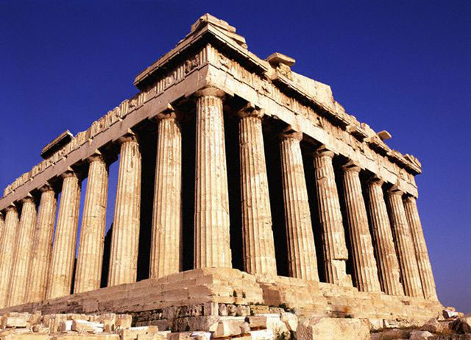
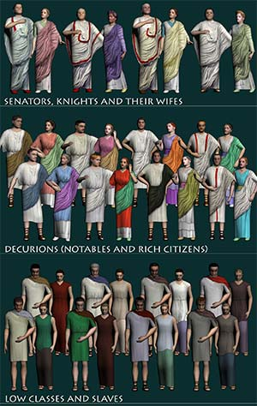
(4) Art / Architecture
(5) Social Classes

Slide 11
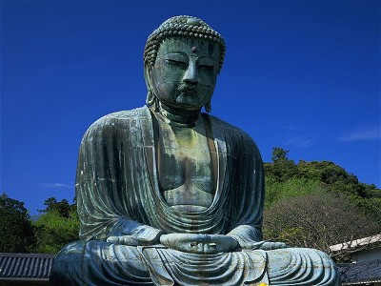
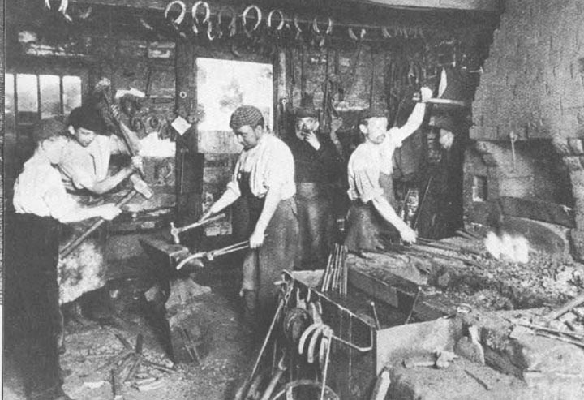
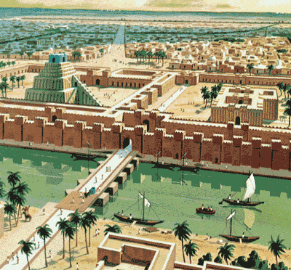
(6) Organized Religion
(7) Job Specialization
(8) Development of Cities

Slide 12
Historical development of society and culture
The anthropologists tend to classify different societies according to the degree to which different groups within the society have unequal access to the advantages such as resources, prestige, and power.
All the societies have developed some degree of inequality among their people through the process of social stratification, the division of members of society into levels with unequal wealth, prestige, and power.

Slide 13
Stages/types of Civilization
Hunting and Gathering Societies
Horticultural Societies(culture of cultivated plants)
Pastoral Societies
Agrarian Societies
Commercial/Industrial Societies

Slide 14
Stages/types of Civilization
Hunting and Gathering Societies. Those peoples whose technology is designed to use primarily wild game and plant resources.
Horticultural Societies. Societies that depend primarily on cultivated plants for subsistence, but that lack the use of draft animals and the plow.
Pastoral Societies. People who emphasize the raising of livestock.
Agrarian Societies. Societies that depend mainly on plant cultivation, and that use draft animals and plows.
Commercial/Industrial Societies. Societies with a majority of the population engaged in trade and manufacturing.

Slide 15
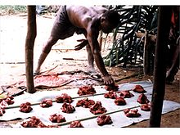
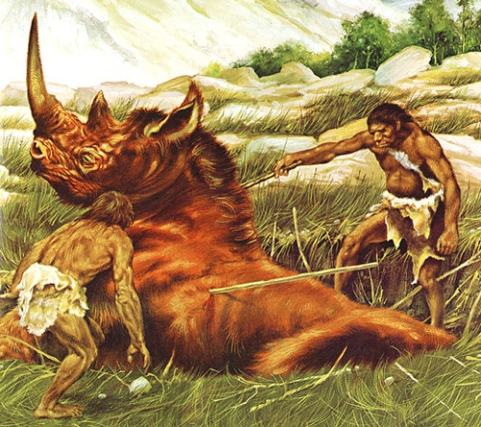
Hunting and gathering Societies
Societies that rely primarily or exclusively on hunting wild animals, fishing, and gathering wild fruits, berries, nuts, and vegetables to support their diet.
For million years or more of hominid history, our ancestors lived in hunting and gathering societies.

Slide 16
Contd..
Despite their longevity, hunting and gathering societies may soon be extinct because they are unable to compete with technologically more advanced societies for territories and other vital resources.
They were more intelligent and probably better able to communicate among themselves than were their hominid forebears, although they inherited a number of valuable customs and technologies from them.

Slide 17
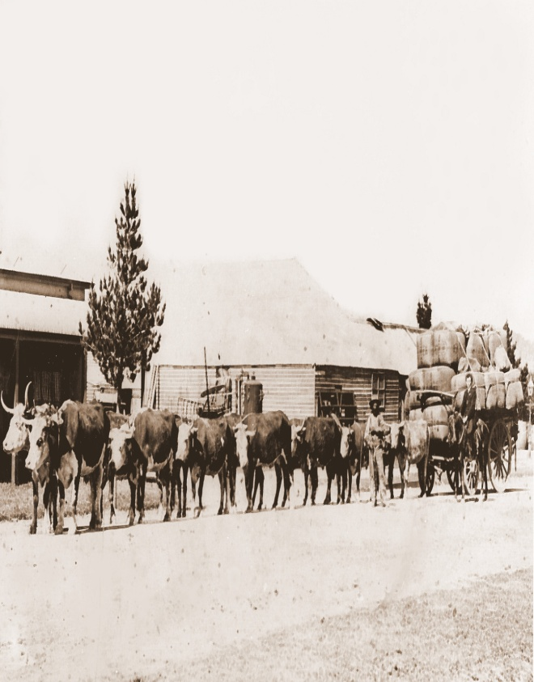
Horticultural societies
Horticultural societies are differentiated from hunting and gathering societies by the use of domesticated plants as the major basis for subsistence.
Horticultural societies are technically differentiated from agrarian societies by their lack of plows and animal traction, and from pastoral societies because they do not make domesticated herd animals the main basis of subsistence.

Slide 18
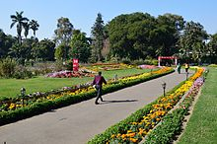
Contd…..
Horticultural societies have agricultural systems that are relatively unproductive per unit of human labor compared to plow agriculture, and more productive per unit land area than hunting and gathering.

Slide 19
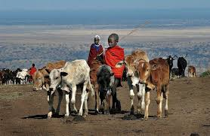
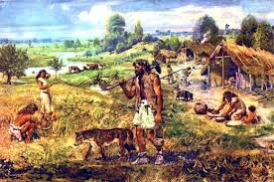
Pastoral Societies
The word 'pastoral' comes from the Latin root word pastor, which means 'shepherd.‘
A pastoral society is a social group of pastoralists, whose way of life is based on pastoralism, and is typically nomadic. Daily life is centered upon the tending of herds or flocks.
Pastoral societies are often organized in tribes, with the ‘household,' often incorporating the extended family, as a basic unit for organization of labor and expenses
The types of livestock used in pastoral societies are all herding herbivores, such as sheep, buffalo, camels, reindeer, goats, or cattle.

Slide 20
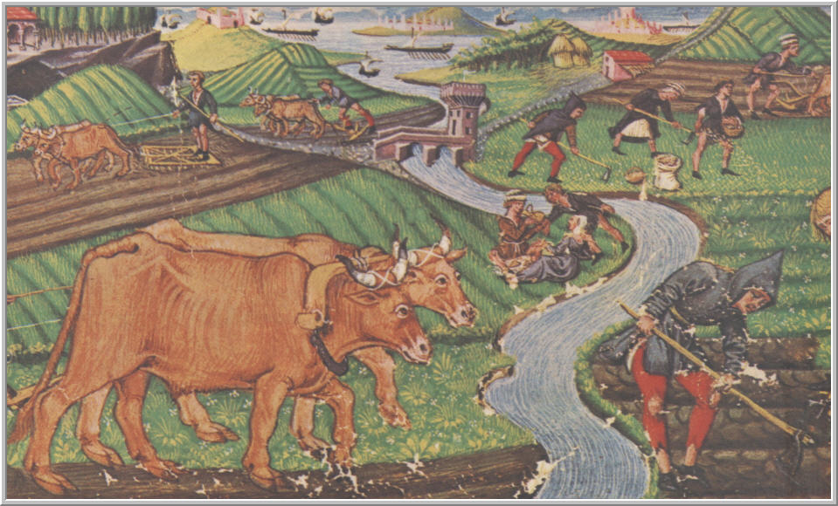
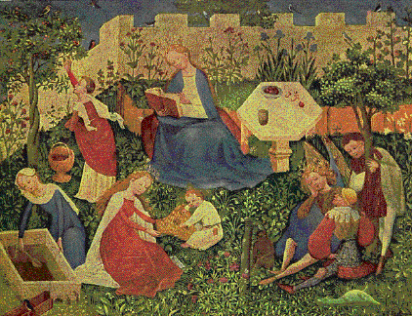
Agrarian Societies
An agrarian society (or agricultural society) is any society whose economy is based on producing and maintaining crops and farmland.
In an agrarian society cultivating the land is the primary source of wealth. Such a society may acknowledge other means of livelihood and work habits but stresses the importance of agriculture and farming.

Slide 21
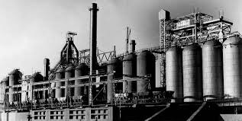
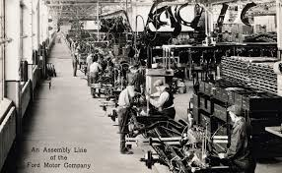
Commercial/Industrial Societies
Industrial society refers to a society driven by the use of technology to enable mass production supporting a large population with a high capacity for division of labor.
Industrial society is characterized by the use of external energy sources, such as fossil fuels, to increase the rate and scale of production.

Slide 22
Concept of indigenous knowledge
Indigenous knowledge is one of the greatest assets of a community.
Indigenous Knowledge means local knowledge that is unique to a given society and is embedded in their cultural traditions.
Indigenous Knowledge is an important part of the culture and history of any local community.
Through indigenous knowledge, local communities have been able to cope and adapt with the devastating effects(badly damage and effect to wildlife) of increased climate variability manifested through frequent droughts and floods.

Slide 23


Indigenous Knowledge
Local or indigenous knowledge refers to the cumulative and complex bodies of knowledge, know – how, practices and representations that are maintained and developed by local communities who have local communities who have long histories of interaction with the natural environment (UNESCO 2012)

Slide 24
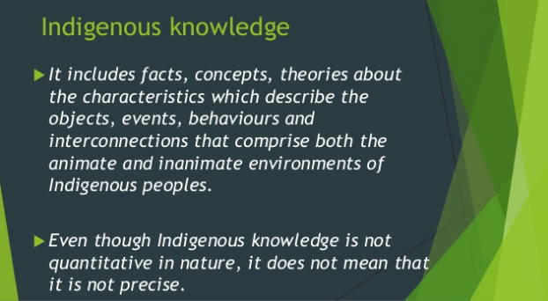

Slide 25
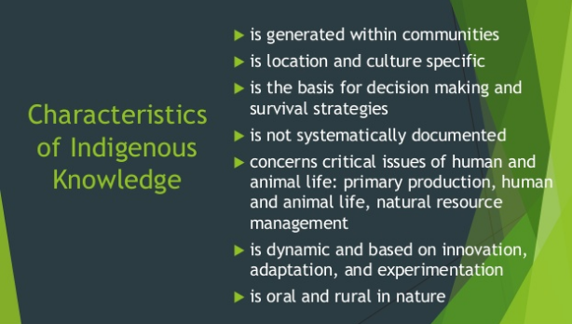

Slide 26
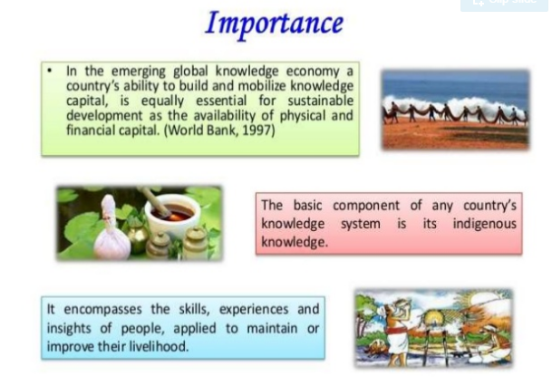

Slide 27
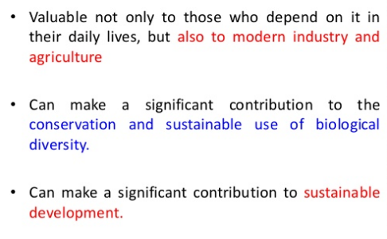

Slide 28
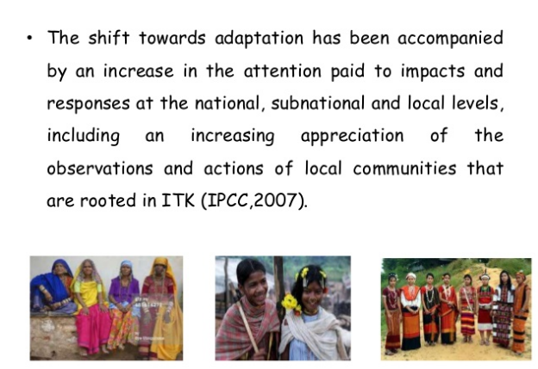

Slide 29
Use of indigenous knowledge on environmental conservation
Indigenous forest management system in Nepal are of diverse nature and community specific. Forest resources in the hills and mountains have been protected for years through local people’s age old technical knowledge.
Indigenous communal forest management system and the typical rules and regulations associated are documented, and are believed to be many generation old knowledge.
Singi Nawa- In Sherpa language, Singi means wood or trees and Nawa means to ask. So, Singi nawa means to ask someone before cutting any trees or woods. This is a custom the Sherpa’s have been practicing for many years.

Slide 30
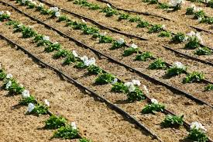
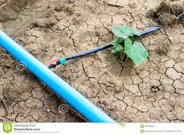
A wide range of Indigenous Technical Knowledge (ITK) related to natural water resources management form Nepal grouped under indigenous farmer managed irrigation systems, drinking water sources management systems, diversion channels, and indigenous milling and grinding techniques have been found.
Indigenous grinding/milling techniques are widespread in the hills of Nepal.
Indigenous technology knowledge for watershed management in Nepal including ITK on water conservation, irrigation canal management, and fishing have been found.

Slide 31
Contd…
Yarsagumba is an unique herb that grows in the Himalayan region of Nepal. The trade of yarsagumba is increasing and it has been regarded as an expensive life saving tonic.
Headache, toothache or any other disease-Yarsagumba is the remedy.
Titepati is plant meaning bitter leaves in Nepali language. It is used as herb for many kinds of diseases. It tis used as a paste for any cuts or bruises. People drink this liquid as they believe that it washes away all the dirts or diseases inside the body.

Slide 32
Contd…
Increased protection of the Intellectual property of Indigenous nationalities from exploitation including pharmaceutical companies and other multinational companies.
Opportunity to equitable sharing of benefits from the use of biological resources and knowledge.
Preserving genetic variety is pointless unless the IK that supported the traditional farming systems is also preserved.

Slide 33
Contd…
Nepal has been a part to the UN Convention on Biological Diversity (CBD) since February 1994.
The main objective of the convention is to ensure conservation of biological diversity, sustainable use of its components and fair and equitable sharing of the benefits arising from the use of genetic resources.
Included in the CBD is the recognition of “the close and traditional dependence of many indigenous and local communities” on biological resources, and the outstanding knowledge about biodiversity that these communities hold.

Slide 34
Thank you

