Slide 1
Concept & scope of preventive health:

Slide 2
Concept & scope of preventive health:
Concept of preventive health:
Preventive health is the use of recognized proactive health screenings, counseling and maintenance to prevent future illness and treatment.
Some preventable health issues are brought by patient behaviors like smoking and environmental or workplace exposure to harmful substances.
Preventive health is also known as “preventive medicine or prophylaxis”.

Slide 3
Cont…..
Preventive health measures save insurance providers and patients from expensive healthcare costs in the long run while providing better patient outcomes.
Usually, these benefits motivate healthcare insurance providers to cover preventive health measures.
Preventive health measures focus on preventable disease, injury and patient illness that can be caught early to save the patient suffering from the resulting condition.
Aside from regularly advised healthy diet and exercise, physicians use other preventative health measures.

Slide 4
Cont….
By using early screenings, warning signs for many health conditions can be detected and the conditions prevented or their impact reduced if they are found early.
Including regular doctor checkups and appropriate immunizations, proactive screening measures can help discover many health conditions in their early stages, including depression, sexually transmitted infections (STI), cancer and diabetes.
Preventive health also focuses on counseling to address patient behaviors and educate patients on how these factors can affect their health. Diabetes, smoking, obesity and STI risks are common counseling topics when addressing patient behavior and awareness in preventive health.

Slide 5
Cont….
So, to bring back to the normal condition form any stage of natural history of disease is the main aim of preventive medicine.
The goals of preventive medicine are to promote health to preserve health, to restore health when it is impaired and to minimize suffering and distress.
All these goals and phenomena of intervention to breakdown the transmission, onset and causation of disease fall under “Prevention”.

Slide 6
For successful prevention, knowledge of the epidemiology of disease is essential which gives answers about when to provide prophylaxis, introduce intervention, minimize one’s exposure to risk factors, apply treatment measures, etc.
In a narrow sense, prevention simply means inhibiting the development of disease before it occurs.

Slide 7
Cont…..
According to the U.S. Centers for Disease Control and Prevention (CDC), 7 out of 10 Americans die each year from chronic diseases, many of which are preventable.
When preventive care is used and illnesses and diseases are caught early enough, individuals can avoid or better control their health problems.
In its broadest definition, prevention includes a healthy lifestyle, exercise, diet and other similar efforts.

Slide 8
Cont…..
Preventive care in a medical setting includes a variety of health care services, such as a physical examination, screenings, laboratory tests, counseling and immunizations.
Preventive care is important because it helps you stay healthy and access prompt treatment when necessary, and it can also help reduce your overall medical expenses.
Stay healthier and get more effective treatment – Many types of screenings and tests can catch a disease before it starts.

Slide 9
Cont…..
Pay less for medical expenses – Preventive care saves you money in two ways:
i. First, preventive care helps lower the long-term cost of managing disease because it helps catch problems in the early stages when most diseases are more readily treatable.
ii. Second, many preventive services are now covered in full by insurance due to the Affordable Care Act (ACA), which means they are free for you if you have health insurance.

Slide 10
Cont…
Ultimately, preventive care provides the benefit of saving lives and improving the quality of your health for years to come.

Slide 11
Level of prevention:
In 1952 Public Health Classifications: Primary, Secondary, and Tertiary Prevention
However, in current usage, the term has been extended to include measures that interrupt or slow the progression of disease. They are:
Primordial prevention: is prevention of the emergence or development of risk factors in countries or population groups in which they have not yet appeared.
Primary prevention (appropriate in the stage of susceptibility) is prevention of disease by altering susceptibility or reducing exposure for susceptible individuals;

Slide 12
3. Secondary prevention (applied in early disease, i.e., preclinical, a clinical stages) is about early diagnosis and adequate treatment of disease and treating before being irreversible/permanent;
4. Tertiary prevention (applied in the late stages of disease) focuses on to reduce the impairments and disabilities.

Slide 13
1. Primordial prevention
Primordial prevention a non-specific and a new concept is receiving special attention in the prevention of chronic disease.
The primordial prevention in its purest sense is the prevention of the emergence or development of risk factors in countries or population groups in which they have not yet appeared.

Slide 14
The major focus of primordial prevention is on the prevention of chronic disease.
The main intervention activity applied in primordial prevention is individual and mass communication.
Primordial prevention can be applied in such case by discouraging children from adopting harmful lifestyles. It is also applicable in the developing countries including Nepal.

Slide 15
l.
2. Primary prevention:
It is both non-specific and specific (biomedical immunization chemo prophylaxis) prevention which can be defined as “action taken prior to the onset of a disease which removes the possibility that a disease will even occur”.
It signifies intervention in the pre-pathogenesis phase of a disease or health problem.
Primary prevention may be accomplished by measures designed to promote general health and well-being and quality of life by specific protective measures.

Slide 16
It includes the concept of "positive health", a concept that encourages achievement and maintenance of "an acceptable level of health that will enable every individual to lead a socially and economically productive life".
Primary prevention is far more that averting the occurrence of a disease and prolonging life.
Primary prevention is a ‘holistic’ approach.

Slide 17
This approach is directed towards socio-economic behavior and life style change.
To have an impact on the population,
population (mass) strategy and high-risk strategy should be implemented as they are usually complementary.
It promotes health to protect against special disease agents and hazards in the environment.

Slide 18
It utilizes knowledge of the pre-pathogenesis phase of disease embracing the agent host and environment.
Prevention of the occurrence of disease consists of measures that fall into two major categories: general health promotion and specific protective measures.
General health promotion includes provision of conditions at home, work and school that favor healthy living, e.g., good nutrition, adequate clothing, shelter, rest and recreation.

Slide 19
It also encompasses the broad area of health education which includes not only instruction in hygiene, but also such diverse areas as sex education, anticipatory guidance for children and parents and counseling in preparation for retirement
Specific protective measures include immunization, environmental sanitation (e.g. purification of water supplies) and protection against accidents and occupational hazards.
Here, primary prevention focuses on changing socio-economic behavior and lifestyle change.

Slide 20
NOTE:
Population (mass) strategy
Another preventive approach is "population strategy" which is directed at the whole population irrespective of individual risk levels. For example, studies have shown that even a small reduction in the average blood pressure or serum cholesterol of a population would produce a large reduction in the incidence of cardiovascular disease.
The population approach is directed towards socio-economic, behavioral and lifestyle changes.

Slide 21
High-risk strategy
The high-risk strategy aims to bring preventive care to individuals at special risk.
This requires detection of individuals at high risk by the optimum use of clinical methods.

Slide 22
.
3. Secondary prevention
It can be defined as “action which halts the progress of a disease at its incipient stage and complications. The interventions of this can be either specific or non-specific.
This prevention is largely the domain of clinical medicine.
The health programmes initiated by government are usually at the level of secondary prevention.
The drawback of this prevention is that the patient has already been subject to mental anguish, physical pain and the community to less of productivity

Slide 23
The specific interventions are early diagnosis (e.g., screening tests, case finding programmes) and adequate treatment.
With such measures it is sometimes possible to cure disease or slow its progression, prevent complications, limit disability, and reverse communicability of infectious diseases.
On a community basis, early treatment of persons with infectious diseases (e.g., sexually transmitted infections) may protect others from acquiring the infection and thus provide at once secondary prevention for the infected individuals and primary prevention for their potential contacts.

Slide 24
Because of our inability to prevent certain disease, efforts at control of many chronic diseases center primarily on secondary prevention.
Examples are diabetes, hypertension, carcinoma of cervix, and glaucoma.
As is true of primary prevention, secondary prevention is a responsibility of physicians both in private practice and in community post.
Health departments and other community agencies often conduct screening surveys designed to uncover asymptomatic disease and to alter the natural history of the condition detected.

Slide 25
4. Tertiary Prevention
It is very specific prevention.
It signifies intervention in the late pathogenesis phase and can be defined as “all measures available to reduce or limit impairments and disabilities, minimize suffering cause by existing departures from good health and to promote the patient adjustment to irremediable conditions.
Modern rehabilitation includes psychosocial vocational and medical components based on teamwork from a variety of professions.

Slide 26
Tertiary prevention is the prevention applied at the late stage of the disease.
This consists of limitation of disability and rehabilitation where disease has already occurred and left residual damage.
Its major theme is maximal utilization of the individual’s residual capacities, with emphasis on remaining abilities than on losses.
Since modern rehabilitation includes psychosocial and vocational as well as medical components, it calls for good teamwork from a variety of professions.

Slide 27
It may also require extensive physical facilities (such as special vehicles and modifications of the home setting) and sufficient funding to provide a variety of services over a prolonged period of time.
Until the occurrence of death, it may be possible throughout the evolution of a disease process to apply appropriate measures to prevent continued progression and deterioration of the patient’s condition.
The different levels of prevention can be fully understood only in relation to the natural history of disease.

Slide 28
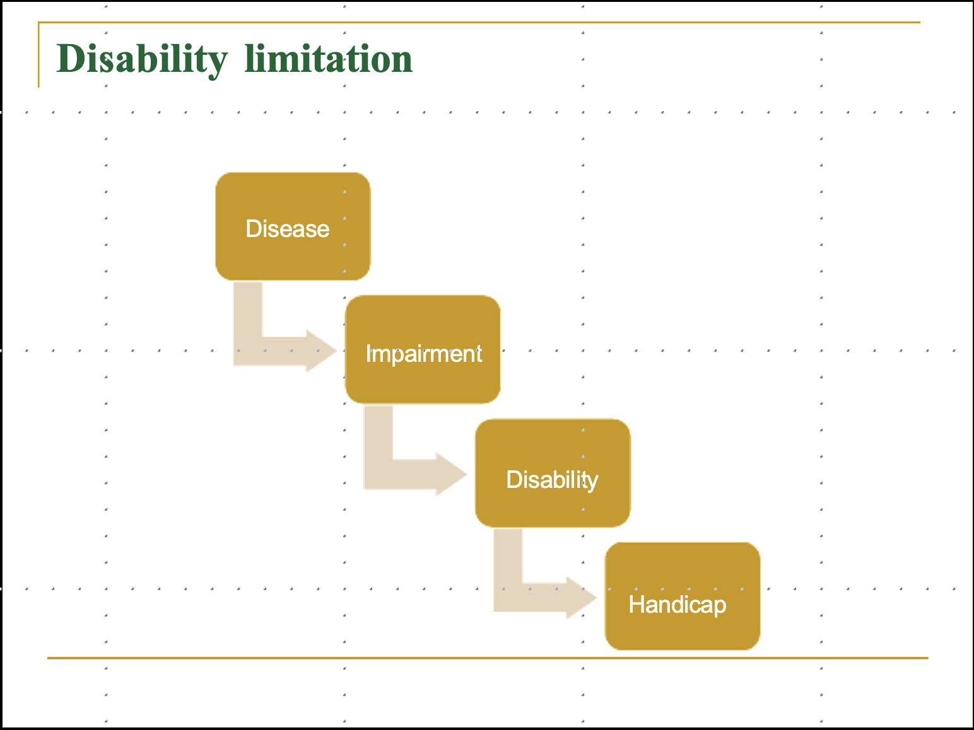

Slide 29
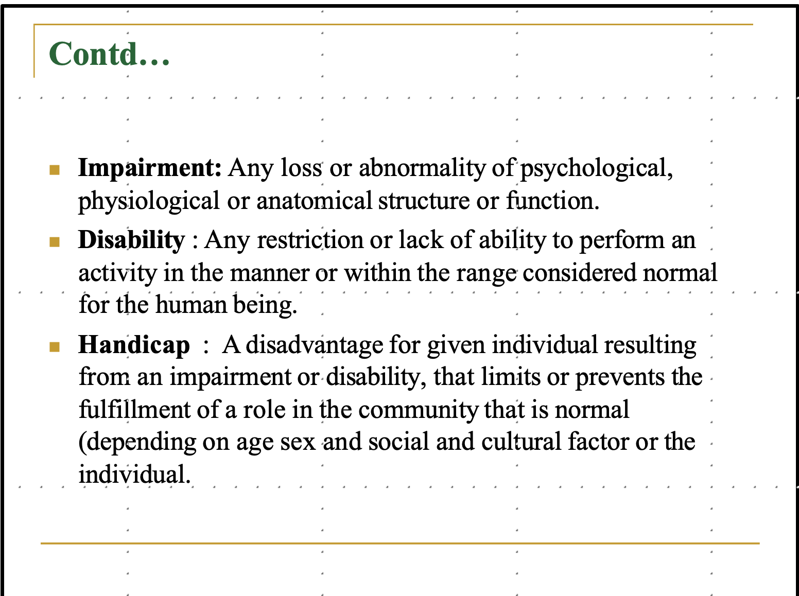

Slide 30
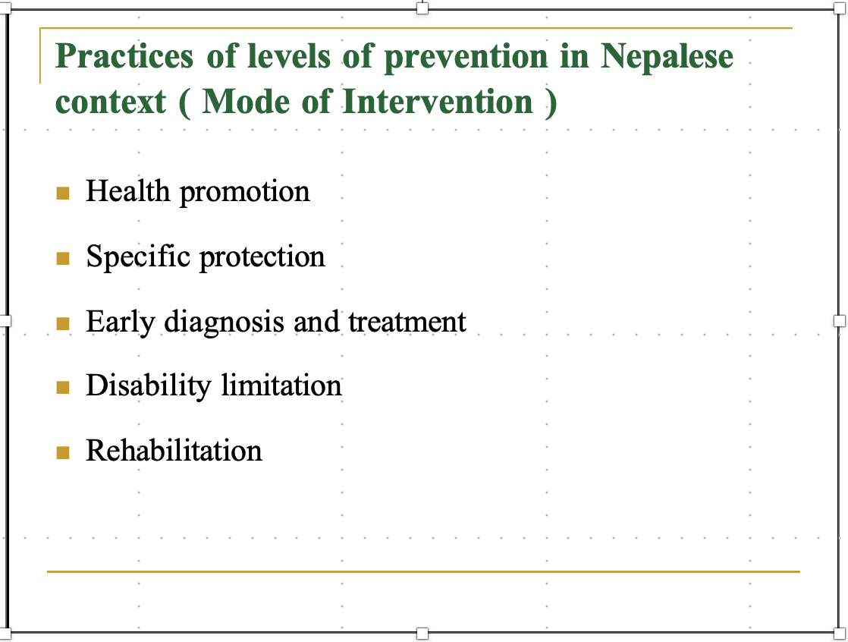

Slide 31
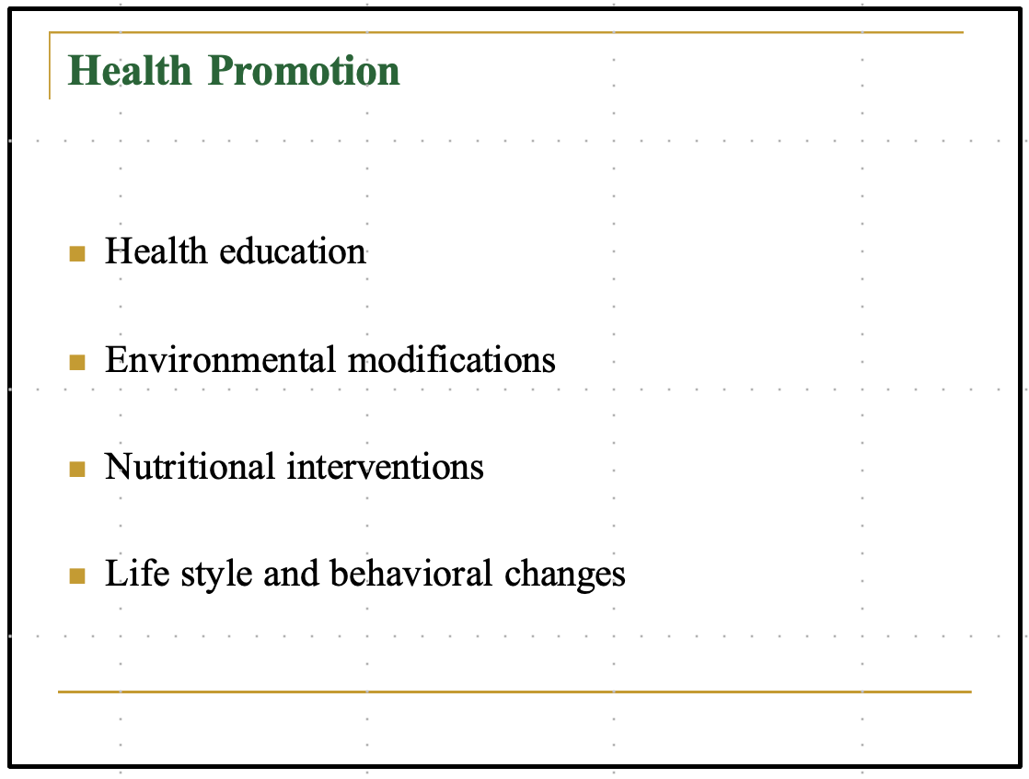

Slide 32
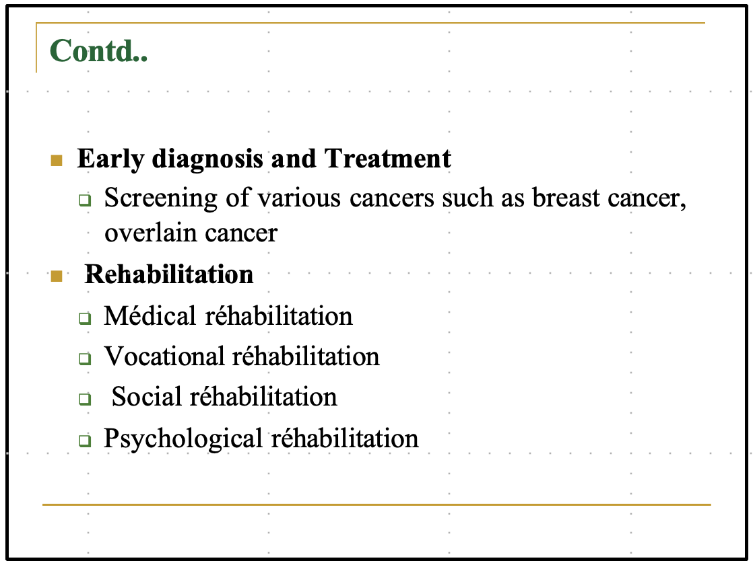

Slide 33
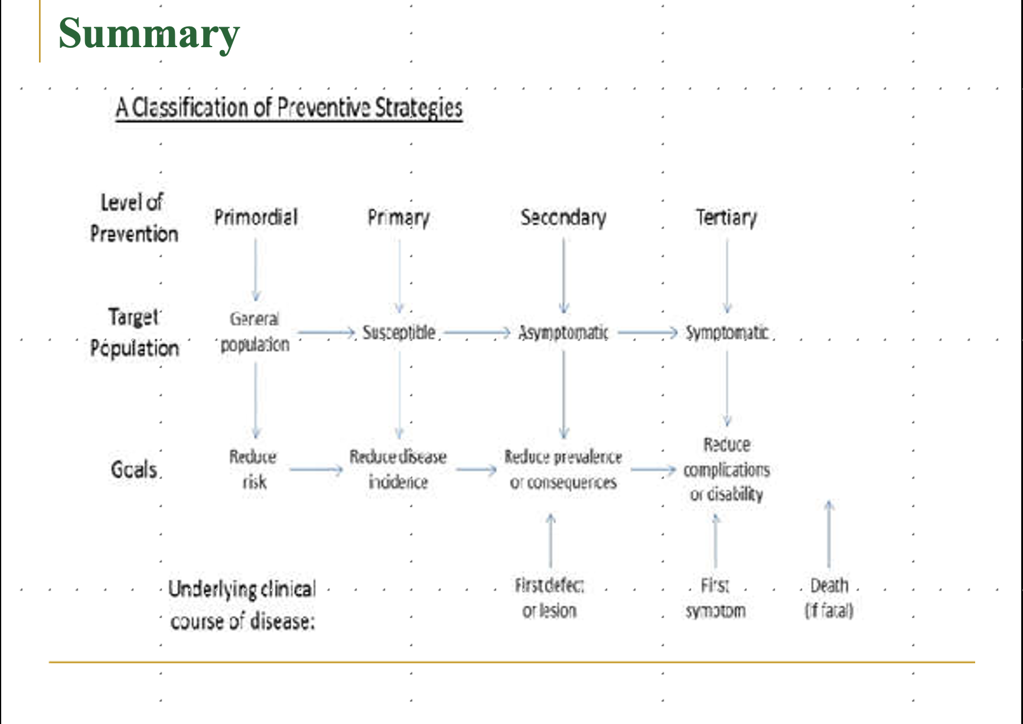

Slide 34
The End

