Slide 1
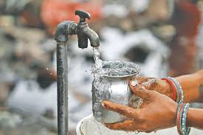
Water Pollution and Health
Rajendra Lamichhane, BPH (PU) MA (TU), MPH (BPKIHS)
Email: rajendralamichhane14@gmail.com

Slide 2
Water:
General requirement of the body is 2 liters per day.
On average a person needs 7.5-15 liters water per day for general purposes
Almost 80% diseases can be avoided providing safe drinking water.
A daily supply of 150-200 litres per capita is considered as an adequate supply to meet the needs for all urban domestic purposes.

Slide 3
Functions and importance of water in human body
The body loses water through breathing, sweating, and digestion, which is why it's important to rehydrate by drinking fluids and eating foods that contain water
Body uses water in all its cells, organs, and tissues to help regulate its temperature and maintain other bodily functions

Slide 4
Functions of Water in the Body
The human body is anywhere from 55% to 78% water depending on body size. Here is the %:
• Muscle consists of 75% water • Brain consists of 90% of water • Bone consists of 22% of water • Blood consists of 83% water

Slide 5
The functions of water in human body are vital.
There are several things that water does for your body:
• Transports nutrients and oxygen into cells • Moisturizes the air in lungs • Helps with metabolism • Protects our vital organ • Helps our organs to absorb nutrients better • Regulates body temperature • Detoxifies • Protects and moisturizes our joints

Slide 6
Every Cell in Your Body NEEDS Water
Every cell in your body needs water from head to toe.
That is why it is so important to drink enough fluid.
the brain consists of 90% water, if we do not supply enough water to our body, our brain cannot function well, and we will get a headache or a migraine.
When we feel fatigue or have a headache, it may be the sign of dehydration.

Slide 7
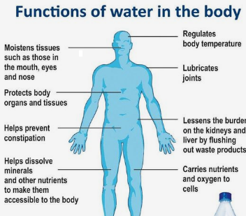

Slide 8
Importance of Water
4. Lose weight: Drinking water helps you lose weight because it flushes down the by-products of fat breakdown. Drinking water reduces hunger; it’s an effective appetite suppressant so you’ll eat less. Plus, water has zero calories.
5. Natural Remedy for Headache: Helps to relieve headache and back pains due to dehydration. Although many reasons contribute to headache, dehydration is the common one.
6. Look Younger with Healthier Skin: You’ll look younger when your skin is properly hydrated. Water helps to replenish skin tissues, moisturizes skin and increases skin elasticity.

Slide 9
Contd…..
7. Better Productivity at Work: Your brain is mostly made up of water, thus drinking water helps you think better, be more alert and more concentrated.
8. Better Exercise: Drinking water regulates your body temperature. That means you’ll feel more energetic when doing exercises. Water also helps to fuel your muscles.
9. Helps in Digestion and Constipation: Drinking water raises your metabolism because it helps in digestion. Fiber and water goes hand in hand so that you can have your daily bowel movement.
10. Less Cramps and Sprains: Proper hydration helps keep your joints and muscles lubricated, so you’ll less likely get cramps and sprains.

Slide 10
Contd…
8. Less Likely to Get Sick and Feel Healthy:
9. Hygiene
Personal Hygiene
Domestic use
10. Sanitation
House holds
Surrounding of house
shed
11. Others

Slide 11
Contd…..
12. Relieves Fatigue: Water is used by the body to help flush out toxins and waste products from the body. If your body lacks water, your heart, for instance, needs to work harder to pump out the oxygenated blood to all cells. So are the rest of the vital organs, your organs will be exhausted and so will you.
13. Good Mood: Your body feels very good and that’s why you feel happy.
14. Reduce the Risk of Cancer: Related to the digestive system, some studies show that drinking a healthy amount of water may reduce the risks of bladder cancer and colon cancer. Water dilutes the concentration of cancer-causing agents in the urine and shortens the time in which they are in contact with bladder lining.

Slide 12
Use of water
Domestic use
Public purpose
Industrial purpose
Power production from hydropower and steam power
Agriculture purpose
Charring away waste from manner

Slide 13
Safe and Wholesome Water:
Free from pathogenic agents
Free from harmful chemical substances
Pleasant to taste (free from colour and odour)
Usable for domestic purpose
*Water is said to be polluted or contaminated if it does not fulfill above criteria.

Slide 14
Sources and availability of water in Nepal
Nepal is among the richest in terms of water resource availability and it is one of the most important natural resource of the country. Water resources are abundant throughout the country in the form of snow covers, rivers, springs, lakes, and groundwater.

Slide 15
Sources of Water
Rain water
Surface water
Impounding reservoirs
River and streams
Tanks, ponds and lake
3. Ground Water
Shallow wells
Deep wells
Springs.

Slide 16
1. Rain Water:
Is the prime source of all water
Is the purest form of water in nature
Chemically, it is very soft water: contains traces (0.0005%) of solids
Impurities: Rain water tends to become impure as it passes through the atmosphere. It picks up suspended impurities from the atmosphere such as dust, soot and microorganisms and gases such as carbondioxide, nitrogen, oxygen, and ammonia

Slide 17
2. Surface water:
i. Impounding reservoirs
Artificial lakes for storing large quantities
Next to rain water in purity
-Impurities: The upland surface water derives its impurities from the catchment area; human habitation, even if there is no human habitation or cattle near, there is still a possibility of contamination caused by wild animals.

Slide 18
2. Surface water…
ii River and Streams
The chief drawback of river water is that it is always grossly polluted and is quite unfit for drinking without treatment
Turbid during rainy season; it may be clear in other seasons.
River water contains dissolved and suspended impurities of all kinds.
Rivers are described as a direct connection between the alimentary canal of the people living upstream and the mouth of those below.
The impurities of river water derived from surface washings, sewage and sullage water, etc.

Slide 19
2.Surface water…
iii Tanks and ponds
-Tanks and ponds are used for washing of clothes, cattle, humans, cooking pots; children use it for swimming and there may be regular defecation around the edges which will be washed into the tank at the next rains.
-A certain amount of natural purification does take place in tank water because of storage, oxidation and other agencies but these are not sufficient to render the water safe.

Slide 20
3. Ground Water
Shallow wells
Taps the water from above the first impervious layer
Moderately hard
Often grossly contaminated
Usually goes dry in summer
ii. Deep Wells
Taps the water from below the first impervious layer
Much harder
Taps pure water
Provides a source of constant supply

Slide 21
3. Ground Water…
iii. Springs:
when ground water comes to the surface and flows freely under natural pressure, it is called a spring.
Spring may be two types shallow springs and deep springs
shallow springs dry up quickly during summer months, whereas deep springs do not show seasonal fluctuations in the flow of water.
Springs are exposed to contamination. Well built protective structures are necessary to safeguard water quality.

Slide 22
Sanitary Well
A sanitary well is one which is properly located, well constructed and protected against contamination with a view to yield a supply of safe water
Point should be taken in to consideration while constructing sanitary well
Location: choosing of proper site. If bacterial contamination is to be avoided, the well should be located not less than 15 m (50 feet) from likely sources of contamination.
2. Lining: the lining of the well should be built of bricks or stones set in cement up to a depth of at least 6 m (20feet)

Slide 23
Point should be taken in to consideration while constructing sanitary well…
3. Parapet wall: There should be a parapet wall up to a height of at least 70-75 cms (28 inch) above the ground
4. Plat form: There should be cement-concrete platform round the well extending at least 1 m in all directions.
5. Drain: There should be a pucca drain to carry off spilled water to a public drain
6. Covering: The top of the well should be closed by a cement concrete cover. Studies have shown that merely covering a well alone caused a marked improvement in bacteriological quality
7. Hand-pump: The well should be equipped with hand pump
8. Consumers responsibility:
The provision of sanitary wells does not guarantee freedom from water-borne diseases unless the consumers observe certain basic precautions at the individual and family level

Slide 24
Sources and Health Effects of Water Pollution

Slide 25
Water Pollution
Water Pollution is the introduction of chemical, physical or biological substance into water that degrades the quality of the water and affects organisms that drink it and live in it. Water Pollution is the contamination of water by foreign matter such as micro-organisms, chemicals, industrial or other wastes, or sewage.
"Water pollution" is defined as the addition of harmful or objectionable material causing an alteration of water quality.

Slide 26
Major pollutants of water :
Sewage and other oxygen-demanding wastes (largely carbonaceous organic material, the decomposition of which leads to oxygen depletion).
Infectious agents.
Plant nutrients that can stimulate the growth of aquatic plants, which then interfere with water uses and, when decaying, deplete the dissolved oxygen and produce disagreeable odours.
Exotic organic chemicals, including pesticides, various industrial products, surface-active substances in detergents, and the decomposition products of other organic compounds.

Slide 27
Major pollutants of water….
Petroleum, especially from oil spills.
Inorganic minerals and chemical compounds.
Sediments consisting of soil and mineral particles washed by storms and flood water from croplands, unprotected soils, mine workings, roads, and bulldozed urban areas.
Radioactive substances from the wastes of uranium and thorium mining and refining, from nuclear power plants, and from the industrial, medical, and scientific use of radioactive materials.

Slide 28
Human activities that contribute to water pollution
Overgrazing
Poor agricultural land management
Removal of riparian vegetation
Sewage, industrial, and domestic discharges
Construction, Mining
Release of gases and aerosols to the atmosphere (fog, dust, forest )
Mismanagement of reservoirs
Accidental spills

Slide 29
Effects on Human Health
In developing nations, there are frequent outbreaks of cholera and diseases due to poor drinking water quality from contaminated waters.
Swimming and drinking in contaminated water can causes skin diseases and also can lead to cancer, reproductive problems, typhoid fever and stomach ailments in humans.
heavy metals poisoning due to consumption of contaminated fish. For example : Mercury poisoning interferes with the nervous system development in foetuses and young children.
Polluted drinking water can causes cholera or typhoid infections and also diarrhea.
Highly polluted water can harm internal organs like heart and kidneys. Contd…

Slide 30
Pesticide contamination of ground water can cause endocrine and reproductive problems to animals and humans.
Sewage contamination carries harmful pathogens and causes disease outbreak.
Synthetic organics cause serious damage to human health.
Chemicals like fluoride, arsenic, lead, chlorine and petrochemicals in water can causes adverse effect on human health.
Water borne diseases like hepatitis, cholera, dysentery and typhoid are common and affect large populations
Pesticides like organophosphates and carbonates affect and damage the nervous system and are carcinogenic. Contd...

Slide 31
Lead accumulation in the body can affect the central nervous system, putting children and pregnant women at high risk.
Excess of fluorides causes yellowing of teeth and damage to spinal cord and other crippling diseases.
Nitrate contamination can prove fatal for infants as it can restrict the oxygen to the reach the brain causing the 'blue-baby' syndrome. It can also cause digestive tract cancers and eutrophication in water bodies.
The process of eutrophication can produce aesthetic problems such as bad tastes and odours and unsightly green scums of algae, as well as dense growth of rooted plants, oxygen depletion in the deeper waters and bottom
Arsenic poisoning cause serious liver and nervous system damage, vascular disease and skin cancer.
Contd….

Slide 32
Nitrates (the salts of nitric acid) in drinking water can cause a disease in infants that sometimes results in death.
Cadmium in sludge-derived fertilizer can be absorbed by crops; if ingested in sufficient amounts, the metal can cause an acute diarrhoeal disorder and liver and kidney damage.

Slide 33
River and ground water pollution
Natural Sources
Septic Systems
Improper Disposal of Hazardous Waste
Landfills
Releases and Spills from Stored Chemicals and Petroleum Products
Surface Impoundments
Sewers and Other Pipelines
Poorly constructed wells

Slide 34
River and ground water pollution
-Pesticide and Fertilizer Use
Drainage Wells
Injection Wells/Floor Drains
Improperly Constructed Wells
Improperly Abandoned Wells
Active Drinking Water Supply Wells
Poorly Constructed Irrigation Wells
Mining Activities Active and abandoned

Slide 35
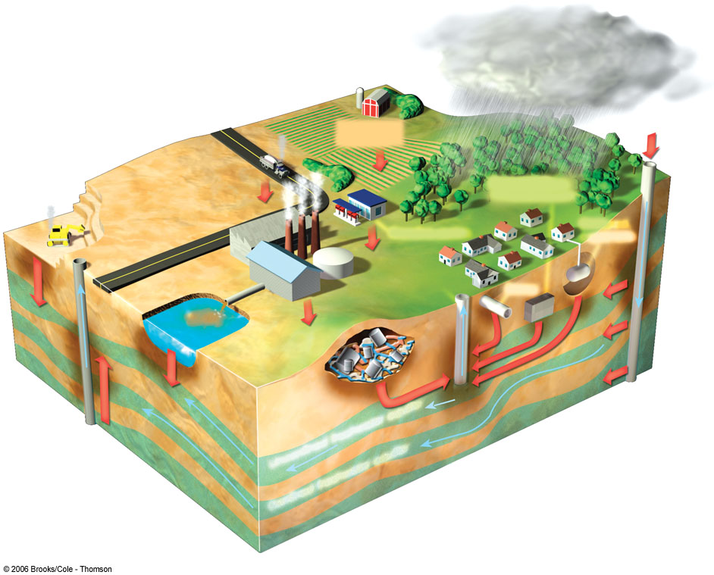
Ground Water Pollution
Polluted air
Hazardous waste injection well
Waste lagoon
Pesticides
and fertilizers
Coal strip mine runoff
De-icing road salt
Buried gasoline and solvent tank
Pumping well
Gasoline station
Water pumping well
Cesspool septic tank
Sewer
Landfill
Leakage from faulty casing
Accidental spills
Discharge
Unconfined freshwater aquifer
Confined aquifer
Confined freshwater aquifer
Groundwater flow

Slide 36
Water and Water Related Diseases

Slide 37
Water Related Diseases
Mans health may be affected by the ingestion of contaminated water either directly or through food; and by the use of contaminated water for purpose of personal hygiene and recreation.

Slide 38
Classification of water related diseases
Biological (Water –borne disease)
Disease due to chemical in water
Water associated problem

Slide 39
Classification…
A. Biological (water-borne diseases)
Those caused by the presence of an infective agent:
Viral : Viral hepatitis A, hepatitis E, poliomyelitis, rotavirus diarrhea in infants
Bacterial: typhoid and paratyphoid fever, bacillary dysentery, Esch.coli diarrhoea, cholera
Protozoal: amoebiasis, giardiasis
Helmenthic; roundworm, threadworm, hydatid disease
Leptospiral: wells disease
2. Those due to the presence of an aquatic host:
Snail : schistosomiasis
b) Cyclops: guineaworm, fish tape worm.

Slide 40
Classification…
B. Disease due to chemical in water
Chemical pollutants of diverse nature derived from industrial and agricultural wastes are increasingly finding their way into public water supplies. These pollutants include detergent solvents, cyanides, heavy metals, minerals and organic acids, nitrogenous substances, bleaching agents, dyes, pigments, sulphides, ammonia, toxic and biocidal organic compounds of great variety.

Slide 41
C. Water associated problems
Dental fluorosis: high levels of fluoride in water
Cyanosis in infant: high levels of nitrate in water
Cardiovascular diseases: hardness of water has a beneficial effect
Diseases like trachoma, scabies and conjunctivitis are transmitted due to inadequate use of water
Some diseases are related to the disease carrying insects breeding in or near water, like: malaria, filaria, arboviruses, onchocerciasis, African trypansomiasis

Slide 42
Water-washed diseases
Water-washed diseases are caused by poor personal hygiene, and skin and eye contact with contaminated water.
They are also sometimes known as water-scarce diseases because they occur when there is not enough water available for adequate personal washing.
They include scabies, trachoma, typhus, and other flea, lice and tick-borne diseases.

Slide 43
Water-based diseases
Water-based diseases are caused by parasites that spend part of their life cycle in water.
For example, schistosomiasis and dracunculiasis are both water-based diseases caused by helminths (parasitic worms).
Schistosomiasis is caused by a worm that spends part of its lifecycle in the body of a particular species of water snail.
People can become infected from swimming or wading in infected water.
Dracunculiasis or guinea worm is transmitted by drinking water that is contaminated with copepods (very small crustaceans) that contain the larvae of the worm

Slide 44
Thank You!

Slide 45
Water Purification

Slide 46
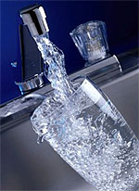
Why water treatment
To make water potable/ safe to drink
Pleasant to taste
Suitable for domestic uses

Slide 47
Purification of water
Purification on large scale
Purification on small scale
Purification of water depends on:
Type of water source
Physical status of the water

Slide 48
Large scale purification comprise of 3 steps:
Storage 2. Filtration 3. Disinfection
1. Storage:
natural way of making water clean
water is made clean not pure
Physical, chemical and biological changes take place
Physical sedimentation of suspended matter
Chemical: oxidation of organic matter; consumption of ammonia and formation of nitrates
Biological: death of pathogens
Optimum storage: 10 to 14 days
Vegetations like algae may develop if stored for more than 2 weeks
*One or more of the components may be used according to the quality of water and the requirements

Slide 49
2. Filtration
Important stage in the water purification
Removes suspended particles
Removes the microorganisms
Efficiency is from 98%-99.99%
Two types of filters are used for the large scale
Slow sand filter
Rapid sand filter

Slide 50
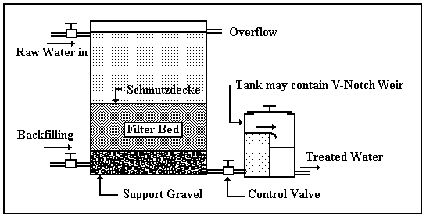
Slow sand Filter
Element of slow sand filter
Supernatent raw water
A bed of graded sand
An under-drainage system and
A system of filter control valves

Slide 51
Slow sand filter…
Consists of sections of filter beds
Fine sand- coarse sand- fine gravel- coarse gravel (e.g. 0.2-0.3 mm)
Working mechanism:
Continuous supply of water to the fine sand surface to create pressure.
sedimentation and oxidation takes place
Rate of flow of water is very slow
A biological layer is formed- vital layer
Vital layer take few days to form
Biological layer oxidizes the organic matter present in water
Filtered water is collected under drainage.
Flow rate 100-200 l/hr/m2 surface area of filter
A minimum depth of .5 m up to 1.5 m is most commonly used

Slide 52
Advantages of slow sand filter
Simple to construct
Simple to operate
Cheaper installation and operation cost
Physical, chemical and biological quality is high
99.9-99.99% efficiency

Slide 53
Cleaning of Slow Sand Filter
Cleaning depends on the quality of raw water
As flow rate slows down the water layer above the sand bed can be drained
the top layer of sand scraped off.
This layer should contain most of the suspended organic matter and silt that was slowing the water flow

Slide 54
Rapid sand filter
Rapid sand filter involves following steps:
Coagulation:
Alum used as coagulant in raw water
Dose depends on turbidity, color
2. Rapid mixing:
Alum mixed water- violent agitation to mix up well
Later slow and gentle stirring of water forms flocs of aluminum hydroxide
Flocs settle down
3. Sedimentation:
coagulated water is let to settle for few hours so that flocs settle down
Thus obtained water is subjected for the filtration
Alum floc is removed by sedimentation
Then followed the filtration like SSF

Slide 55
Comparison of Rapid and Slow Sand Filter
 | Rapid Sand Filter | Slow Sand Filter
Space | Occupies very little space | Occupies large area
Rate of filtration | 200m.g.a.d. | 2-3 m.g.a.d.
Effective size of sand | 0.4-0.7mm | 0.2-0.3mm
Preliminary treatment | Coagulation, sedimentation | Plain sedimentation
Washing | By back washing | By scraping sand bed
Frequent washing | Required | Not required

Slide 56
Comparison of Rapid and Slow Sand Filter…
 | Rapid Sand Filter | Slow Sand Filter
Mechanism of action | Essentially physical | Both physical and mechanical
Operation | Hilly skilled | Less skilled
Removal of turbidity | Good | good
Removal of colour | Good | Fair
Removal of bacteria | 98-99 percent | 99.9-99.99 percent
Suitability | For big cities | For small towns

Slide 57
Small Scale Purification
Boiling
Filtration
Disinfection
Cloth filtration
Solar disinfection

Slide 58

Boiling
Simple way to kill microorganism
Boil as to get the bubbles
Safe method of water treatment
Disadvantages of boiling:
Large amount of fuel required
High cost
Affects the taste of water
May cause accident at home
Chances to be recontaminated
*Boil water vigorously for 1 minute and allow it to cool to room temperature

Slide 59
Filtration
Candle filter
Stone filter
Sand filter
Cloth filter

Slide 60
Candle filter
Removes larger microorganisms
Some virus cannot be removed. (HepA)
Advantages:
Proven reduction of bacteria and protozoa in lab
Ease to use
Long life if filter remains unbroken
Generally of low cost.
Disadvantages:
Low rate of virus inactivation
Lack of residual protection and removal of 100% bacteria- may lead to recontamination
High initial cost
Does not remove dissolved contaminants

Slide 61
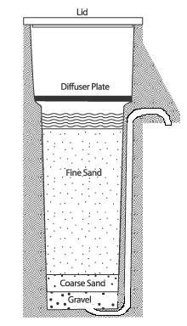
Bios and filter:
It is simply a concrete container, enclosing layers of sand and gravel which trap and eliminate sediments, pathogens and other impurities from the water.

Slide 62
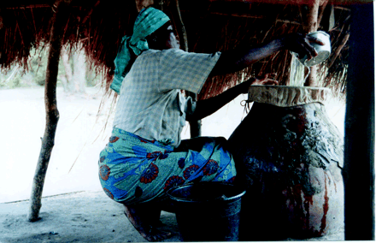
Cloth filter
A fine, thin cotton cloth is used to filter the water.
Helps in reducing suspended particles

Slide 63
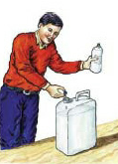
Disinfection:
Physical disinfection: includes boiling and ultraviolet radiation.
Chemical disinfection: includes addition of ozone, chlorine or its compounds.

Slide 64
Chemical disinfection
Bleaching powder
Chlorine solution
High test hypochlorite (HTH)
Chlorine tablets
Iodine solution
Potassium permanganate

Slide 65
Bleaching powder
chlorinated lime containing 33% chlorine
unstable and looses chlorine on exposure to air, light and moisture
Should be stored in a cool, dry and dark place in a closed container resistant to corrosion
The principle is to maintain a free residual chlorine of 0.5 mg/l in the water after a contact period of 1 hour
Not suitable for highly polluted water

Slide 66
Chlorine solution
Can be prepared from bleaching powder or available as chlorine solution in market
Degraded on exposure to air, light and moisture
Should be stored in a cool, dry and dark place in a closed container

Slide 67
High test hypochlorite (HTH)
Also called perchloron
Calcium compound containing 60 to 70% of available chlorine
More stable than bleaching powder
Chlorine tablets
Can be used in small scale
Tablets available in market are expensive
Iodine solution
Emergency disinfection
2 drops of 2% ethanol-solution of iodine can disinfect 1 litre of water after a contact period of 20 to 30 minutes
Disadvantages: expensive; metabolically active

Slide 68
Potassium permanganate
Strong oxidising agent but not a powerful disinfectant
Once popular but not used nowadays
Effective against Vibrio cholerae
Changes the colour, smell and taste of water

Slide 69
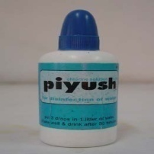
Advantages of chlorination:
Proper chlorination will kill bacteria
Can remove large amounts of iron from water by adding chlorine to oxidize the clear soluble iron into the filterable reddish insoluble form
Chlorine helps remove manganese and hydrogen sulphide in the same way
Disadvantages of chlorination:
Adding chlorine may prevent nitrates from being reduced to the toxic nitrite form only
If the concentration is great enough the water will taste bad so that consumption may be reduced

Slide 70

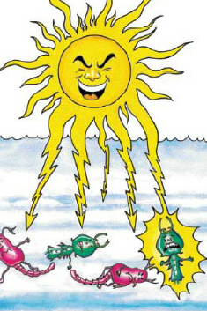
Solar Disinfection (SODIS)
-simple, low cost and effective technology for disinfecting water at household level.
-requires only sunlight and transparent plastic bottles. Both ultra violet radiation & heat provided by sunlight helps to inactivate the bacteria in the water, making the treated water safe for drinking

Slide 71
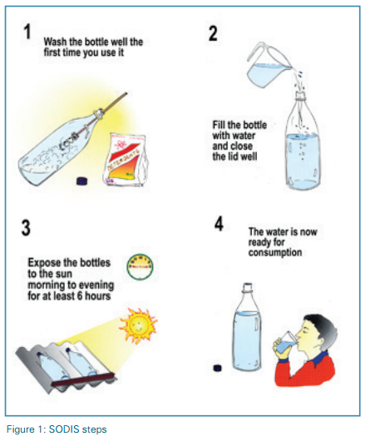
SODIS:
Solar Water Disinfection, improves the microbiological quality of drinking water, using solar UV- radiation and temperature to inactivate pathogens causing diarrhea

Slide 72
The SODIS method consists of the following simple steps:
1. Wash a plastic bottle: The bottle must be clean, transparent, colourless, 2l in volume or smaller, and have all plastic or paper labels removed. We recommend using PET bottles and to wash them with soap before the first usage.
2. Fill bottle with water: Potentially contaminated water is filled into a PET bottle. The water should not be very turbid.
3. Expose bottle to the sun: The bottle is exposed to direct sunlight for one full day (at least 6 hours including noon hours) on mostly sunny days, or 2 days when the sky is more than 50% clouded. On days of continuous rainfall, SODIS should not be used.
4.Store water: The treated water is stored in the bottles until consumption in order to avoid re-contamination.

Slide 73
Advantages of SODIS
• Effectiveness against pathogenic bacteria
• Easy to understand and to apply
• very low cost
• Integrated protection from re-contamination if water is stored in the SODIS bottles
• No adverse effect on the water’s taste
Drawbacks of SODIS Method
• Limited effectiveness against certain pathogenic viruses and protozoa
• Dependent on access to sufficient numbers of PET-bottles
• Dependent on sufficient sunlight
• Relatively high daily labour demand
• Relatively high treatment time

Slide 74
WHO recommended guidelines for drinking water quality
Acceptability aspects
Microbiological aspects
Chemical aspects
Radiological aspects

Slide 75
I. Acceptability aspects
Physical parameters
Turbidity: Free from turbidity < 5 nephalo metric turbidity units is acceptable
Colour: Free from colour, less than 15 True Colour units
Taste: Free from the disagreeable taste
Odour: No disagreeable odour
Temperature: Cool water is generally more palatable. Low water temperature tends to decrease the efficiency of treatment process.

Slide 76
I. Acceptability aspects…
2. Inorganic constituents:
1. Chlorides: -Standard prescribed 200mg/litre
-Maximum permissible level is 600mg/litre
2.Hardness: -Taste threshold for the calcium ion is 100-300mg/litre
(In some instances hardness excess of 500mg/litre is tolorated by consumer)
3.Ammonia: -Ammonia in water is an indicator of possible bacterial, sewage and animal waste pollution. Ammonia can compromise disinfection efficiency. (natural levels in ground and surface waters may contain below 0.2mg/litre)
4. pH: An acceptable pH of drinking water is between 6.5-8.5
5. Sodium: Average taste threshold for sodium is 200mg/litre
Notes:
Result in nitrite formation in distribution systems, can cause the failure of filtres for the removal of manganese, and cause taste and odour problem

Slide 77
2. Inorganic constituents….
Manganese: concentration below 0.1mg/litre are usually acceptable to consumers, this may vary with local circumstances
Oxygen absorbed: should not exceed more than 1mg/l at 37 º c in three hours
Copper:<1mg/litre
Total dissolved solids (TDS): <600 mg/ litre

Slide 78
2. Microbiological aspects:
Ideally all sample should be free from coliform organism
Throughout the year 95% sample should not contain coliform organism in 100ml
No sample should contain E.coli in 100ml
No sample should contain more than 3 coliform organism in 100ml
Free from any viruses infections for man

Slide 79
3. Chemical aspects
The presence of certain chemicals in excess of prescribed limits may constitute ground for rejection of the water as a source of public water supply. These substances may be inorganic or organic.
Recommended maximum limit of concentration
Mercury 0.006mg/litre
Cadmium 0.003mg/litre
Selenium 0.04mg/litre
Arsenic, cyanide, lead 0.01mg/litre
Fluorides 1.5 mg/litre
Nitrite 3mg/litre provisional guideline value
Nitrate 50mg/litre
Nickel 0.07mg/litre
Barium 0.7mg/litre
K. Park 23rd Edition

Slide 80
4. Radiological aspects
The activity of a radio-active material is the number of nuclear disintegration per unit of time
The proposed guideline Values are:
Gross alpha activity 0.5 Bq/L
Gross beta activity 1.0 Bq/L
*The unit of activity is a becquerel (Bq); 1 Bq= 1 disintegration per second. Formerly, the unit of activity 1.0 Bq/L

Slide 81
Prevention of water pollution
Prevention of pollution reduces or eliminates the input of pollutants and wastes into the environment. However, pollution can be controlled by proper choice of preventive and remedial measures.
1. Safe water supply
The supply water should be safe and wholesome. Water should be distributed to the community after proper treatment or purification. Surveillance has to be exercised at every point in the distribution system to ensure supply of safe water to consumer.

Slide 82
Prevention of water pollution…
2. Sanitary well
Sanitary well assists for the prevention of water pollution. It is necessary to maintain the well sanitary.
50 m far from manure pit, latrine, soakage pit e.t.c
Well should be covered
1 m pucca plat form

Slide 83
Prevention of Water Pollution…
3. Proper drainage system
Water sources are easily contaminated by improper drainage system i.e. waste water from house, street, park is directly connected to water resources. Therefore, drainage should be properly managed for prevention of water pollution.
4. Proper management of sewage
Sewage is the most important pollutant of water sources. There must be sewerage system for proper management of sewage. Sewage must be treated before reaching water resources.
5. Good Agriculture practices
Manure or compost should be used instead of commercial inorganic fertilizers to fertilize plants.

Slide 84
Prevention of water pollution….
6. Integrated pest management
Farmers can also reduce pesticides runoff and leaching by applying pesticides only when needed. They can reduce the need for pesticides by using biological pest control or integrated pest management.
7. Minimizing the wastes with 3R concept
Wastes can be prevented or at least reduces by the three R’s of resource use : Reduce, Reuse and Recycle.
8. Prevention of erosion and silting
Erosion can be reduced by reforestation. Reforestation would reduce soil erosion and the severity of flooding and loss of earth’s previous biodiversity.

Slide 85
Prevention of water pollution….
9. Change the habits of people
Water sources are polluted by different bad habits of people like open defecation, disposal of waste, washing clothes e.t.c near or surroundings of water resources. Therefore, theses types of habits must be changed for prevention of water pollution.
10. Health Education
Above activities are not achieved without health education. So, health education should be given to the community with explore the relation between water and health.

Slide 86
Prevention of water pollution….
11. Strict adherence to water laws:
Laws and legislation relating to pollution should be strictly followed by all. People should be made aware that adherence to water laws are in their own interest.

Slide 87
Prevention of water-related diseases
At individual/ household level
Increasing the quantity of water used
Filtration and disinfection of water before use
Use of clean utensils
Maintainence of proper hygeine: proper washing of hands before cooking and eating; after toilets; after handling wastes
Proper waste disposal
At community level
Maintaining a clean water source and distribution system
Regularly cleaning and disinfecting the public water collection sites
Proper management of waste
Provisions for early diagnosis and management of water-related diseases in the community
At national level
Formulation and implementation of effective water policy
Formulation and implementation of effective health policy

Slide 88
Acts and policies for water resource management in Nepal

Slide 89
Principal role of water law plays
Protecting the right to water as a basic human right;
Ensuring access to water for drinking, health and sanitation;
Ensuring access to water for food production;
Meet the water needs of industry and commerce;

Slide 90
Acts and policies for water resource management in Nepal
1 | Essential Commodity Protection Act 1955 (2012 BS) | Deems drinking water an essential commodity and strictly protects drinking water. Prohibits any unauthorized use or misuse, stealing, damaging etc. of drinking water
2 | Muluki Ain 1963 (2020 BS) | Sets out the order of priority of use of water for irrigation. Regulates traditional farmer managed irrigation systems
3 | Solid Waste (Management and Resource Mobilization) Center Act 1987 (2044 BS) | Establishes the Solid Waste Management and Resource Mobilization Center as the responsible authority for the management of solid waste. Deals with the pollution of water by solid waste

Slide 91
4 | Solid Waste (Management and Resource Mobilization) Regulation 1989 (2046 BS) | Deals with the collection, transportation and disposal of solid waste. Deals with the provision of public toilets and bath houses
5 | Nepal Water Supply Corporation Act 1989 (2046 BS) | Establishes the Nepal Water Supply Corporation as the perpetual, autonomous government controlled corporation responsible for the supply of drinking water. Prohibits certain acts and provides penalties/punishment for violation
6 | The Constitution of the Kingdom of Nepal 1990 (2047 BS) | Guarantees the right to life and property. Provides for the acquisition of property under certain circumstances and for compensation.
7 | Water Resource Act 1992 (2049 BS) | The umbrella Act governing water resource management. Declares the order of priority of water use. Vests ownership of water in the State. Provides for the formation of water user associations and establishes a system of licensing. Prohibits water pollution

Slide 92
8 | Electricity Act 1992 (2049 BS) | Governs the use of water for hydropower production. Establishes a system of licensing. Sets out the powers, functions and duties of a licence holder. Provides certain financial incentives for licence holders. Sets out the powers of the government.
9 | Industrial Enterprises Act 1992 (2049 BS) | Requires permission for the extension and diversification of environmentally sensitive industries. Provides financial incentives for industrial enterprises that minimize harmful effects on the environment
10 | Water Resource Regulation 1993 (2050 BS) | The umbrella Regulation governing water resource management. Sets out the procedure to register a Water User Association and to obtain a license. Establishes the District Water Resource Committee. Sets out the rights and obligations of Water User Associations and licence holders. Deals with the acquisition of house and land and compensation.

Slide 93
11 | Electricity Regulation 1993 (2050 BS) | Sets out the procedure for obtaining a license. Deals with the acquisition of house and land and compensation. Sets out the powers, functions and duties of licence holders
12 | Environment Protection Act 1996 (2053 BS) | Requires certain persons/bodies to conduct an EIA or IEE. Deals with the prevention and control of pollution
13 | Environment Protection Regulation 1997 (2054 BS | Lists the water related projects required to conduct an EIA or IEE. Deals with the control of water pollution and pollution control certificate

Slide 94
14 | Drinking Water Regulation 1998 (2055 BS) | Regulates the use of drinking water. Provides for the formation of Drinking Water User Associations and sets out the procedure for registration. Deals with licensing of use drinking water. Deals with the control of water pollution and maintenance of quality standards for drinking water. Sets out the conditions of service utilization by consumers. Provides for the acquisition of house and land and compensation

Slide 95
15 | Local Self Governance Act 1999 (2055 BS) | Establishes a decentralised governance structure Sets out the powers, functions and duties of the VDC, Municipality and DDC in relation to water and sanitation. Sets out which natural resources are assets of local bodies and empowers local bodies to levy a natural resource tax.

Slide 96
16 | Local Self Governance Regulation 1999 (2056 BS) | Sets out the powers, functions and duties of VDC, Municipality and DDC in relation to water and sanitation. Establishes the procedure for the formulation of water related plan and project implementation.
17 | Irrigation Regulation 2000 (2056 BS) | Deals with Irrigation Water User Associations and the transfer of projects to Irrigation Water User Associations. Provides for a joint management system by HMGN and Irrigation Water User Association. Deals with Irrigation and River Control Committee Sets out the conditions of service utilisation. Sets out the obligations of user of irrigation and provides for service charges. Deals with the protection, repair and maintenance of irrigation systems.

Slide 97
Thank You !

