Slide 1


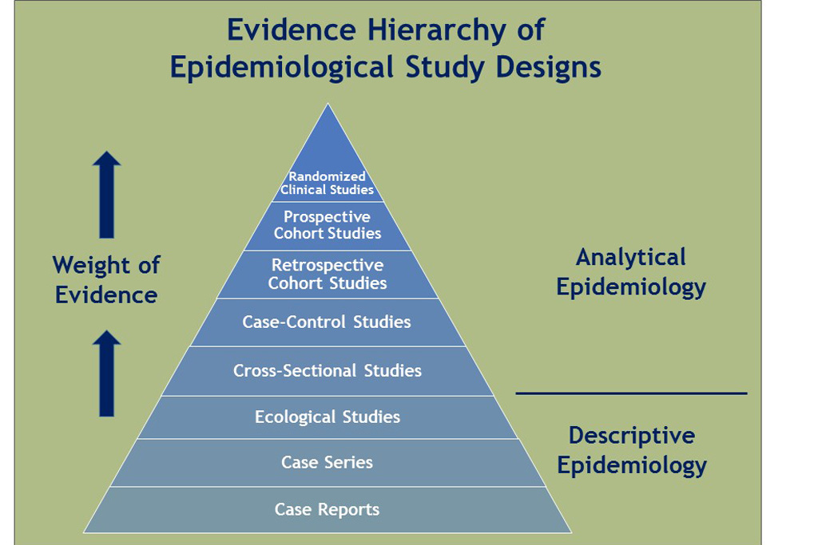

Unit III: Epidemiological Methods/Study Designs… 16 hours
Damaru Prasad Paneru, PhD, Associate Professor, SHAS, PoKU

Slide 2
Methods of Measuring association between exposures and health problems
Definition of terms: cause, risk factors, association, dose-response relationship, dose-effect relationship, exposure, effect
Determination of cause of disease/ identification of risk factors of health problems: Analytical cross- sectional study, ecological study case control study, nested case control study, estimation and quantification of strengthens of association- odds ratio
Estimation of outcome due to the exposure: cohort study, estimation and quantification of strengthens of association- relative risk
Establishing causal relationship in epidemiology

Slide 3
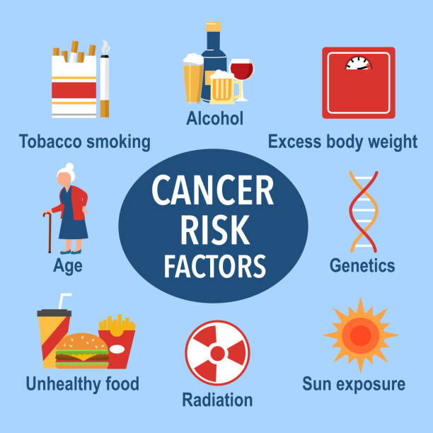
Definition of terms
Cause: A cause of a disease event is an event, condition or characteristics that preceded the disease event and without which the disease would not have occurred.
Risk: A probability or threat of damage, injury, liability loss or any other negative occurrence that is caused by external or internal vulnerabilities and that may be avoided through presumptive actions.
Risk factors: a risk factor or determinant is a variable associated with an increased risk of disease or infection.

Slide 4
RISK FACTORS
The definite agent for many disease have not been identified like cancer, coronary heart disease, peptic ulcer, and mental illness do not have definite agents.
Risk factor is an attribute or exposure significantly associated with the development of disease.
In other word, these are the determinants that can be modified by intervention thereby reducing the possibility of occurrence disease or specific outcome

Slide 5
Characteristics of risk factors
Risk factors are suggestive but not absolute.
Presence of factors does not guarantee for the causation of disease
Observable or modifiable
Risk group
The group of demographic population whom the risk of having disease or ill health can be occurred. e.g. Mothers at risk babies

Slide 6
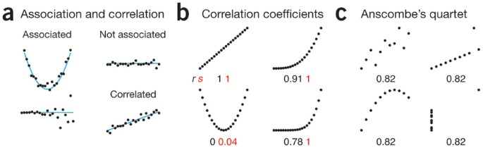
Association
Statistical dependence between two or more events, characteristics or variables.
An association is present if the probability of occurrence of an event or characteristic or the quality of a variable, depends upon the occurrence of one or more other variables.

Slide 7
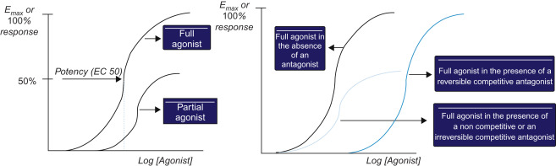
Contd…
Dose Response Relationship: the relationship of observes outcomes in a population to varying levels of protective or harmful agent such as a form of medication or an environmental containment.
Dose effect relationship: association between dose and magnitude of graded effect in an individual or population.

Slide 8
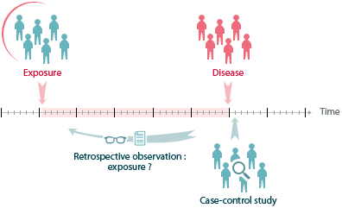
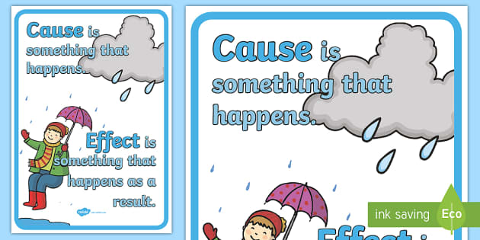
Contd…..
Exposure: In epidemiology, the term “exposure” can be broadly applied to any factor that may be associated with an outcome of interest.
Effect : A change which is a result or consequence of an action or other cause.

Slide 9
Determination of cause of disease/ identification of risk factors of health problems
Epidemiologic research is devoted to searching for causal factors that influence one’s risk of disease.
Ideally, the goal is to identify a cause so that appropriate public health action might be taken.
Identifying disease risk factors is generally done by comparing the characteristics of diseased and non-diseased populations. However, imperfect disease detectability generates disease observations that do not necessarily represent accurately the true disease situation.
Epidemiological studies such as analytical cross- sectional study, ecological study, case control study and nested case control studies are indicated to search for the cause of disease/health problems.

Slide 10
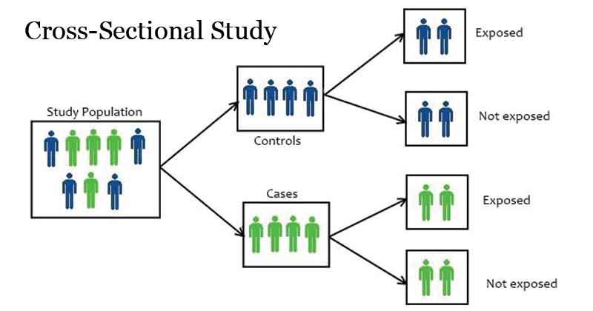
1. Analytical cross- sectional study for identification of risk factors/cause of health problems
The purpose is to measure the association between an exposure and a disease, condition or outcome within a defined population.
In this study, researchers investigate an association between two parameters. They collect data for exposures and outcomes at one specific point in time in order to measure an association between an exposure and a condition within a defined population.
The purpose of this type of study is to compare health outcome differences between exposed and unexposed individuals.

Slide 11
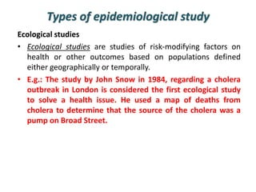
2. Ecological study for identification of risk factors/cause of health problem
Ecologic studies assesses the overall frequency of disease in a series of populations and looks for a correlation with the average exposure in the populations.
These studies are unique in that the analysis is not based on data on individuals. Instead, the data points are the average levels of exposure and the overall frequency of disease in a series of populations.
An ecological study is a study design that uses group-level or aggregate-level data to figure out if there is a potential association between two variables.
For example, let’s say you want to figure out if women that eat more fat have a higher risk of breast cancer.

Slide 12
3. Case-Control study
Case controls studies are also called retrospective studies
These are the first attempts to test causal hypothesis.
These are relatively simple and economical to carry out and used to investigate the cause of disease especially rare diseases

Slide 13
contd....
Case control study has three features:
Both exposure and outcome has occurred before the start of study
The study proceeds from backward from effects to cause
Uses a comparison group to support or refute an inference
Case-Control study: A type of observational analytic epidemiologic investigation in which case and controls are compared to identify the etiological factors of the disease concerned.

Slide 14
Contd…
What is case?
Those having particular outcome of interest
What is control ?
Those who are not having the similar outcome like cases
Individuals with a particular condition or disease (cases) selected for comparison with individuals without that particular disease or condition (controls)
Cases and controls are compared with respect to the proportion having history of an exposure or characteristic of interest

Slide 15
a
c
b
d
Fig: diagram of case control study

Slide 16
Steps of Case control study
Selection of the cases and controls
Matching
Measurement of exposure
Analysis and interpretation

Slide 17
A) Selection of the cases and controls
a. Selection of cases
The first step of this study is to select the cases from the different sources.
Cases must be defined on the basis of two broad criteria.
# Diagnostic criteria:
# Eligibility criteria:

Slide 18
Sources of Cases
Hospital / Medical care facility
General population
Disease Registries

Slide 19
b. Selection of Controls
Controls are used to compare history of exposure in cases with that in individuals free of the study disease
Most difficult & critical issue
Controls should be comparable to cases i.e. both groups at equal risk of exposure

Slide 20
Sources of controls 1.Hospital Controls 2. Neighborhood (neighbor control), 3. Relative controls, 4. Friend controls 5. General population

Slide 21
How Many Control Groups?
1, 2 or more
- Ideally single, most comparable to cases
- Two or more control groups
- Information difficult to interpret if in conflict
- Association will be stronger if at similar level in both

Slide 22
Control - Case Ratio
Optimal 1:1
Substantial cases and controls
Costs similar
2:1 / 3:1 / 4:1
- Cases limited
- Cost greater for cases

Slide 23
2. Matching
- Pairing of one or more controls to each case on the basis of “Similarity” with respect to selected variables eg. Age, Sex, race, blood group, occupation etc.
Objectives
- Elimination of biased comparisons
- Matched analysis should follow matched design

Slide 24
Types of Matching
Individual matching
Group matching (frequency matching)

Slide 25
Problems with matching : Over Matching
Difficult to identify appropriate matching.
To minimize the problem, more variables are not taken for matching.

Slide 26
3. Measurement of exposure
Definitions and criteria about exposure are just as important as those used to define cases and controls.
It is important to recognize that when case control studies are being used to test associations

Slide 27
4. Analysis and interpretation
The final step of case control study is to analyze the data and interpret the results.
It is used to find out:
The exposure rates among cases and controls to suspected factors
Estimation of disease risk associated with exposure (Odds ratio)

Slide 28
Let us consider 2x2 table
Exposures | Cases | Controls | Total
++ | a | b | a+b
---- | c | d | C+d
Total | a+c | b+d | a+b+c+d
Exposure rates | a/a+c | b/b+d

Slide 29
a. Exposure rates
Total no of exposed cases (a)
Total no. of cases (a+c)
Exposure rates among cases
Thus, exposure rate among cases = a/a+c
Similarly,
Exposure rates among controls
Thus, exposure rates among controls = b/b+d
=
Total no of exposed controls (b)
Total no. of controls (b+d)
=

Slide 30
b. Estimation of Risk associated with exposure
The association of an exposure and a disease is measured by calculating odds ratio.

Slide 31
Odds Ratio
It is the ratio of the odds of exposure among the cases to the odds in favor of exposure among the controls. It is given by:
or
OR indicates that an outcome will occur given a particular exposure, compared to the odds of the outcome occurring in the absence of that exposure.
Odds Ratio =
Odds of exposure among cases /odds of exposure among controls
This determines the risk associated with particular exposure.

Slide 32
OR =
Probability of that an event will occur
Probability that event will not occur

Slide 33
Analysis
Odds Ratio :
 | Cases | Controls
Exposures + | a | b | a+b
Exposure - | c | d | c+d
Total | a+c | b+d | n

Slide 34
Odds of exposure among cases a / a+c c / a+c Odds that a control is exposed b / b+d d / b+d

Slide 35
Contd.....
Odds ratio
Odds of exposure among cases
Odds of exposure among controls
=
OR= a/c
b/d
= ad/bc
Interpretation
indicates that the cases were ….. times (more/less)likely than the controls have exposed to particular factor.
Note: Odds Ratio is equivalent to Relative Risk (RR) when the disease is rare.

Slide 36
Estimation and quantification of strengthens of association in case control study
The odds ratio is the “measure of association” for a case-control study. It quantifies the relationship between an exposure and a disease/outcome in a case-control study. The odds ratio tells us how many times higher (or lower) the odds of exposure to a factor is among cases than among controls.
The odds ratio (OR) is a measure of how strongly an event is associated with exposure.
Example:
In the case-control study conducted by Doll and Hill, there were 120 females. There were 60 females with lung cancer, and 41 of these admitted to smoking. There were 60 females without cancer, and 28 of these admitted to smoking. Calculate the odds ratio for the association between smoking and lung cancer in women, rounding off to two decimal places. Also, think about how you would interpret this odds ratio in a sentence.

Slide 37
Contd….
An odds ratio of….
1.0 (or close to 1.0) indicates that the odds of exposure among case-patients are the same as, or similar to, the odds of exposure among controls. The exposure is not associated with the disease.
Greater than 1.0 indicates that the odds of exposure among case-patients are greater than the odds of exposure among controls. The exposure might be a risk factor for the disease.
Less than 1.0 indicates that the odds of exposure among case-patients are lower than the odds of exposure among controls. The exposure might be a protective factor against the disease.
The magnitude of the odds ratio is called the “strength of the association.” The further away an odds ratio is from 1.0, the more likely it is that the relationship between the exposure and the disease is causal. For example, an odds ratio of 1.2 is above 1.0, but is not a strong association. An odds ratio of 10 suggests a stronger association.

Slide 38
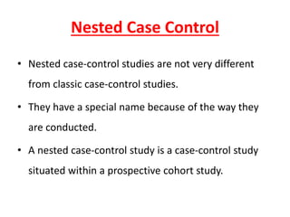
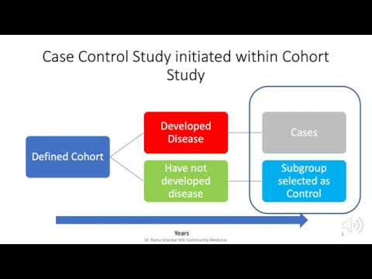
Nested case control study
A nested case–control study is a variation of a case–control study in which cases and controls are drawn from the population in a fully enumerated cohort.
A nested case-control study design involves the selection of several healthy controls for each case, typically from those still under observation at the time when the case developed the disease

Slide 39
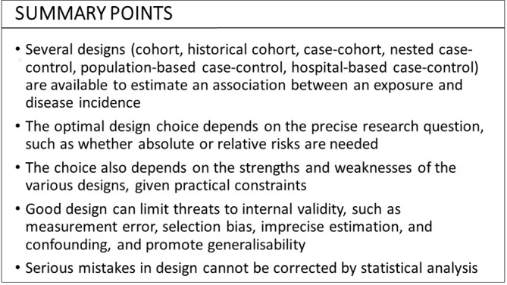
Estimation of outcome/s due to the exposure
In epidemiology, investigators are interested in measuring or assessing the relationship of exposure with a disease or an outcome.
A common task in epidemiology is to quantify the strength of association between exposures (‘risk factors’) and disease outcomes.

Slide 40
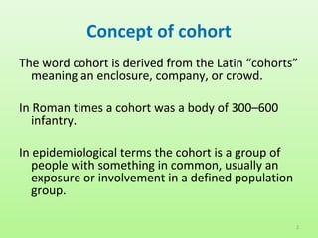
Cohort study is another important analytical study to refute or prove the existence of an association between suspected cause and disease.
Contd……

Slide 41
FEATURES OF COHORT STUDY
1. The prospect (future effect) of a suspected cause is studied. – Prospective study
2. This study proceeds forward from cause to effect. – Forward looking study
3. The study groups are observed over a period of time. – Longitudinal study

Slide 42
FEATURES OF COHORT STUDY
4. The frequency of diseases (incidence) can be determined. – Incidence study
5. The study is done among the cohorts.
– Cohort study

Slide 43
What is Cohort ?
Cohort is defined as a group of people who share a common characteristic or experience within a defined time period.
Example; Birth cohort, Occupation cohort, Exposure cohort, Marriage cohort, etc.

Slide 44
Definition of cohort study
A type of analytic study in which groups of individuals defined on the basis of their exposure status are followed to assess the occurrence of disease

Slide 45
Indications for Cohort Study
When there is good evidence of an association between exposure and disease.
When exposure is rare but incidence of the disease is high among the exposed.

Slide 46
Indications for Cohort Study
When follow up of study population is easy.
When the cohort is stable.
When the study population is accessible and cooperative.
When there is sufficient fund to carry out the study.

Slide 47
Types of Cohort Studies
1. Prospective Cohort Studies:
2. Retrospective Cohort Study:
3. Retro-Prospective Study
Closed cohort and dynamic population study

Slide 48
Steps of a cohort study
Selection of study groups
Measurement of exposure
Selection of comparison group
Follow up
Analysis and interpretation

Slide 49
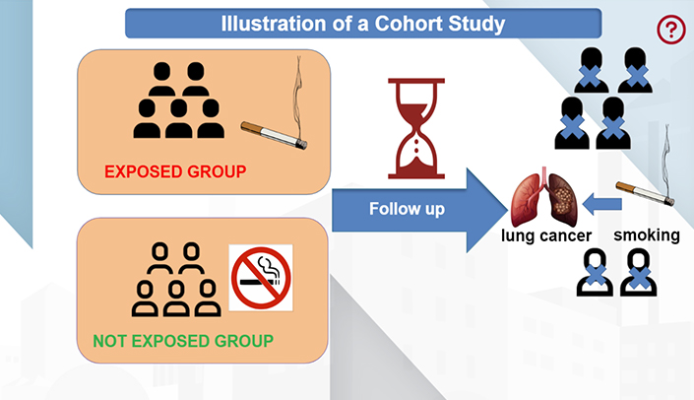
1a. Selection of study elements:
The subjects are usually assembled either from general population that can be readily studied .
Study subjects are selected from
General Population
Special group

Slide 50
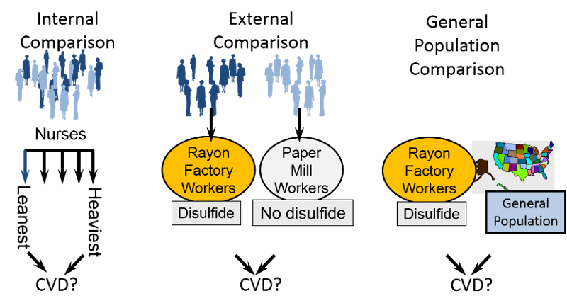
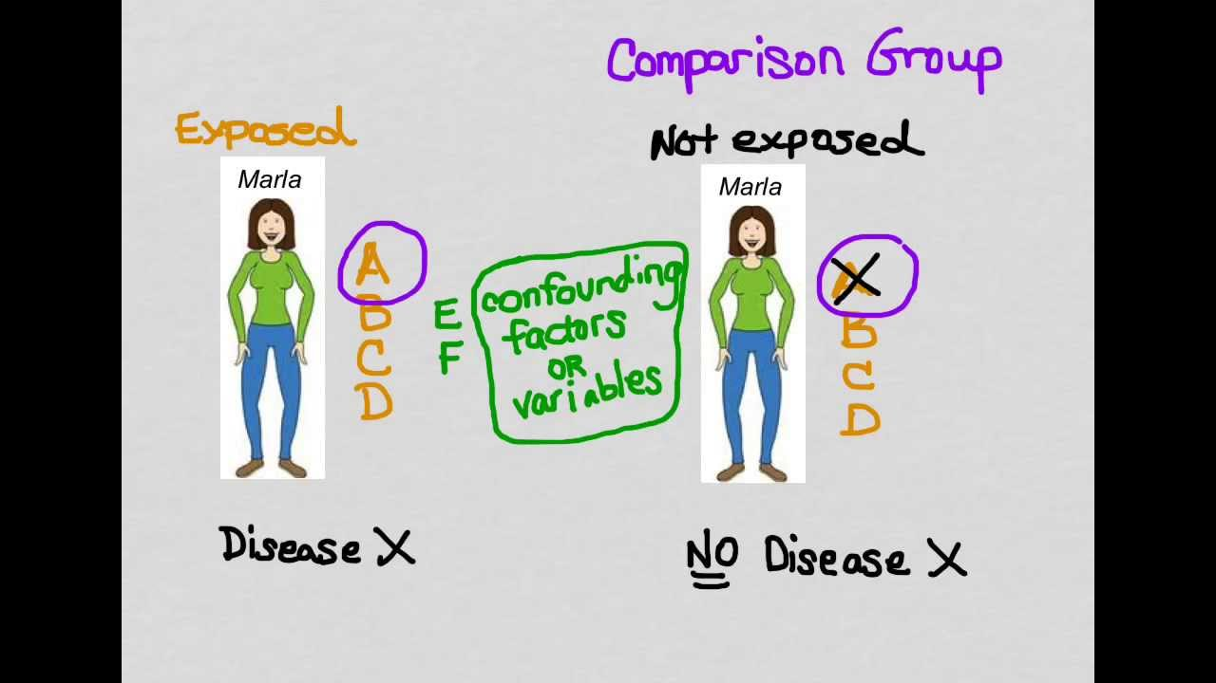
1b.Selection of Comparison Groups:
There are many ways of assembling comparison groups.
Internal Comparison: Comparison within groups.
External Comparison: When information or degree of exposure is necessary to put up an external control.

Slide 51
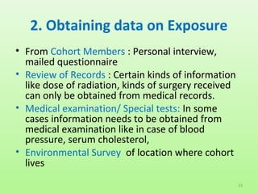
2. Obtaining data on exposure
Information about exposure may be obtained directly from the cohort members through personal interview or mailed questionnaire

Slide 52
Contd…
Review of records: Certain kinds of information can be obtained only from medical records.
Medical examination on special tests: Some types of information can be obtained only by medical examination.
Environmental Surveys: This is the best source for obtaining information on exposure.

Slide 53
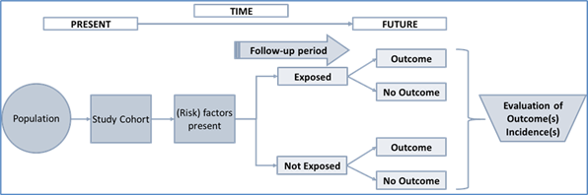
3. Follow up
One of the problems in cohort studies is the regular follow-up of all the Participants.
At the start of the study the methods should be
devised depending upon the outcome to be determined.

Slide 54
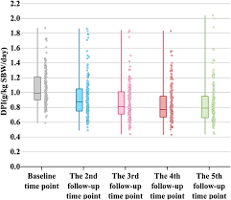
Example

Slide 55
4. Analysis and interpretation
The data analysis can be done in terms of
Incidence rates of outcomes among exposed and non exposed
Estimation and quantification of risk associated with particular exposure/outcome

Slide 56
Design of a Cohort Study
TIME
Disease
People without the disease
EXPOSED
Non disease
POPULATION
Disease
NON EXPOSED
Non disease
DIRECTION OF INQUIRY

Slide 57
Concept of Study
Example : TIME ( 20-28 weeks of gestation to post partum period
poor Pregnancy outcomes
Pregnant Women without any disorders
Pregnant women 20-28 gestational age
follow up
good outcomes
DIRECTION OF INQUIRY

Slide 58
Selection Exposure to Observation Assessment Analysis
of cohort the factor for a period of the effect
Study Cohort Factor (+ve)
follow up occurrence of disease stat calc Control Cohort Factor (-ve)
Present Future

Slide 59
Selection Exposure to Observation Assessment Analysis
of cohort the factor for a period of the effect
Study Cohort Factor (+ve)
follow up occurrence of disease stat calc Control Cohort Factor (-ve)
Present Future

Slide 60
Measures of association
Do Not
Develop
Disease
Develop
Disease
Exposed
a
b
c
d
Not Exposed
R.R
Incidence in exposed
=
Incidence in non-exposed

Slide 61
EXAMPLE
Cohorts Developed No change
lung cancer
Study cohort (6000) 65 5935
(smokers)
Control cohort (5000) 05 4995
(non-smokers)

Slide 62
Calculation
1. Incidence rate:
(a) Among the smokers = 65/6000 = 11 per thousand
(b) Among the non-smokers = 5/5000 = 1 per thousand
2. Relative Risk or Risk Ratio :
Incidence among the exposed
RR = = 11/1 = 11
Incidence among the non-exposed

Slide 63
Contd..
3. Attributable Risk :
(Incidence among exposed) (Incidence among
non-exposed)
AR = X 100
Incidence among exposed
10 - 1
= X 100 = 90 Percent
10

Slide 64
Strengths/Advantages
Correct temporal relationship between exposure and the outcome of the disease
Disease rates can be calculated directly
Allows the evaluation of multiple effects from a single exposure
Generally involved good information on exposure

Slide 65
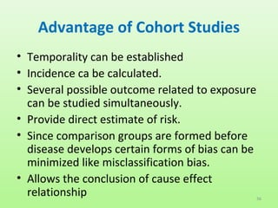

Slide 66
Limitations/Disadvantage
Large number of subjects are required if the outcome of interest is rare
Requires long follow-up, if latency period is long
Expensive
Investigator should consider several issue: availability of study groups, records, and feasibility of complete follow-up of subjects

Slide 67
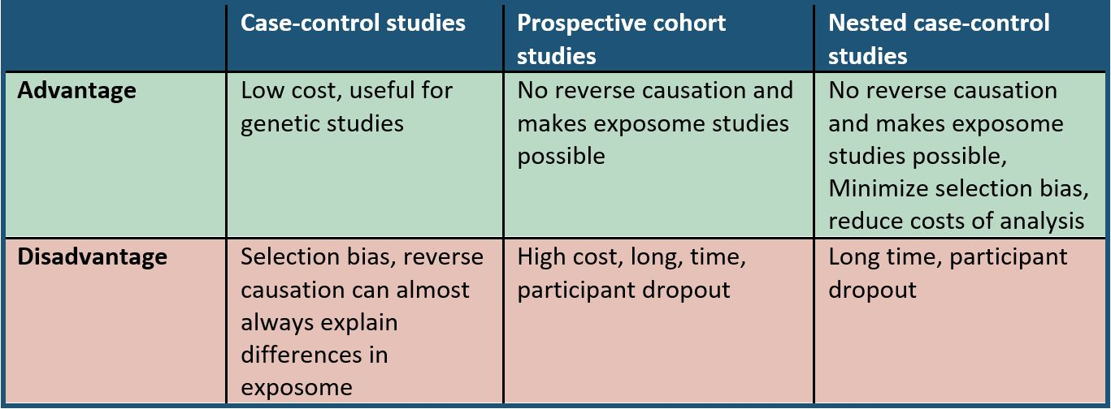
Comparative summary of advantages and disadvantages

Slide 68
Establishing causal relationship in epidemiology
This is very important and difficult part in epidemiological studies.
Even an association has been observed, one has to prove ultimately whether there has been causal association or not.
Establishing a causal relationship is a trial process in epidemiology.
It is a process which explains that a particular hypothesis is real one and causal.

Slide 69
How to establish the cause of a disease?
OBSERVED ASSOCIATION?
Could it be due to selection or measurement bias?
No
Could it be due to confounding?
No
Could it be a result of chance?
Probably not
Could it be causal?
Apply guidelines and make judgment

Slide 70
Contd…..
British statistician Sir Austin Bradford Hill in 1965 proposed a set of features /criteria that should be sought when deciding the causal relationship between factor and outcome.
This is known as Hill’s criteria to define causality

Slide 71
Guideline/criteria for Causal Association
SN | Criteria | Comments
1 | Temporal Relation | Does the cause precede the effect?
2 | Biological plausibility | Does the association supported by other knowledge (mechanism of action; evidence from animal experiments)?
3 | Consistency | Have other studies shown similar results
4 | Strength of association | What is the strength of the association between the cause and the effect? (Relative risk)
5 | Dose-response relationship | Increased rate of exposure to the possible cause is associated with increased effect?
6 | Specificity | One cause Leads to one effect
7 | Reversibility | Does the removal of a possible cause lead to reduction of risk of disease?
8 | Analogy | Cause effect relationship already established for a similar exposure or disease
9 | Study design | RCTs are the strongest study designs
10 | Coherence of association and judging the evidences | Based on available evidence or should be coherence with known facts that are thought to be relevant: uncertainty always remains

Slide 72
1.Temporal relationship (Relationship with time)
Cause must precede the effect. (Essential)
Which is cart & Which hourse?
Drinking contaminated water occurrence of diarrhea
However many chronic cases, because of insidious onset and ignorance of precise induction period, it become hard to establish a temporal sequence as which comes first -the suspected agent or disease.

Slide 73
2. Plausibility (Biological plausibility)
Consistent with biological knowledge of day
Smoking causing lung cancer
Smoking causes skin cancer?
Lack of plausibility may simply reflect lack of scientific knowledge

Slide 74
3. Consistency of association
Different persons, in Different places, in Different circumstances & times by Different method (by various types studies) is established the Same result by several studies.
Cigarette smoking and lung cancer. More than 50 retrospective studies and at least nine prospective studies

Slide 75
Meta-analysis of the relative risk of cleft palate in the offspring of mothers who smoked during pregnancy compared with the offspring of mothers who did not smoke

Slide 76
4. Strength of association
Relative risks/Odds ratio greater than 2 can be considered strong
Risk ratio | Interpretation
< 1 | Protective
0.9-1.1 | No association
1.2- 1.6 | Weak Causal association
1.7- 2.5 | moderate causal association
>2.6 | Strong causal association

Slide 77
5. Dose – response relationship ( The Biological gradient )
Death rates from lung cancer (per 1000) by number of cigarettes smoked, British male doctors, 1951 –1961

Slide 78
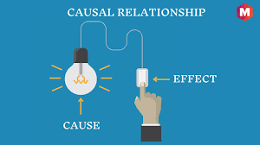
6. Specificity
One to one association
Critics
Haemolytic Streptococal tonsilitis
Streptococci Scarlet fever
Erysipelas

Slide 79
7. Reversibility
Fig 7: Stopping works: cumulative risk of lung cancer mortality
Critics: e.g. Infection of HIV/ AIDS

Slide 80
8. Study design
Relative ability of different types of study to “prove” causation

Slide 81
9. Analogy (= Similarity, = reasoning from parallel cases)
Judging by analogy
known effect of drug thalidomide & rubella in pregnancy
accepting slighter but similar evidence with another drug or another viral disease

Slide 82
10. Coherence of association & Judging the evidence
Based on available evidence or should be coherence with known facts that are thought to be relevant: uncertainty always remains
Correct temporal relationship is essential; then greatest weight may be given to plausibility, consistency and the dose–response relationship. The likelihood of a causal association is heightened when many different types of evidence lead to the same conclusion.

Slide 83
Thank You

