Slide 1
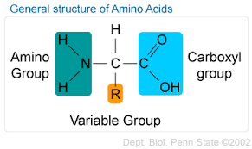
CHEMISTRY OF AMINO ACIDS

Slide 2
INTRODUCTION
Amino acids are the hydrolyzed products of proteins and are also called as the monomeric building blocks of proteins.
The commonly occuring amino acids are α-amino acids (except proline) because they have a primary amino group (-NH₂) and a carboxylic group (-COOH) as substituents on the α-carbon atom.
Although about 300 amino acids occur in nature, only 20 of them are seen in human body. This is because of the universal nature of the genetic code available for the incorporation of only 20 amino acids when the proteins are synthesized in the cells.
The first to be discovered was asparagine, in 1806.
The last of the 20 to be found, threonine, was not identified until 1938.

Slide 3
STRUCTURE OF AMINO ACIDS
All the 20 amino acids found in proteins have a carboxyl group (-COOH) and an amino group (-NH₂) bound to the same carbon atom called the α-carbon.
Amino acids differ from each other in their side chains or R-groups, attached to the α-carbon which vary in structure, size and electric charges and therefore influences the solubility of amino acids in water.
The 20 amino acids of proteins are often referred to as the standard or primary or normal amino acids.
Fig. General structure of amino acids

Slide 4
The standard amino acids have been assigned three letters abbreviations and one letter symbol.
The abbreviations for amino acids are the first three letters of their names, except Aspargine (Asn), Glutamine (Gln), Isoleucine (Ile) and Tryptophan (Trp).
The symbols for many amino acids are the first letters of their names (e.g. G for glycine and L for leucine); the other symbols have been agreed on by convention.
One of the 20 amino acid, proline is an imino (-NH) acid not an amino (-NH₂) acid as are other 19.
The amino acids mostly exist in the ionized form in the biological system.
Amino acids in solution at neutral pH exist predominantly as dipolar ions (also called zwitterions).
In the dipolar form, the amino group is protonated (-NH3⁺) and the carboxyl group is deprotonated (-COO⁻).

Slide 5
Name of amino acid | Special group present | 3- letter abbreviation | 1-letter abbreviation | Molecular weight
Glycine |  | Gly | G | 77
Alanine |  | Ala | A | 89
Valine |  | Val | V | 117
Leucine |  | Leu | L | 131
Isoleucine |  | Ile | I | 131
Serine | Hydroxyl | Ser | S | 105
Threonine | Hydroxyl | Thr | T | 119
Cysteine | Sulfhydryl | Cys | C | 121
Methionine | Thioester | Met | M | 149
Asparagine | Amide | Asn | N | 132
Glutamine | Amide | Gln | Q | 146
Aspartic acid | Beta-carboxyl | Asp | D | 133
Glutamic acid | Γ-carboxyl | Glu | E | 147
Lysine | ε-amino | Lys | K | 146
Arginine | Guanidium | Arg | R | 174

Slide 6
Phenylalanine | Benzene | Phe | F | 165
Tyrosine | Phenol | Tyr | Y | 181
Tryptophan | Indole | Trp | W | 204
Histidine | Imidazole | His | H | 155
Proline(imino acid) | Pyrrolidine | Pro | P | 115

Slide 7
OPTICAL ISOMERS OF AMINO ACIDS
If a carbon is attached to four different groups, it is asymmetric and therefore exhibits optical isomerism.
The amino acids (except glycine) possess four distinct groups ( R, H, COO⁻, NH₃⁺ ) held by α-carbon. Thus, all the amino acids (except glycine where R = H) have optical isomers.
Isoleucine and threonine have 2 optically centers.
The structures of L – and D – amino acids are written based on the configuration of L – and D – glyceraldehyde.
All the amino acids found in proteins are exclusively of the L-configuration.
D-amino acids are found in some antibiotics (Gramicidin-S, Polymyxin, Actinomycin-D and Valinomycin) produced by microorganisms and in bacterial cell wall peptidoglycan.
Two free D-amino acids - D-serine and D-aspartic acid have been found to be present in the fore-brain and brain periphery respectively.

Slide 8
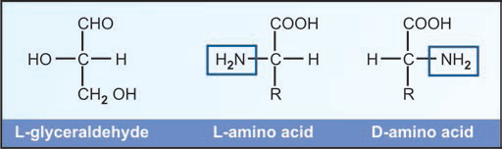
Fig. L and D amino acids

Slide 9
CLASSIFICATION OF AMINO ACIDS
There are five ways of classifying amino acids depending on the :
Chemical nature of the amino acid in the solution.
Structure of the side chain of the amino acids.
Nature of polarity of the side chain of the amino acids.
Nutritional requirement of amino acids.
Metabolic product of amino acids.

Slide 10
CLASSIFICATION BASED ON CHEMICAL NATURE OF THE AMINO ACID IN SOLUTION
According to this type of classification amino acids are classified as follows:
Neutral amino acids
These amino acids are neutral in reaction and have one amino (-NH₂) and one carboxylic (-COOH) group.
They are also called as mono-amino mono-carboxylic acids.
Examples are :
Glycine Serine Phenylalanine
Alanine Threonine Tyrosine
Valine Cysteine Tryptophan
Leucine Methionine Asparagine
Isoleucine Proline Glutamine
Acidic amino acids
These are acidic in solution and are monoamino dicarboxylic acids, e.g.
Aspartic acid
Glutamic acid

Slide 11
Basic amino acids
These are basic in solutions and are diamino monocarboxylic acids, e.g.
Lysine
Arginine
Histidine

Slide 12
CLASSIFICATION BASED ON CHEMICAL STRUCTURE OF SIDE CHAIN OF THE AMINO ACID
According to this type of classification, amino acids are classified as:
Aliphatic amino acids
Amino acids having aliphatic side chain.
It is again sub-divided into
A. Monoamino monocarboxylic acids
1. Simple amino acids
Such as glycine and alanine.
Glycine has the smallest possible side chain, i.e. a hydrogen atom (-H) as the R group.
Alanine has a methyl group (-CH₃) in its side chain.
2. Branched chain amino acids
These amino acids have a aliphatic hydrocarbon side chain which has a branch in its structure, i.e. some group is attached to one of the carbon atoms of the aliphatic side chain.
There are three amino acids which are labelled as branched chain amino acids.
These are valine, leucine and isoleucine.

Slide 13
3. Hydroxy amino acids
There are two amino acids which have a hydroxy (-OH) group in their aliphatic side chain.
These are serine and threonine.
4. Sulphur containing amino acids
Some amino acids, in addition to C, H, O and N, also contain sulphur (S) as a part of its aliphatic side chain.
These are cysteine and methionine.
Cysteine has a free sulfhydryl or thiol group (-SH) which can form a disulphide bond (-S-S-) with another cysteine residue.
Through the oxidation of the two thiol groups, it can form another amino acid called cystine or dicysteine.
Selenocysteine (Sec or U), considered to be the 21st amino acid, resembles cysteine with the exception that it contains a selenol group (-SeH) instead of a thiol (-SH) group.
Methionine does not contain a free –SH group. Instead it has a thiol linkage as -CH₃- S- in its side chain.

Slide 14
5. Amino acids with amide group
They have amide group in their side chain.
E.g. Asparagine, glutamine
B. Monoamino dicarboxylic acids
They contain two molecules of carboxylic acids.
E.g. Aspartic acid and glutamic acid
C. Dibasic moncarboxylic acids
They contains two amino groups.
E.g. Lysine, and arginine.
Aromatic amino acids
These amino acids have an aromatic ring which is neutral in reaction.
There are three amino acids which are grouped as aromatic amino acids.
These are phenylalanine (alanine with a phenyl group) and tyrosine (4-hydroxy-phenylalanine) and a tryptophan (alanine attached to an indole ring).
Heterocyclic or Imino amino acids
This amino acid has a secondary amino, i.e. imino (-NH) group not a primary one NH₂, e.g. proline
Notes:
Imino (Imines) : compounds containing the group –NH- in which the nitrogen atom is part of a ring structure, or the group structure =NH, in which the nitrogen atom is linked to a carbon atom by a double bond.

Slide 15
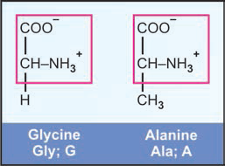
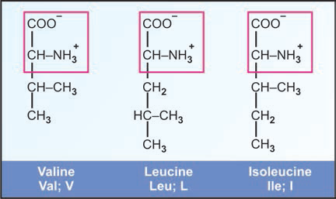
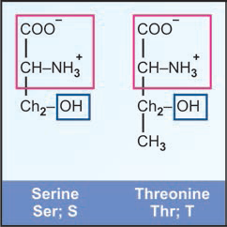
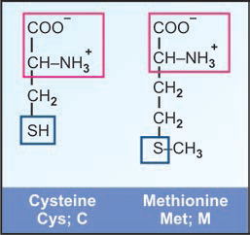
Fig. Simple amino acids
Fig. Branched chain amino acids
Fig. Hydroxy amino acids
Fig. Sulphur containing amino acids

Slide 16
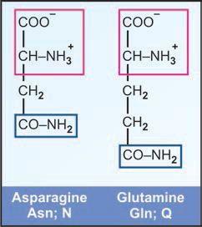
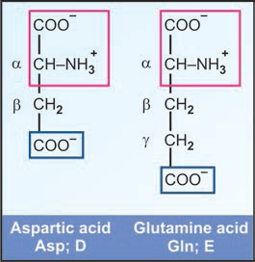
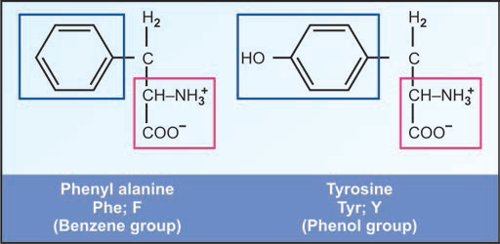
Fig. Amino acids with amide groups
Fig. Dicarboxylic amino acids
Fig. Aromatic amino acids

Slide 17
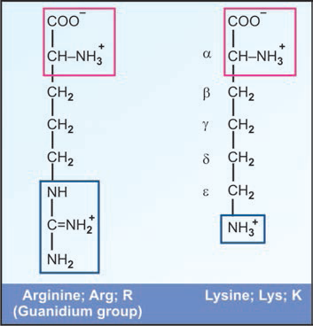
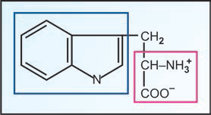
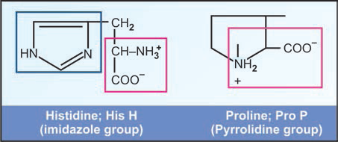
Fig. Dibasic amino acids
Fig. Tryptophan (Trp) (W) with indole group
Fig. Histidine and proline

Slide 18
CLASSIFICATION BASED ON NATURE OR POLARITY OF SIDE CHAIN OF AMINO ACID
Amino acids having non-polar side chains
The side chains of hydrophobic amino acids interact poorly with water.
They have either aliphatic or aromatic side chains.
These groups are hydrophobic (water repellant) and lipophillic.
Therefore, the parts of proteins made up of these amino acids will be hydrophobic in nature.
E.g. alanine, valine, leucine, isoleucine, methionine, proline, phenylalanine and tryptophan.
Amino acids having polar side chains
The side chains of the hydrophilic amino acids contain polar groups that may be either charged or uncharged.
The R groups of these amino acids interact favourably with water and are more soluble in water or more hydrophilic than those of non-polar amino acids because they contain functional groups that form hydrogen bonds.
Amino acids having uncharged or non-ionic polar side chains
E.g. glycine, serine, threonine, cysteine, tyrosine, glutamine and asparagine.

Slide 19
Classification of amino acids according to polarity of their side chains
Non-polar side chain | Polar side chain
Glycine Alanine Valine Leucine Isoleucine Methionine Phenylalanine Tryptophan proline | Uncharged | charged
 | Serine Threonine Asparagine Glutamine Tyrosine cysteine | Lysine Arginine Histidine Aspartate glutamate
2. Amino acids having charged or ionic polar side chains (hydrophilic)
Acidic amino acids : They have a negative charge on the R group : Aspartic acid and glutamic acid. (tyrosine is mildly acidic).
Basic amino acids : They have a positive charge on the R group : Lysine, Arginine and Histidine.

Slide 20
NUTRITIONAL CLASSIFICATION OF AMINO ACIDS
On the basis of nutritional requirement, amino acids are classified into two groups:
Essential or indispensable amino acids
The amino acids which cannot be synthesized in the body and, therefore need to be supplied through the diet are called essential amino acids.
They are required for proper growth and maintenance of the individual.
E.g. Isoleucine, Leucine, Threonine, Lysine, Methionine, Phenylalanine, Tryptophan , Arginine, Histidine and Valine.
In patients suffering from severe malnutrition (e.g. cancer cachexia), essential amino acids are administered parenterally.
The two amino acids namely arginine and histidine can be synthesized by adults and not by growing children, hence these are considered as semi-essential amino acids.
Notes:
Any Help In Learning These Little Molecules Proves Truly Valuable

Slide 21
Non-essential or dispensable amino acids
The body can synthesize about 10 amino acids to meet the biological needs, hence they need not be consumed in the diet.
These are – glycine, alanine, serine, cysteine, aspartate, asparagine, glutamate, glutamine, tyrosine and proline.
Conditionally essential amino acids
Person suffering from a moderate to severe chronic illness, person may lose the ability to manufacture enough non-essential amino acids and thus require supplementation.
These conditionally essential amino acids are Arginine, Glycine, Cysteine, Tyrosine, Proline and Glutamine.

Slide 22
Classification of amino acids according to their dietary requirement
Essential | Semi-essential | Non-essential
Methionine Threonine Tryptophan Valine Isoleucine Leucine Phenylalanine lysine | Arginine Histidine | Glycine Alanine Serine Cysteine Tyrosine Aspartate Glutamate Asparagine Glutamine proline

Slide 23
METABOLIC CLASSIFICATION OF AMINO ACIDS
On the basis of their catabolic end products, the twenty standard amino acids are divided in three groups.
Glucogenic amino acids
Those which can be converted into glucose.
Fourteen out of 20 standard amino acids are glucogenic amino acids.
2. Ketogenic amino acids
Those which can be converted to ketone bodies.
Two amino acids leucine and lysine are exclusively ketogenic.
3. Both glucogenic and ketogenic
Those which can be converted to both glucose and ketone bodies.
Four amino acids isoleucine, phenylalanine, tryptophan and tyrosine are glucogenic and ketogenic.

Slide 24
Metabolic classification of amino acid
Glucogenic | Ketogenic | Both glucogenic and ketogenic
Glycine Alanine Serine Cysteine Aspartic acid Asparagine Glutamic acid Glutamine Proline Histidine Arginine Methionine Threonine valine | Leucine Lysine | Isoleucine Phenylalanine Tyrosine tryptophan

Slide 25
BIOLOGICAL SIGNIFICANCE OF AMINO ACIDS
Amino acids as building blocks of proteins and peptides
Amino acids are used as building blocks for the synthesis of proteins and peptides.
They are required to support growth and normal health of humans.
Synthesis of biologically important compounds
Amino acids are utilized for the synthesis of several biologically important compounds.
Examples are :
Glycine : Heme, formate, glutathione, bile acids, purine nucleotides, creatine phosphate, serine and oxalate.
Serine : N^{5,10}-methylene tetrahydrofolate, glycine and phosphatidylserine.
Tyrosine : Thyroid hormones (T₃ and T₄), dopamine, norepinephrine, epinephrine and melanin.
Tryptophan : NAD, alanine, serotonin and melatonin.

Slide 26
Amino acids as source of energy
Amino acids are not commonly used for providing energy,
However, under conditions of starvation or impaired utilization of glucose by tissues as occurs in diabetes mellitus, amino acids provide energy by either converting to glucose or ketone bodies.
Inborn errors of amino acid metabolism
Phenylketonuria (classical type) results from the deficiency of phenylalanine hydroxylase.
Alkaptonuria is due to the deficiency of homogenitisic acid oxidase.
Cystinosis is due to the intracellular defect of the transport of cystine across the lysosomes.

Slide 27
Role of amino acids in detoxification
Some of the amino acids are utilized in conjugation reactions of detoxification. Examples are :
Glycine combines with benzoic acid (as benzoyl CoA) to form hippuric acid in the liver and hippuric acid is excreted in the urine.
Transport and storage form of ammonia
Amino acid glutamine play an important role in transport and storage of amino nitrogen in the form of ammonia.
Amino acids not found in proteins
L-ornithine is an intermediate in urea cycle. It is formed from arginine.
L-citrulline is an intermediate in urea cycle. It is formed form ornithine.
γ-aminobutyric acid (GABA) is an inhibitor neurotransmitter. It is formed from decarboxylation of glutamic acid.

Slide 28
Transport and storage form of ammonia
Amino acid glutamine play an important role in transport and storage of amino nitrogen in the form of ammonia.
As a buffer
Both free amino acids and some amino acids present in protein can potentially act as buffer.
E.g. histidine can serve as the best buffer at physiological pH.

Slide 29
PROPERTIES OF AMINO ACIDS
PHYSICAL PROPERTIES
Solubility
Most of the amino acids are usually soluble in water and insoluble in organic solvents.
2. Melting points
Amino acids generally melt at higher temperatures, often above 200°C.
3. Taste
Amino acids may be sweet (Gly, Ala, Val), tasteless (Leu) or bitter (Arg, Ile).
Aspartame, an artificial sweetener contains aspartic acid and phenylalanine.
Notes:
Chinese resturant syndrome : It refers to a group of symptoms that some people experience after eating food from a Chinese restaurant. These symptoms often include a headache, skin flushing, and sweating. A food additive called monosodium glutamate (MSG) is often blamed for the symptoms some people experience after eating Chinese food.

Slide 30
Monosodiun gluatamate (MSG; ajinomoto) is used as a flavoring agent in food industry, and Chinese foods to increase taste and flavour.
In some individuals intolerant to MSG, Chinese restaurant syndrome (a headache, skin flushing, and sweating) is observed
4. Optical properties
All the amino acids except glycine possess optical isomers due to the presence of asymmetric carbon atom. E.g. isoleucine, threonine.
5. Ionization of amino acids
Due to ionizing property of amino acids, amino acids exert:
Acid base behaviour
Amphoteric properties (Zwitter ion formation)
Buffering activity.

Slide 31
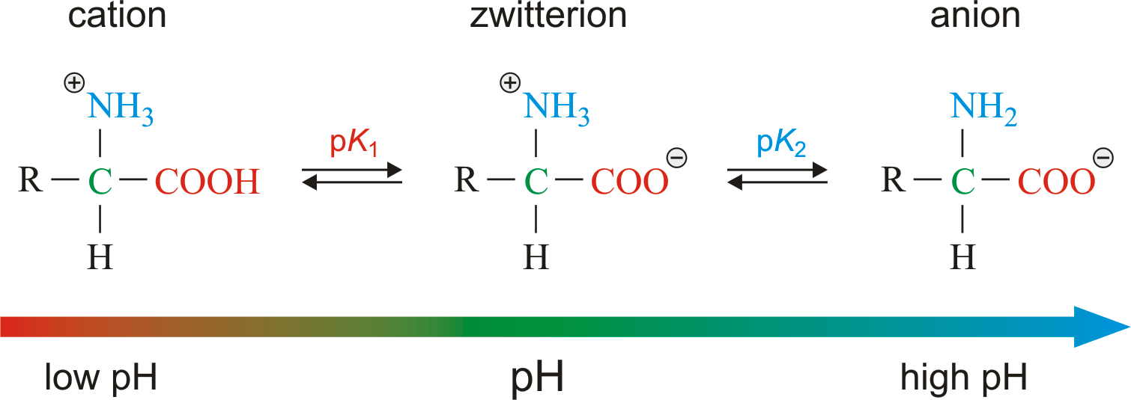
Acid/base behaviour of amino acids
The acid base properties of amino acids depend on the amino and carboxyl groups attached to the α-carbon.
The carboxyl (-COOH) group of an amino acid can donate proton (H⁺) and behave as an acid, forming a negatively charged anion.
Amino group (-NH₂) of an amino acid can accept the proton (H⁺) which behave as a base, forming positively charged cation.
Thus, amino acids in aqueous solution are ionized and act as acids and bases.
Fig. Ionic forms of amino acid in acidic, basic and isoelectric pH

Slide 32
Amphoteric properties of Amino Acids and Formation of Zwitter ion at Isoelectric pH
Substances having a two-way property are called amphoteric or ampholytes (Greek word ampho means both).
Amino acids contain both acidic (-COOH) and basic (-NH₂) groups.
They can donate a proton or accept a proton, hence amino acids are regarded as ampholytes.

Slide 33
Zwitter ion (Dipolar molecule)
The name zwitter is derived from the German word which means hybrid.
Zwitter ion (or dipolar ion) is a hybrid molecule containing positive and negative ionic groups.
The amino acids rarely exist in a neutral form with free carboxylic (-COOH) and free amino (-NH₂) groups.
Monoamino monocarboxylic acids exist in aqueous solutions as dipolar molecule or zwitter ions, which means that they have both positive and negative charges on the same amino acids.
In strongly acidic pH (low pH), the amino acid is positively charged (cation) while in strongly alkaline pH (high pH), it is negatively charged (anion).
Each amino acid has a characteristic pH (e.g. leucine, pH 6.0) at which it carries both positive and negative charges and exists as zwitterion.
Thus, the overall molecule is electrically neutral.
Isoelectric pH
It is defined as the pH at which a molecule exists as a zwitterion or dipolar ion and carries no net charge. Thus, the molecule is electrically neutral.

Slide 34
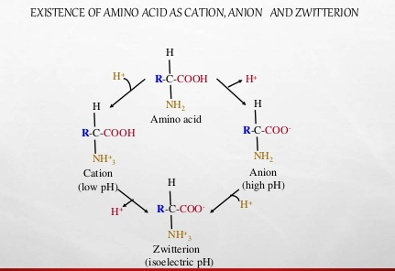

Slide 35
Buffering action of amino acids
Each of the acidic and basic amino acids contain an ionisable group in its side chain. Thus, both free amino acids and some amino acids present in proteins can potentially act as buffers.
Among the 20 standard amino acids, histidine serves as the best buffer at physiological pH.
Because the side chain of histidine has pKa of 6.0 and can serve as the best buffer at physiological pH.
All other amino acids have pKa value, too far away from pH 7 to be an effective physiological buffer.
Maximum buffer capacity occurs at pH equal to the pKa.

Slide 36
CHEMICAL PROPERTIES
The general reactions of amino acids are mostly due to the presence of two functional groups namely carboxyl (-COOH) group and amino (-NH₂) group.
Reactions due to –COOH group
Amino acids form salts (-COONa) with bases and esters (-COOR’) with alcohols.
2. Decarboxylation
Amino acids undergo decarboxylation to produce corresponding amines.
This reaction assumes significance in the living cells due to the formation of many biologically important amines.
These include histamine, tyramine and γ-amino bytyric acid (GABA) from the amino acids histidine, tyrosine and glutamate respectively.

Slide 37
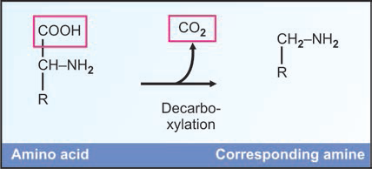
Histidine → Histamine + CO2
Tyrosine → Tyramine + CO2
Tryptophan → Tryptamine + CO2
Lysine → Cadaverine + CO2
Glutamic acid → Gamma amino butyric acid (GABA) + CO2

Slide 38
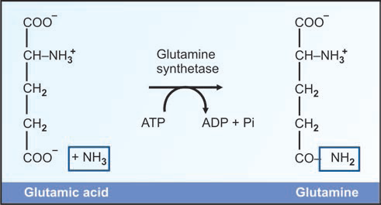
3. Reaction with ammonia (Amide formation)
The –COOH group of dicarboxylic amino acids (other than alpha carboxyl) can combine with ammonia to form the corresponding amide.
For example,
Aspartic acid + NH3 → Asparagine
Glutamic acid + NH3 → Glutamine
The amide group of glutamine serves as the source of nitrogen for nucleic acid synthesis.
Fig. Formation of glutamine
Notes:
Amides : organic compounds containing –CO.NH2 (the amide group)

Slide 39
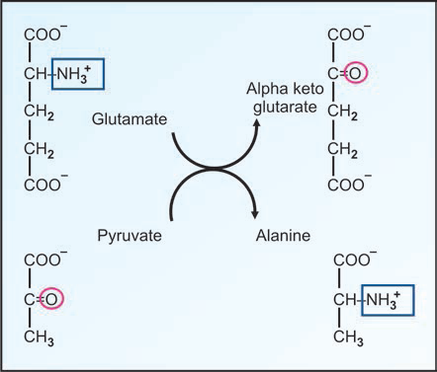
Reactions due to - NH₂ group
1. The amino groups behave as bases and combine with acids (e.g. HCl) to form salts (-NH₃⁺Cl⁻).
2. Transamination
Transfer of an alpha amino group from an amino acid to a keto acid to form a new amino acid is a very important reaction in amino acid metabolism.
This is an important reaction in the body for the interconversion of amino acids and for synthesis of non-essential amino acids.
Fig. Transamination reaction

Slide 40
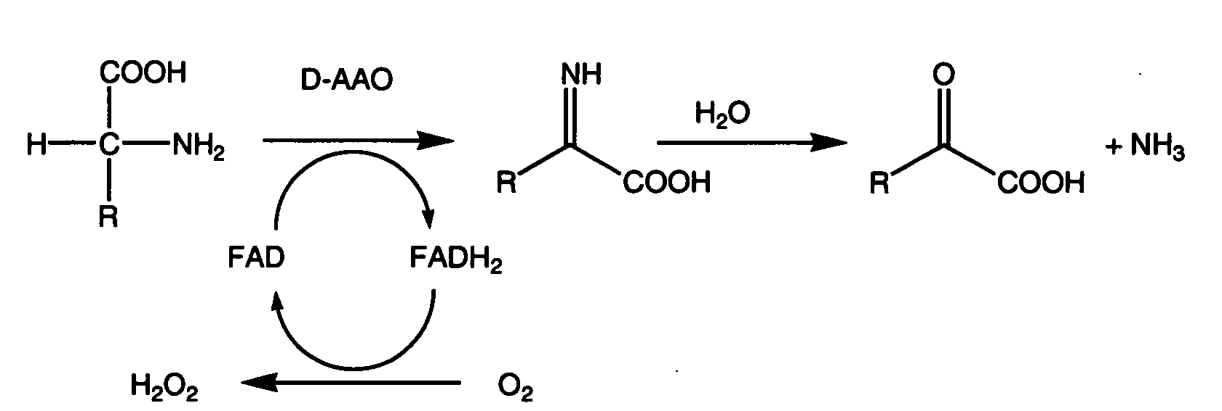
3. Oxidative Deamination
The alpha amino group is removed from the amino acid coupled to oxidation process to form the corresponding keto acid and ammonia.
Oxidative deamination reactions of amino acids are involved in the metabolism of amino acids and production of ammonia.
In the body, glutamic acid is the most common amino acid to undergo oxidative deamination.
Fig. Oxidative Deamination of amino acids

Slide 41
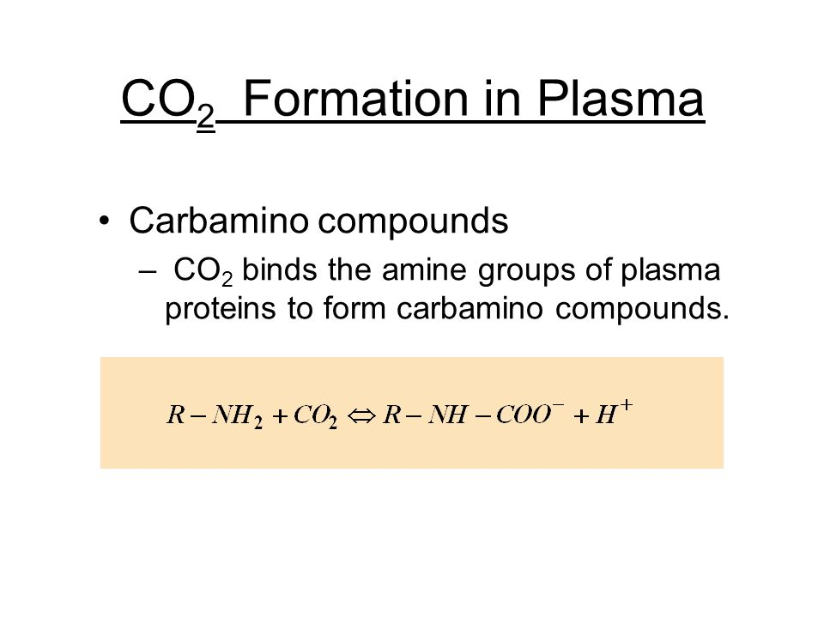
4. Formation of Carbamino compound
Carbon dioxide adds to the alpha amino group of amino acids to form carbamino compounds.
The reaction occurs at alkaline pH and serves as a mechanism for the transport of carbon dioxide from tissues to the lungs by haemoglobin.
Hb—NH2 + CO2→ Hb—NH—COOH (Carbamino-Hb)
Fig. Formation of Carbamino compound

Slide 42
5. Reaction with ninhydrin
The alpha amino acids react with ninhydrin to form a purple, blue or pink colour complex (Ruhemann’s purple).
Amino acid + Ninhydrin keto acid + NH₃ + CO₂ + Hydrindantin
Hydrindantin + NH₃ + Ninhydrin Ruhemann’s purple
Ninhydrin reaction is effectively used for the quantitative determination of amino acids and proteins.
Proline and hydroxy proline give yellow colour with ninhydrin.

Slide 43
Reactions due to side chains
Transmethylation
Transmethylation is transfer of methyl group (-CH₃) from S-adenosylmethionine (active methionine) to an acceptor.
Transmethylation is an essential process since many biological compounds become functionally active only after methylations.
Transmethylation synthesizes biologically important compounds like Choline, Creatine, Epinephrine, Nor-epinephrine.
Methionine + Acceptor → Methylated Acceptor + Homocysteine
Ester formation by the OH group
The hydroxy amino acids can form esters with phosphoric acid. In this manner, the serine and threonine residues of proteins are involved in the formation of phosphoproteins.
Similarly, O-glycosidic bonds are formed by interaction of hydroxyl groups of hydroxy amino acids (usually serine) with carbohydrate residues in glycoproteins.
Carbohydrates are attached to proteins in glycoproteins by glycosidic bonds.

Slide 44
3. Reaction of the amide group
The amide groups of Glutamine and Asparagine can form N-glycosidic bonds with carbohydrate residues to form glycoproteins.
4. Reactions of SH group
Cysteine has sulfhydryl (SH) group and it can form a disulfide (S-S) bond with another cysteine residue.
The two cysteine residues can connect two polypeptide chains by the formation of interchain disulfide bonds or links.
The dimer formed by two cysteine residues is sometimes called Cystine or Dicysteine.

Slide 45
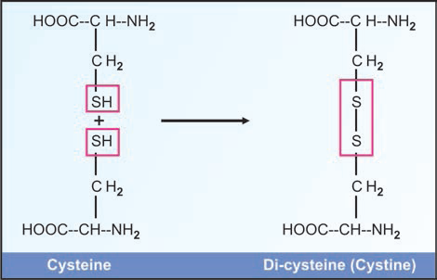
Fig. Formation of disulfide bridges

Slide 46
Amino acid derivatives of importance
Gamma amino butyric acid (GABA, a derivative of glutamic acid) and dopamine (derived from tyrosine) are neurotransmitters. GABA pentin can pass blood brain barrier and can form GABA in brain.
Histamine (synthesized form histidine) is the mediator of allergic reactions.
Thyroxine (from tyrosine) is an important thyroid hormone.
4. Cycloserine, a derivative of serine is an antituberculosis drug. Azaserine inhibits reactions where amide groups are added, and so acts as an anticancer drug.
5. Histidine residues are important in the buffering activity of proteins.
6. Ornithine and Citrulline are derivatives of arginine, and are essential for urea synthesis.

Slide 47
AMINO ACIDS AS DRUGS
There are certain non-standard amino acids that are used as drugs.
D-Penicillamine (D-dimethylglycine), a metabolite of penicillin, is employed in the chelation therapy of Wilson’s disease. This is possible since D-penicillamine can effectively chelate copper.
N-Acetylcysteine is used in cystic fibrosis, and chronic renal insufficiency, as it can function as an antioxidant.
Gabapentin (γ-aminobutyrate linked to cyclohexane) is used as an anticonvulsant.
Notes:
Anticonvulsants are a diverse group of pharmacological agents used in the treatment of epileptic seizures.
Wilson disease is a rare autosomal recessiveinherited disorder of copper metabolism that is characterized by excessive deposition of copper in the liver, brain, and other tissues

Slide 48
PEPTIDE BOND
Definition
Peptide bond is an amide bond formed between the α-carboxyl group of one amino acid and the α-amino group of another amino acid.
Formation of a peptide bond
Alpha carboxyl group of one amino acid reacts with alpha amino group of another amino acid to form a peptide bond or CO-NH bridge.
Proteins are made by polymerization of amino acids through peptide bonds.
Two amino acids are combined to form a dipeptide; three amino acids form a tripeptide; four will make a tetrapeptide.
A few amino acids together will make an oligppeptide.
And combination of 10 to 50 amino acids is called as a polypeptide.
Long polypeptide chains containing more than 50 amino acids are called proteins.

Slide 49
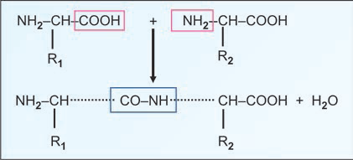
Fig. Peptide bond formation

Slide 50
Characteristic of peptide bond
The peptide bond is a partial double bond.
The C-N bond is ‘trans’ in nature and there is no freedom of rotation because of the partial double bond character.
The distance is 1.32Aͦ which is midway between single bond (1.49Aͦ) and double bond (1.27Aͦ).
The side chains are free to rotate on either side of the peptide bond.
Writing of peptide structures
The peptide chains are written with the free amino end (N-terminal residue) at the left, and the free carboxyl end (C-terminal residue) at the right.
The amino acid sequence is read from N-terminal end to C-terminal end.
Shorthand to read peptides
The amino acids in a peptide or protein are represented by the 3-letter or one letter abbreviation.
This is the chemical shorthand to write proteins.

Slide 51
Naming of peptides
For naming peptides, the amino acid suffixes –ine (glycine), -an (tryptophan), -ate (glutamate) are changed to –yl with the exception of C-terminal amino acid.
Thus a tripeptide composed of an N-terminal glutamate, a cysteine and a C-terminal glycine is called glutamyl-cysteinyl-glycine.

Slide 52
BIOLOGOCALLY IMPORTANT PEPTIDES
Generally, the term peptide is applied when the number of constituent amino acids is less than 10.
Some examples of biologically active peptides and their functions are:
Glutathione
It is a tripeptide composed of 3 amino acids.
Chemically, glutathione is γ-glutamyl-cysteinyl-glycine.
It serves as a coenzyme for certain enzymes e.g. prostaglandin PGE₂ synthetase, glyoxylase.
It prevents the oxidation of sulfhydryl (-SH) groups of several proteins to disulfide (-S-S-) groups. This is essential for the protein function, including that of enzymes.
Glutathione (reduced) performs specialized functions in erythrocytes
It maintains RBC membrane structure and integrity.
It protects hemoglobin from getting oxidized by agents such as H₂O₂.
Glutathione is involved in the transport of amino acids in the intestine and kidney tubules via γ-glutamyl cycle or Meister cycle.

Slide 53
Glutathione is involved in the detoxification process. The toxic substances (organophosphates, nitro compounds) are converted to mercapturic acids.
Toxic amounts of peroxides and free radicals produced in the cells are scavanged by glutathione peroxidase (a selenium containing enzyme).
2. Thyrotropin releasing hormone (TRH)
It is a tripeptide secreated by hypothalamus.
TRH stimulates pituitary gland to release thyrotropic hormone.
3. Oxytocin
It is a hormone secreted by posterior pituitary gland and contains 9 amino acids (nonapeptide).
Oxytocin causes contraction of uterus.
4. Vasopressin (antidiuretic hormone, ADH)
ADH is also a nonapeptide produced by posterior pituitary gland.
It stimulates kidneys to retain water and thus increases the blood pressure.
5. Angiotensins
Angiotensin I is a decapeptide (10 amino acids) which is converted to angiotensin II (8 amino acids)
Angiotensin II stimulates the release of aldosterone from adrenal gland and also has hypertensive effect.

Slide 54
6. Methionine enkephalin
It is a pentapeptide found in the brain and has opiate like function.
It inhibits the sense of pain.
7. Bradykinin and kallidin
They are nona and decapeptides, respectively.
Both of them act as powerful vasodilators.
They are produced from plasma proteins by snake venom enzymes.
8. Peptide antibiotics
Antibiotics such as gramicidin, bacitracin, tyrocidin and actinomycin are peptide in nature.
9. Aspartame
It is a dipeptide ( aspartylphenylalanine methyl ester), produced by a combination of aspartic acid and phenylalanine.
Aspartame is about 200 times sweeter than sucrose, and is used as a low-calorie artificial sweetner in softdrink industry.
10. Gastrointestinal hormones
Gastrin, secretin etc. are the gastrointestinal peptides which serve as hormones.
Notes:
Opiate : any drug containing or derived from opium.

