Slide 1
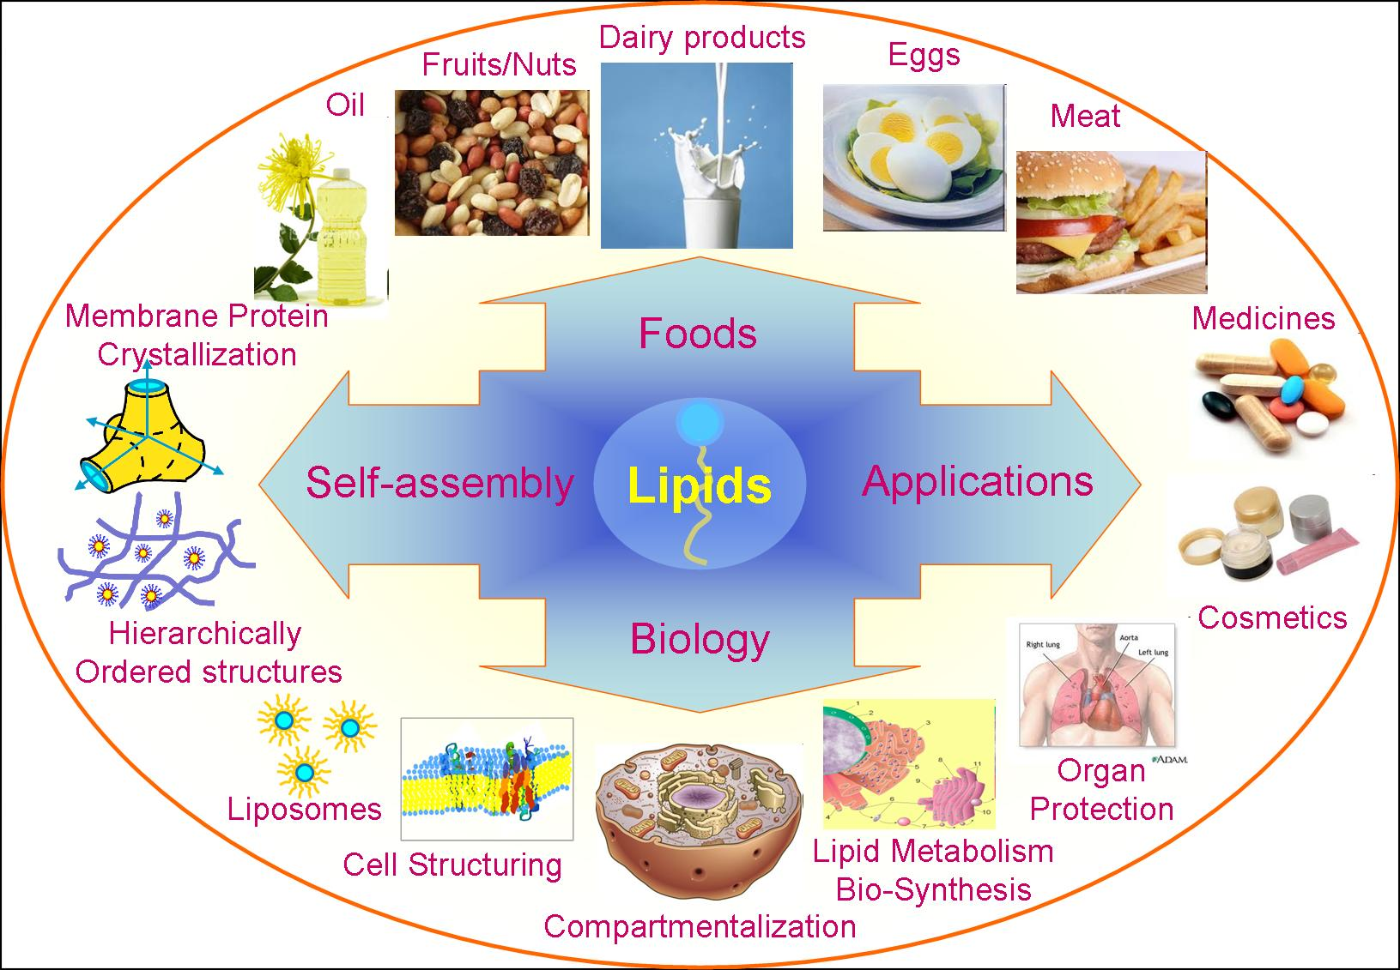
CHEMISTRY OF LIPIDS

Slide 2
DEFINITION:
Lipids (Greek – Lipos : Fat) may be regarded as organic substances relatively insoluble in water, soluble in organic solvents (alcohol, ether etc.), actually or potentially related to fatty acids and utilized by the living cells.
FUNCTIONS OF LIPIDS:
Storage form of energy (triacylglycerol)
Structural components of biomembranes (phospholipids and cholesterol)
Metabolic regulators (steroid hormones and prostaglandins)
Act as surfactants, detergents and emulsifying agents (amphipathic lipids)
Act as electric insulators in neurons
Provide insulation against changes in external temperature (subcutaneous fat).
Give shape and contour to the body.
Protect internal organs by providing a cushioning effect (pads of fat)
Help in absorption of fat soluble vitamins (A,D,E and K).
Improve taste and palatability of food.
Notes:
Trunk : the body exclusive of the head and limbs.
Atherosclerosis : the most common form of arterioscleorosis, marked by cholesterol-lipid-calcium deposits in the walls of arteries that may restrict blood flow.

Slide 3
CLASSIFICATION OF LIPIDS
Based on the chemical nature, lipids are broadly classified as:
Simple lipids
Compound (or complex) lipids
Derived lipids
Miscellaneous lipids
LIPIDS
Simple Compound Derived
Phospholipids Ketone bodies
Fats Waxes -Glycerophospholipids Sterols
Oils -Sphingolipids Fatty acids
Proteolipids -Saturated
(lipoproteins) - Unsaturated
Monounsaturated Polyunsaturated

Slide 4
Simple lipids
They are esters of fatty acids with alcohols.
They are mainly of two types.
Fats and oils (triacylglycerols)
These are esters of fatty acids with glycerol.
Fats and oils differ only in that oils are a liquid while fats are a solid at room temperature.
Fats are obtained from animal sources, have more saturated fatty acids and thus higher melting points.
Oils are abundant in plant seeds and are usually rich in unsaturated fatty acids.

Slide 5
b. Waxes
Esters of fatty acids with alcohols other than glycerol.
These alcohols may be aliphatic or alicyclic.
Cetyl alcohol is most commonly found in waxes.
Waxes are used in the preparation of candles, lubricants, cosmetics, ointments, polishes etc.
COMPLEX (or COMPOUND) LIPIDS
These are esters of fatty acids with alcohols containing additional groups such as phosphate, nitrogenous base, carbohydrate, protein etc.
Depending on these extra groups, they are sub-classified as:
Phospholipids
They contain phosphoric acid and frequently a nitrogenous base in addition to alcohol and fatty acids.

Slide 6
a. Glycerophospholipids
These phospholipids contain glycerol as the alcohol.
E.g. lecithin, cephalin
b. Sphingophospholipids
Sphingosine is the alcohol in this group of phospholipids.
E.g. shphingomyelin.
2. Glycolipids
These lipids contain a fatty acid, carbohydrate and nitrogenous base.
The alcohol is sphingosine, hence they are also called as glycosphingolipids.
E.g. cerebrosides, gangliosides.

Slide 7
3. Lipoproteins
Macromolecular complexes of lipids with proteins.
4. Other complex lipids
Sulfolipids, aminolipids and lipopolysaccharides are among the other complex lipids.
Derived lipids
These are the derivatives obtained on the hydrolysis of simple and compound lipids which possesses the characteristics of lipids.
E.g. glycerol, fatty acids, lipid (fat) soluble vitamins, steroid hormones, hydrocarbons and ketone bodies.
Miscellaneous
These include a large number of compounds possessing the characteristics of lipids.
E.g., carotenoids, squalene, hydrocarbons such as pentacosane (in bee wax), terpenes etc.

Slide 8
ARTIFICIAL FAT
Sucrose polyester, i.e. a sucrose molecule attached to 6-8 fatty acid molecules is called artificial fat or synthetic fat replacer, commercially available as Olestra.
It is prescribed in patients who need to markedly cut down their dietary fat intake for medical or cosmetic reasons.
It is undigested and unabsorbed in the gastrointestinal tract, hence, it is devoid of any energy value.
However, it tastes like fat and is used in potato chips, tortilla chips, corn chips, crackers etc.
It is fortified with fat soluble vitamins.

Slide 9
FATTY ACIDS
INTRODUCTION
Fatty acids are aliphatic carboxylic acids with hydrocarbon side chain and have the general formula, R-CO-OH, where COOH(carboxylic group) represents the functional group.
Depending on the R group (the hydrocarbon chain), the physical properties of fatty acids may vary.
Fatty acids, are included in the group of derived lipids.
It is the most common component of lipids in the body.
In human body, free fatty acids are formed only during metabolism
The major source of circulating free fatty acids is the adipose tissue which releases fatty acids after hydrolysis of its storage triacylglycerols.
They have a limited solubility in water and are mainly bound to plasma albumin which has specific binding sites for free fatty acids.
Notes:
Fortify : to increase the strength or quality of food or drink by adding something to it.

Slide 10
PHYSICAL AND CHEMICAL PROPERTIES OF FATTY ACIDS
Generally, short chain fatty acids, i.e. those between 4C and 8C, are liquid while long chain fatty acids, i.e. those with more than 15 carbon atoms are solid at room temperature.
Fatty acids present in various oils react with alkali and form salts. Salts of the various acids are used as soaps and emulsifying agents.
Unsaturated fatty acids undergo reduction and are converted to saturated fats, such as hydrogenation of a vegetable oil results in the formation of ghee.
Unsaturated fatty acids exhibit cis-trans isomerism, due to the presence of double bond.
Various fatty acids can be separated from a mixture by gas-liquid chromatography.

Slide 11
NOMENCLATURE OF FATTY ACIDS
The nomenclature of a fatty acid depends upon the name of the hydrocarbon chain with the same number of carbon atoms where the suffix ‘-oic’ is substituted for the final ‘e’ in the name of the hydrocarbon.
Delta system
Carbon atoms are numbered, beginning with the carboxyl carbon (-COOH) as carbon atom number 1.
The next carbon atom, to which the carboxyl carbon group is attached, is designated as α-carbon.
Accordingly, carbon-3 (C3) is the β-carbon and C4 is the γ-carbon.
2. Omega system
The carbon atoms in a fatty acid also be counted beginning at the methyl terminal (CH₃-) end of the chain and depending on where a double bond is first encountered.
This carbon atom at the terminal CH₃- group is called as the omega (ω) carbon.
Recently, replacement of the symbol ω by the letter ‘n’ has been recommended as an n-numbering system.
  6 5 4 3 2 1
CH3 — CH2 — CH2 — CH2— CH2 — COOH
ω1 ω2 ω3 ω4 ω5

Slide 12
CLASSIFICATION OF FATTY ACIDS
Fatty acids are classified in 3 ways:
Classification based on the nature of hydrocarbon chain
Classification based on the number of carbon atoms
Classification based on the length of carbon chain.

Slide 13
CLASSIFICATION OF FATTY ACIDS BY THE NATURE OF HYDROCARBON CHAIN
Accordingly, fatty acids may be divided into two groups, i.e. saturated fatty acids and unsaturated fatty acids.
Saturated fatty acids
Saturated fatty acids do not have double bonds.
The systematic name gives the total number of carbons and has the suffix ‘-anoic’, e.g. palmitic acid which has 16 carbon atoms and designated as hexadecanoic acid.
The general formula of a saturated fatty acid is written as CH₃(CH₂)_{n} COOH, where ‘n’ specifies the number of methylene group.
Examples are palmitic acid ( C 16 saturated fatty acid) and stearic acid (C 18 saturated fatty acid) which are most abundant in body fat.
Each animal species will have characteristic pattern of fatty acid composition.
Human body fat contains 50% oleic acid, 25% palmitic acid, 10% linoleic and 5% stearic acid.

Slide 14
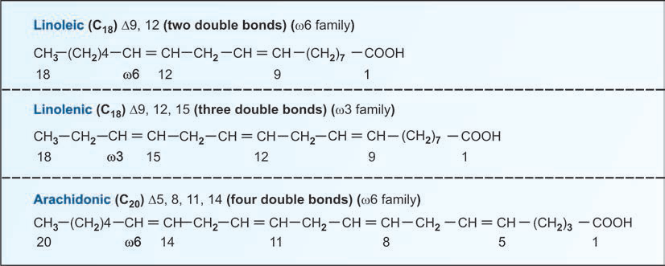
2. UNSATURATED FATTY ACIDS
Unsaturated fatty acids are fatty acids having double bond.
They are named by adding the suffix ‘enoic’ after the systematic name. e.g. octadecenoic acid (oleic acid), a fatty acid with 18 carbon atoms and a double bond.
Widely used convention to name an unsaturated fatty acid is to indicate the number of carbon atoms, followed by the number of double bonds with their positions in the carbon chain, such as octadecenoic acid may be written as 18:9, i.e. a fatty acid with 18 carbon atoms and one double bond present on C9, i.e. between C9 and C10.
The location of the double bond can also be indicated by the symbol , followed by superscript indicating the number of carbon atoms.

Slide 15
Based on the number of double bonds, unsaturated fatty acids are grouped into two types: monounsaturated fatty acids and polyunsaturated fatty acids.
Monounsaturated fatty acids
Monounsaturated fatty acids have only one double bond.
Example is oleic acid (C18 :1 ⁹).
b) Polyunsaturated fatty acids (PUFA)
Polyunsaturated fatty acids have 2 or more double bonds.
Fatty acids obtained from plant seeds usually contain two or more double bonds.
Examples are linoleic acid (C 18 fatty acid, 2 double bond at C9-10 and C12.13) (C18 :2 ^{9,12}).
Linolenic acid (C18 fatty acid. 3 double bonds at C9-10, 12-13 and C15-16) (C18 :3 ^{9,12,15}).
Arachidonic acid (C 20 fatty acid, 4 double bonds at C 5-6, 8-9, 11-12 and 14-15) (C20 :4 ^{5,8,11,14}).
(C18 :1 ⁹).
(C18 :1 ⁹).
(C18 :1 ⁹).
(C18 :⁹

Slide 16
CLINICAL SIGNIFICANCE OF PUFA
Linoleic and linolenic acids are polyunsaturated fatty acids. They are called essential fatty acids, because they cannot be synthesized by the body and have to be supplied in the diet.
Unsaturated fatty acids are also designated as
ω3 family – linolenic acids
ω6 family – linoleic and arachidonic acids
ω9 family – oleic acid
3. Arachidonic acid is the precursor of prostaglandins. It can be synthesized in the body, if the essential fatty acids are supplied in the diet.
4. The penta-enoic acid present in fish or oil is of great nutritional importance (ω3 unsaturated fatty acid) and also promotes a reduction in plasma triacylglycerols.
5. Eicosanoids (eicosa = twenty) are derived from 20 C arachidonic acid. They are poly-enoic fatty acids. They are prostanoids (prostaglandins, prostacyclins, thromboxane) and leukotrienes.
6. PUFA are also used in the esterification of cholesterol and thus helps in its transport and metabolism. Diets with high ratio of PUFA: saturated fatty acids can cause a decrease in serum cholesterol.
7. Consumption of fat containing ω-6 fatty acids (principally linoleic acid) lowers plasma cholesterol level.
8. Arachidonic acid also acts as precursor of eicosanoids such as prostaglandins.

Slide 17
Classification based on the number of carbon atoms
Most of the fatty acids that occur in natural lipids are of even carbons (usually 14C – 20C).
This is due to the fact that biosynthesis of fatty acids mainly occurs with the sequential addition of 2 carbon units.
Palmitic acid (16C) and stearic acid (18C) are the most common.
Among the odd chain fatty acids, propionic acid (3C) and valeric acid (5C) are well known.

Slide 18
Classification based on the length of carbon chain.
Depending on the length of carbon chains, fatty acids are categorized into 3 groups – short chains with less than 6 carbons; medium chain with 8 to 14 carbons and long chain with 16 to 24 carbons.

Slide 19
ISOMERISM IN UNSATURATED FATTY ACIDS
Unsaturated fatty acid exhibit geometric isomerism depending on the orientation of the groups around the double bond axis.
If the atoms or acyl groups are present on the same side of the double bond, it is a cis configuration.
On the other hand, if the groups occur on the opposite side, it is a trans configuration.
E.g. oleic acid is a cis isomer while elaidic acid is a trans isomer.
Cis isomers are less stable than trans isomers.
Most of the naturally occuring unsaturated fatty acids exist as cis isomers.
The polyunsaturated fatty acids (PUFA) exist in cis configuration in naturally occuring lipids.
Unsaturated fatty acids are chemically more reactive than the saturated fatty acids and are prone to alterations by processes such as lipid peroxidation.
The melting points decreases with the degree of unsaturation.

Slide 20
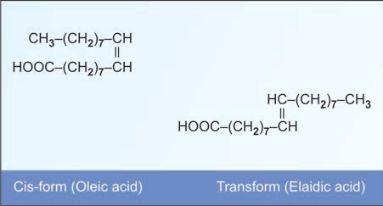

Slide 21
TRANS FATTY ACIDS (TFA)
They are present in dairy products and in hydrogenated edible oils.
They are generally considered to be injurious to health.
However, they are used in food industry as they increase the shelf life of the fried food.
Fast food preparations have a high TFA content.
Trans fatty acids adversely affects multiple risk factors for chronic diseases, including composition of blood lipids and lipoproteins, systemic inflammation, endothelial dysfunction, insulin resistance, diabetes and adiposity.
It is high in processed foods and bakery products, where partially hydrogenated vegetable oils are used for cooking.

Slide 22
ESSENTIAL FATTY ACIDS
DEFINITION
The fatty acids that cannot be synthesized by the body and, therefore, should be supplied in the diet are known as essential fatty acids (EFA).
EXAMPLES OF ESSENTIAL FATTY ACIDS
Chemically, essential fatty acids are polyunsaturated fatty acids, namely linoleic acid (18 : 2; 9, 12) and linolenic acid (18 : 3; 9, 12, 15).
Arachidonic acid (20 : 4; 5, 8, 11, 14 ) become essential, if its precursor linoleic acid is not provided in the diet in sufficient amounts.

Slide 23
BIOCHEMICAL BASIS FOR ESSENTIALITY
Linoleic acid and linolenic acid are essential since humans lack the enzymes that can introduce double bonds beyond carbons 9 to 10.
FUNCTIONS OF ESSENTIAL FATTY ACIDS
Growth and reproduction : They are required for growth and reproductive function.
Structural components of cell plasma membrane : They are essential components of cell membranes. They contribute to membrane fluidity.
3. Precursor of eicosanoids : Arachidonic acid is a precursor for the formation of eicosanoids. Eicosanoids include prostaglandins, prostacyclins, thromboxanes and leuckotrienes.
4. Retinal function : Docosahexaenoic acid (C-22:6) is formed from linolenic acid. It is richly present in retina and required for retinal function.
5. Lowering of plasma cholesterol : They lower plasma cholesterol level. Hence essential fatty acids are claimed to offer protection against coronary heart disease.
6. Prevention of fatty liver : They are incorporated in to phospholipids. Hence, they prevent the development of fatty liver.

Slide 24
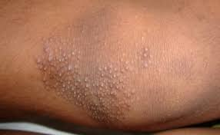
CASUE OF DEFICIENCY
Deficiency of essential fatty acids are rare.
Essential fatty acid deficiency results from long standing dietary deficiency such as long standing parenteral nutrition.
DEFICIENCY OF ESSENTIAL FATTY ACIDS
The deficiency of EFA results in phrynoderma or toad skin, characterized by the presence of horny eruptions on the posterior and lateral parts of limbs, on the back and buttocks and poor wound healing.
Notes:
Parenteral : denoting any medication route other than the alimentary canal, such as intravenous, subcutaneous, intramuscular, or mucosal.

Slide 25
EICOSANOIDS
INTRODUCTION
Eicosanoids (Greek – eicosa: twenty) are physiologically and pharmacologically active compounds derived from 20-carbon (eicosa) polyunsaturated (enoic) fatty acids such as arachidonic acid.
Eicosanoids are classified into two main classes : prostanoids and leukotrienes.
Prostanoids are further grouped into prostaglandins, prostacyclins and thromboxanes.
Prostaglandins (PGs) were first discovered in human semen by Ulf von Euler (of Sweden) in 1930.
They were named due to their solubility in ether (PGE) and phosphate buffer (PGF, F for fosfat, in Swedish).
All other prostaglandins discovered later were denoted by a letter – PGA, PGH etc.

Slide 26
SYNTHESIS
The synthesis of eicosanoids involves :
Release of arachidonic acid
Synthesis of prostanoids (prostaglandins, prostacyclins and thromboxanes) from arachidonic acid through cyclooxygenase pathway.
Synthesis of leukotrienes through lipooxygenase pathway

Slide 27
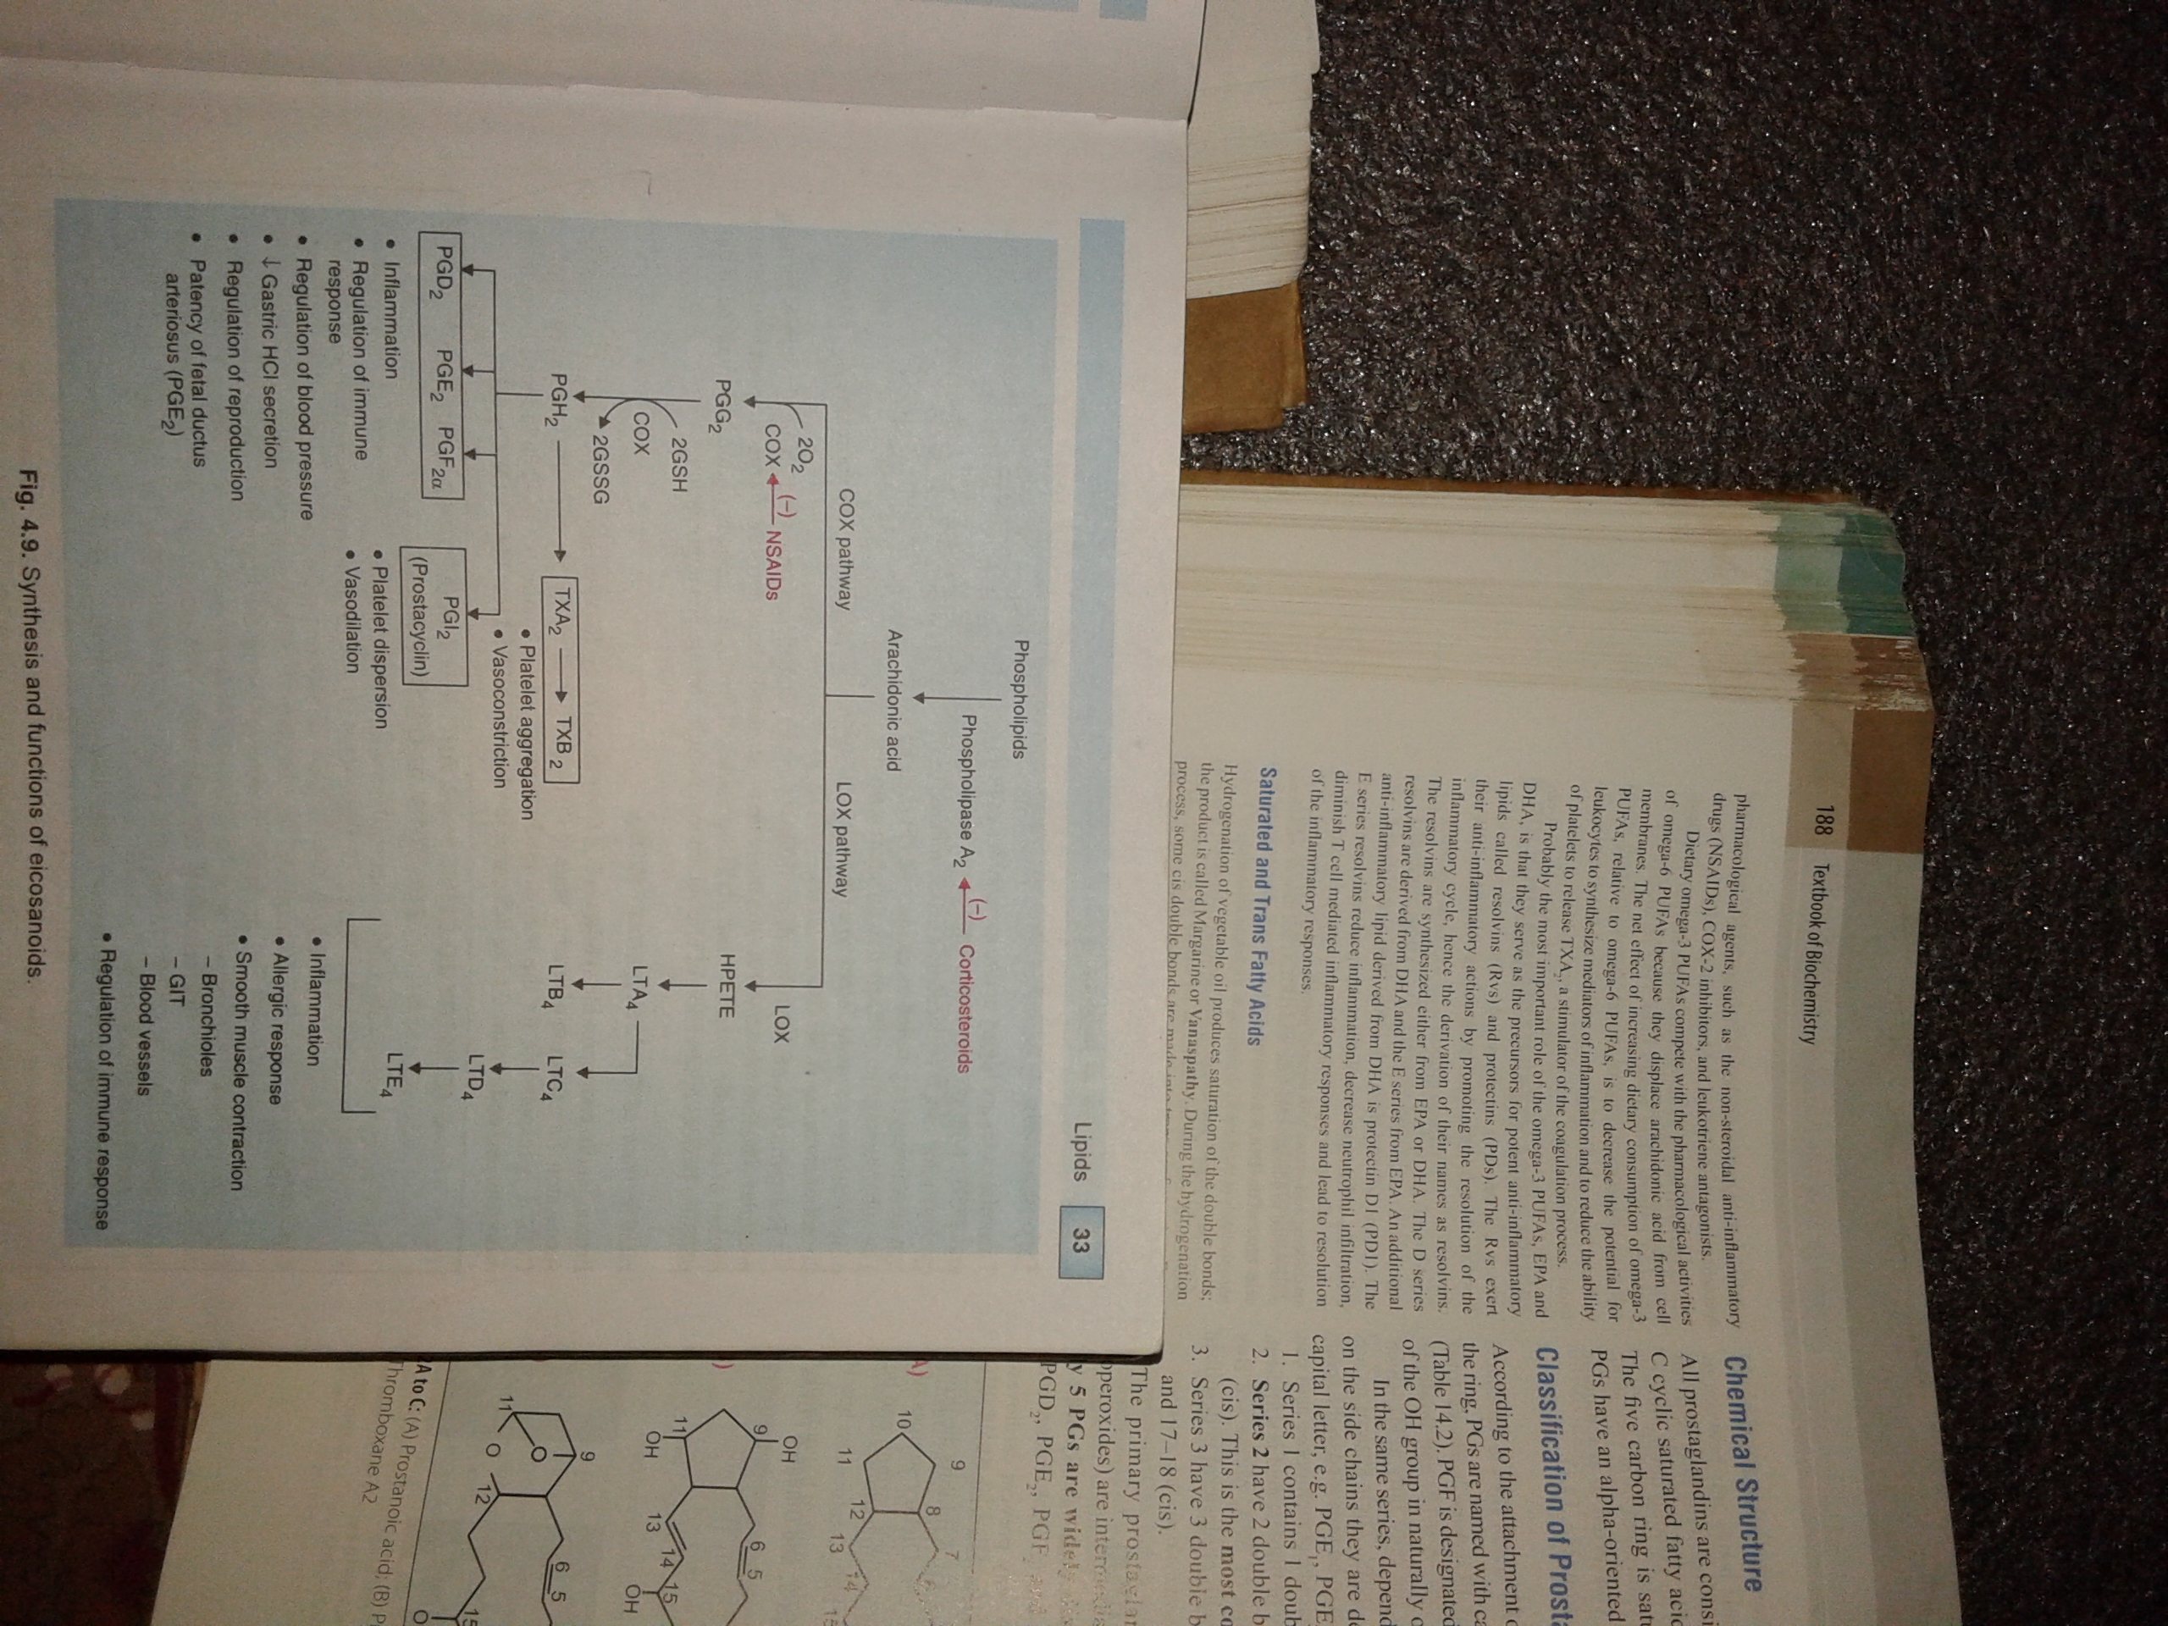
Notes:
Patency of fetal ductus arteriosus : of An uncorrected PDA may lead to congestive heart failure with increasing age. The ductus arteriosus is a fetal blood vessel that closes soon after birth. In a PDA, the vessel does not close and remains "patent" (open), resulting in irregular transmission of blood between the aorta and the pulmonary artery.

Slide 28
TRIACYLGLYCEROLS (TRIGLYCERIDES)
INTRODUCTION
Triacylglycerols or neutral fats (also called triglycerides) are fatty acid tri-esters of glycerol (glycerin, a trihydric alcohol) are simple lipids.
The fats and oils that are widely distributed in both plants and animals are chemically triacylglycerols.
Dietary fat, which is an important source of energy for the body, mainly contains triacylglycerols.
Fat is stored in the body in the form of triacylglycerols, mainly in the adipose tissue.
They are insoluble in water and non-polar in character and are commonly known as neutral fats.
A molecule of triacylglycerol may contain three similar or dissimilar fatty acid residue which may be saturated or unsaturated
Generally, with the primary alcoholic groups, i.e. at the positions, C1 and C3, of glycerol, there are saturated fatty acids while at C2 there is an unsaturated fatty acids.
Triacylglycerols are named according to the presence of the fatty acid residues on the glycerol moiety, e.g. 1-palmitoyl-2-arachidonoyl-3-stearoylglycerol has palmitic acid at C1, arachidonic acid at C2, and stearic acid at C3 of glycerol.

Slide 29
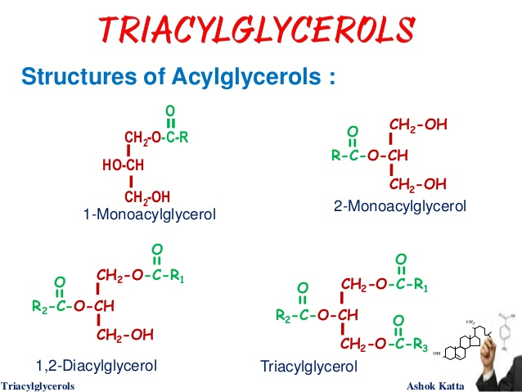
Notes:
Acyl group : A group of the type RCO-, where R is an organic group. An example is the acetyl group CH₃CO-.

Slide 30
CLASSIFICATION OF TRIACYLGLYCEROLS
Triacylglycerols are classified in three ways based on
Nature of fatty acids
Chain length of fatty acids and
Physical properties

Slide 31
CLASSIFICATION BASED ON NATURE OF FATTY ACIDS
Depending on the nature of fatty acids present, triacylglycerols are grouped into simple triacylglycerols and mixed triacylglycerols.
1. SIMPLE TRIACYLGLYCEROLS
They contain the same type of fatty acid residue at all the three carbons e.g. tristearoyl glycerol or tristearin containing stearic acid at all the 3 carbons, tripalmitin containing palmitic acid at all the 3 carbons and triolein containing oleic acid at all the 3 carbons.
2. MIXED TRIACYLGLYCEROLS
They contain different types of fatty acid residues esterified with glycerol.
Generally, two hydroxyl groups are esterified to similar fatty acid and the third with a different one.
Example is 1,3 palmitoyl 2-linoyl glycerol.

Slide 32
CLASSIFICATION BASED ON CHAIN LENGTH OF FATTY ACIDS
Depending on the chain length of fatty acids, triacylglycerols are grouped into short chain, medium chain and long chain triacylglycerols.
SHORT CHAIN TRIACYLGLYCEROLS
They contain fatty acids having 2 to 6 carbon atoms.
Example is tributyrin (butyric acid is a C 4 fatty acid)
2. MEDIUM CHAIN TRIACYLGLYCEROLS
They contain fatty acids having 8 to 14 carbon atoms.
Example is tricaprolin (caprolic acid is a C 8 fatty acid).
3. LONG CHAIN TRIACYLGLYCEROLS
They contain fatty acids having 16 or more carbon atoms.
Example is 1,3 palmitoyl 1-linoeoyl glycerol.
Palmitic acid is a C16 fatty acid and linoleic acid is a C18 fatty acid.

Slide 33
CLINICAL SIGNIFICANCE
Short chain and medium chain triacylglycerols are recommended in conditions of impaired digestion of triacylglycerols because they are readily absorbed by intestinal mucosal cell bypassing (a) digestion (requiring pancreatic lipase), and (b) mixed micelle formation (requiring bile salts).
In contrast, long chain triacylglycerols require both digestion and mixed micelle formation for absorption.

Slide 34
CLASSIFICATION BASED ON PHYSICAL PROPERTIES
Based on physical properties, triacylglycerols are grouped into fats or oils.
FATS
Fats are triacylglycerols that are solids at room temperature.
They are rich in saturated fatty acids.
They usually contain long chain fatty acids.
They are usually of animal origin.
Examples are beef fat, pig fat, butter.
2. OILS
Oils are triacylglycerols that are liquids at room temperature.
They are rich in unsaturated fatty acids.
They contain significant amounts of short chain or medium chain fatty acids.
Most of the oils are of plant origin.
Examples are coconut oil, sunflower oil, groundnut oil, olive oil, corn oil and cotton seed oil.
Oils can be converted to fat by hydrogenation.

Slide 35
CHEMICAL REACTIONS
Important chemical reactions of triacylglycerols include :
Rancidity
Saponification
Hydrogenation
Halogenation and
Hydrolysis.

Slide 36
RANCIDITY
DEFINITION
Rancidity is defined as the appearance of unpleasant odor and taste of fats on storage.
TYPES
The two common types of rancidity are
1. Oxidative rancidity and
2. Hydrolytic rancidity
Oxidative rancidity
Oxidative rancidity is due to oxidation of unsaturated fatty acids.
Oxidation of unsaturated fatty acids leads to the production of ketones, aldehydes and peroxy radicals (free radicals) which cause damage to the biomolecules in the cells.
Notes:
Peroxy radical : The hydroperoxyl radical, also known as the perhydroxyl radical, is the protonated form of superoxide with the chemical formula HO₂

Slide 37
Oxidation of unsaturated fatty acids are increased by heat, light, moisture and air.
Oxidation of unsaturated fatty acids can be prevented by addition of antioxidants that inactivate free radicals.
Antioxidants are either natural such as vitamin E and β-carotenes or synthetic antioxidants such as butylated hydroxytoluene (BHT) and butylated hydroxyanisole (BHA).
Hydrolytic rancidity
Hydrolytic rancidity occurs due to partial hydrolysis of triacylglycerols by bacterial enzymes (lipases).
Lipases hydrolyze fats to form free fatty acids.
Hydrolytic rancidity is common in butter.
When butter is allowed to stand at room temperature, hydrolysis of butter results in the release of fatty acids and glycerol.

Slide 38
Butyric acid is one of the short chain fatty acids produced during hydrolysis.
Butyric acid has disagreeable odor and the butter appears rancid.
This occurs because of the action of microorganisms present in the air hydrolyzing the butter.
Hence, it is advisable to keep the butter covered and keeping the butter in refrigerator.

Slide 39
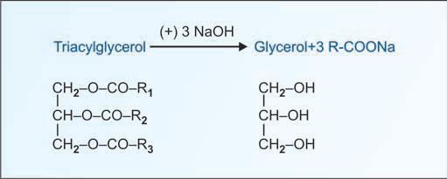
SAPONIFICATION
The hydrolysis of triacylglycerols by alkali to produce glycerol and soaps is known as saponification.
Soaps are defined as metallic salts of fatty acids.
Sodium salts of fatty acids forms hard soaps and potassium salts of fatty acids form soft soaps.
Soaps behave as micelles.
They form mixed micelles when mixed with hydrocarbon compounds such as oils.
They are used as cleaning agents and detergents.
Saponification number is used in the analysis of triacylglycerols.
Fig. Saponification
Notes:
Hard soap : soap made by using sodium hydroxide or sodium carbonate
Soft soap : a semi-fluid soap, especially one made with potassium rather than sodium salts.

Slide 40
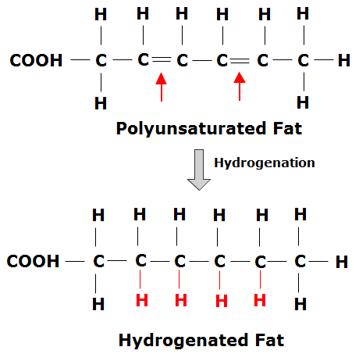
HYDROGENATION
Hydrogenation is saturation of unsaturated fatty acids leading to solidification of oils.
Hydrogenation provides a means for the preparation of edible solid fat from low priced oils such as cottonseed oil.

Slide 41
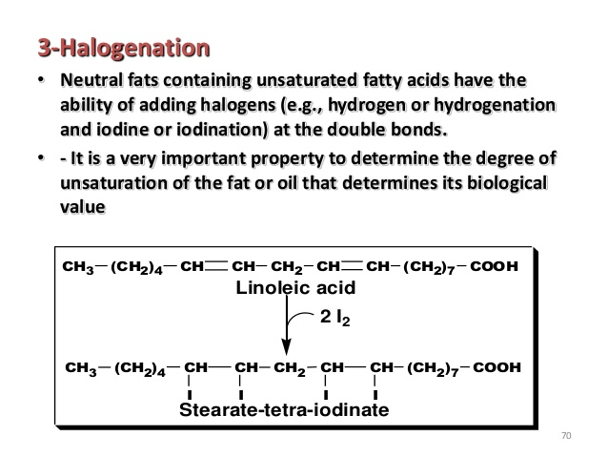
HALOGENATION
Halogenation refers to addition of halides such as iodine and bromine to unsaturated fatty acids.
Iodine number is used as index of degree of unsaturation of fatty acids present in triacylglycerols.

Slide 42
HYDROLYSIS
Triacylglycerols undergoes stepwise enzymatic hydrolysis by lipases to finally liberate free fatty acids and glycerol.
This reaction is important for digestion of fat in the gastrointestinal tract and fat mobilization from the adipose tissues.
Derivatives of glycerol such as glycerylnitrate are used as vasodilators in the treatment of angina pectoris.
Deficiency of pancreatic lipase due to pancreatic disease leads to an impaired digestion of lipids. This condition is called steatorrhoea.
Notes:
Angina pectoris : An oppressive pain or pressure in the chest caused by inadequate blood flow and oxygenation to heart muscle. It is usually produced by atherosclerosis.

Slide 43
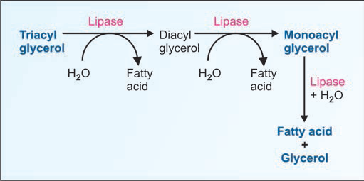
Fig. Hydrolysis of triglycerides

Slide 44
TESTS TO CHECK PURITY OF FATS AND OILS
Iodine number
It is defined as the number of grams of iodine absorbed by 100 gm of fat or oil.
Iodine number is a measure of degree of unsaturation of fat or oil.
If an oil contains more number of unsaturated fatty acids, then more iodine is absorbed by the oil and the iodine number is more.
Determination of iodine number will help to know the degree of adulteration of a given oils.
E.g. iodine number of butter is 28, and that of sunflower oil is 130.

Slide 45
2. Saponification number
It is defined as the number of milligrams (mg) of KOH required to hydrolyze (sponify) one gram of fat or oil.
Saponification number is an index of the chain length of fatty acids in fat or oil.
Saponification number is proportional to the chain length of fatty acids (and inversely proportional to the molecular weight).
If the oil contains more short chain fatty acids, it requires more alkali to form soap because there are more molecules of short chain fatty acids in a given amount of oil.
Examples : Human fat has low saponification number (195-200) because it is rich in long chain fatty acid such as palmitic acid.

Slide 46
3. Acid number
It is defined as the number of mg of KOH required to completely neutralize free fatty acids present in one gram fat or oil.
Acid number is an index of degree of rancidity or degree of decomposition of fatty acid in fat.
Fat having high acid number is not suitable for human consumption.
Example : Acid number of pure refined oil is very low (about zero).

Slide 47
4. Reichert-Meissl (RM) number
It is defined as the number of ml of 0.1 N KOH required to completely neutralize the soluble volatile fatty acids distilled from 5 g of fat.
Reichert-Meissl number is an index of amount of volatile fatty acids such as butyric acid and caproic acid.
RM number is useful in testing the purity of butter since it contains a good concentration of volatile fatty acids (butyric acid, caproic acid and caprylic acid.
Butter has RM number in the range of 25-30, while it is less than 1 for most other edible oils.

Slide 48
FUNCTIONS OF TRIACYLGLYCEROLS
Storage form of lipids for energy
Triacylglycerols can be stored to very great extent in adipose tissue and its hydrolysis results in the release of fatty acids for oxidation to provide energy.
2. Insulation
Localization of adipose tissue in the body is mostly subcutaneous.
Hence, fat provides a good insulation to protect against cold.
3. Thermogenesis
Brown adipose tissue is involved in thermogenesis.
4. Protection of internal organs
A pad of fat surrounding soft tissue and fat pad of greater omentum and lesser omentum provide protection against traumatic injury to internal organs.

Slide 49
PHOSPHOLIPIDS
DEFINITION
Phospholipids are complex or compound lipids containing phosphoric acid, in addition to fatty acids, nitrogenous base and alcohol.
CLASSIFICATION OF PHOSPHOLIPIDS
Depending on the type of alcohol present, phospholipids are further grouped into
Glycerophospholipid (or phosphoglycerides) that contain glycerol as the alcohol.
Sphingophospholipid that contain sphingosine as the alcohol.

Slide 50
GLYCEROPHOSPHOLIPIDS
INTRODUCTION
Glycerophospholipids are the phospholipids containing glycerol as the alcohol.
They consists of glycerol 3-phosphate esterified at its C₁ and C₂ with fatty acids.
Usually, C₁ (α1-carbon) contains an saturated fatty acid while C₂ (β-carbon) contains an unsaturated fatty acid of glycerol.
Glycerophospholipids contain nitrogenous base as the additional group attached to phosphate group.
Glycerophospholipids are the major lipid components of the biological membrane.
A hydrolyzed products of glycerophospholipids such as 1,2-Diacylglycerol functions as an intracellular signal molecule that activates protein kinase.

Slide 51
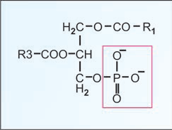
PHOSPHATIDIC ACID
The simplest glycerophospholipid is phosphatidic acid.
It is produced by hydrolysis of the membrane lipids in blood platelets and injured cells, and stimulates cell growth as a part of the wound repair process.
The phosphoryl group of phosphatidic acid may be linked to a nitrogenous compound such as ethanolamine, choline or serine, or to some other group like inositol thereby forming various glycerophospholipids, e.g. phosphatidylcholine (lecithin), phosphatidylehanolamine (cephalin), phosphatidylinositol, etc.
Fig. L-phosphatidic acid

Slide 52
PHOSPHATIDYLCHOLINE (LECITHIN)
COMPOSITION
Chemically, lecithin (Greek, lekithos = egg yolk) contain choline ( a nitrogenous base) at C3 in a phosphatidic acid.
Fatty acid at carbon 1 is usually palmitic acid or stearic acid.
Fatty acid at carbon 2 is usually oleic acid, linoleic acid, linolenic acid and or arachidonic acid.
SOURCES
These are widely distributed in brain, lungs, nerve cells, sperm and egg yolk.
FUNCTIONS
Lecithins are surface active agents and help in emulsification of fat.
It is a source of choline required for the synthesis of a neurotransmitter called acetylcholine.
Phosphatidylcholine is hydrolyzed by phospholipase A₂ to release arachidonic acid which is a precursor of eicosanoids.

Slide 53
ACTION OF PHOSPHOLIPASES
Phospholipases are enzymes that hydrolyze phospholipids.
Phospholipase A₂ acts on an intact lecithin molecule hydrolyzing the fatty acid esterified to the beta (second) carbon atom. The products are lysolecithin and fatty acid.
Phospholipase A2
Lecithin ——————→ Lysolecithin + fatty acid
Phospholipase A1
Lecithin ——————→ Acyl glycerophosphorylcholine
+ fatty acid
Phospholipase C
Lecithin ——————→ 1,2 diacyl glycerol
+ Phosphoryl choline
Phospholipase D
Lecithin ——————→ Phosphatidic acid + choline

Slide 54
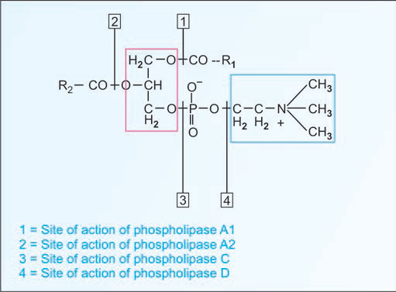
Fig. Lecithin. R1 and R2 are fatty acids. Red rectangle depicts glycerol group. The blue rectangle is choline which shows polar or hydrophilic property

Slide 55
CLINICAL
1. SNAKE VENOM
The venom of Indian cobra is rich in phospholipase A₂ .
Entry of the venom into the circulation of a victim of cobra-bite results in extensive hydrolysis of fatty acids at position C2 of membrane glycerophospholipids.
This alters the membrane integrity especially of RBC.
Further, the released lysolecithin acts as detergent and disrupts the membrane leading to hemolysis.
The liberation of hemoglobin into the circulation may be sufficiently high (exceeding the capacity of haptoglobin and hemopexin, the hemoglobin-binding plasma proteins) to block the renal tubules and cause acute renal failure.

Slide 56
2. LUNG SURFACTANT
Normal lung function depends on a constant supply of lung surfactants.
It is a surface active agent and prevents the adherence of inner surface of the lungs due to surface tension.
Pulmonary surfactant is a lipoprotein rich in phospholipid.
The principal agent responsible for its surface tension-reducing properties is dipalmitoyl phosphatidyl-choline (DPPC), also called dipalmitoyl lecithin.
The alveolar lining is coated with a special surface-active agent, pulmonary surfactant, which not only lowers surface tension at the gas-liquid interface but also changes surface tension with changes in alveolar diameter.
Respiratory distress syndrome in infants is a disorder characterized by the absence of dipalmitoyl lecithin.
Because the lungs are among the last to develop, the synthesis of surfactant appears rather late in gestation.
In humans, surfactant appears at about weeks 34 (a full term pregnancy is 40 weeks).
Failure of proper lung maturation during the perinatal period is still a major cause of death in newborns.

Slide 57
The lung may be structurally intact but functionally immature if inadequate amounts of surfactant are available to reduce surface tension and stabilize surface forces during breathing.
Premature birth and certain hormonal disturbances (such as those seen in diabetic pregnancies) interfere with the normal control and timing of lung maturation. These infants have immature lungs at birth which often leads to infant respiratory distress syndrome (IRDS), also called hyaline membrane disease.
Breathing is extremely labored because surface tension is high, making it difficult to inflate the lungs.
Because of the high surface tension, these infants develop pulmonary edema and atelectasis.
The syndrome can be treated with exogenous surfactants and hydrocortisone injection during antenatal period.
A related condition in adults is called adult respiratory distress syndrome.
Notes:
Atelectasis (at-uh-LEK-tuh-sis) — a complete or partial collapse of a lung or lobe of a lung — develops when the tiny air sacs (alveoli) within the lung become deflated. It's a breathing (respiratory) complication after surgery.
Pulmonary edema is a condition caused by excess fluid in the lungs. This fluid collects in the numerous air sacs in the lungs, making it difficult to breathe. In most cases, heart problems cause pulmonary edema.

Slide 58
LECITHIN : SPHINGOMYELIN RATIO
Lecithin : sphingomyelin ratio (L/S ratio) in the amniotic fluid is used for the evaluation of fetal lung maturity
Before 33-35 weeks of gestation, the ratio is nearly 1.0.
At term, there is a marked increase in lecithin concentration and thus the L/S ratio increases to more than 5.0.
In a premature low birth weight infant, the ratio is <2.0. such infants are likely to develop respiratory distress syndrome.

Slide 59
FUNCTIONS OF PHOSPHOLIPIDS
In association with proteins, phospholipids form the structural components of membranes and regulate membrane permeability.
Phospholipids ( lecithin, cephalin and cardiolipin) in the mitochondria maintain the conformation of electron transport chain components and thus cellular respiraiton.
Phospholipids participate in the absorption of fat from the intestine.
4. Phospholipids are essential for the synthesis of different lipoproteins, and thus participate in the transport of lipids.
5. Accumulation of fat in liver (fatty liver) can be prevented by phospholipids, hence they are regarded as lipotropic factors.
6. Arachidonic acid, an unsaturated fatty acid liberated from phospholipids, serves as precursor for the synthesis of eicosanoids.
7. Phospholipids participate in the reverse cholesterol transport and thus help in the removal of cholesterol from the body.
8. Phospholipids act as surfactants (agents lowering surface tension). For instance, dipalmitoyl phosphatidylcholine is an important lung surfactant.
9. cephalins, an important group of phospholipids participate in blood clotting.
10. Phosphatidylinositol is the source of second messengers –inositol triphosphate and diacylglycerol, that are involved in the action of some hormones.

Slide 60
LIPOPROTEINS (PROTEOLIPIDS)
INTRODUCTION
Lipoproteins are molecular complexes that consist of lipids and proteins (conjugated proteins).
They function as transport vehicles for lipids in blood plasma.
Lipoproteins deliver the lipid components (triacylglycerol, cholesterol, cholesterol esters and phospholipids) to various tissues for utilization.
STRUCTURE
Lipoproteins are composed of inner core of non-polar lipids such as triacylglycerols and cholesterol esters surrounded by outer core of polar lipids such as phospholipids, free cholesterol and apolipoproteins.
Apolipoproteins (apo means detached or separated) combines with lipid to form several types of lipoprotein particles.

Slide 61
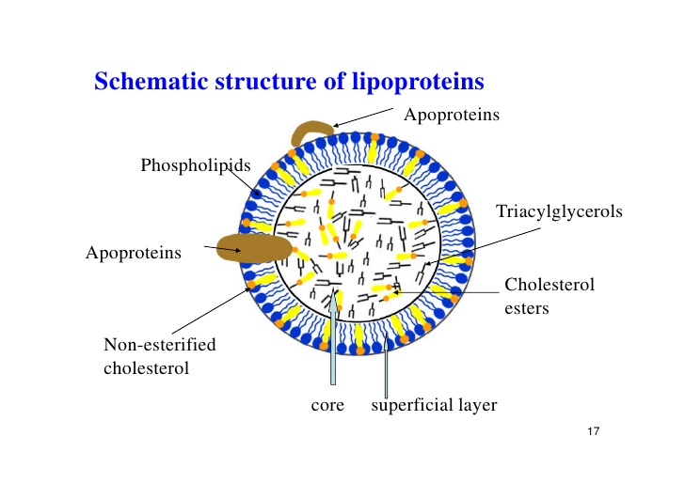
Fig. Structure of lipoproteins

Slide 62
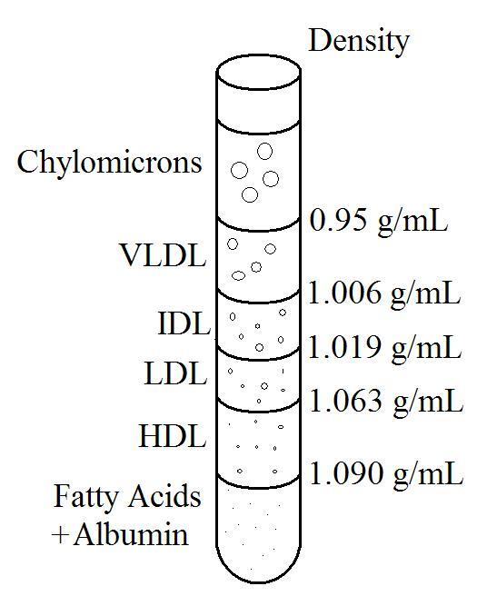
CLASSIFICATION
Depending on the density ( by ultracentrifugation) or on the electrophoretic mobility, the lipoproteins in plasma are classified into five major types.
Chylomicrons
Very low density lipoproteins (VLDL) or pre-beta lipoproteins
Intermediate density lipoproteins (IDL) or broad-beta lipoproteins
Low density lipoproteins (LDL) or beta-lipoproteins
High density lipoproteins (HDL) or alpha-lipoproteins

Slide 63
CHYLOMICRONS
Chylomicrons are lipoproteins that have the lowest density on ultracentrifugation and remain at origin on electrophoresis.
Chylomicrons are rich in triacylglycerols.
The major apolipoproteins present are apolipoprotein B-48 and apolipoprotein C.
Chylomicrons are synthesized in the small intestine.
They are required for the transport of dietary triacylglycerols to the peripheral tissues.
Increased chylomicron levels in serum is seen in Type I hyperlipoproteinemia and diabetes mellitus.

Slide 64
VERY LOW DENSITY LIPOPROTEINS
They have very low density on ultracentrifugation and migrate to prebeta position on electrophoresis.
They are rich in triacylglycerols.
The major apolipoproteins present are apolipoprotein B-100 and apolipoprotein C.
Very low density lipoproteins are synthesized in the liver.
They are required for the transport of endogenous (liver) triacylglycerols to the peripheral tissues.
Increased levels in serum are seen in Type IV hyperlipoproteinemia, diabetes mellitus and nephrotic syndrome.

Slide 65
INTERMEDIATE DENSITY LIPOPROTEINS
They are one of the plasma lipoproteins that have intermediate density on ultracentrifugation and migrate to broad-beta position on electrophoresis.
They are rich in triacylglycerols.
The major apolipoproteins present are apolipoprotein B-100 and apolipoprotein E.
They are synthesized in the liver.
They are required for the transport of endogenous (liver) triacylglycerols to the peripheral tissues.
Increased levels in serum are seen in Type III hyperlipoproteinemia, diabetes mellitus and nephrotic syndrome.
Notes:
Hyperlipoproteinemias : elevation in one or more of the lipoprotein fractions constitutes hyperlipoproteinemias.

Slide 66
LOW DENSITY LIPOPROTEINS
They are one of the plasma lipoproteins that have low density on ultracentrifugation and migrate to beta position on electrophoresis.
They are rich in cholesterol, cholesterol ester and phospholipids.
The major apolipoproteins present are apolipoproteins B-100 and apoprotein E.
They are formed from very low density lipoproteins in the plasma (circulation).
They are required for the transport of cholesterol to the tissues (cholesterol influx).
Increased levels in serum are seen in Type II hyperlipoproteinemia, diabetes mellitus and nephrotic syndrome.

Slide 67
HIGH DENSITY LIPOPROTEINS
They have high density on ultracentrifugation and migrate to alpha position on electrophoresis.
They are rich in cholesterol, cholesterol ester and phospholipids.
The major apolipoproteins are apolipoprotein AI and AII.
They are synthesized in the liver.
They are required for the transport of cholesterol from the tissues to the liver (cholesterol efflux).
Decreased levels are seen in Tangier disease, diabetes mellitus and persons with sedentary life-style.

Slide 68
PLASMA LIPIDS
LIPID FRACTION | REFERENCE VALUES (mg/dl)
TOTAL LIPID | 400-600
TOTAL CHOLESTEROL LDL- CHOLESTEROL HDL-CHOLESTEROL VLDL-CHOLESTEROL | 150-200 80-150 30-60 20-40
TRIGLYCERIDES | 75-150
PHOSPHOLIPIDS | 150-200
FREE FATTY ACIDS | 5-15

Slide 69
CHD RISK AND LIPID PARAMETERS
 | Low risk (desirable level) | Borderline risk | High risk
Total cholesterol (mg/dL) | <200 | 200-400 | > 240
LDL cholesterol (mg/dL) | <130 | 130-160 | > 160
HDL cholesterol (mg/dL) | >60 | 35-60 | >35
Triglyceride(mg/dL) | <200 | 200-400 | >400

Slide 70
STEROIDS
Steroids are the compounds containing a cyclic steroid nucleus (or ring) namely cyclopentanoperhydrophenanthrene (CPPP).
It consists of a phenanthrene nucleus (rings A, B and C) to which a cyclopentane ring (D) is attached.
The steroid nucleus represents saturated carbons, unless specifically shown as double bonds.
The methyl side chains (19 & 18) attached to carbons 10 & 13 are shown as single bonds.
At carbon 17, steroids usually contain a side chain.

Slide 71
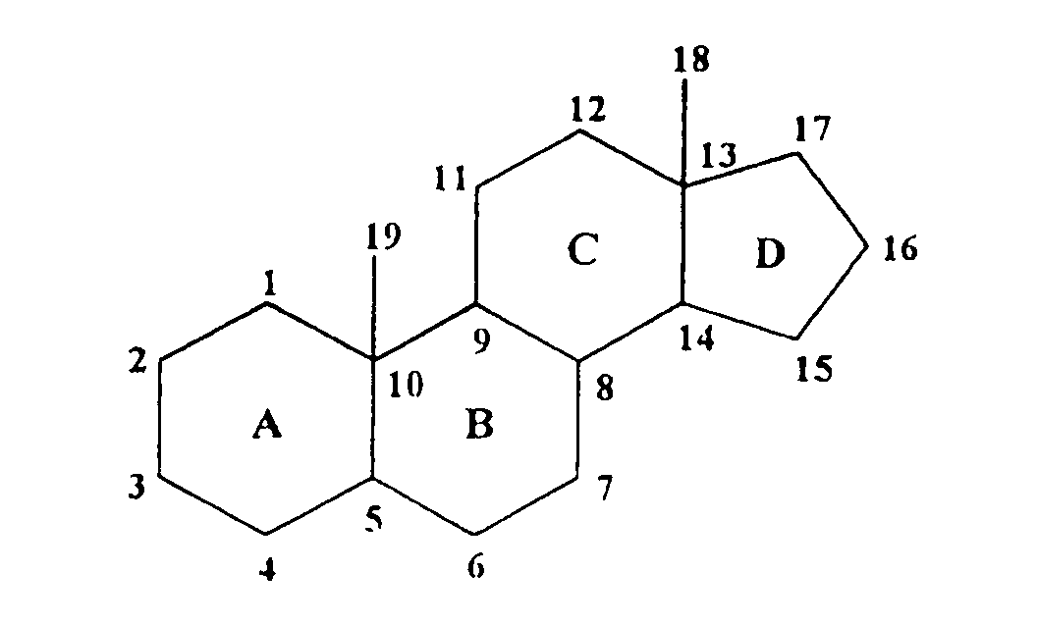
There are several steroids in the biological system which includes cholesterol, bile acids, vitamin D, sex hormones, adrenocortical hormones, sitosterols, cardiac glycosides and alkaloids.
If the steroid contains one or more hydroxyl groups it is commonly known as sterol (means solid alcohol).

Slide 72
CHOLESTEROL
INTRODUCTION
Cholesterol, exclusively found in animals, is the most abundant animal sterol.
It is widely distributed in all cells and is a major component of cell membranes and lipoproteins.
Cholesterol (Greek : chole - bile) was first isolated from bile.
Cholesterol literally means ‘solid alcohol from bile’.

Slide 73
STRUCTURE
The molecular formula of cholesterol is (C₂₇H₄₆O).
It has 27 carbon atoms, a hydroxyl group at C3, a double bond between C5 and C6, two methyl groups at C18 and C19, and a side chain at C17.
Because of the OH group (at C3), cholesterol is a steroid alcohol (sterol).
Due to presence of this OH group cholesterol can also be esterified to long-chain fatty acids to form cholesteryl esters.

Slide 74
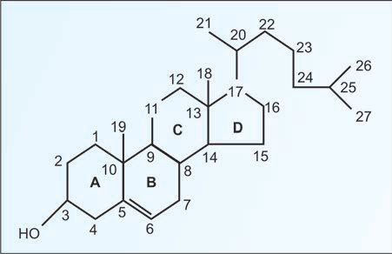
OCCURENCE
The body of an adult contains about 1g cholesterol/kg body weight.
About 25% of it is in the membranes of the nervous system where it is a major component of the myelin sheath.
It is a precursor of various substances such as steroid hormones (glucocorticoids, mineralocorticoids, androgens and estrogens).
Normal serum cholesterol level is 150-250 mg/dl.
Eggs, meat and milk are the main dietary sources of cholesterol.
The amount synthesized in the body each day is at least twice of that ingested in the average diet which is nearly 250-750 mg/day.

Slide 75
PROPERTIES AND REACTIONS
Cholesterol is an yellowish crystalline solid.
The crystals, under the microscope, show a notched appearance.
Cholesterol is insoluble in water and soluble in organic solvents such as chloroform, benzene, ether etc.
Some of the test for the qualitative identification and quantitative estimation includes Salkowski’s test, Liebermann-Burchard reaction and Zak’s test.

Slide 76
FUNCTIONS OF CHOLESTEROL
Cholesterol is a poor conductor of heat and electricity.
It is present in abundance in nervous tissue.
It appears that cholesterol functions as an insulating cover for the transmission of electrical impulses in the nervous tissue.
Cholesterol performs several other biochemical functions which include its role in membrane structure and function, in the synthesis of bile acids, hormones (sex and cortical) and vitamin D.

