Slide 1
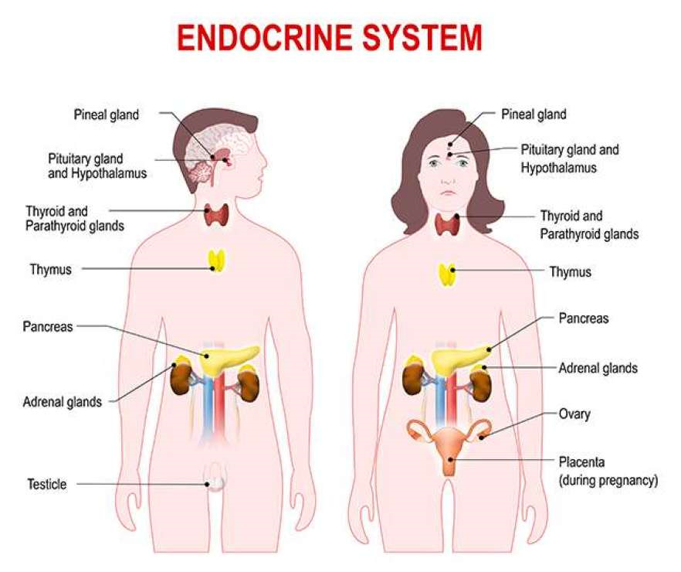
HORMONES

Slide 2
SYSTEMS OF INTERNAL COMMUNICATION
The living body possesses a remarkable communication system to coordinate its biological functions.
Animals have two systems of internal communication and regulation:
The nervous system
The nervous system conveys high-speed electrical signals along specialized cells called neurons.
The endocrine system
The endocrine system, made up of endocrine glands, secretes hormones that coordinate slower but longer-acting responses to stimuli.
TYPES OF ENDOCRINE TISSUES
Endocrine system includes two types of tissues:
Tissues having endocrine secretion as the primary function
Includes pituitary gland, thyroid gland, parathyroid gland, adrenal glands and gonads.
Tissues having functions other than primary endocrine function
Includes pancreas, kidney, heart, thymus, hypothalamus and digestive tract.
Notes:
Autocrine : This type of signalling occurs when the same cell act as sender and recipient.
Paracrine : This type of signalling is effected by local mediators which have their effect near the site of secretion without entering the circulation.
Juxtacrine : This type of signalling occurs when the two type of cells are adjacent to each other so that contact is established through gap junctions or through protein molecules on the surface of the two cells.
Endocrine : This type of signalling is between cells which are located at a distance form each other and the signal may be hormones or chemical messengers secreted into circulation.

Slide 3
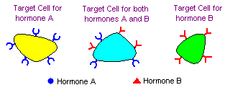
A cell is a target because it has a specific receptor for the hormone
Most hormones circulate in the blood, coming into contact with essentially all cells. However, a given hormone usually affects only a limited number of cells, which are called target cells. A target cell responds to a hormone because it bears receptors for the hormone.

Slide 4
INTRODUCTION
The word hormone is derived from a Greek verb meaning to excite.
Hormones are produced by special cells or glands such as adrenals, ovaries, parathyroids, pituitary, testes and thyroid.
These glands secrete their hormones directly into the bloodstream and are known as endocrine glands.
Endocrinology is the study of hormones and their interactions.
DEFINITION
CLASSICAL DEFINITION
Hormones are organic substances, produced in small amounts by specific tissues (endocrine glands), secreted into the blood stream to control the metabolic and biological activities in the target cells.
MODERN DEFINITION
Hormone is synthesized by one type of cells and transported through blood to act on another type of cells.

Slide 5
CLASSIFICATION
Hormones may be classified in many ways based on their characteristics and functions.
BASED ON THE CHEMICAL NATURE (CHEMICAL STRUCTURE)
The hormones can be categorized into three groups considering their chemical nature.
Protein or peptide hormones
Most hormones fall into this class.
These are water soluble and may have 3 to over 200 amino acid residues.
These contains peptide bonds, i.e. peptides/protein hormones.
E.g. insulin, glucagon, antidiuretic hormone, oxytocin.
Amino acid derivatives
These are small, water soluble compounds derived from amino acids.
E.g. epinephrine, nor-epinephrine, thyroxine (T₄), tri-idothyronine (T₃).
3. Steroid hormones
These are fat soluble (lipophilic) and all are derivatives of cholesterol, i.e. steroids.
E.g. glucocorticoids, mineralocorticoids, sex hormones (androgen, estrogen).

Slide 6
II. BASED ON THE MECHANISM OF HORMONE ACTION
Hormones are classified into two groups (I and II) based on the location of the receptors to which they bind and the signals (nature of second messenger) used to mediate their action.
Group I hormones (Hormones with intracellular receptors)
Solubility of hormones
The hormones of Group I are lipophilic which readily pass through the plasma membrane.
Location of receptors
Receptors for hormones acting through intracellular receptors are located in the cytosol or nucleus.
Second messenger
Hormone action occurs through the formation of hormone-receptor complex that acts as a second messenger.

Slide 7
Group I. HORMONES THAT BIND TO INTRACELLULAR RECEPTORS
Hormone(s) | Origin | Major functions)
Estrogens | Ovaries and adrenal cortex | Female sexual characteristics, menstrual cycle.
Progestins | Ovaries and placenta | Involved in menstrual cycle and maintenance of pregnancy.
Androgens | Testes and adrenal cortex | Male sexual characteristics, spermatogenesis.
Glucocorticoids | Adrenal cortx | Affect metabolisms, suppress immune system.
Mineralocorticoids | Adrenal cortex | Maintenance of salt and water balance.
Calcitriol (1, 25-DHCC) | Kidney (final form) | Promotes absorption of calcium form intestine, kidney and bone.
Thyroid hormones (T₃, T₄) | Thyroid | Promote general metabolic rate.

Slide 8
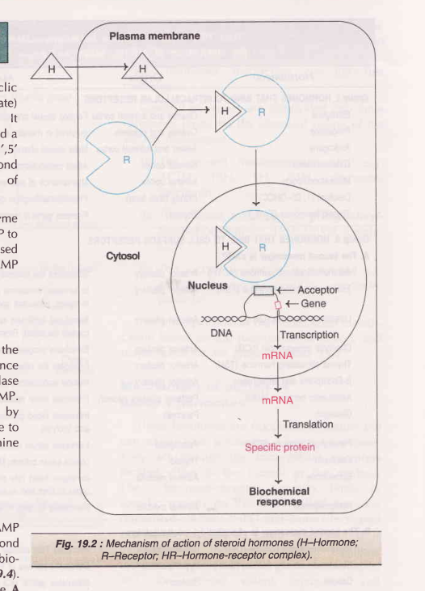
Mechanism of action
Hormone diffuses across the plasma membrane of target cells and binds to the receptor in the cytosol or nucleus.
The receptors for steroid hormones are found mainly in the cytoplasm and the receptors for the thyroid hormones are found in the nucleus.
In the cytoplasm, the receptor exists in a complex with heat shock protein (HSP).
Binding of hormone to receptor causes dissociation of HSP and a conformational change of the receptor.
In the cytoplasm, hormone (H) interact with their appropriate receptor (R) and forms hormone receptor complex (H-R complex).

Slide 9
The hormone receptor complex formed in the cytosol is then translocated to the nucleus.
In the nucleus, the hormone-receptor complex binds to specific regions on the DNA called ‘hormone response element’ (HRE) or ‘steroid response element’ (SRE).
The binding of hormone receptor complex to the hormone response element in DNA results in increased expression of specific genes which in turn results in either stimulation or inhibition of rate of transcription and formation of mRNA.
These mRNA get translate into proteins (the final gene product).
Newly formed proteins in the cell controls the cellular metabolic functions.

Slide 10
Hormone response elements (HREs); N means any nucleotide may be present at that place
Hormone | Name of HRE | Nucleotide sequence at the specific area of binding on DNA
Glucocorticoid | GRE | (GGTACA)NNN (TGTTCT)
Mineralocorticoid | MRE | do
Androgens | ARE | do
Estrogens | ERE | (AGGTCA)NNN (TGACCT)
Thyroxin | TRE | (GATCA)NNNNN (TGACC)
Vitamin D | VDRE | do
Cyclic AMP | CRE | TGACGTCA

Slide 11
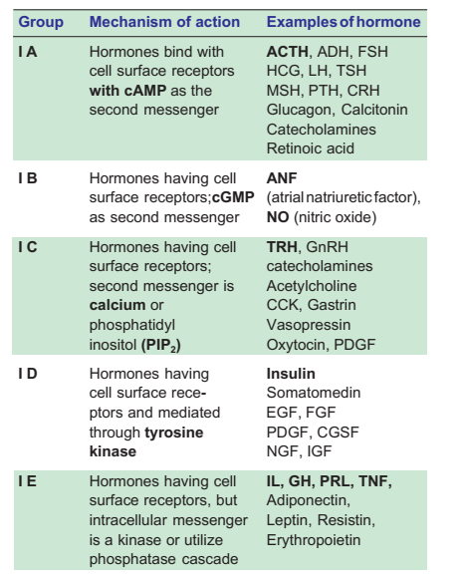
2. Group II hormones (hormones with cell surface receptors)
Solubility of hormones
The hormones of Group II are hydrophilic which cannot pass through the plasma membrane.
Location of receptors
Receptors for hormones acting through cell surface receptors are located in the plasma membrane surface.
Second messenger
Hormone action occurs through the formation of mediatory molecules called as a second messengers.

Slide 12
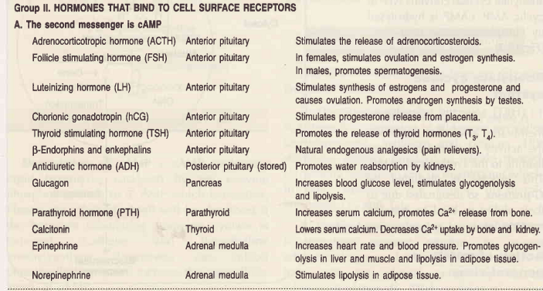

Slide 13
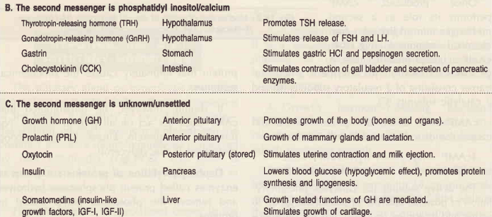

Slide 14
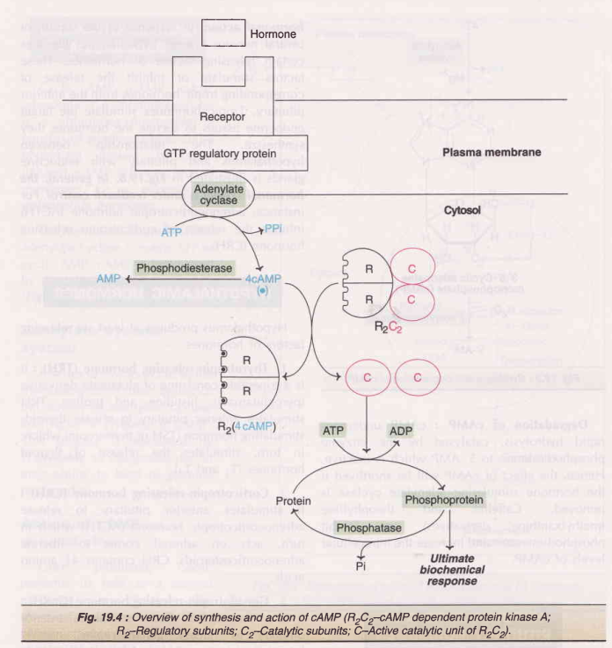
Mechanism of action
Hormone cannot diffuse across the plasma membrane of target cells and binds to the receptor on the cell surface.
Interaction of the hormone with the cell-surface receptor causes a conformational changes in the receptor and in turn activates enzymes inside the cell thereby resulting in the synthesis of the second messenger (cAMP, cGMP, phosphatidyl inositol), which activates the phosphorylating enzymes.

Slide 16
Cyclic AMP (– cAMP, Cyclic adenosine 3’,5’-monophosphate) act as a second messenger for a majority of polypeptide hormones.
The membrane-bound enzymes adenylate cyclase converts ATP to cyclic AMP.
This process is mediated by G-proteins, so designated due to their ability to bind to guanine nucleotides.
Once produced, cAMP activates protein kinase A.
Protein kinase A is a heterotetramer consisting of 2 regulatory subunits (R) and 2 catalytic subunits (C).
cAMP binds to inactive protein and causes the dissociation of R an C subunits.
The active subunit (C) catalyzes phosphorylation of proteins which ultimately causes the biochemical response.
cAMP undergoes rapid hydrolysis, catalyzed by the enzyme phosphodiesterase to 5’ AMP which is inactive.

Slide 17
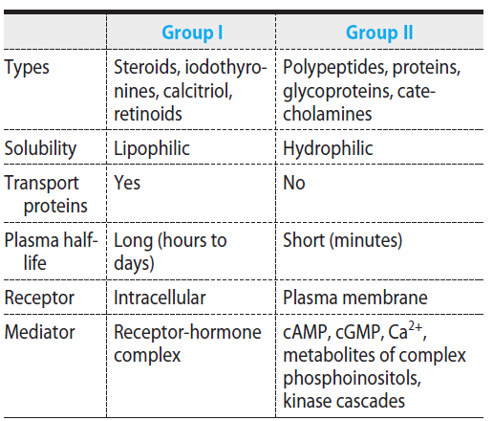
General Features of Hormone Classes

Slide 18
Functions of Hormones
Help to regulate:
Chemical composition and volume of internal environment.
Metabolism and energy balance
Contraction of smooth and cardiac muscle fibers.
Glandular secretion
Some immune system activity
Control growth and development
Regulate operation of reproductive system
Help to regulate circadian rhythms
Notes:
Glandular : pert to or of the nature of a gland.
Circadian rhythms : pert to events that occur at approx. 24 hr intervals, such as certain physiological phenomena; biological clock.

Slide 19
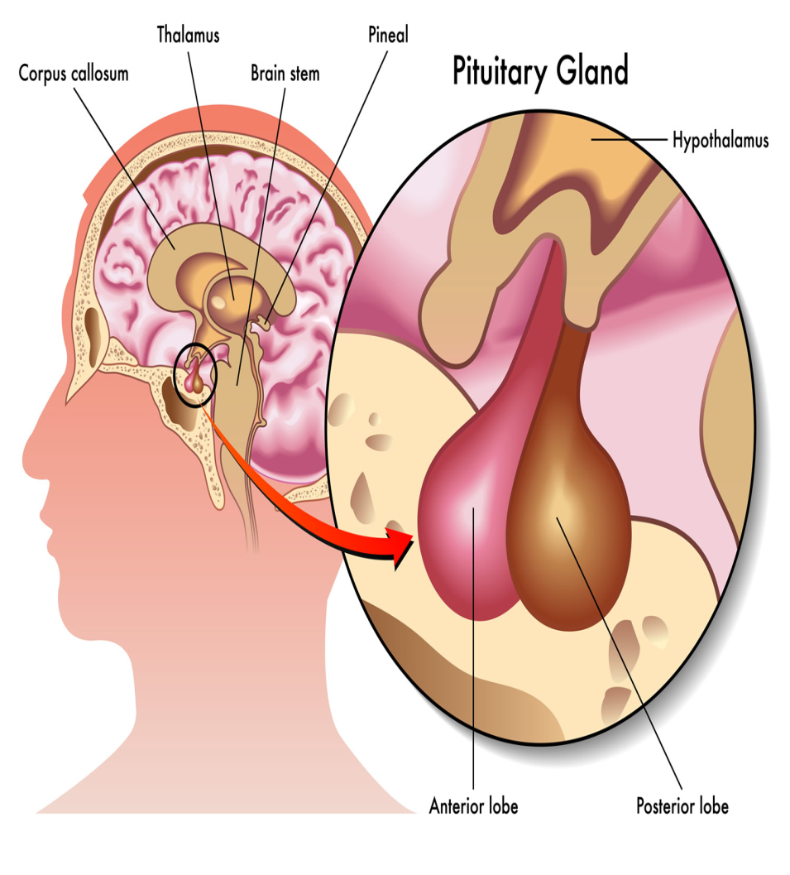
HYPOTHALAMIC AND PITUITARY HORMONES
INTRODUCTION
Hypothalamus is a specialized center in the brain that function as a master coordinator of hormonal action.
In response to the stimuli of central nervous system, hypothalamus liberates certain releasing factors or hormones.
These factors stimulate or inhibit the release of corresponding tropic hormones from the anterior pituitary.
Tropic hormones stimulate the target endocrine tissues to secrete the hormones they synthesize.
Fig. A diagrammatic view of hypothalamus and pituitary gland
Notes:
A tropic hormone is a hormone that stimulates an endocrine gland to grow and secrete it's hormones.(Onehormone causes another hormone to do something) In humans, tropic hormones are secreted by the adenohypophysis(anterior pituitary gland).

Slide 20
HYPOTHALAMIC HORMONES
Major hypothalamic releasing factors
NAME | PYSIOLOGICAL FUNCTIONS
Thyrotropin releasing hormone (TRH) | Induces secretion of TSH and PRL; neuromodulator
Gonadotropin releasing hormone (GnRH) | Releases LH and FSH; induces spermatogenesis, ovulation and testosterone
Growth hormone releasing hormone (GHRH) (somatotropin) | Stimulates growth hormone secretion
Corticotropin releasing factor (CRF) | Release of ACTH. Inhibited by cortisol
Growth hormone inhibitory factor (somatostatin) | Inhibits secretion of GH and TSH. Inhibits gut hormones, pancreatic and gastric secretion.
Prolactin releasing factor (PRF) | Release of prolactin
Prolactin inhibitory factor (PIF) | Inhibits PRL release.
Notes:
Tropic : The area between the two tropics.

Slide 21
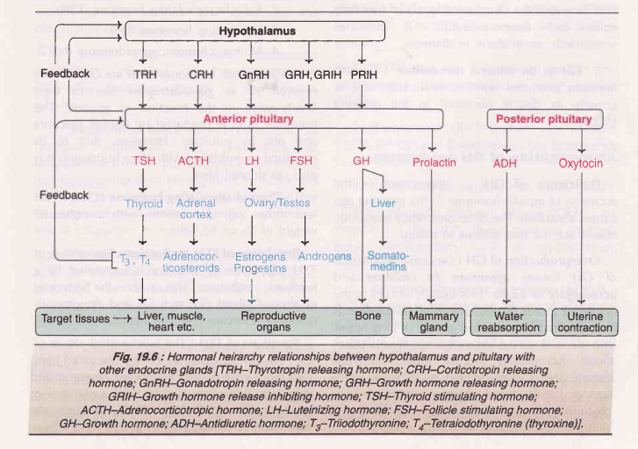
Fig. Hormonal heirarchy relationships between hypothalamus and pituitary with other endocrine glands.

Slide 22
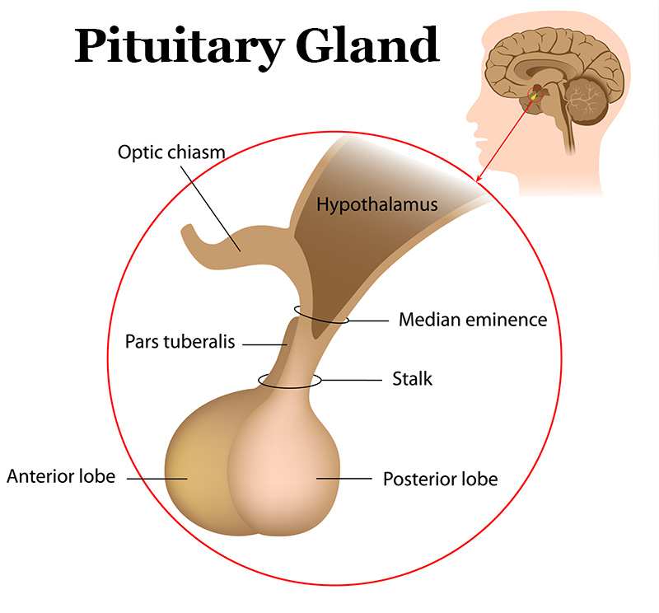
PITUITARY GLAND
Pituitary gland is composed of two parts i.e. anterior pituitary and posterior pituitary.
Anterior pituitary or adenohypophysis is truly the master endocrine organ.
The anterior pituitary hormones are tropic in nature, stimulating the secretion of hormones from the target organs.
Fig. A pituitary gland

Slide 23
Hormones of anterior pituitary
ACRONYM | FULL NAME | PYSIOLOGICAL FUNCTIONS
GH | Growth hormone (Somatotropin) | Overall growth
ACTH | Adrenocorticotropic hormone | Stimulation of synthesis of hormones of the adrenal cortex.
LH | Luteinizing hormone | Ovulation, secretion of progesterone
FSH | Follicle stimulating hormone | Growth of the follicles
TSH | Thyroid stimulating hormone | Stimulation of thyroid hormone synthesis
MSH | Melanocyte stimulating hormone | Darkening of skin
PRL | Prolactin (Somatomammotropin) | Proliferation of synthesis of mammary gland and milk secretion
LPH | Lipotropic hormone | Precursor of β-MSH and endorphins

Slide 24
GROWTH HORMONE (GH)
Introduction
Also called somatotropin.
Synthesized by acidophils (somatotropic cells) of anterior pituitary.
Maximum level of is seen during deep sleep.
This supports the adage “if you don’t sleep, you won’t grow”.
Biochemical functions of growth hormone
Growth hormone promotes growth and also influences the normal metabolisms (protein, carbohydrate, lipid and mineral ) in the body.

Slide 25
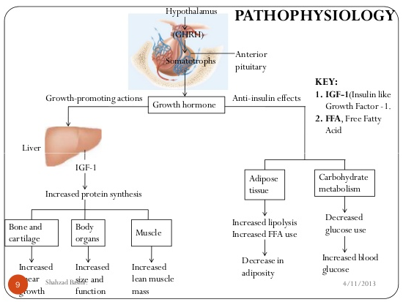

Slide 26
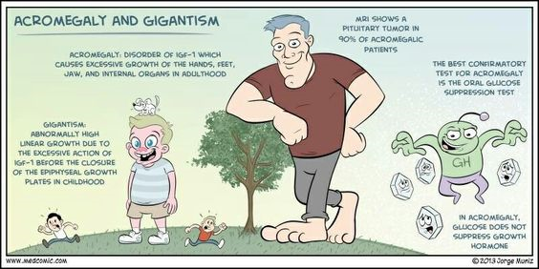
Abnormalities of GH production
Deficiency of GH
Impairment in the secretion of growth hormone in the growing age causes dwarfism.
Overproduction of GH
Excessive production of GH causes gigantism in children and acromegaly in adults.
Gigantism is characterized by increased growth of long bones and this is observed before the epiphyseal plate closure.
Acromegaly occurs after epiphyseal closure and is characterized by increase in the size of hands, facial changes (enlarged nose, protruding jaw), excessive hair, thickening of skin etc.

Slide 27
PROLACTIN (PRL)
Introduction
Also called lactogenic hormone, luteotropic hormone, mammotropin or luteotropin.
Secreted by lactotropic cells of adenohypophysis.
Biochemical functions of PRL
Controls the initiation and maintenance of lactation.
Stimulates lactation on estrogen primed breast.
Promotes the growth of corpus luteum (hence also known as luteotropic hormone) and stimulates the production of progesterone.
Increases synthesis of milk protein and fat.
Abnormality of PRL production
Hyperprolactemia is a cause of infertility in females.

Slide 28
THYROID STIMULATING HORMONE (TSH)
Introduction
It is a glycoprotein synthesized by the somatotroph cells of the anterior pituitary.
Functions of TSH
Promotes uptake of iodide from the circulation by thyroid gland.
Enhances the conversion of iodide (I⁻) to active iodide (I⁺), a process known as organification.
Increases the proteolysis of thyroglobulin to release T₃ and T₄ into the circulation.
Increases the synthesis of proteins, nucleic acids and phospholipids in thyroid gland.
Normal TSH level is 0.5 – 5 microunits per mL.
Abnormalities
Increased serum TSH levels are seen in primary hypothyroidism (3-100 times normal).
Decreased levels are observed in primary hyperthyroidism, secondary hyperthyroidism (pituitary origin), tertiary hypothyroidism (hypothalamic), subclinical hyperthyroidism (e.g. toxic multinodular goiter).

Slide 29
GONADOTROPINS
Introduction
Gonadotropins include follicle stimulating hormone (FSH), lutenizing hormone (LH) and human chorionic gonadotropin (hCG).
FSH and LH are synthesized by the gonadotroph cells of the anterior pituitary.
Human chorionic gonadotropin (hCG) are synthesized by the syncytiotrophoblast cells of placenta during pregnancy.
Functions
Biochemical function of FSH
In females :
- stimulates follicular growth.
- increases the weight of the ovaries.
- enhances the production of estrogens.
In males :
- stimulates testosterone production.
- required for spermatogenesis.

Slide 30
2. Biochemical functions of LH
Stimulates the production of progesterone from corpus luteum cells in females and testosterone from Leydig cells in males.
LH and FSH are collectively responsible for the development and maintenance of secondary sexual characteristics in males.
3. Biochemical functions of hCG
During pregnancy prevents disintegration of the corpus luteum so as to maintain the synthesis of progesterone by this tissue.
Following implantation of the embryo, the cells of the placenta secrete hCG.
Its appearance in the plasma and urine is one of the earliest signals of pregnancy and the basis of many pregnancy tests.

Slide 31
ADRENOCORTICOTROPIC HORMONE (ACTH)
Introduction
It is secreted by corticotroph cells of the anterior pituitary.
Biochemical functions
Promotes the conversion of cholesterol to pregnenolone in the adrenal cortex.
Enhances RNA and protein synthesis and thus promotes adrenocortical growth.
Increases lipolysis by activating lipase of adipose tissue.
Disorder
Excessive production causes Cushing’s syndrome .
The associated symptoms include negative nitrogen balance, impaired glucose tolerance, hypertension, edema, muscle atrophy etc.
Notes:
Muscle atrophy : Muscle atrophy is when muscles waste away. The main reason for muscle wasting is a lack of physical activity. This can happen when a disease or injury makes it difficult or impossible for you to move an arm or leg.

Slide 32
HORMONES OF POSTERIOR PITUITARY
ACRONYM | FULL NAME | PHYSIOLOGICAL FUNCTIONS
ADH | Antidiuretic hormone | Elevation of blood pressure, reabsorption of water
 | Oxytocin | Contraction, parturition and sperm transport, and ejection of milk

Slide 33
OXYTOCIN
Introduction
Oxytocin release from posterior pituitary gland is caused by the neural impulses of nipple stimulation, vaginal and uterine distension.
Biochemical functions
Causes the contraction of pregnant uterus (smooth muscles) and induces labor.
In mammals, causes contraction of myoepithelial cells of breast causing milk ejection.
Oxytocin synthesized in the ovary appears to inhibit the synthesis of steroids.

Slide 34
ANTIDIURETIC HORMONE
Introduction
Release of ADH (also called vasopressin) is mostly controlled by osmoreceptors (of hypothalamus) and baroreceptors (of heart).
Any increase in the osmolarity of plasma stimulates ADH secretion.
Biochemical functions
Primarily concerned with the regulation of water balance in the body.
Stimulates kidneys to retain water and thus, increases the blood pressure.

Slide 35
In the absence of ADH, the urine output would be around 20 l/day.
ADH acts on the distal convoluted tubules of kidneys and causes water reabsorption with a result that the urine output is around 0.5-1.5 l/day.
Disorders
Impaired secretion (less secretion) results in Diabetes insipidus.
This disorder is characterized by the excretion of large volume of dilute urine (polyuria).

Slide 36
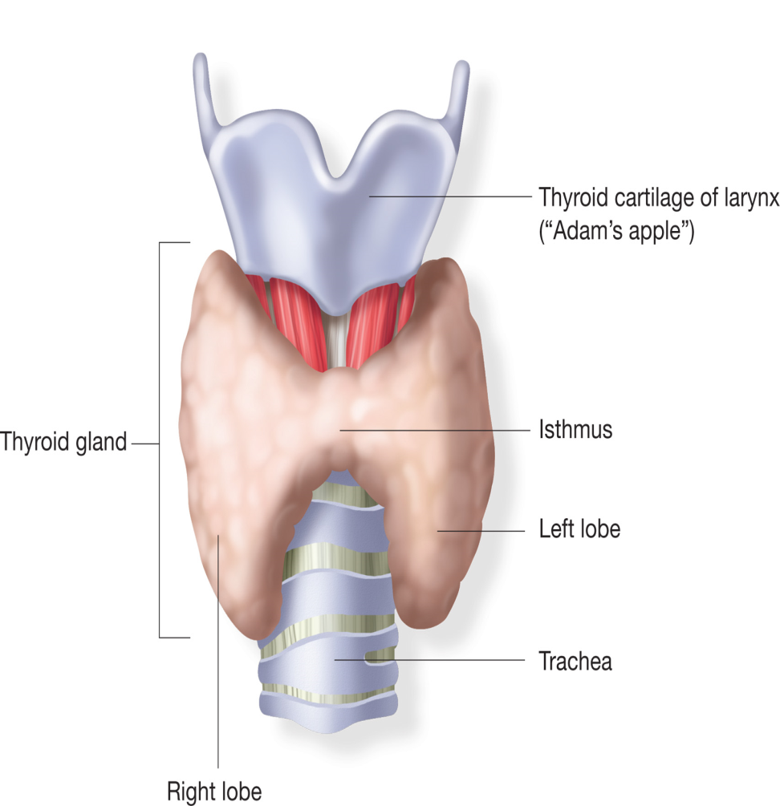
THYROID GLAND
The thyroid gland is positioned in the lower anterior neck and is shaped like a butterfly.
It is made up of two lobes that rest on each side of the trachea, with a band of tissue called isthmus, running anterior to the trachea and bridging the lobes.
The thyroid gland is responsible for the production of two hormones : thyroid hormone and calcitonin.
Fig. Thyroid gland

Slide 37
HORMONES OF THYROID GLAND
ACRONYM | FULL NAME | PHYSIOLOGICAL FUNCTIONS
T₄ | Thyroxine | Stimulation of O₂ consumption and metabolic rate
 | Calcitonin | Lowering of plasma Ca²⁺ and phosphorous

Slide 38
THYROID HORMONES (T₄ & T₃)
Biochemical functions of thyroid hormones
Calorigenic effect or thermogenesis i.e. one milligram of T₄ will produce an excess of 1000 kcal.
Influence on the metabolic rate
Basal metabolic rate (BMR) is increased i.e. increases the O₂ consumption in most of the tissues of the body (exception – brain, lungs, testes and retina).
Na⁺-K⁺ ATP pump
Na⁺-K⁺ ATPase activity is directly correlated to thyroid hormones.
Obesity in some individuals is attributed to a decreased energy utilization and heat production due to diminished Na⁺-K⁺ ATPase activity.

Slide 39
Effect on protein synthesis
Function as anabolic hormones and cause positive nitrogen balance and promote growth and development.
Effect on carbohydrate metabolism
The overall effect is to enhance blood glucose level (hyperglycemia).
Effect on lipid metabolism
Lipid turnover and utilization are stimulated by thyroid hormones.
Abnormalities of thyroid function
Three abnormalities associated with thyroid functions are known.

Slide 40
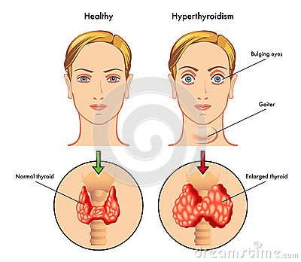
Goiter
An abnormal increase in the size of the thyroid gland is known as goiter.
Simple endemic goiter is due to iodine deficiency in the diet.
Mostly found in the geographical regions away from sea coast where the water and soil are low in iodine content.

Slide 41
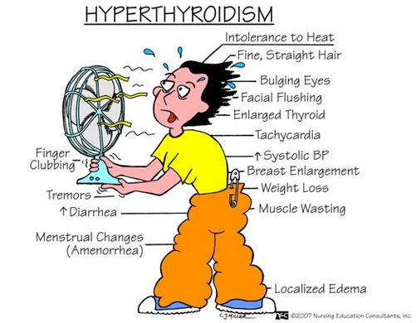
Hyperthyroidism
Also known as thyrotoxicosis and is associated with overproduction of thyroid hormones.
Characterized by increased metabolic rate (higher BMR), nervousness, irritability, anxiety, rapid heart rate, loss of weight despite increased appetite, sweating, sensitivity to heat and often protrusion of eye balls.
Caused by Grave’s disease or due to increased intake of thyroid hormones.
Grave’s disease is due to elevated thyroid stimulating IgG also known as long acting thyroid stimulator (LATS) which activates TSH and, thereby, increases thyroid hormone production.
Notes:
Tremors : A tremor is an involuntary, somewhat rhythmic, muscle contraction and relaxation involving oscillations or twitching movements of one or more body parts. It is the most common of all involuntary movements and can affect the hands, arms, eyes, face, head, vocal folds, trunk, and legs. Most tremors occur in the hands.

Slide 42
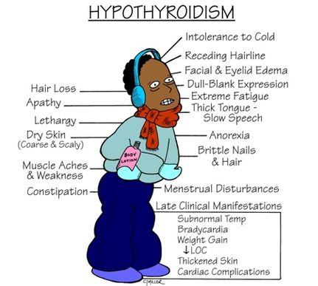
Hypothyroidism
Caused due to decreased circulatory levels of T₃ and T₄.
Women are more susceptible than men.
Characterized by reduced BMR, slow heart rate, weight gain, constipation, sensitivity to cold, dry skin etc.
Hypothyroidism in children is associated with physical and mental retardation, collectively known as cretinism.
Hypothyroidism in adult causes myxedema, bagginess under the eyes, puffiness of face, slowness in physical and metal activities.
Notes:
Apathy : lack of interest, enthusiasm, or concern
Lethargy : a pathological state of sleepiness or deep unresponsiveness and inactivity.

Slide 43
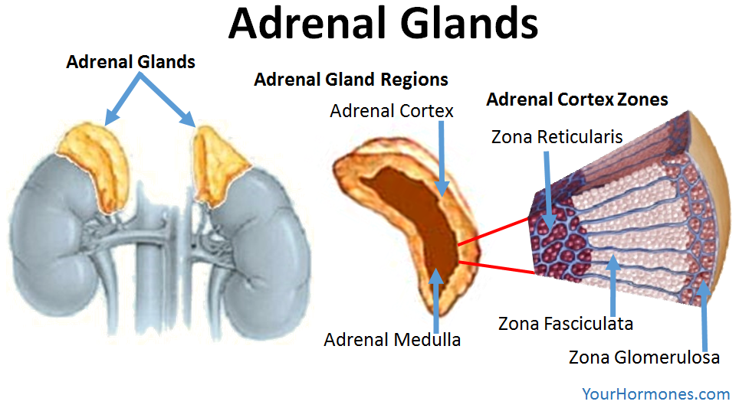
ADRENAL GLAND
Adrenal glands are shaped like pyramids, located superiorly and medially to the kidneys.
The adrenal gland is composed of the outer adrenal cortex and inner adrenal medulla.
The cortex is differentiated into three structurally and functionally distinct zones.
The adrenal gland is a multifunctional organ that produces the steroid hormones and neuropeptides essential for life.

Slide 44
HORMONES OF ADRENAL GLAND
Hormone | FULL NAME | PHYSIOLOGICAL FUNCTIONS
Glucocorticoids (origin is from Zonafasciculata) | Cortisol (from adrenal cortex) | Metabolism of carbohydrates, proteins and lipids, resistance to infections
Mineralocorticoids (Origin is from Zonaglomerulosa) | Aldosterone (from adrenal cortex) | Electrolyte and water balance
 | Epinephrine and norepinephrine (form adrenal medulla) | Stimulation of sympathatic nervous system, glycogenolysis and lipolysis.
Notes:
The sympathetic nervous system (SNS) is part of the autonomicnervous system (ANS), which also includes the parasympatheticnervous system (PNS). The sympathetic nervous systemactivates what is often termed the fight or flight response.

Slide 45
Glucocorticoids
Introduction
Produced mostly by zona fasciculata.
They affect glucose (hence the name), amino acid and fat metabolism in a manner that is opposite to the action of insulin.
Cortisol (also known as hydrocortisone) is the most important glucocorticoid in humans.
The important glucocorticoids are – cortisol, cortisone and corticosterone.

Slide 46
Biochemical functions of glucocorticoids
System | effect
Carbohydrates | The influence of glucocorticoids on carbohydrate metabolism is to increase blood glucose concentration. The biological actions are generally opposite of insulin.
Lipids | Increase lipid mobilization; facilitate lipolytic hormones leading to increase in free fatty acids.
Proteins and nucleic acids | Catabolism of proteins and nucleic acids increased. Increased urea production.
Fluid and electrolytes | Promotes water excretion by increase in GFR and inhibition of ADH secretion.
Bone and calcium | Decrease serum calcium by inhibiting osteoblast function, leading to osteroporosis.
Secretory action | Stimulates secretion of gastric acid and enzyme. Induces acid peptic disease.
Connective tissue | Impaired collagen formation. Poor wound healing.
Immune system | Immunosuppressant. Lysis of lymphocytes. Anti-inflammatory and antiallergic

Slide 47
Mineralocorticoids
Introduciton
These are also 21-carbon containing steroids produced by zona glomerulosa.
Biochemical functions of mineralocorticoids
The most active and potent mineralocorticoid is aldosterone.
It promotes Na⁺ reabsorption at the distal convoluted tubules of kidney.
Aldosterone is a stress hormone and its concentration is increased in the blood during stressful situations.

Slide 48
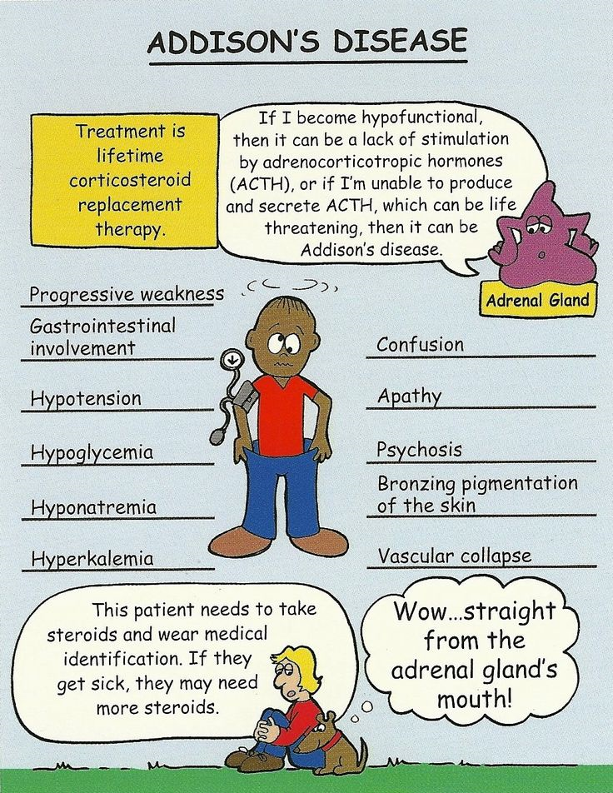
Abnormalities of adrenocortical function
Addison’s disease
It is associated with hypofunction of adrenal cortex.
This condition is characterized by decreased blood glucose level, loss of weight, loss of appetite (anorexia), muscle weakness, impaired cardiac function, low blood pressure, decreased Na⁺ and increased K⁺ level in serum, increased suceptibility to stress.

Slide 49
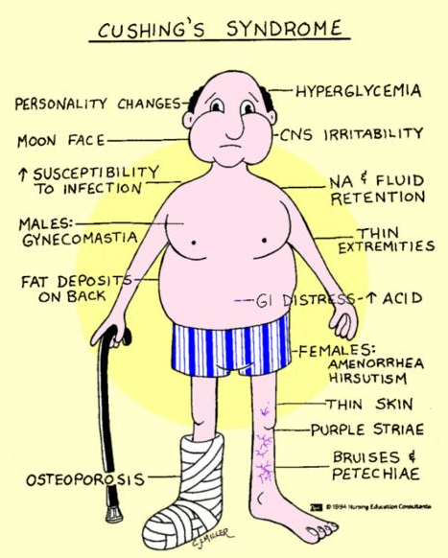
2. Cushing’s syndrome
It is characterized by excessive secretion of cortisol.
Cushing’s syndrome is characterized by central obesity, buffalo hump, purple striae on the abdomen, impaired glucose intolerance, impotence, loss of libido (males), muscle weaknes etc.
Notes:
Hirsutism : Hirsutism (HUR-soot-iz-um) is a condition of unwanted, male-pattern hair growth in women. Hirsutism results in excessive amounts of dark, course hair on body areas where men typically grow hair — face, chest and back.

Slide 50
Epinephrine and nor-epinephrine
Introduction
Adrenal medulla produces two important hormones – epinephrine (formely adrenaline) and norepinephrine (formely noradrenaline).
Both of these hormones are catecholamines since they are amine derivatives of catechol nucleus.
Biochemical functions of catecholamines
The amino acid tyrosine is the precursor for the synthesis of catecholamines.
Catecholamines are produced in response to fight, fright and flight which include the emergencies like shock, cold, fatigue, emotional conditions like anger etc.

Slide 51
1.Effects on carbohydrate metabolism
The overall effect of catecholamine on carbohydrate metabolism is to elevate blood glucose levels and make it available for the brain and other tissues to meet the emergencies.
2. Effects on lipid metabolism
Both epinephrine and norepinephrine enhance the breakdown of triacylglycerols (lipolysis) in adipose tissue.
This causes increase in the free fatty acids in the circulation which are effectively utilized by the heart and muscle as fuel source.
3. Effects on physiological functions
Catecholamine (most predominantly epinephrine) increase cardiac output, blood pressure and oxygen consumption.
Catecholamines stimulate smooth muscle contraction of the blood vessels supplying skin and kidney.
Platelet aggregation is inhibited by catecholamines.

Slide 52
Abnormalities of catecholamine production
Pheochromocytomas
It is tumor of the adrenal medulla.
Patients with pheochromocytoma produce, store and secrete increased amounts of catecholamines.
There is impaired glucose tolerance, elevated hematocrit and hypercalcemia in majority of the patients.
Diagnosis is established by the increased urinary excretion of vanillylmandelic acid (VMA).
Notes:
Hematocrit : The hematocrit, also known by several other names, is the volume percentage of red blood cells in blood. It is normally 40% for men and 31% for women

Slide 53
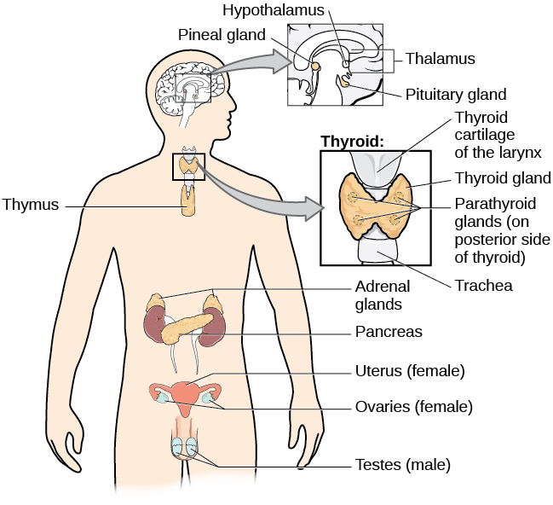
HORMONES OF GONADS
The gonads (testes in males, ovaries in females) perform closely related dual functions.
Synthesize sex hormones;
Produce germ cells
The sex hormones are categorized into three groups
Androgens or male sex hormones
Estrogens or female sex hormones
Progesterone
The male sex hormones or androgens are produced by the Leydig cells of the testes.
Estrogens are predominantly ovarian hormones, synthesized by the follicles and corpus leuteum of ovary.

Slide 54
HORMONES OF GONADS
Hormone | Tissue origin | PHYSIOLOGICAL FUNCTIONS
Estrogen (Estradiol) | Ovarian | Maturation and function of female secondary sex organs
Estrogens | Placental | Maintenance of pregnancy
Progestins (Progesterone) | Ovarian | Implantation of ovum and maintenance of pregnancy
Progestins | Placental | Mimic action of progesterone
Androgens (Testosterone) | Testicular | Maturation and function of male secondary sex organs

Slide 55
Androgens
Introduction
Produced by the Leydig cells of the testes and to a minor extent by the adrenal glands in both the sexes.
Physiological and biochemical functions of androgens
Sex-related physiological functions
Androgens, primarily dihydrotestosterone (DHT) and testosterone, influence:
Growth, development and maintenance of male reproductive organs.
Sexual differentiation and secondary sexual characteristics.
Spermatogenesis
Male pattern of aggressive behaviour.

Slide 56
Biochemical functions
1. Effect on protein metabolism
Androgens are anabolic in nature i.e. promote RNA synthesis (transcription) and protein synthesis (translation) and thus cause positive nitrogen balance.
Effect on carbohydrate and fat metabolism
Increases glycolysis, fatty acid synthesis and citric acid cycle.
Effect on mineral metabolism
It promotes mineral deposition and bone growth before the closure of epiphyseal cartilage.

Slide 57
Estrogens
Introduction
Estrogens are predominantly ovarian hormones, synthesized by the follicles and corpus luteum of ovary.
Physiological and biochemical functions of estrogens
sex-related physiological functions
Growth, development and maintenance of female reproductive organs.
Maintenance of menstrual cycles.
Development of female sexual characteristics.

Slide 58
2. Biochemical functions
- Lipogenic effect
Increase lipogenesis in adipose tissue and, for this reason women have relatively more fat (about 5%) than men.
- Hypocholesterolemic effect
Lower the plasma total cholesterol ( LDL & HDL). This explains the low incidence of atherosclerosis and coronary heart disease in the women during reproductive age.
- Anabolic effect
Promote transcription and translation (anabolic effect).

Slide 59
- Effect on bone growth
Promote calcification and bone growth.
It is believed that decalcification of bone in the postmenopausal women leading to osteoporosis is due to lack of estrogens.
  Effect on transhydrogenase
  Transhydrogenase is an enzyme activated by estrogen.
  It is capable of transferring reducing equivalents from NADPH to NAD⁺.
  It is explained that in the women after menopause, the transhydrogenase activity is low.
  This results in the diversion of NADPH towards lipogenesis causing obesity.

Slide 60
Progesterone
Introduction
Progesterone is synthesized and secreted by corpus luteum and placenta.
Progesterone, as such, is an intermediate in the formation of steroid hormones from cholesterol.
Biochemical functions of cholesterol
Essentially required for the implantation of fertilized ovum and maintenance of pregnancy.
Promotes the growth of glandular tissue in uterus and mammary gland.
Progesterone increases the body temperature by 0.5 – 1.5 F°.

Slide 61
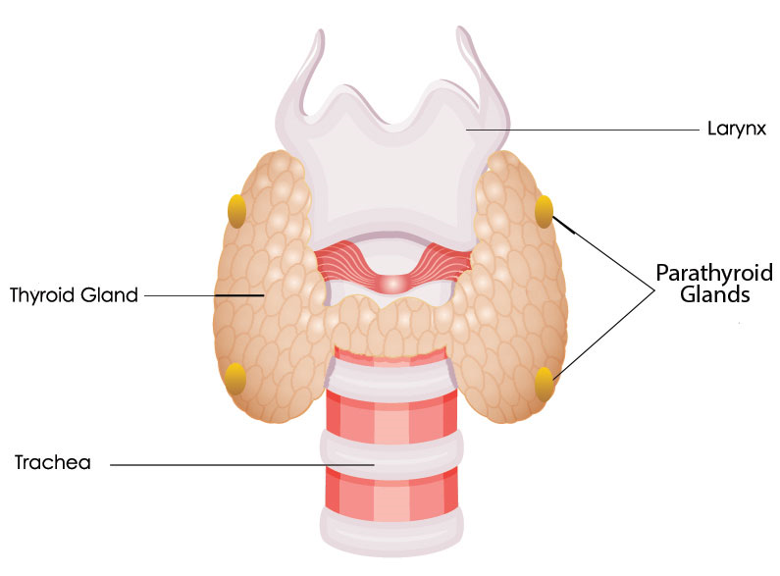
PARATHYROID GLAND
Parathyroid hormone is secreted by the four parathyroid gland embedded in the thyroid tissue.
The chief cells of the gland secrete the PTH.

Slide 62
HORMONES OF PARATHYROID GLAND
HORMONES | PHYSIOLOGICAL FUNCTIONS
Parathyroid hormone (PTH) | Regulation of plasma calcium and phosphorous

Slide 63
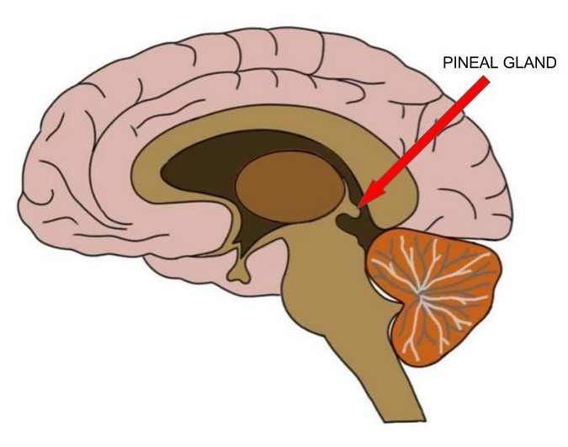
PINEAL GLAND
The pineal gland, also known as the pineal body, conarium or epiphysis cerebri is a small endocrine gland in the vertebrate brain.
The pineal gland produces melatonin.

Slide 64
HORMONES OF PINEAL GLAND
HORMONES | PHYSIOLOGICAL FUNCTIONS
melatonin | Melatonin helps to modulate sleep patterns. Melatonin production is stimulated by darkness and inhibited by light.

Slide 65
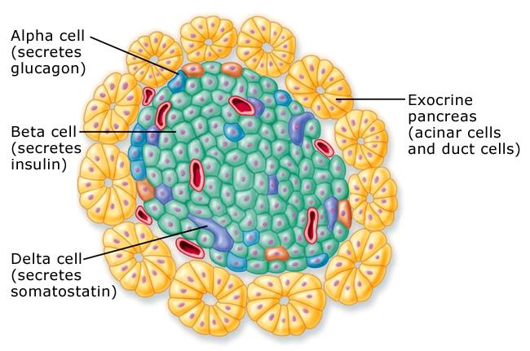
HORMONES FROM PANCREAS
The endocrine functions of pancreas is contributed by islets of Langerhans.
There are four types of cells in islets of Langerhans secreting different hormones.
A cells synthesize glucagon
B cells synthesize insulin
D cells synthesize somatostatin
F cells secrete pancreatic polypeptide

Slide 66
PANCREATIC HORMONES
HORMONES | PHYSIOLOGICAL FUNCTIONS
Insulin (secreted by beta cell) | Regulation of blood glucose
Glucagon (secreted by alpha cell) | Glycogenolysis
Somatostatin (secreted by delta cell) | Inhibition of insulin release

Slide 67
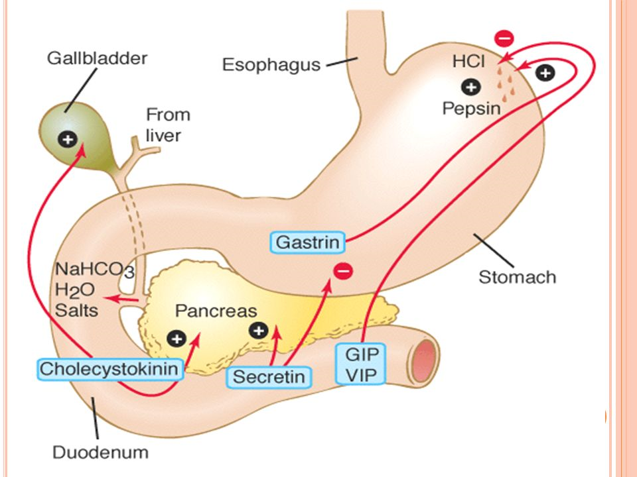
HORMONES FROM GIT
The specialized cells lining the GIT are responsible for the production of GIT hormones.
A large number of GIT hormones have been identified.

Slide 68
GIT HORMONES
HORMONES | PHYSIOLOGICAL FUNCTIONS
Gastrin | Secretion of gastric acid
Secretin | Secretion of pancreatic bicarbonate
Cholecystokinin-pancreozymin | Contraction of gall bladdar
Motilin | Stimulation of GIT motility
Vasoactive intestinal peptide (VIP) | Neurotransmitter
Gastric inhibitory polypeptide (GIP) | Inhibition of gastric secretion and motility

