Slide 1
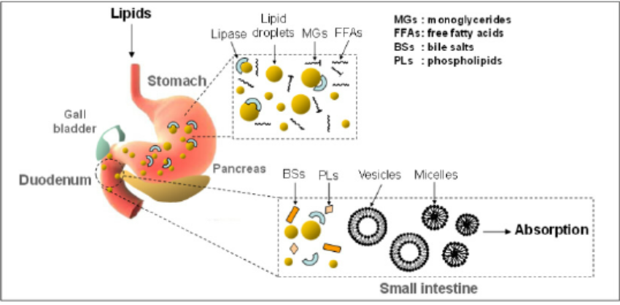
LIPIDS METABOLISM

Slide 2
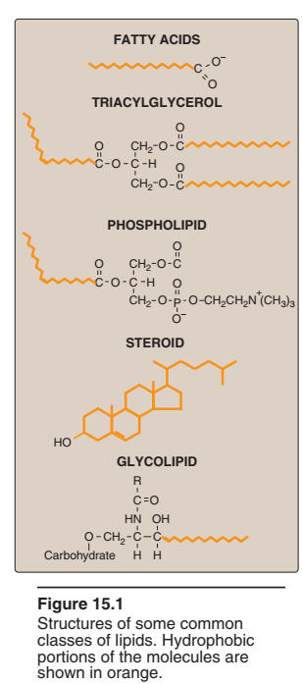
INTRODUCTION
Lipids are a heterogeneous group of water-insoluble organic molecules that can be extracted from tissues by non-polar solvents.
On an average, an adult man consumes nearly 50-100g of lipids per day.
Lipids constitute about 15-20% of the body weight in humans.
Triacylglycerols (triglycerides) are the most abundant lipids comprising 85-90% of body lipids.
In extreme case, humans can fast and survive for 60-90 days, and the obese persons can survive even longer (6 months to one year) without food.
Fig. Structure of some common classes of lipids

Slide 3
Why should fat be the fuel reserve of the body?
There are two main reasons for fat being the fuel reserve of the body.
Triacylglycerols are highly concentrated form of energy, yielding 9 Cal/g, in contrast to carbohydrates and proteins that produce only 4 Cal/g.
The triacylglycerols are non-polar and hydrophobic in nature, hence stored in pure form without any association with water (anhydrous form). On the other hand, glycogen and proteins are polar. One gram of glycogen combines with 2g of water for storage.
In some animals, triacylglycerols stored under the skin serve not only as energy stores but as insulation against low temperatures. In hibernating animals (bears, for example), the huge fat reserves accumulated before hibernation serve the dual purposes of insulation and energy storage.

Slide 4
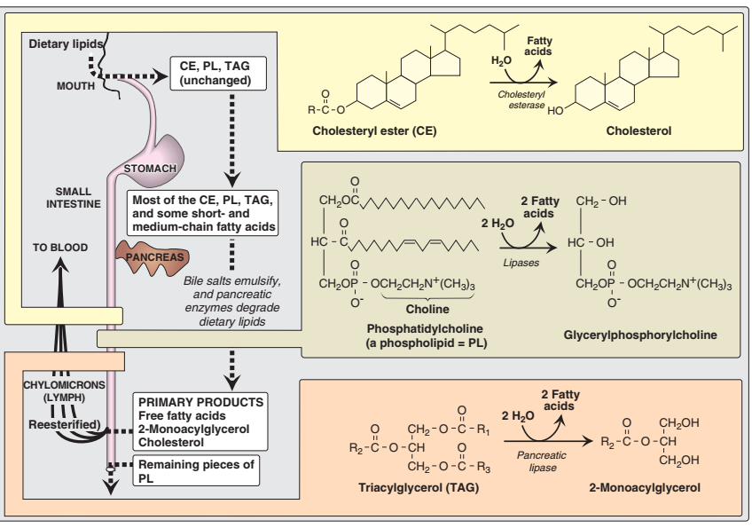
DIGESTION OF LIPIDS

Slide 5
PROCESSING OF DIETARY LIPID IN THE STOMACH
The digestion of lipids begins in the stomach, catalyzed by an acid stable lipase (lingual lipase from sublingual gland of mouth) which enters the stomach along with food.
TAG molecules, particularly those containing fatty acids of short- or medium-chain length (fewer than 12 carbons, such as are found in milk fat, butter and ghee), are the primary target of this enzyme.
These same TAGs are also degraded by a separate gastric lipase, secreted by the gastric mucosa.
Both enzymes are relatively stable, with pH optimums of pH 4 to pH 6.
These “acid lipases” play a particularly important role in lipid digestion in neonates, for whom milk fat is the primary source of calories.
They also become important digestive enzymes in individuals with pancreatic insufficiency, such as those with cystic fibrosis.
Up to 30% digestion of triglycerides occurs in stomach.

Slide 6
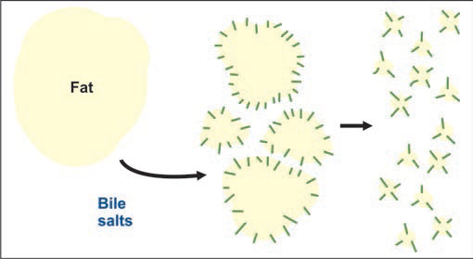
EMULSIFICATION OF DIETARY LIPID IN THE INTESTINE
Emulsification is a pre-requisite for digestion of lipids.
The critical process of emulsification of dietary lipids occurs in the duodenum.
The lipids are dispersed into smaller droplets; surface tension is reduced; and surface area of droplets is increased as a result of emulsification.
Emulsification is accomplished by two complementary mechanisms, namely, use of the detergent properties of the bile salts, and mechanical mixing due to peristalsis.
The bile (pH 7.7) entering the duodenum serves to neutralize the acid chyme from the stomach and provides a pH favourable for the action of pancreatic enzymes.
Bile salts (sodium glycocholate and sodium taurocholate), made in the liver and stored in gallbladder, are derivatives of cholesterol.
Fig. Action of bile salts.

Slide 7
STEATORRHEA
Introduction
Steatorrhea is a clinical condition characterized by passage of bulky fatty stools resulting from impaired digestion and absorption of triacylglycerols.
Causes
Absence of bile acids
Characteristic features
Absorption of lipid soluble vitamins is compromised.
Deficiency becomes manifest of vitamin K at first (increased bleeding tendency after minor cuts).
Diagnosis
The presence of steatorrhea is confirmed by the measurement of 24 hour fecal fat excretion.
Steatorrhoea is commonly seen in obstructive jaundice and in advanced case of hepatic jaundice.
Management
The treatment includes treatment of the underlying condition, restriction of fat in the diet and administration of medium chain triacylglycerols.

Slide 8
DEGRADATION OF DIETARY LIPIDS BY PANCREATIC ENZYMES
The dietary TAG, cholesteryl esters, and phospholipids are enzymatically degraded (digested) by pancreatic enzymes.
TAG degradation
TAG molecules in the intestine are acted upon by an esterase, pancreatic lipase, which preferentially removes the fatty acids esterified to the 1st and 3rd carbon atoms of glycerol.
The primary products of hydrolysis are thus a mixture of 2-monoacylglycerol and free fatty acids.
A second protein, colipase, also secreted by the pancreas, binds the lipase at a ratio of 1:1, and anchors it at the lipid-aqueous interface.
Orlistat, an antiobesity drug, inhibits gastric and pancreatic lipase, thereby decreasing fat absorption, resulting in loss of weight.

Slide 9
Cholesteryl ester degradation
Most dietary cholesterol is present in the free (nonesterified) form, with 10-15% present in the esterified form.
Cholesterol esters are hydrolysed by pancreatic cholesteryl ester hydrolase (cholesterol esterase) , which produces cholesterol plus free fatty acids.
Cholesteryl ester hydrolase activity is greatly increased in the presence of bile salts.
Phospholipid degradation
Pancreatic juice is rich in the proenzyme of phospholipase A₂ that, like procolipase, is activated by trypsin and, like cholesteryl ester hydrolase, requires bile salts for optimum activity.
Phospholipase A₂ removes one fatty acid from carbon 2 of a phospholipid, leaving a lysophospholipid.
The remaining fatty acid at carbon 1 can be removed by lysophodpholipase leaving a glycerylphosphoryl base, that may be excreted in the feces, further degraded, or absorbed.
The major end products of the digestion of TAG are 2-MAG (78%), 1-MAG (6%), glycerol and fatty acids (14%). Thus digestion of TAG is partial (incomplete).

Slide 10
Physiologically important lipases
lipase | Site of action | Preferred substrate | Product (s)
Lingual/acid stable lipase | Mouth, Stomach | TAGs with short and medium chain FAs | FFA + DAG
Pancreatic lipase + co-lipase | Small intestine | TAG with long chain FAs | FFA + DAG
Intestinal lipase with bile acids | Small intestine | TAGs with medium chain FAs | FFA + DAG
Phospholipase A2 + bile acids | Small intestine | PLs with unsaturated FA on position 2
Lipoprotein lipase | Capillary walls | TAGs in chylomicron or VLDL | FFA + DAG
Hormone sensitive lipase | Adipocytes | TAG stored in adipose tissue | FFA + DAG

Slide 11
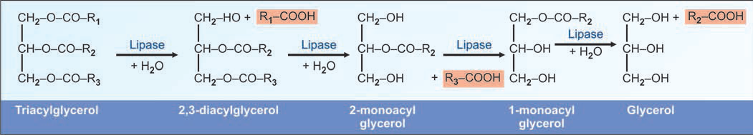
Fig. 11.1. Complete hydrolysis of triglyceride. In the intestines, generally fats are only partially hydrolysed

Slide 12
ABSORPTION OF LIPIDS
Absorption of long chain fatty acids
Long chain fatty acids (chain length more than 14 carbons) are absorbed to the lymph and not directly to the blood.
2. Mixed micelle formation
The products of digestion, namely 2 monoacylglycerols, long chain fatty acids, cholesterol, phospholipids and lysophospholipids are incorporated into molecular aggregates to form mixed micelles.
Micellar formation is essential for the absorption of fat-soluble vitamins such as vitamin A, D and K.
Fatty acids, 2-MAG and other digested products diffuse into the mucosal cell.
Bile salts, due to its amphipathic nature helps to form micellar aggregates.
Enterohepatic circulation of bile salts
The bile salts are left behind and reabsorbed from the ileum and returned to the liver to be re-excreted (enterohepatic circulation)
About 98% of dietary lipids are normally absorbed.

Slide 13
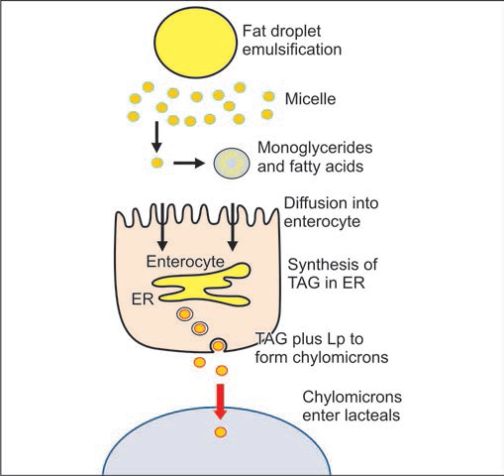
Re-esterification inside the mucosal cell
Once inside the intestinal mucosal cell, the long chain fatty acids are re-esterified to form triacylglycerols.
Chylomicrons
The TAG, cholesterol ester and phospholipid molecules along with apoproteins B48 and apo-A are incorporated into chylomicrons.
The chyle (milky fluid) from the intestinal mucosal cells loaded with chylomicrons are transported through the lacteals into the thoracic duct and then emptied into systemic circulation.
The serum may appear milky after a high fat meal (postprandial lipemia) due to the presence of chylomicrons in circulation.
Fig. Absorption of fat as chylomicrons.

Slide 14
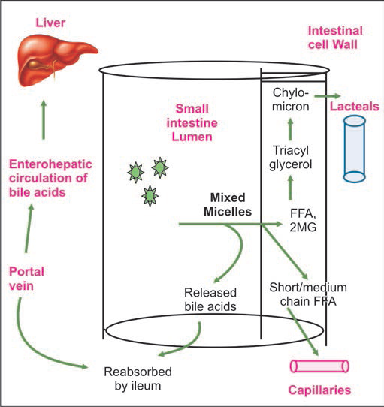
Fig. Absorption of fatty acids

Slide 15
Abnormalities in Absorption of Lipids
Defective digestion
In steatorrhea, daily excretion of fat in feces is more than 6 g per day.
It is due to chronic diseases of pancreas.
Defective absorption
Defective absorption may be due to diseases such as
Celiac diseases, sprue, Crohn’s disease
Surgical removal of intestine
Obstruction of bile duct : This may be due to gallstones, tumors of head of pancreas, enlarged lymph glands etc. The result is deficiency of bile salts.
3. Chyluria
There is an abnormal connection between the urinary tract and lymphatic drainage system of the intestine.
Urine appears milky due to lipid droplets.

Slide 16
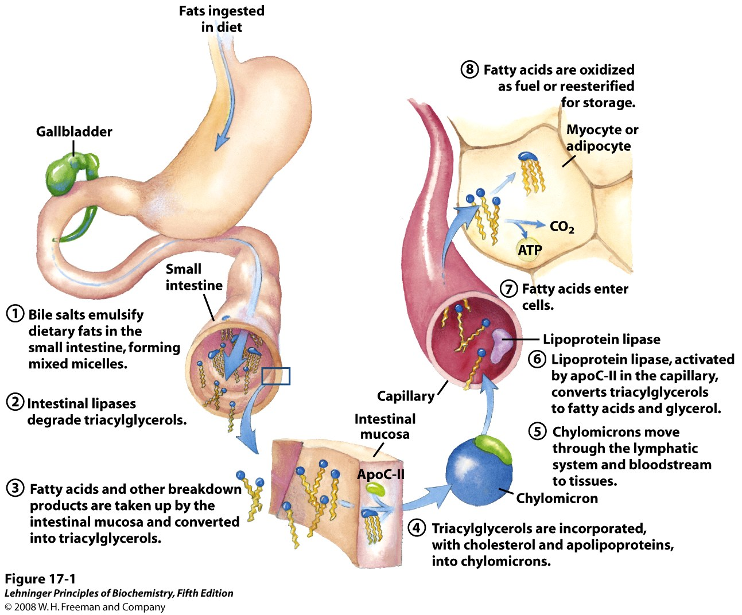
Fig. Processing of dietary lipids in vertebrates
Notes:
FIGURE 17-1 Processing of dietary lipids in vertebrates. Digestion and absorption of dietary lipids occur in the small intestine, and the fatty acids released from triacylglycerols are packaged and delivered to muscle and adipose tissues. The eight steps are discussed in the text.

Slide 17
MOBILIZATION OF FAT FROM ADIPOSE TISSUE
SIGNIFICANCE
Lipolysis refers to conversion of triacylglycerols to free fatty acids and glycerol.
Adipose tissue lipolysis is the major source of free fatty acids for oxidation in other tissues (mainly liver).
REACTIONS
Lipolysis in adipose tissue is carried out by the sequential action of three lipases.
Hormone sensitive triacylglycerol lipase catalyzes the hydrolysis of triacylglycerol to diacylglycerol and free fatty acid.
Diacylglycerol lipase catalyzes the hydrolysis of diacylglycerol to monoacylglycerol and free fattyacid.
Monoacylglycerol lipase catalyzes the hydrolysis of monoacylglycerol to free fatty acid and glycerol.

Slide 18
MOBILIZATION OF FAT FROM ADIPOSE TISSUE
When low levels of glucose in the blood trigger the release of hormones (e.g. epinephrine, glucagon)
The hormone binds its receptor in the adipocyte membrane and thus
Stimulates adenylyl cyclase, via a G protein, to produce cAMP. This activates PKA, which phosphorylates the hormone-sensitive lipase and perilipin molecules on the surface of the lipid droplet.
Phosphorylation of perilipin permits hormone sensitive lipase access to the surface of the lipid droplets, where it hydrolyzes triacylglycerols to free fatty acids.
Fatty acids leave the adipocyte, bind serum albumin in the blood, and are carried in the blood.
They are released from the albumin and enter a myocyte via a specific fatty acid transporter.
In the myocyte, fatty acids are oxidized to CO₂, and the energy of oxidation is conserved in ATP, which fuels muscle contraction and other energy requiring metabolisms in the myocyte.

Slide 19
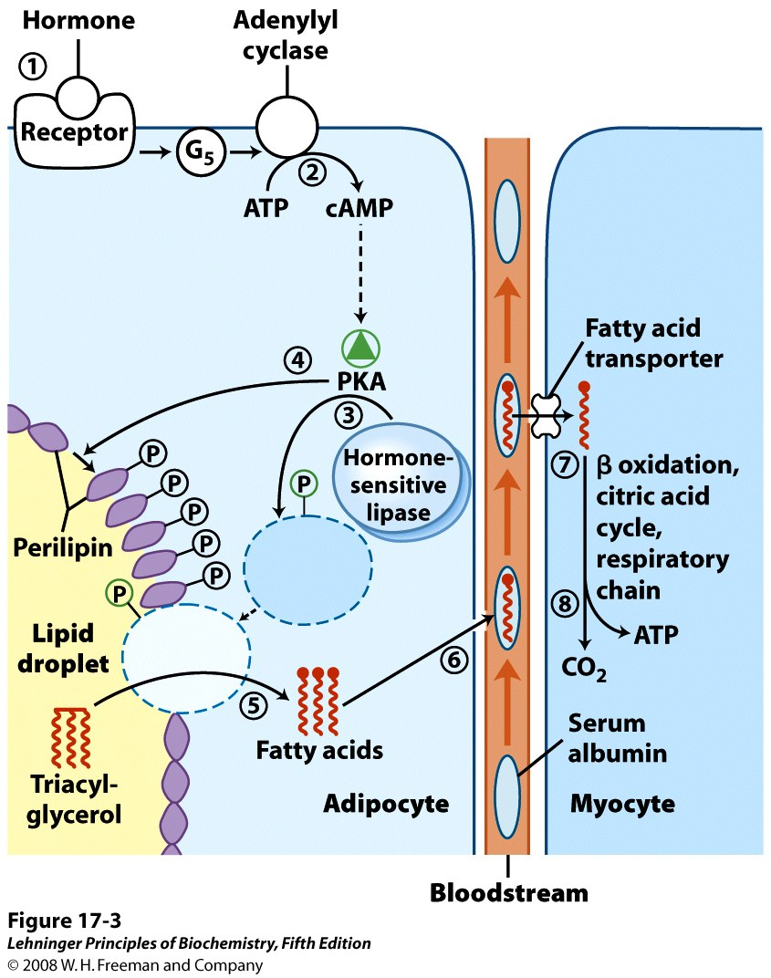
Fig. Mobilization of triacylglycerols stored in adipose tissue.
Notes:
FIGURE 17-3 Mobilization of triacylglycerols stored in adipose tissue. When low levels of glucose in the blood trigger the release of glucagon, 1 the hormone binds its receptor in the adipocyte membrane and thus 2 stimulates adenylyl cyclase, via a G protein, to produce cAMP. This activates PKA, which phosphorylates 3 the hormone-sensitive lipase and 4 perilipin molecules on the surface of the lipid droplet. Phosphorylation of perilipin permits hormone-sensitive lipase access to the surface of the lipid droplet, where 5 it hydrolyzes triacylglycerols to free fatty acids. 6 Fatty acids leave the adipocyte, bind serum albumin in the blood, and are carried in the blood; they are released from the albumin and 7 enter a myocyte via a specific fatty acid transporter. 8 In the myocyte, fatty acids are oxidized to CO₂, and the energy of oxidation is conserved in ATP, which fuels muscle contraction and other energy-requiring metabolism in the myocyte.

Slide 20
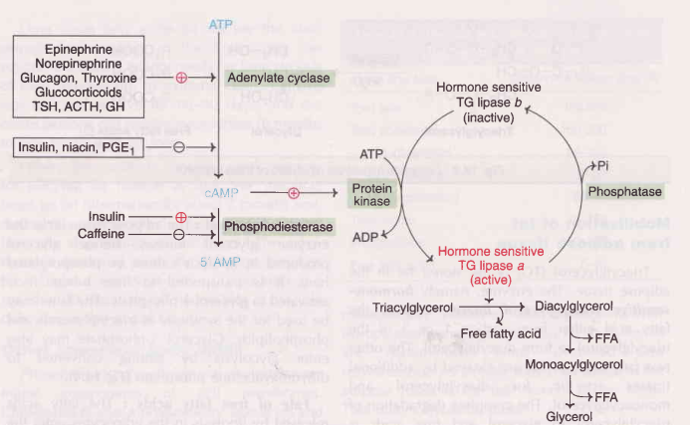
Regulation of hormone-sensitive TG-lipase
Fig. Control of lipolysis in adipose tissue

Slide 21
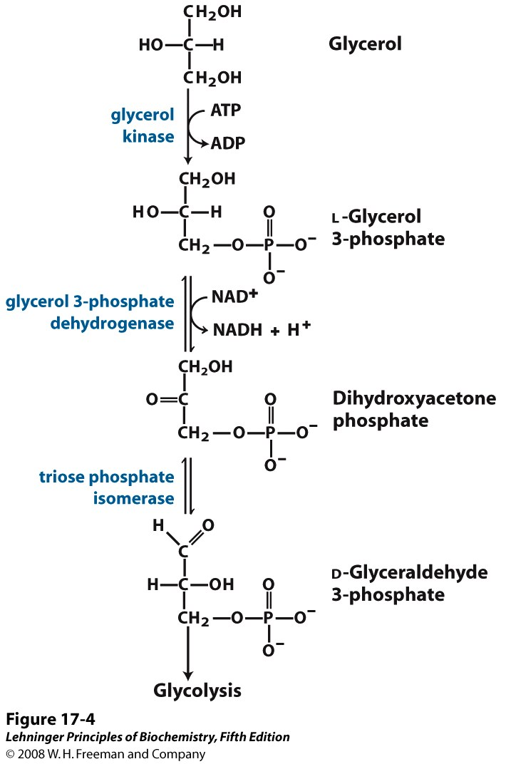
FATE OF GLYCEROL
The adipose tissue lacks the enzyme, glycerol kinase, hence glycerol produced in lipolysis cannot be phosphorylated here.
It is transported to liver where it is activated to glycerol 3-phosphate.
Glycerol 3-phosphate may be used for the synthesis of triacylglycerols and phospholipids.
Glycerol 3-phosphate may also enter glycolysis by getting converted to dihydroxyacetone phosphate.

Slide 22
FATTY ACID OXIDATION
Tissues involved in oxidation:
Fatty acids are oxidized by most of the tissues in the body.
Brain, erythrocytes and adrenal medulla cannot utilize fatty acids for energy requirement.
Site of Oxidation:
Oxidation of fatty acids takes place in the mitochondria.
Pathways of Oxidation:
Fatty acids are oxidized through three pathways:
β oxidation which is the major pathway of oxidation of fatty acids.
α oxidation which is the minor pathway of fatty acid oxidation.
ω oxidation which is also the minor pathway for fatty acid oxidation.
Stages of Fatty acid Oxidation:
The oxidation of fatty acids involves three stages
Activation of fatty acids occuring in the cytosol
Transport of fatty acids into mitochondria
Oxidation proper in the mitochondrial matrix

Slide 23
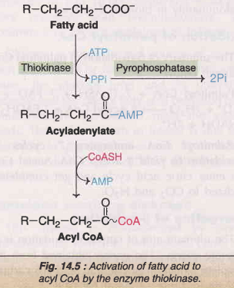
I. Fatty Acid Activation
Fatty acids are activated to acyl CoA by thiokinases or acyl CoA synthetases.
The reaction occurs in two steps and requires ATP, coenzyme A and Mg²⁺.
In the activation, two high energy phosphates are utilized, since ATP is converted to pyrophosphate (PPi).
The enzyme inorganic phosphatase hydrolyses PPi to phosphate (Pi).
The immediate elimination of PPi makes this reaction totally irreversible.
Three different thiokinases, to activate long chain (10-20 carbon), medium chain (4-12 carbon) and short chain (<4 carbon) fatty acids have been identified.

Slide 24
II. TRANSPORT OF ACTIVATED FATTY ACIDS FROM THE CYTOSOL TO THE MITOCHONDRIA
Longer chain acyl CoAs (>C12)are not able to readily cross the inner mitochondrial membrane.
A specialized carnitine carrier system (carnitine shuttle) operates to transport activated fatty acids from cytosol to the mitochondria.
This occurs in four steps
Acyl group of acyl CoA is transferred to carnitine (β-hydroxy γ-trimethyl aminobutyrate) catalyzed by carnitine acyltransferase I (present on the outer surface of inner mitochondrial membrane).
The acyl-carnitine is transported across the membrane to mitochondrial matrix by a specific carrier protein.
Carnitine acyl transferse II (found on the inner surface of inner mitochondrial membrane) converts acyl-carnitine to acyl CoA.
The carnitine released returns to cytosol for reuse.
INHIBITOR OF CARNITINE SHUTTLE :
carnitine acyl transferase I is inhibited by malonyl CoA, a key metabolite involved in fatty acid synthesis that occurs in cytosol.

Slide 25
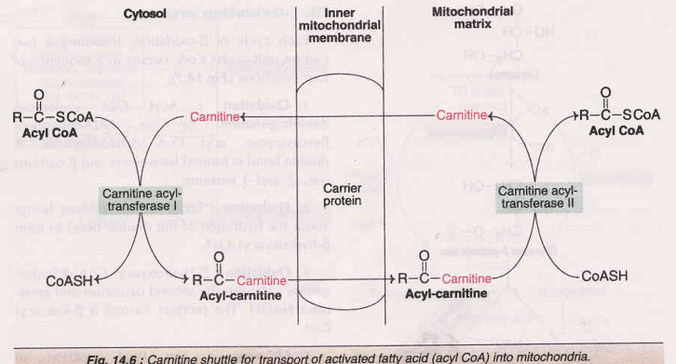

Slide 26
III. OXIDATION PROPER
β-oxidation
β-oxidation of fatty acid is oxidation of fatty acid at the β carbon atom.
The process of β-oxidation of fatty acids was proposed by Knoop and requires CoA, FAD and NAD.
Each cycle of β-oxidation, liberating a two carbon unit-acety CoA, occurs in a sequence of four reactions.
Oxidation
Acyl CoA undergoes dehydrogenation by an FAD-dependent flavoenzyme, acyl CoA dehydrogenase.
A double bond is formed between α and β carbons (i.e., 2 and 3 carbons).
2. Hydration
Enoyl CoA hydratase brings about the hydration of the double bond to form β-hydroxyacyl CoA.

Slide 27
3. Oxidation
β-hydroxyacyl CoA dehydrogenase catalyzes the second oxidation and generates NADH.
The product formed is β-ketoacyl CoA.
4. Cleavage
The final reaction in β-oxidation is the liberation of a 2 carbon fragment, acetyl CoA from acyl CoA.
This occurs by a thiolytic cleavage catalyzed by β-ketoacyl CoA thiolase (or simply thiolase).
The new acyl CoA, containing two carbons less than the original, reenters the β-oxidation cycle.
The process continues till the fatty acid is completely oxidized.
The overall reaction for each cycle of β-oxidation
C_{n} Acyl CoA + FAD + NAD⁺ + H₂O + CoASH
C_{(n-2)} Acyl CoA + Acetyl CoA + FADH₂ + NADH + H⁺
This oxidation process corresponds to saturated (no double bond) and even carbon fatty acids.

Slide 28
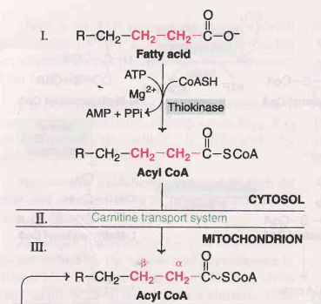
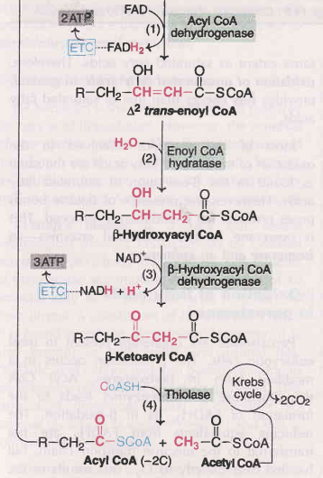

Slide 29
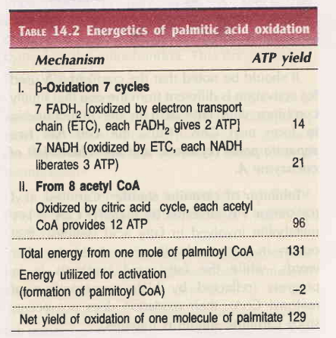
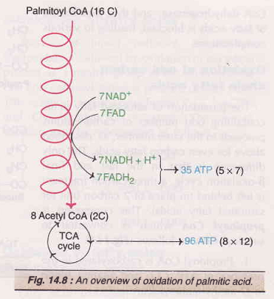
Oxidation of Palmitoyl CoA

Slide 30
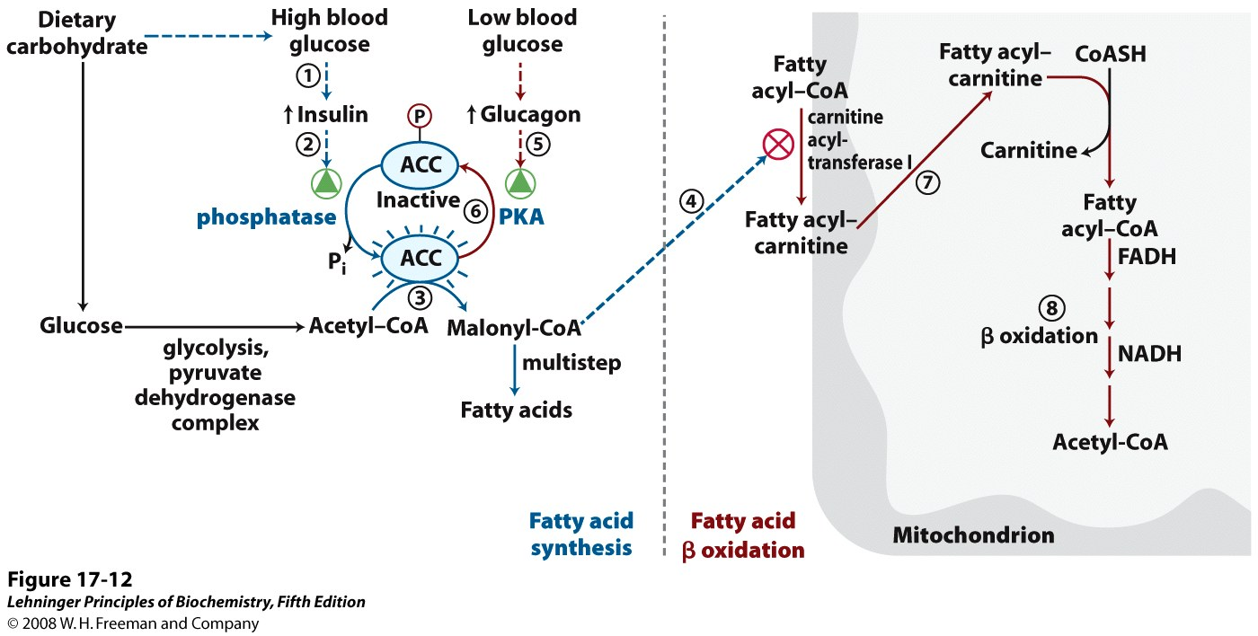
REGULATION OF FATTY ACID OXIDATION

Slide 31
SIGNIFICANCE OF β-OXIDATION:
i. PROVISION OF ENERGY
Fatty acid oxidation provides 20-30% of energy requirement of the cell.
ii. KETONE BODIES
On conditions of short supply of glucose to the cell (such as starvation and diabetes mellitus) excessive breakdown of fatty acids leads to the formation of ketone bodies.
Ketone bodies provide energy to the peripheral tissues such as muscle and kidney
iii. UTILIZATION OF ACETYL CoA FOR THE SYNTHESIS OF BIOMOLECULES
Acetyl CoA derived from β-oxidation of fatty acids may be utilized for several biosynthetic reactions such as synthesis of acetylcholine and cholesterol.

Slide 32
SUDDEN INFANT DEATH SYNDROME
INCIDENCE
The enzyme defect has a frequency of 1 in 10,000 births.
CAUSE
The real cause of SIDS is not known.
It is now estimated that at least 10% of SIDS is due to deficiency of medium chain acyl CoA dehydrogenase.
CLINICAL FEATURES AND BIOCHEMICAL FINDINGS
The individual is unable to oxidize fatty acids of 6 to 12 carbons.
The symptoms are seen during the first year of life and symptoms become more apparent after prolonged fasting.
The clinical features are accumulation of fat in liver, increased blood levels of medium chain fatty acids, hypoglycemia, increased excretion of medium chain fatty acids in urine, vomiting and coma.
The condition has a high mortality (20% - 60%) in children.
TREATMENT
If the condition is detected early after birth, the treatment consists of :
Low fat diet, high carbohydrate diet, and
Avoidance of long intervals between the meals (to prevent excessive oxidation of fatty acids).

