Slide 1
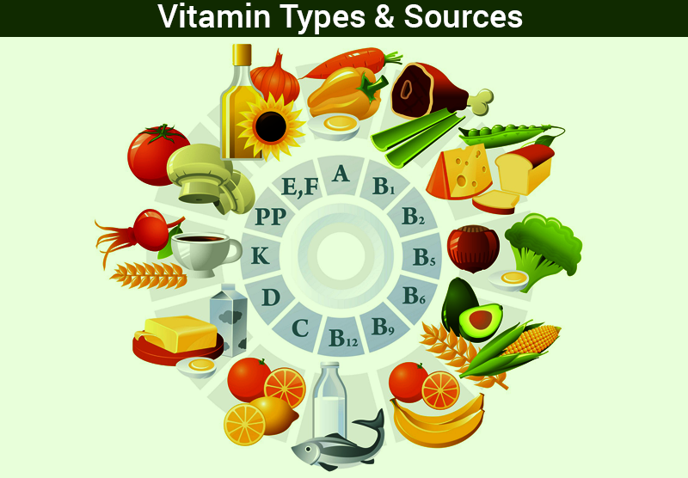
VITAMINS

Slide 2
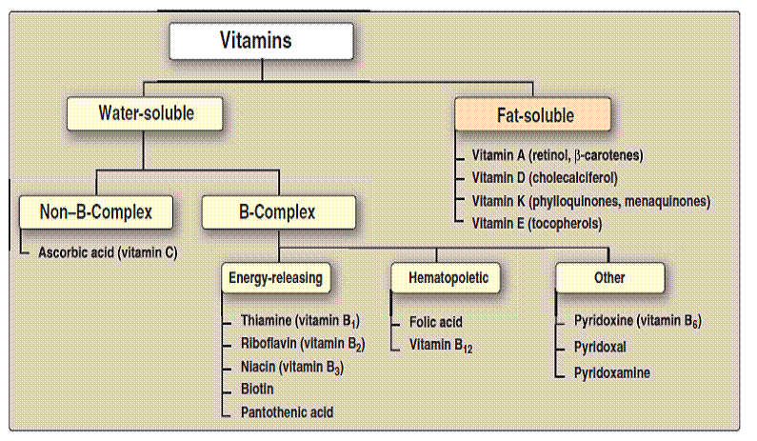
DEFINITION
Vitamins may be defined as organic compounds required in the diet in small amounts to perform specific biological functions for normal maintenance of optimum growth and health of the organism.
CLASSIFICATION OF VITAMINS

Slide 3
COMPARISON OF TWO TYPES OF VITAMINS
 | FAT SOLUBLE VITAMINS | WATER SOLUBLE VITAMINS
SOLUBILITY IN FAT | Soluble | Not soluble
WATER SOLUBILITY | Not soluble | Soluble
ABSORPTION | Along with lipids, requires bile salts | Absorption is simple
CARRIER PROTEINS | Present | No carrier proteins
STORAGE | Stored in liver | No storage
EXCRETION | Not excreted | Excreted
DEFICIENCY | Manifests only when stores are depleted | Manifests rapidly as there is no storage
TOXICITY | Hypervitaminosis may result | Unlikely, since excess is excreted
TREATMENT OF DEFICIENCY | Single large doses may prevent deficiency | Regular dietary supply is required
MAJOR VITAMINS | A,D,E and K | B and C

Slide 4
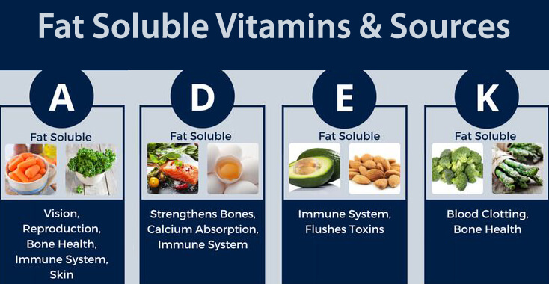
FAT SOLUBLE VITAMINS

Slide 5
VITAMIN A
INTRODUCTION
Vitamin A is also called as the anti-night blindness factor.
The active form of vitamin A is present only in foods of animal origin. However, its provitamins carotenes are found in plants.
All the compounds with vitamin A activity are referred to as retinoids (active form).
CLASSIFICATION
Vitamin A occurs in two forms in food. They are retinoids and carotenes.
Retinoids occur in four different forms. They are:
retinol (an alcohol, A), retinal (an aldehyde, A₁), retinoic acid (oxidized form) and 3-dehydroretinol (A₂).
BIOCHEMICAL FUNCTIONS
1. Normal visual functioning of the eyes
Vitamin A is essential for vision, both for the rods as well as for the cones, in the retina.
2. Cell growth and differentiation
Vitamin A, particularly as retinoic acid, plays a key role in the synthesis of membrane glycoproteins, glycosaminoglycans etc.

Slide 6
Immunity
It ensures an optimal functioning of the immune system since vitamin A is required to maintain the integrity of the tissues lining the eyes, gastrointestinal tract etc.
Antioxidant vitamin
Both vitamin A and β-carotene detoxify free radicals and are therefore lipid-phase antioxidants.
5. Anticancer vitamin
The ability of vitamin A to maintain epithelial integrity, to strengthen the immune response and to act as an antioxidant, makes it an important anticancer vitamin.
Intermediary metabolism
Vitamin A favors synthesis of the steroid hormones particularly cortisterone and cortisol that in turn favor gluconeogenesis.
DIETARY SOURCES
Liver , carrots, sweet potatoes and green-leafy vegetables are good sources of vitamin A.
Papaya, carrots, sweet potatoes and green-leafy vegetables are good sources of carotenes.

Slide 7
RECOMMENED DAILY ALLOWANCE
Children = 400 – 600 μg/day
Men = 750 – 1000 μg/day
Women = 750 μg/day
Pregnancy = 1000 μg/day
DEFICIENCY MANIFESTATIONS
Night blindness or Nyctalopia
Visual activity is diminished in dim light.
The dark adaptation time is increased.
Xerophthalmia
The conjuctiva becomes dry, thick and wrinkled, gets keratinized and loses its normal transparency.
Bitot’s spots
Bitot’s spots mean accumulation of foamy/cheesy material on the conjuctiva.
This is due to increased thickness of conjuctiva incertain areas.
Keratomalacia
When the xerophthalmia persists for a long time, it progresses to keratomalacia (ulcer of the cornea).
5. Skin and mucous membrane lesions

Slide 8
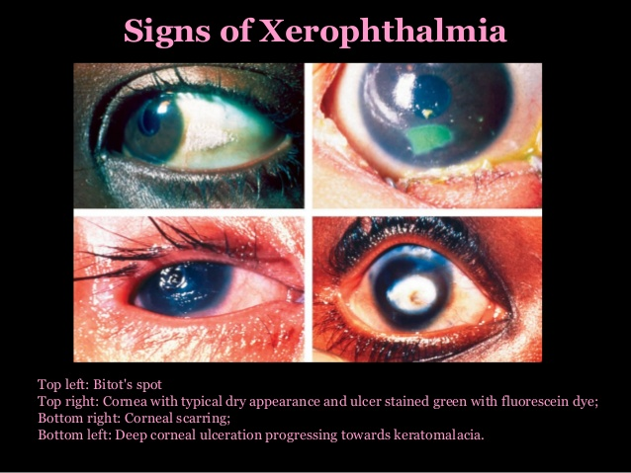
VITAMIN A DEFICIENCY
Function of rods/cones Growth/integrity of epithelium
in retina Conjunctival xerosis
Dark adaptation time Bitot’s spots
(i.e. dark adaptation) Corneal xerosis
Nyctalopia Corneal ulcer
(Night blindness)
Keratomalacia
(Ulcer perforation)
Corneal scar
Xerophthalmia
Permanent blindness

Slide 9
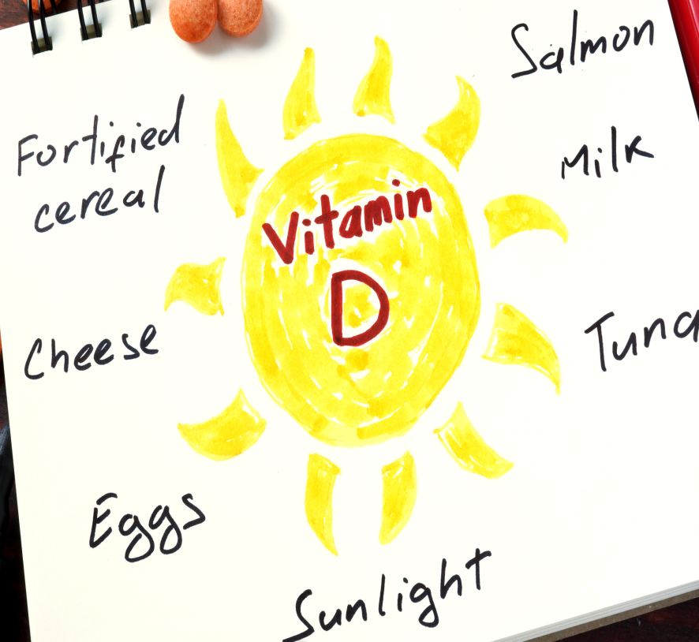
VITAMIN D
INTRODUCTION
Vitamin D (calciferol) is a sterol and is called as anti-rickets factor.
It is also known as sunshine vitamin and is considered to be a prohormone.
Vitamin D is derived either from 7-dehydrocholesterol or ergosterol by the action of ultraviolet radiations.
The activation of vitamin D takes place partly in the liver and partly in the kidney.
The active form of the vitamin D is 1,25-dihydroxycholecalciferol also called as calcitriol [1,25(OH)₂.D₃].
Two common forms of the vitamin are vitamin D₂ (ergocalciferol) and vitamin D₃ (cholecalciferol).
DIETARY SOURCE

Slide 10
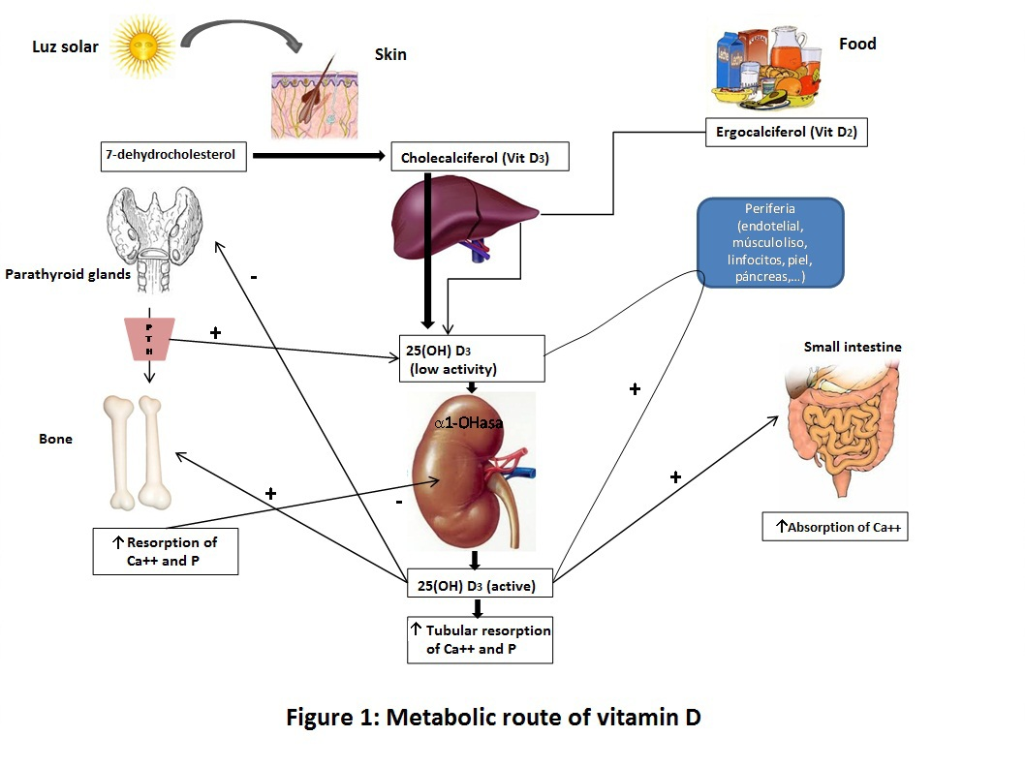
BIOLOGICAL FUNCTIONS OF CALCITRIOL
The biological functions of calcitriol may be divide into calcemic and extracalcemic effects.
Calcemic effects
The net regulation of serum calcium and phosphorous levels is achieved through its action in the intestine, bone and kidneys.
In the intestine
Calcitriol induces the synthesis of alkaline phosphatase, calcium binding proteins such as calmodulin, and Ca²⁺ - dependent ATPase to increase the efficiency of absorption of calcium as well as phosphorous.
In bones
Calcitriol stimulates the synthesis of the proteins osteocalcin and osteopontin in the osteoblasts; these protein become a part of the bone matrix (osteoid) and bind calcium. Thus, calcitriol favors mineralization when serum calcium is normal or rising (as after a meal). However, when serum calcium tends to fall, calcitriol promotes the differentiation of pre-osteoclasts which in turn mobilize calcium from the bone, i.e. causes demineralization of the bone and restores normocalcemia.

Slide 11
In kidney
Calcitriol increases the tubular reabsorption of calcium and excretion of phosphorous.
The overall effect of calcitriol therefore is to maintain calcium/phosphorous homeostasis.
2. Extracalcemic effects
The major extraclacemic effects of calcitriol are:
Cell proliferation and differentiation
Insulin release
Action of growth hormone
Immune response
Fertility
RECOMMENDED DAILY ALLOWANCE
Children = 10 μg/day
Adults = 5 to 10 μg/day
Pregnancy, lactation = 10 μg/day

Slide 12
DEFICIENCY OF VITAMIN D
The deficiency diseases are rickets in children and osteomalacia in adults.
Rickets
Definition
Rickets is vitamin D deficiency state in children.
Age
It is usually seen in children between the ages 4 months and 2 years.
Causes
Most common causes for rickets are dietary deficiency and non-exposure to sunlight.
Clinical features
Delayed closure of fontanelle, delayed dentition, pigeon chest, deformities of bone, weight bearing bones are bent to form bow-legs.
Biochemical findings
Decreased plasma calcium
Decreased plasma phosphorous
Increased plasma alkaline phosphatase

Slide 13
Osteomalacia
Definition
Ostemalacia refers to vitamin D deficiency in adults.
Causes
The condition is caused by inadequate exposure to sunlight or low dietary intake.
Clinical features
Demineralization occurs mainly in spine, pelvis and lower extremities.
Bowing of the long bones due to weight of the body.
Flattening of pelvis bones may cause difficulty during labor.

Slide 14
VITAMIN E
INTRODUCTION
Vitamin E (tocopherol) is a naturally occuring antioxidant.
Vitamin E is also called tocopherol where tocos means child birth.
It is essential for normal reproduction in many animals, hence known as anti-sterility vitamin.
Vitamin E is described as a vitamin in search of a disease.
DIETARY SOURCE
The richest sources are germ oil, corn oil, fish oil, soya oil, eggs.
Coconut oil and olive oils are relatively low in vitamin E.
BIOCHEMICAL FUNCTIONS
Vitamin E is the most powerful natural antioxidant.
It protects RBC from hemolysis.
It boosts immune system.
It is needed for the optimal absorption of amino acids form the intestine.
It reduces the risk of atherosclerosis by reducing oxidation of LDL.
It is involved in proper synthesis of nucleic acids.

Slide 15
RECOMMENED DAILY ALLOWANCE
Males = 10 mg/day
Females = 8 mg/day
Pregnancy = 10 mg/day
Lactation = 12 mg/day
DEFICIENCY SYMPTOMS
Deficiency of vitamin E does not produce a specific disease with rapidly progressing symptoms.
Low levels of vitamin E have been reported in conditions such as anemia, infections, some types of cancers, Alzheimer’s disease etc.
Deficiency of vitamin E is also seen in children with fat malabsorption.
In vitamin E deficiency, red blood cells become more fragile.
Other deficiency symptoms includes certain reproductive defects such as sterility, degeneration of the testes, muscular dystrophy etc.

Slide 16
VITAMIN K
INTRODUCTION
The name vitamin K (Koagulation factor) has been derived from the Danish word Koagulation since it has an important role in blood clotting.
Vitamin K is the only fat soluble vitamin with a specific coenzyme function.
FORMS
The most important form which occurs naturally is vitamin K₁ (phylloquinone).
Vitamin K₂ ₍menaquinone or farnequinone) is synthesized by the intestinal bacteria.
Vitamin K₃ (menadione) is a synthetic compound available commercially.
The active form of vitamin K is KH₂.

Slide 17
BIOLOGICAL FUNCTIONS
Biochemical role in blood coagulation
Vitamin K is required for the formation of active form of blood clotting factors II, VII, IX and X.
2. γ-carboxylation of other proteins
Vitamin K is also required for the γ-carboxylation of osteocalcin, a bone protein. Osteocalcin is involved in the regulation of bone mineralization.
3. Vitamin K and oxidative phosphorylation
Vitamin K is required for the electron transport and oxidative phosphorylation.
SOURCES OF VITAMIN K
Green leafy vegetables are good dietary sources.
Other sources are cabbage, cauliflower, tomatoes, spinach and other green vegetables.
It is also present in egg yolk, meat, liver etc.

Slide 18
RECOMMENDED DAILY ALLOWANCE
RDA is 50 – 100 mg/day.
DEFICIENCY OF VITAMIN K
In normal adults dietary deficiency seldom occurs since the intestinal bacterial synthesis is sufficient to meet the needs of the body.
Deficiency can occur in conditions of impaired abosorption (eg. In conditions of biliary obstruction, celiac sprue etc.), sterile bacteria (by administrationof antibiotics), impaired formation of active form of vitamin K (in liver diseases).
VITAMIN K ANTAGONISTS
Due to structural similarity to vitamin K, dicumarol and Warfarin act as antagonists to vitamin K.
Warfarin and dicurmarol will competitively inhibt the gamma carboxylation system. Hence they are widely used as anticoagulants for therapeutic purposes.

Slide 19
WATER SOLUBLE VITAMINS

Slide 20
VITAMIN C
INTRODUCTION
Vitamin C is also known as ascorbic acid, anti-scorbutic factor or anti-scurvy factor.
Vitamin C is a water soluble versatile vitamin.
It is easily destroyed by heat, hence 70% are lost during cooking.
Only L-ascorbic acid and dehydroascorbic acid have antiscorbutic activity.
DIETARY SOURCE
Rich sources are amla, guava, lemon and green leafy vegetables.
BIOCHEMICAL FUNCTIONS
Hydroxylation of proline and lysine
Ascorbic acid is necessary for the post-translational hydroxylation of proline and lysine residues which is required for the cross links formation in collagen.
2. Tryptophan metabolism
Ascorbic acid is necessary for the hydroxylation of tryptophan which is required for the formation of serotonin.
Iron metabolism
Ascorbic acid reduces ferric iron to ferrous iron state, which is preferentially absorbed.

Slide 21
4. Hemoglobin metabolism
It is useful for re-conversion of met-hemoglobin to hemoglobin.
Folic acid metabolism
Ascorbic acid is helping the enzyme folate reductase to reduce folic acid to tetrahydrofolic acid.
Antioxidant property
Daily intake of vitamin C reduces the risk of cancer.
Cataract
Regular intake of vitamin C reduces the risk of cataract formation.
RECOMMENDED DAILY ALLOWANCE
RDA is 75 mg/day.
During pregnancy, lactation, and in aged people requirement may be 100 mg/day.
DEFICIENCY MANIFESTATIONS
The clinical condition of vitamin C deficiency is known as scurvy.
Clinical features of scurvy
Swollen and bleeding gums, Petechial hemorrhages
Arthritis, Delayed wound healing
Anemia
Fatigue, depression and susceptibility to infections.
Biochemical findings
Decreased plasma, platelet and leukocyte ascorbic levels
Treatment
Supplementation of vitamin C

Slide 22
THIAMINE (VITAMIN B1)
INTRODUCTION
Thiamine (anti-beriberi or antineuritic vitamin) is the first member of the vitamin B complex and therefore is known as vitamin B₁.
Tea, coffee, raw-fish and shellfish contain thiaminase which can destroy the vitamin.
Thiamine pyrophosphate (TPP) is an active coenzyme form of vitamin thiamine.
SOURCES
Aleurone layer of cereals (food grains) is a rich source of thiamine.
When the grains are polished, aleurone layer is usually removed.
Yeast is also a very good source.

Slide 23
PHYSIOLOGICAL ROLE OF THIAMINE
1. Pyruvate dehydrogenase
TPP is used in oxidative decarboxylation of alpha keto acids, e.g pyruvate dehydrogenase catalyzes the breakdown of pyruvate to acetyl CoA, and carbon dioxide.
2. Alpha ketoglutarate dehydrogenase
Another reaction that requires TPP is the oxidative decarboxylation of alpha ketoglutarate to succinyl CoA and CO₂.
3. Transketolase
The enzyme transketolase uses TPP in the HMP shunt pathway of glucose.
RDA
It depends on calorie intake (0.5 mg/1000 calories).
Requirement is 1-1.5 mg/day.

Slide 24
DEFICIENCY MANIFESTATIONS
Beriberi
The deficiency of vitamin B₁ results in a condition called beri-beri.
The early symptoms are anorexia, weakness etc.
Wet beriberi
Cardiovascular manifestations are prominent.
Death occurs due to heart failure.
Dry beriberi
CNS manifestations are the major features.
Infantile beriberi
It occurs to infants born to mothers suffering from thiamine deficiency.
Polyneuritis
It is common in chronic alcoholics.
Alcohol inhibits intestinal absorption of thiamine, leading to thiamine deficiency.

Slide 25
RIBOFLAVIN (VITAMIN B₂)
INTRODUCTION
Riboflavin (B₂) is also called as lactoflavin due to its high content in milk.
Riboflavin with phosphoric acid forms flavin mononucleotide (FMN) which is a coenzyme form of the vitamin.
The other coenzyme forms are flavin adenine dinucleotide (FAD)
DIETARY SOURCE
Rich sources are liver, dried yeast and egg.
Good sources are fish, whole cereals, legumes etc.
BIOCHEMICAL FUNCTIONS
Riboflavin is a precursor of coenzymes FMN and FAD, which are required for several oxidation-reduction reactions.
It is needed for maintenance of mucosal epithelium and the ocular tissues.
Flavins are involved in the metabolism of iron, pyridoxine and folate.
They are also involved in protection against peroxidation in metabolism of xenobiotics.
RDA
1.5 mg/day for adults.
Additional 0.2-0.4 mg/day for pregnancy, lactation and old age.

Slide 26
Deficiency manifestations
Deficiency is uncommon but may be associated with niacin or iron deficiency.
Symptoms include cheilosis, glossitis, dermatitis, photophobia and lacrymation.
Notes:
Cheilosis = painful inflammation at the corner of the mouth.
Glositis = inflammation of the tongue

Slide 27
NIACIN (VITAMIN B₃)
INTRODUCTION
Niacin is also known as pellagra preventive factor or anti-pellagra factor because of its role in the prevention of pellagra.
Niacin and nicotinic acid are synonyms.
Active forms of niacin are :
Nicotinamide adenine dinucleotide (NAD⁺)
Nicotinamide adenine dinucleotide phosphate (NADP⁺)
DIETARY SOURCE
Yeast, liver, legumes and meat are major sources.
Limited amount are synthesized from tryptophan.
BIOCHEMICAL FUNCTIONS
NAD⁺ and NADP⁺ are involved in oxidation reduction reactions catalyzed by dehydrogenase in metabolism.
NAD seems to play a role in DNA repair and other cellular responses to DNA damage.
RDA
Normal requirement is 20 mg/day.
During lactation additional 5 mg is required.

Slide 28
DEFICIENCY MANIFESTATION
Pellagra
The clinical condition resulting from niacin deficiency is called pellagra.
Clinical features of pellagra includes aneorexia, weakness, dermatitis, diarrhoea and dementia.
Biochemical findings are : decreased N-methylnicotinamide in urine and decreased plasma and erythrocyte concentration of NAD and NADP.
THERAPEUTIC USE OF NIACIN
Administration of niacin in pharmacological doses (2-4 g/day, 200 times the RDA) results in a number of biochemical effects in the body.
Inhibits lipolysis in the adipose tissue and decreases the circulatory free fatty acids.
Triacylglycerol synthesis in the liver is decreased.
It is used in the treatment of hyperlipoproteinemia type II b (elevation of LDL and VLDL).
Notes:
Dementia = Brain disease marked by memory disorders

Slide 29
PYRIDOXINE (VITAMIN B₆)
INTRODUCTION
It is a group of 3 compounds- pyridoxine, pyridoxal and pyridosamine which contain a pyridine ring.
Active form of pyridoxine is pyridoxal phosphate (PLP).
DIETARY SOURCE
Rich source are yeast, rice polishing, cereals, legumes (pulses), oil seeds and green leafy vegetables.
RDA
Its requirement is related to protein intake.
For adult = 1 to 2 mg/day.
Pregnancy and lactation =2.5 mg/day.

Slide 30
BIOCHEMICAL FUNCTIONS
Active form of vitamin B₆, PLP acts as coenzyme in large number of reactions of amino acid metabolism. For example:
Transamination
Decarboxylation
Nonoxidative deamination
Trans-sulfuration
Condensation reactions of amino acids
Vitamin B₆ is essential in glycogen metabolism in muscle and liver since it acts as a coenzyme for phosphorylase.
Vitamin B₆ is required for the absorption of dietary amino acids.
DEFICIENCY MANIFESTATIONS
Deficiency of Vitamin B₆ may occur in patients with tuberculosis who are taking the anti-tuberculosis drug isonicotinic acid hydrazide which acts as an antagonist to Vitamin B₆ .
Deficiency symptoms include cheilosis, glossitis, and hypochromic anemia.
In infants, deficiency of Vitamin B₆ affects central nervous system and results in convulsions, demylination of the peripheral nerves and degeneration of axons.
Pyridoxine has been shown to be helpful in the treatment of nausea and vomiting during pregnancy, radiation therapy and muscular dystrophy.

Slide 31
PANTOTHENIC ACID (VITAMIN B₅)
INTRODUCTION
The name pantothenic acid is derived form the Greek word ‘pantothene’ meaning from “everywhere”.
Pantothenic acid formely known as chick anti-dermatitis factor (or filtrate factor) is widely distributed in nature.
DIETARY SOURCE
It occurs in all animal and plant tissues.
Rich sources are yeast, liver, egg, potato, cereals.
RDA
RDA is about 10 mg/day.

Slide 32
BIOCHEMICAL FUNCTIONS
The functions of pantothenic acid are exerted through coenzyme A or CoA as it is an important constituent of coenzyme A.
Coenzyme-A participates in reactions concerned with:
Reactions of citric acid cycle
Fatty acid synthesis and oxidation
Acetylation reaction of drugs
Synthesis of cholesterol
Utilization of ketone bodies
DEFICIENCY MANIFESTAITONS
No clear-cut case of pantothenic acid deficiency has been reported.
Deficiency symptoms include headache, fatigue, muscle cramps and gastrointestinal disturbance.
It has been used with limited success in the treatment of burning feet syndrome and in the healing of ulcers.

Slide 33
BIOTIN (VITAMIN B₇)
INTRODUCTION
Biotin is also called as anti-egg white injury factor since it protects animals against the toxicity of raw-egg white.
It was formerly known as vitamin H.
DIETARY SOURCE
Rice polish, whole cereals, milk, yeast and meat (liver, kidney) are good sources of biotin.
RDA
About 200 – 300 mg/day
BIOCHEMICAL FUNCTIONS
Biotin (as active biotin) is required as a coenzyme by carboxylase and is important in several reactions involving CO₂ fixation, such as:
In the carboxylation of pyruvate to form oxaloacetate with the enzyme with the enzyme pyruvate carboxylase.
In transcarboxylation reaction, i.e. in the catabolism of branched chain amino acids.
DEFICIENCY MANIFESTATIONS
Biotin deficiency is not generally seen as it can be synthesized by the intestinal flora.
Consumption of raw-egg white, however, can produce neurological abnormalities by inhibiting the absorption of biotin.
Deficiency may cause mild dermatitis, nausea, loss of appetite, muscular pain and anemia.

Slide 34
FOLIC ACID (VITAMIN B₉)
INTRODUCTION
The name is derived form the Latin word folium, which means leaf of vegetable.
Folic acid is also called as pteroylglutamic acid as structurally it contains a pteridine nucleus.
DIETARY SOURCE
Rich sources of folate are yeast, green leafy vegetables.
Moderate sources are cereals, pulses, oil seedss and egg.
Milk is a poor source.
RDA
RDA is 200 μg/day.
In pregnancy 400 μg/day and during lactation 300 μg/day.

Slide 35
BIOCHEMICAL FUNCTIONS
The active form of the folic acid (folate) is its coenzyme form called as tetrahydrofolic acid (FH₄).
Tetrahydrofolate (FH₄) serves both as acceptor as well as donor of one carbon unit, in a variety of reactions involved in amino acid and nucleotide metabolism.
Conversion of serine to glycine
Synthesis of thymidylate (pyrimidine nucleotide)
Catabolism of histidine
Synthesis of purine
Synthesis of methionine from homocysteine.

Slide 36
DEFICIENCY MANIFESTATIONS
Folic acid deficiency is very common and is perhaps the most commonly seen vitamin deficiency.
Deficiencies are seen in:
Pregnancy
Defective absorption
Hemolytic anemias
Dietary deficiency
Folate trap

Slide 37
The most common biochemical manifestations of folate deficiency are:
Macrocytic anemia
It is the most characteristic feature of foalte deficiency.
During RBC generation, DNA synthesis is delayed, but protein synthesis is continued. Thus, hemoglobin accumulates in RBC precursors.
Reticulocytosis is often seen. These abnormal RBCs are rapidly destroyed in spleen. Reduced generation and increased destruction of RBCs result in anemia.
Leucopenia and thrombocytopenia are also manifested.
The peripheral blood picture in folate deficiency is dyescribed as macrocytic.
Hyperhomocysteinemia
Folic acid deficiency may cause increased homocycteine levels in blood since remethylation of homocycteine is affected.
Birth defects
Folic acid deficiency during pregnancy may lead to neural tube defects (spina bifida) in the fetus.
Cancer
Folate deficiency contributes to the etiology of bronchial carcinoma and cervical carcinoma.

Slide 38
VITAMIN B₁₂
INTRODUCTION
Vitamin B₁₂ is also known as cobalamin, anti-pernicious anemia vitamin, and extrinsic factor (EF) of Castle.
Chemically, it is also known as cyanocobalamin due to the presence of cyano group and a cobalt atom.
It is a unique vitamin, synthesized by only microorganisms and not by animals and plants.
Vitamin B₁₂ is water soluble, heat stable and red in color.
DIETARY SOURCE
Vitamin B₁₂ is not present in vegetables.
Liver is the richest source.
Curd is a good source, because lactobacillus can synthesize B₁₂.

Slide 39
BIOCHEMICAL FUNCTIONS
Methyl malonyl CoA isomerase
D-Methyl malonyl CoA is formed in the body from propionyl CoA.
D-Methyl malonyl CoA is then isomerized to L-Methyl malonyl CoA by methylmalonyl CoA mutase (containing Ado B₁₂)
Homocysteine methyl transferase
Vitamin B₁₂, as methylcobalamin is used in this reaction.
This is an important reaction involving N⁵-methyl tertrahydrofoalte from which tetrahydrofolate is liberated.
RDA
Normal daily requirement is 1-2 μg/day.
During pregnancy and lactation is 2 mg/day.
Those who take folic acid, should also take vitamin B₁₂.

Slide 40
DEFICIENCY MANIFESTATIONS
Folate trap
Vitamin B₁₂ deficiency causes simultaneous folate deficiency due to the folate trap.
Megaloblastic anemia
In the peripheral blood, megaloblasts and immature RBCs are observed.
Abnormal homocysteine level
In vitamin B₁₂ deficiency, the homocysteine is accumulated, leading to homocysteineuria.
Demyelination
Deficiency of vitamin B₁₂ leads to deficient formation of myelin sheaths of nerves.
Achlorhydria
Absence of acid in gastric juice is associated with vitamin B₁₂ deficiency.

