Slide 1
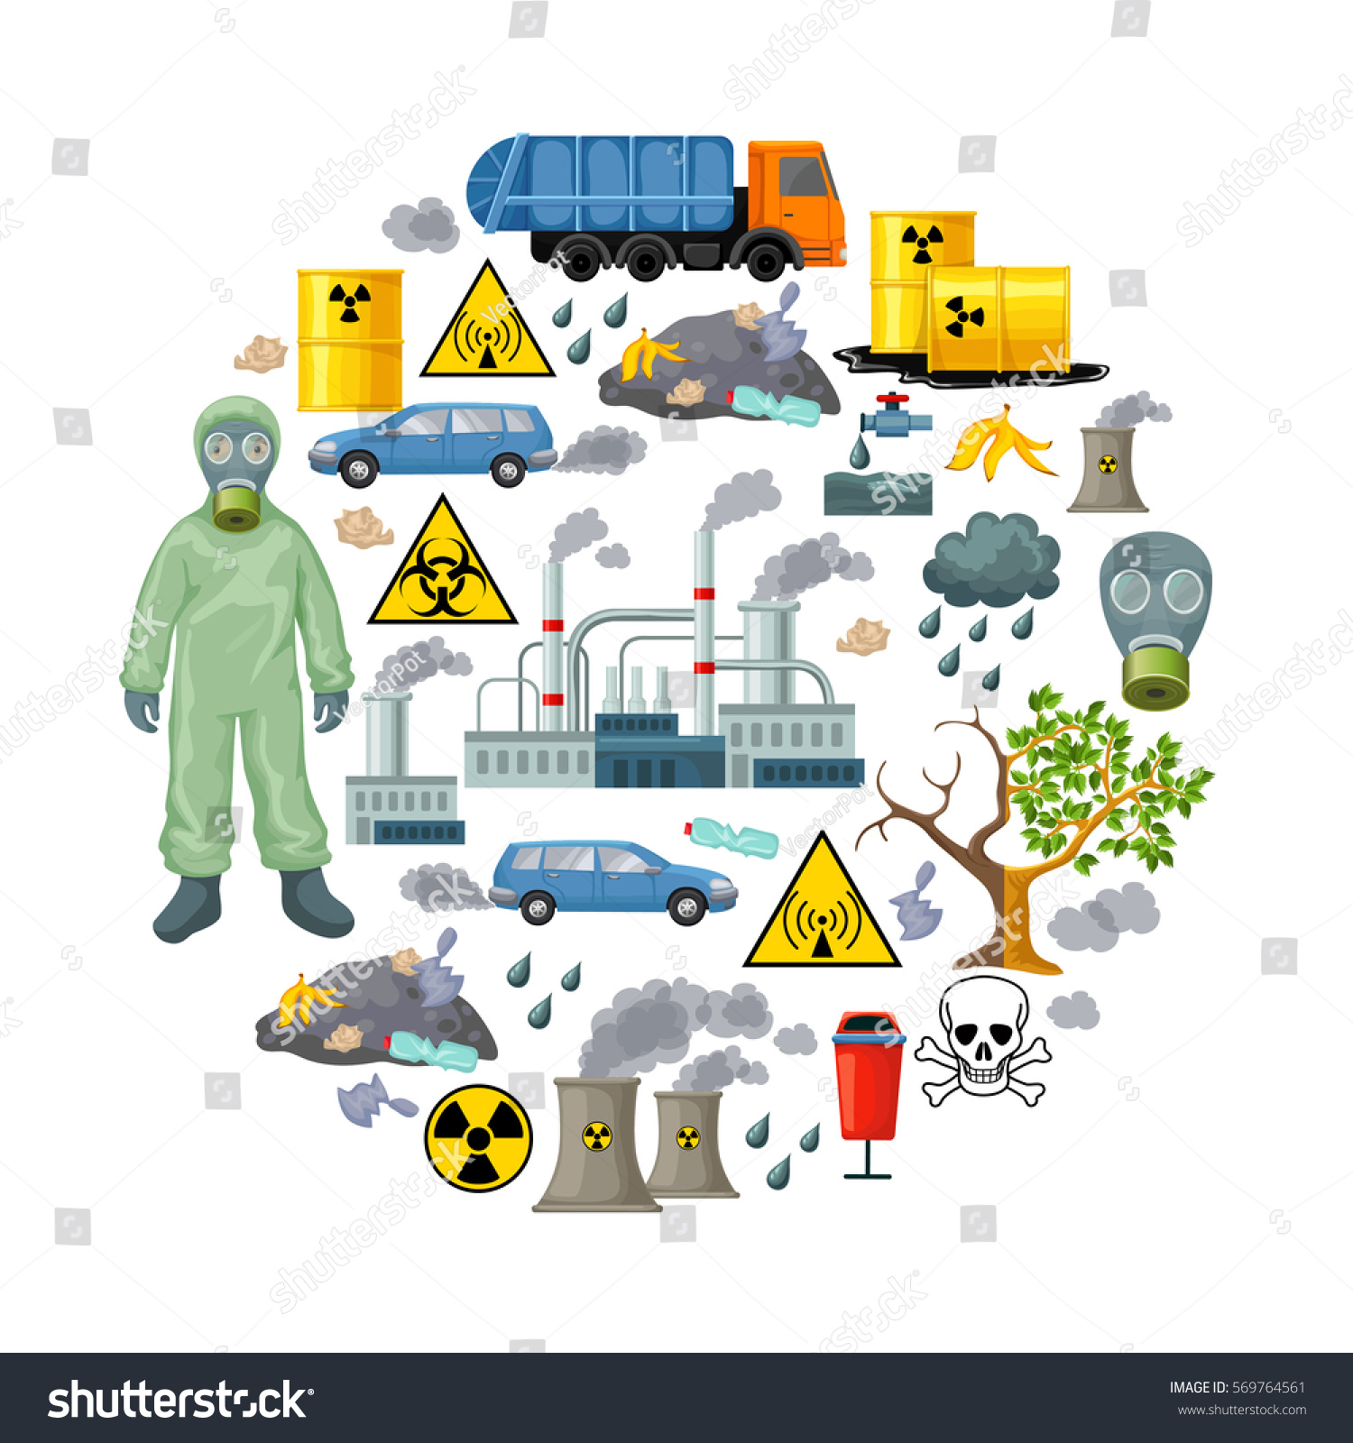
ENVIRONMENTAL POLLUTION AND HEAVY METAL POISONS

Slide 2
ENVIRONMENTAL POLLUTANT
Any substance present in the environment, which may produce abnormality in metabolism or alter the wellbeing of an organism, is called environmental pollutant.
POISON
A poison is a substance which causes death or harm if introduced in the living body or brought into contact with parts of the body.
Lethal doses (per kg body weight) of some toxic substances are : Cyanide = 1 mg/kg body weight; Morphine = 25 mg/kg; Aspirin = 500 mg/kg; Ethyl alcohol = 10 g/kg.
TOXINS
Specific proteins produced by living organisms (mushroom toxin or tetanus toxin).
Most exhibit immediate effects.

Slide 3
CORROSIVES
INTRODUCTION
Corrosive are defined as substances that causes visible discoloration, destruction, or irreversible changes in living tissue at the point of contact within four hours.
Examples are strong acids (H₂SO₄, HCl); strong alkalis (NaOH, NH₃); and salts (ZnCl₂, K₂CrO₄)).
Corrosives are immediately dangerous to the tissues they contact.
EFFECT ON LIVING TISSUE
Action on living tissue (e.g. skin, flesh and cornea) is mainly based on acid-base reactions of amide hydrolysis, ester hydrolysis and protein denaturation.
These reactions lead to chemical burns and are the mechanism of the destruction posted by corrosives.
CAUSE OF DEATH
Circulatory collapse
Spasm of glottis
Corrosives remove water from the tissues, coagulate the cellular proteins and convert hemoglobin into hematin.

Slide 4
DIAGNOSIS
Sulphuric acid can be detected from the gastric fluid by reacting with barium chloride to form white precipitate.
Common alkalies ( NH₃, KOH, NaOH) can be detected in the gastric juice by reacting with silver nitrate to form a brown precipitate.
PERSONAL PROTECTIVE EQUIPMENT
Use of personal protective equipment such as protective gloves, protective aprons, acid suits, safety goggles, a face shield, or safety shoes.
USES
Most drain cleaners contain either acids or alkalis due to their capabilities of dissolving greases and proteins inside water pipes such as limescale.
In chemical use; catalytic sulfuric acid is used in the alkylation process in an oil refinery.

Slide 5
CYANIDE POISOINING
INTRODUCTION
Cyanide is classified as a super toxic substance that can exist as a gas or solid or in solution.
SOURCES OF CYANIDE
Industrial sources
Insecticides, photographic solutions, metal polishing materials, jewellery cleaners etc.
Natural sources
Seeds of Prunus species, cherry and apricot
Environmental sources
Smoke, volcanoes, and natural biogenic processes from higher plants etc.
Notes:
Corn kernels are the fruits of maize. Maize is a grain, and the kernels are used in cooking as a vegetable or a source of starch.
Prunus : A slow growing african evergreen whose bark is used as a source of an herbal remedy for benign diseases of the prostate.

Slide 6
SIGN AND SYMPTOMS OF TOXICITY
Mild toxicity
Nausea
Dizziness
Drowsiness
2. Moderate toxicity
Loss of consciousness for a short period
Convulsion
Vomiting
Cyanosis
3. Severe toxicity
Deep coma
Dilated non-reactive pupils
Deteriorating cardio-respiratory function

Slide 7
MECHANISM OF POISONING
Cyanide in serum readily crosses all biological membranes and binds to Fe³⁺ in the heme of cytochrome a.a₃ component of the terminal step (i.e. at cytochrome oxidase step) in the electron transport chain within mitochondria.
This binding prevents oxygen from reacting with the cyt a.a₃ as the final electron acceptor.
As a result of this, mitochondrial respiration and energy production is stopped and cell death occurs rapidly from tissue hypoxia, particularly of the CNS.
DIAGNOSIS
Following micro diffusion, whole blood CN- is measured by photometric analysis or by gas chromatography.
Notes:
Antidote : a medicine taken or given to counteract a particular poison.
Chelation : is a type of bonding of ions and molecules to metal ions. It involves the formation or presence of two or more separate coordinate bonds between a polydentate (multiple bonded) ligand and a single central atom.

Slide 8
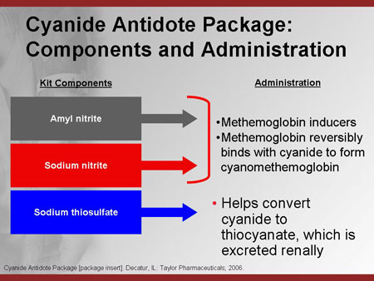
TREATMENT OF POISONING
Antidote such as Dicobalt edetate (Kelocyanor).
Another method is to give sodium nitrites and sodium thiosulfate intravenously.
But in practice, death is instantaneous and time may not be available for the treatment.

Slide 9
IRRITANTS
INTRODUCTION
Irritants are substances that may cause injuries to the skin, eyes or airways after a single exposure.
A low concentration of a corrosive substance is usually an irritant.
These injuries may range from small, initially invisible injuries after exposure to weak irritants up to chemical burns after exposure to very strong irritants (i.e. corrosive substances).
SOURCES OF IRRITANTS
Important chemical irritants are phosphorous, chlorine, bromine and iodine.
Metallic irritants are arsenic, antimony, mercury, copper, lead, zinc and silver.
Organic irritants from plants include castor, croton.

Slide 10
PHOSPHOROUS
It is a poison affecting cellular oxidation.
It exists in two forms i.e. Yellow phosphorus and Red phosphorus.
Red phos.mixed with powdered glass is used on the side of the match box.
Accidental poisoning in children may occur due to chewing of fireworks or rat poisons.
Acute poisoning; Sign/Symptoms: GIT
garlic taste in mouth, garlic smell in
breath and vomitus
luminosity of vomit and faeces is diagnostic
Skin : slow healing burns.
Symptoms resemble acute liver disease.
The poison is oxidized in the body.

Slide 11
NEUROTOXINS
Many poisons are neurotoxins.
They cause death because they stop the heart and lungs from working.
Most of them work by interfering with control of muscle contractions.
These may act at cerebral level, e.g. opium, alcohol, ether, chloroform, datura, belladona, cannabis, etc.
Those acting at spinal level are aconite, quinine and oleander.

Slide 12
HEAVY METAL POISONS
1. LEAD POISONING
SOURCES OF LEAD POISON
A. Occupational
  Lead smelters
  Painter/decorators
  Battery manufacturers
  Stain-glass workers
  Jewellery makers
  Bronze workers etc...
B. Environmental
  paint (walls, furniture, toys)
  water
  food
  air (petrol, industry), dust/soil
    e.g. curtain/fishing weight, snooker chalk
C. Other
  traditional remedies (Ayruvedic)
  surma & kohl cosmetics
  lead shot
  lead glazed ceramics
  foreign body ingestion

Slide 13
MECHANISM OF POISONING
Lead inhibits heme synthesis.
Lead particularly inhibits delta aminolevulinic acid (ALA) synthase and ALA-dehydratase.
Lead also inhibits the enzyme ferrochelatase.
Lead inhibits absorption of iron and calcium.
Diagnosis of Lead Poisoning
Blood lead is the best test (normal <100µg/l)
Other tests much less reliable
  Urine lead - variable, more useful for organic lead
  RBC Zn protoporphyrin, Urine coproporphyrin, δALA
SIGN AND SYMPTOMS OF LEAD POISONING
Lead is not biodegradable.
In blood about 10 mg/dL can be tolerated.
More than 10 mg/dL in children and more than 25 mg/dL in adults leads to toxic manifestations.

Slide 14
Miscarriage, stillbirth, and premature birth are reported in lead poisoning of mothers.
Permanent neurological sequelae, cerebral palsy and optic atrophy may be seen.
In children, mental retardation, learning disabilities, behavioral problems, hyperexcitability and seizures are seen.
Anemia, abdominal colic and loss of appetite are very common.
If the blood level is more than 70 mg/dL, acute toxicity is manifested, as encephalopathy, convulsions, mania, neuropathy, abdominal colic, severe anemia and kidney damage.
Discoloration and blue line along the gums.
TREATMENT
Calcium dodecyl edetate (calcium disodium versenate), penicillamine and dimercaprol (BAL) are used as antidotes.
Dimercaptosuccinic acid is a better but costly antidote.
Notes:
A stillbirth : is a baby born dead after 24 completed weeks of pregnancy. If the baby dies before 24 completed weeks, it's known as a miscarriage or late foetal loss.
Neurological sequelae are medical conditions associated with damaged neurons resulting from a previous disease, injury or other trauma.
Cerebral palsy is the general term for a number of neurological conditions that affect movement and co-ordination.
Optic atrophy refers to the death of the retinal ganglion cell axons that comprise theoptic nerve with the resulting picture of a pale optic nerve on funduscopy
A seizure is the physical findings or changes in behavior that occur after an episode of abnormal electrical activity in the brain. The term "seizure" is often used interchangeably with "convulsion.“
Abdominal colic is a term used to describe severe spasmodic pain in the abdomencaused by distention, obstruction or inflammation.
Encephalopathy :a disease in which the functioning of the brain is affected by some agent or condition (such as viral infection or toxins in the blood).
Convulsion : a sudden, violent, irregular movement of the body, caused by involuntary contraction of muscles and associated especially with brain disorders such as epilepsy, the presence of certain toxins or other agents in the blood, or fever in children.
Mania : mental illness marked by periods of great excitement or euphoria, delusions, and overactivity.

Slide 15
2. MERCURY POISONING
INTRODUCTION
Metallic mercury is a liquid at room temperature, its elemental symbol, Hg.
SOURCES OF MERCURY POISONING
The sources of mercury poisoning may be elemental, inorganic or organic mercury.
Elemental mercury
Inhalation of mercury vapor from broken thermometers, sphygomanometers or from dental amalgam.
In acute poisoning, pulmonary edema and encephalopathy may result.
In chronic poisoning, oral lesion (gingivitis, salivation and stomatitis), tremor and psychological changes (insomnia, shyness, emotional instability, memory loss) are the hallmark. This is called erythrism.
Inorganic mercury
Calomel (cathartic), topical medicines and in plastic industry.
Acute effects include gingivitis, gastritis, vomiting and pulmonary edema.
Chronic effects include erethism, especially the neuropsychiatric manifestations predominate.
Notes:
Dental amalgam : is a liquid mercury and metal alloy mixture used to fill cavities caused by tooth decay. Low-copper amalgam commonly consists of mercury (50%), silver (~22–32%), tin (~14%), copper (~8%) and other trace metals.
Gingivitis : inflammation of the gums.
Salivation : to have a lot of saliva produced in your mouth because you see or smell food that you want to eat.
Stomatitis, a general term for an inflamed and sore mouth, can disrupt a person's ability to eat, talk, and sleep.

Slide 16
Organic mercury
Paints, fungicides and cosmetic.
Eating fish containing methyl mercury.
The exposure of methyl mercury may produce ataxia and visual field constriction.
In severe cases, temor, hearing loss and spasticity may also be seen.
LABORATORY FINDINGS
Normal blood level of mercury is <1 mg/dL. When it is increased toxicity appear.
In chronic poisoning, urinary excretion is elevated.
Hair analysis can detect organic mercury compounds. (Normally hair contains <1 μg/g of Hg).
TREATMENT
Treatment with penicillamine will mobilize Hg, allowing for its excretion in the urine.
Therapy may be terminated after the daily urine excretion rate of Hg falls below 50 μg/L.
Notes:
Pulmonary edema is a condition caused by excess fluid in the lungs. This fluid collects in the numerous air sacs in the lungs, making it difficult to breathe.

Slide 17
ALUMINIUM TOXICITY
SOURCES OF ALUMINIUM TOXICITY
From packing and building material, paint pigments, insulating materials, cosmetic, antacids, and aluminium cooking vessels.
The tolerable upper limit of absorption is 1 mg/day.
If intake exceeds 100 mg/day, toxicity results.
MECHANISM OF TOXICITY
Aluminium stimulates production of free radicals.
It prevents absorption of calcium, phosphorous and iron.
It also interferes with heme synthesis.
TOXICITY MANIFESTATIONS
Aluminium toxicity may lead to Alzheier’s disease, Parkinson’s disease, degeneration of dendrites, microcytic hypochromic anaemia and osteomalacia.
TREATMENT
Aluminium related bone disease are treated with deferoxamine.

Slide 18
ARSENIC TOXICITY
INTRODUCTION
Arsenic is the best known of the metal toxins.
Arsenic exists in numerous toxic and non-toxic forms.
The toxic forms include (1) As³⁺ or As(III), (2) the more toxic As⁵⁺ or As(V), monomethylarsine (MMA); and (4) dimethylarsine (DMA).
SOURCES OF POISONING
Fruit sprays, pesticides, rat poisons, etc.
MECHANISM OF POISONING
Arsenic acts on sulfhydryl enzymes and interferes with cell metabolism.
It may also cause intravascular hemolysis, which leads to hemoglobinuria.

Slide 19
TOXICITY MANIFSTATIONS
The trivalent or pentavalent organic arsenic compounds are less toxic than inorganic arsenic compounds.
The symptoms are anaphylactic reactions or later development of agranulocytosis, hepatitis, jaundice and encephalitis.
TREATMENT
British antilewisite (BAL) is an effective antidote for treating.
As intoxication, the active agent in BAL is dimercaprol, a sulfhydryl-reducing agent.
Notes:
Anaphylactic reactions (anaphylaxis) are sudden, widespread, potentially severe and life-threatening allergic reactions. Anaphylactic reactions often begin with a feeling of uneasiness, followed by tingling sensations and dizziness.

Slide 20
PESTICIDES AND INSECTICIES

Slide 21
DICHLORODIPHENYLTRICHLOROETHANE (DDT)
It is a fat soluble and deposited in the adipose tissue.
It is not excreted. Thus concentration inside the body goes on increasing.
Even though DDT is banned in many countries, it is still available in many countries.
Many antifungal agents sprayed on fruits are having long-term effects on depressed spermatogenesis and fertility.

Slide 22
ORGANOPHOSPHOROUS COMPOUNDS
Organophosphorous (ORP) and organocarbamates (ORC) are the common pesticides and organosulfur compounds (dithiocarbamates) are fungicides.
Organophosphorous compounds, parathion and malathion are powerful neurotoxic agents.
They inhibit acetylcholinesterase through phosphorylation of the active center of the enzyme. Hence, acetylcholinesterase accumulates in the nerve endings.
Thus, the transfer of nerve impulses across synapses and at the nerve-muscle junction is prevented.
Diagnosis depends on the estimation of cholinesterase in serum and RBC.
The antidote is atropine sulfate and cholinesterase reactivators (diacetyl monoxime or pralidoxime).

Slide 23
AIR POLLUTANTS
INTRODUCTION
The atmosphere contains mostly nitrogen (78.09%) and oxygen (20.94%), carbon dioxide (0.03%), and water vapour.
The permissible level of total suspended particles (TSPs) is 230 mg/cu.m.
A contaminant that occurs in the atmosphere in sufficiently high concentrations to cause an adverse effect, is called a pollutant.
SOURCES OF POLLUTANTS
Natural sources of pollution
volcanic eruption, forest fires, dust storms and air borne particles.
Artificial sources of pollution
Emissions from automobiles, industry and power plants. E.g. carbon dioxide, carbon monoxide hydrocarbons, oxides of nitrogen, oxides of sulfur and lead.

Slide 24
MANIFESTATION OF POLLUTANTS
Chronic respiratory
Chronic respiratory symptoms are associated with sulfur oxide or particulates in air.
Exacerbations of bronchitis were associated with high concentrations of smoke and sulfur oxide.
Children living in polluted areas show diminished ventillatory function when compared with their counterparts living in less polluted areas.
Heart disease
Heart disease are also related to pollutants such as ozone, sulfur dioxide, sulfates and cadmium in the air.
High level of carbon monoxide decreases ability to concentrate and decreases visual threshold.
Inhalation of air borne lead can cause neurological disturbances.

Slide 25
TOXIC SUBSTANCES IN FOODSTUFFS
Toxic substances in foodstuffs may be considered under the following headings:
Toxins normally present in plants
Contamination occuring during cultivation
Products of post-harvest period
Chemical contaminants during food processing
Food adulterants
Toxins entering during or after cooking

Slide 26
Toxins normally present in plants
Protease inhibitors
Many legumes (soybean, peanut), cereals (corn) and tubers (potato) contain trypsin inhibitors.
They are destroyed by cooking but partially cooked foods may have this activity, inhibiting digestion and absorption of amino acids.
Goitrogens
They prevent iodine uptake or utilization by thyroid gland.
Thio-oxazolidone is present in cabbage, radish.
Thiocynates and isothiocynates are seen in mustard and other oil seeds.
Polyphenolic glycosides are present in the red skins of groundnut and almonds.
Antivitamins
Orange peel contains citral, which inhibits vitamin A activity.
Black berries and red cabbage contain thiaminase, which destroys vitamin B₁.
Raw eggs containing avidin can decrease available biotin.

Slide 27
iv. Cyanogenic glycosides
Cereals (sorghum), legumes (lima beans) and tubers (tapioca or cassava) contain cyanogenic compounds, which on hydrolysis produce hydrocyanic acid. Hence, they are highly toxic when taken raw.
Favism
Ingestion of uncooked broad bean (vicia fava) may cause hemolytic anemia in susceptible persons with glucose-6-phosphate dehydrogenase (GPD) deficiency.
Alkaloids
Some mushrooms contain poisonous alkaloids.
If taken in large quantities, it may produce acute necrosis of liver and death may result.
Pressor amines
They increase the blood pressure.
Histamine, tyramine, tryptamine, serotonin and epinephrine are present in good quantities in banana and cheese.

Slide 28
Contamination occuring during cultivation
This is due to pesticides and insecticides.
These toxins could be removed by repeated washing and by peeling of outer layers of vegetables and fruits.
Products of post-harvest period
Fungal infections
During post-harvest storage, contamination with fungus is very common.
Aspergillus flavus produces aflatoxins, which are hepatotoxic and carcinogenic.
Maximum permissible limit of aflatoxin contamination is 0.05 ppm.
Ergot (claviceps purpurea)
It is the fungal that usually grows in moist food grains (millet, wheat, barley).
Ergostamine, ergotoxin and ergometrin ar present in this fungus.
The disease caused by these toxins is called ergotism.
Contamination during food processing
Petroleum products are used to extract oil from seeds.
These solvent residues may remain in the extracted oil.
Mineral oil have hepatotoxic and carcinogenic properties.

Slide 29
Food adulterants
Lathyrism
It is characterized by paralysis of lower limbs.
It is seen in persons consuming large quantities of Lathyrus sativus (Khesari dal).
The toxic principle from lathyrus sativus is identified as beta oxalyl amino alanine (BOAA).
Argemone oil
Mustard oil may be adulterated with argemone oil.
Argemone oil contains the alkaloid, sanguinarine which causes vomiting, diarrhoea, congestive cardiac failure and edema.
Toxins entering during food preparation
Mono sodium glutamate (Aginomoto) is a common food additive.
It produces transient symptoms like numbbess and palpitation.
It may deteriorate mental alertness in children that is why it is unsuitable for children below the age of 5.

