Slide 1

ABORTION
School of Health and Allied Sciences
Pokhara University
2018

Slide 2
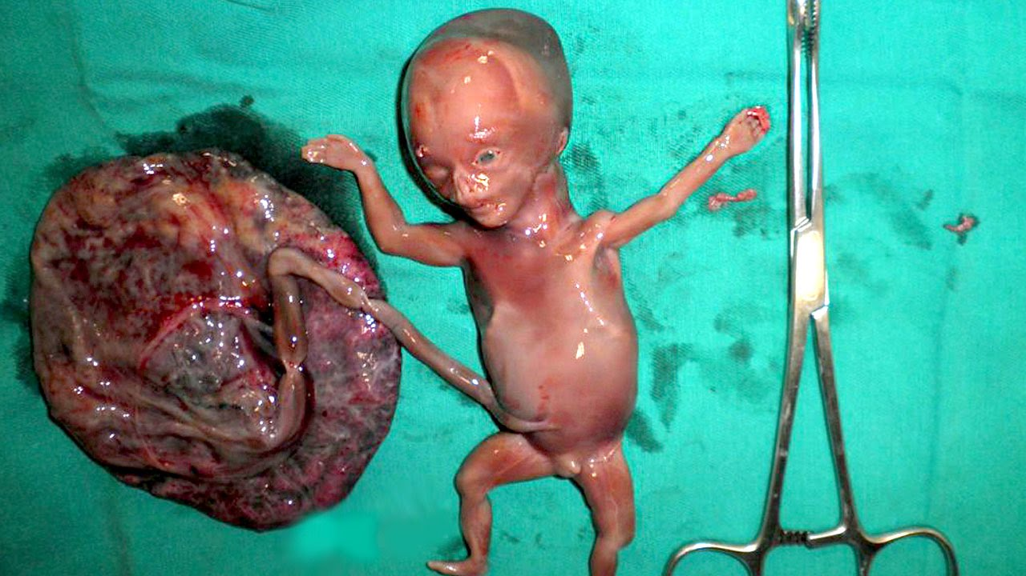
Contents
1. Overview of concept, definition and various forms of abortion and their causes
2. Health effects of unsafe abortion and its prevention
3. Overview of safe abortion law, policies and strategies in Nepal
4. Challenges of liberal abortion strategies to public health functions
5. Sex selective abortion and its impacts on demography

Slide 3
Concepts of abortion
"The spontaneous or induced termination of pregnancy before the fetus reaches a viable age."
"Expulsion from the uterus an embryo or fetus prior to the stage of viability (20 weeks' gestation or fetal weight <500g). A distinction made between [abortion] and premature birth: premature infants are those born after the stage of viability but prior to 37 weeks."
"Premature expulsion from the uterus of the products of conception, either the embryo or a nonviable fetus."
"An abortion refers to the termination of a pregnancy. It can be induced through a pharmacological or a surgical procedure, or it may be spontaneous (also called miscarriage)."

Slide 4
Definitions of abortion
Simply defining abortion, it can be defined as "The death or expulsion of the fetus either spontaneously (which is also called miscarriage) or by induction before the period of viability i.e. 22 weeks of gestation period.
Abortion can also be defined as the expulsion or extraction of all or any part of the placenta (and its related product of conception), without an identifiable fetus or with a fetus (dead or alive) weighing less than 500gm.
According to WHO, Abortion is the termination or initiation of termination of pregnancy before reaching viability (before 20 weeks or <500grams.

Slide 5
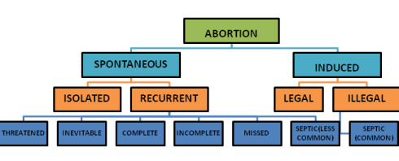
Various forms of abortion
Mostly there occurs two different forms of abortion and they are:
Spontaneous abortion
Induced abortion

Slide 6
Various forms of abortion
Spontaneous abortion:
Miscarriage, also known as spontaneous abortion and pregnancy loss, is the natural death of an embryo or fetus before it is able to survive independently. Some use the cutoff of 20 weeks of gestation, after which fetal death is known as a stillbirth.
Occurring naturally without any deliberate attempt on the part of pregnant women.

Slide 7
Various forms of abortion
Spontaneous abortion:
Types:
Threatened miscarriage
Inevitable miscarriage
Complete miscarriage
Incomplete miscarriage
Missed miscarriage
Recurrent miscarriage

Slide 8
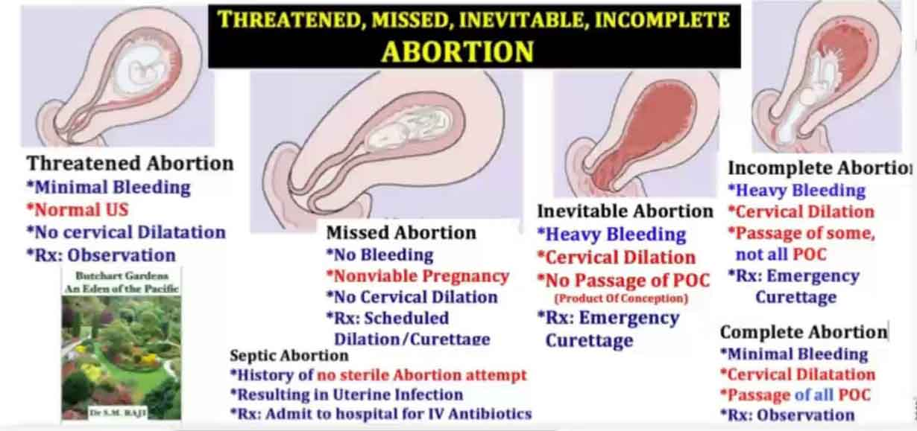
Various forms of abortion

Slide 9
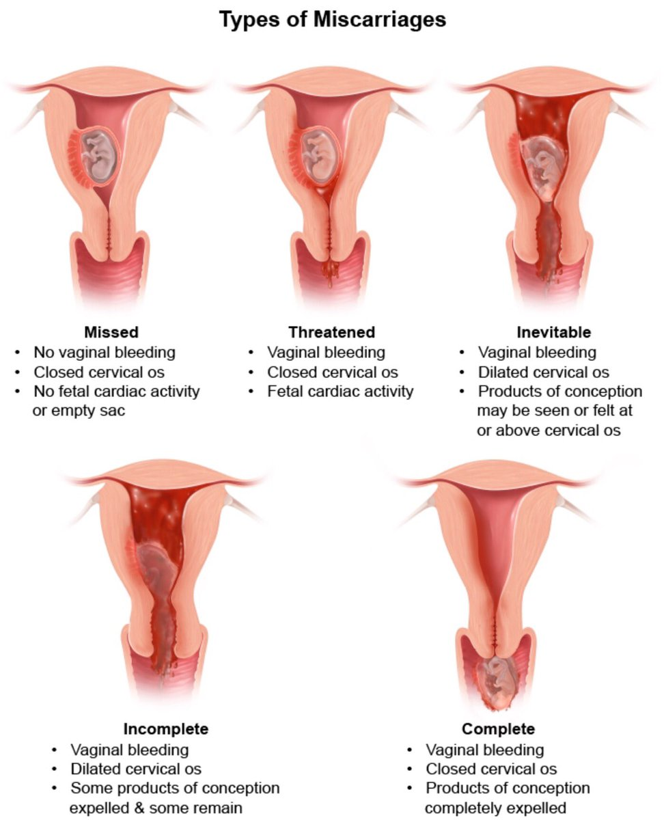
Various forms of abortion

Slide 10
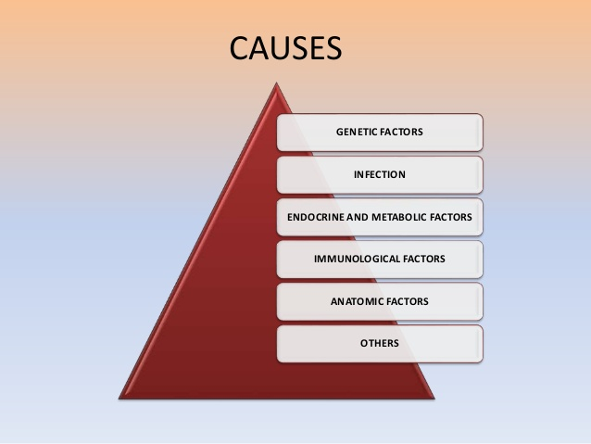
Various forms of abortion
Causes of spontaneous abortion:
Infection
Medical conditions in the mother, such as diabetes or thyroid disease
Hormone problems
Immune system responses
Physical problems in the mother
Uterine abnormalities

Slide 11
Various forms of abortion
Risk factors of spontaneous abortion:
Age. Women older than age 35 have a higher risk of miscarriage than do younger women. At age 35, you have about a 20 percent risk. At age 40, the risk is about 40 percent. And at age 45, it's about 80 percent.
Previous miscarriages. Women who have had two or more consecutive miscarriages are at higher risk of miscarriage.
Chronic conditions. Women who have a chronic condition, such as uncontrolled diabetes, have a higher risk of miscarriage.
Uterine or cervical problems. Certain uterine abnormalities or weak cervical tissues (incompetent cervix) might increase the risk of miscarriage.
Smoking, alcohol and illicit drugs. Women who smoke during pregnancy have a greater risk of miscarriage than do nonsmokers. Heavy alcohol use and illicit drug use also increase the risk of miscarriage.
Weight. Being underweight or being overweight has been linked with an increased risk of miscarriage.

Slide 12
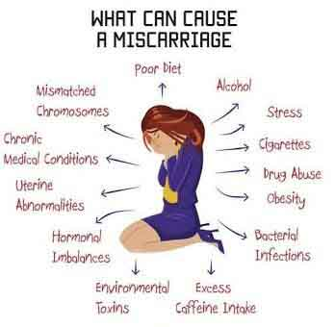
Various forms of abortion

Slide 13
Various forms of abortion
Induced abortion:
When a procedure is done or medication is taken to end a pregnancy, it is called an induced abortion.
A self-induced abortion (or self-induced miscarriage) is an abortion performed by the pregnant woman herself or with the help of other, non-medical assistance. Although the term includes abortions induced with legal over-the-counter medication.
It also refers to efforts to terminate a pregnancy through alternative, sometimes more dangerous means. Such practices may present a threat to the health of women. If the abortion does not result in termination of the pregnancy, damage to the fetus can occur.
It means to abort the fetus through artificial means. It can be for therapeutic purpose and criminal purpose.

Slide 14
Various forms of abortion
Induced abortion:
Types:
Therapeutic Abortion: It is a legal termination of pregnancy by a qualified medical practitioner in the interest of the mother when her life is in danger situation.
Criminal Abortion: It is an illegal termination of pregnancy which is done by unauthorized and unqualified persons who have little knowledge of asepsis.
Septic Abortion: It is associated with incomplete abortion which is particularly criminally induced type.
Complete Abortion: In this form of abortion, the products of conception are expelled completely from the uterus and the uterine cavity is empty.
Incomplete Abortion: In incomplete abortion, fetus has been expelled out but whole or the part of placenta and membranes have been retained in uterus.

Slide 15
Various forms of abortion
Causes of induced abortion:
To stop child bearing
To postpone childbearing
Socioeconomic conditions
Relationship problems
Age
Health status
Coercion

Slide 16
Unsafe abortion
An unsafe abortion refers to an unhygienic or unhealthy abortion, performed by an unskilled or untrained birth attendant and involving inappropriate methods.
According to World Health Organization (WHO) (2011), “An unsafe abortion is a procedure for terminating an unintended pregnancy either by persons lacking the necessary skills or in an environment lacking the minimal medical standards, or both.”

Slide 17
Health effects of unsafe abortion
incomplete abortion (failure to remove or expel all of the pregnancy tissue from the uterus)
haemorrhage (heavy bleeding)
infection
uterine perforation (caused when the uterus is pierced by a sharp object)
damage to the genital tract and internal organs by inserting dangerous objects such as sticks, knitting needles, or broken glass into the vagina or anus.

Slide 18
Health effects of unsafe abortion
Acute Complications
• Incomplete abortion
• Sepsis
• Hemorrhage
• Uterine Perforation
• Bowel injury
Long-term Complications
• Chronic pelvic pain
• Pelvic inflammatory disease
• Tubal blockage and secondary infertility
• Increased risk of spontaneous abortion or premature delivery in subsequent pregnancies.

Slide 19
Health effects of unsafe abortion
Treatment and care
Hemorrhage: timely treatment of heavy blood loss is critical, as delays can be fatal.
Infection: treatment with antibiotics along with evacuation of any remaining pregnancy tissue from the uterus as soon as possible.
Injury to the genital tract and/or internal organs: if this is suspected, early referral to an appropriate level of health care is essential.

Slide 20
Prevention of unsafe abortion
Government: The government should introduce strict laws to prohibit unsafe abortions, and anyone disobeying these rules should be duly punished. The government should also provide basic facilities of transport, medical healthcare and fully trained SBAs.
Community: At a community level, awareness sessions should be conducted and unskilled workers should be trained.
Individual: At individual level, nurses and midwives should provide pamphlets and flyers to youth and married couples regarding preventive measures. They can educate young girls about unsafe practices, their prevention and safety precautions, and encourage them to further educate the community about unsafe abortions. In addition, it is our responsibility to enable uneducated people to seek the help of NGOs and demand the government to provide for their needs, and also to make people aware of healthy practices.
An unsafe abortion can be prevented by providing sexual awareness and education, access to safe and legal abortion, and use of contraceptives and other family-planning methods (WHO, 2014)

Slide 21
Prevention of unsafe abortion
We can prevent unsafe abortion by following:
Ensure universal access to family planning
Increase the availability of safe abortion services to the extent allowed by law
Improve the quality and accessibility of post abortion care
Educate communities about reproductive health and unsafe abortion; and
Work for changes in policies to safeguard women’s reproductive health.

Slide 22
Overview of safe abortion law, policies and strategies in Nepal
Period before 2002, Muluki Ain of Nepal did not permit the termination of pregnancies.
During those days, abortion was taken as infanticide and consider equal with other kinds of murder or homicide also
Slowly effort to liberalize the abortion law began in the 1970s by organizing high-level conference in 1974 by FPAN.
Considering these, during 1980s and 1990s, different studies were conducted to identify the status of induced abortion, existing practices and its consequences on women’s health due to those. Studies found that induced abortions were highly prevalent in urban and rural areas which were mostly unsafe. So, issues were raised to legalize the abortion in country.
Similarly, after the ICPD1994 and Beijing conference 1995, availability of and access to safe abortion services increasingly begin to be understood in the context of women’s right. As a result of which, different major events were occurred to legalize the abortion from1996 to 2002 in country.
Finally, on 6th September 2002, abortions become legalized in Nepal with the formulation of National Safe Abortion Policy.

Slide 23
Overview of safe abortion law, policies and strategies in Nepal
Before 2002, Nepal's 1963 legal code known as the Muluki Ain, prohibited abortion and characterized abortion as an offence against life, making no exception even when pregnancy threatened a women’s life. The reproductive rights impetus of ICPD galvanized the women’s health advocates and others to reform abortion laws in Nepal.
The 2002 reform permits abortion:
(a) On request up to 12 weeks of pregnancy;
(b) Up to 18 weeks if the pregnancy is the result of rape or incest; and
(c) At any time during the pregnancy if the life, physical or mental health of the woman is at risk or if the fetus is deformed.

Slide 24
Overview of safe abortion law, policies and strategies in Nepal
The law does not require consent from anybody, including husband or partner, except the adult woman to ensure that she is not forced or deceived into having an abortion against her will or choice.
Young women under 16 years require consent of the guardian or a near relative.
Sex-selective abortion is illegal.
Soon after the law was passed, a Task Force was established to develop and implement plans for the provision of safe abortion services.
Providers (doctors and midwives) were trained and facilities were upgraded and both providers and facilities were accredited for the provision of safe abortion. Medical abortion was introduced and expanded to 75 districts.

Slide 25
Challenges of liberal abortion strategies to public health functions
“Unsafe abortion continues to be a major public health problem in many countries. A woman dies every eighth minute somewhere in a developing country due to complications arising from unsafe abortion. She was likely to have had little or no money to procure safe services, was young - perhaps in her teens - living in rural areas and had little social support to deal with her unplanned pregnancy. She might have been raped or she might have experienced an accidental pregnancy due to the failure of the contraceptive method she was using or the incorrect or inconsistent way she used it. She probably first attempted to self-induce the termination and after that failed, she turned to an unskilled, but relatively inexpensive, provider. This is a real life story of so many women in developing countries in spite of the major advancements in technologies and in public health.”

Slide 26
Challenges of liberal abortion strategies to public health functions
Issues and controversies associated with legal abortions
Physical and Medical issue,
Psychological issue,
Social and Realistic Issues, and
Moral issue
Challenges for treatment of abortion-related complications:
This often require several days of hospitalization and staff time, as well as
Also needs more blood transfusions, antibiotics, pain control medications and other drugs.

Slide 27
Challenges of liberal abortion strategies to public health functions
View in favor of abortion legalization
–Women should have the right to control their own bodies.
–No child should be brought into the world unwanted.
–Legal abortion should be conducted in authorized medical settings in which considerable care is taken to avoid harming the mother physically or psychologically.
–Women must have the option of a safe, legal abortion if they desire.
View against abortion legalization
–Fetus is a living being and therefore its right to life must be respected.
–No one has the moral right to take that life.
–Because the fetus is unable to defend itself, opponents of abortion believe that others are obligated to defend the fetus against the efforts of those who want to "kill it".

Slide 28
Sex selective abortion and its impacts on demography
Sex-selective abortion is the practice of terminating a pregnancy based upon the predicted sex of the infant. The selective abortion of female fetuses is most common where male children are valued over female children, especially in parts of East Asia and South Asia (particularly in countries such as People's Republic of China, India and Pakistan), as well as in Nepal also.
Sex-selective abortion affects the human sex ratio—the relative number of males to females in a given age group, with China and India, the two most populous countries of the world, having unbalanced gender ratios.
Many scholars have noted the difficulty in reconciling the discriminatory nature of sex-selective abortion with the right of women to have control over their own bodies.

Slide 29
Sex selective abortion and its impacts on demography
There is concern that bans in sex selective abortion may put women who seek sex-selective abortions in danger because they may seek unsafe abortions, and that these bans do not address the root cause of sex-selective abortion, including the pregnant women's fear that they or their future daughters will suffer abuse, violence and stigmatization.
Parents’ preference for sons is common in countries in East Asia through South Asia, to the Middle East and North Africa. Sons are preferred because they have a higher wage-earning capacity (especially in agrarian economies), they continue the family line and they usually take responsibility for care of parents in illness and old age. There are also specific local reasons for son preference: in Nepal and India, the expense of the dowry; and in South Korea and China, deep-rooted Confucian values and patriarchal family systems.

Slide 30
Sex selective abortion and its impacts on demography
It is also thought that large numbers of excess men will lead to an expansion of the sex industry.
The recent rise in numbers of sex workers in China has been attributed more to increased socioeconomic inequality, greater mobility and a relaxation in sexual attitudes than an increase in the sex ratio.
There may also be positive aspects of this easy access to sex selection. First, access to prenatal sex determination probably results in an increase in the proportion of wanted births, leading to less discrimination against girls and lower female mortality.

Slide 31
Sex selective abortion and its impacts on demography
As numbers of women in society fall, they become more highly valued and their social status increases. Not only will this benefit the women’s self-esteem, mental health and well-being, but the improved status of women should result in reduced son preference, with fewer sex-selective abortions and an ultimate rebalancing of the sex ratio.

Slide 32
Possible questions regarding abortion
Is abortion a public health issue?
"Define abortion. Describe different forms of abortion with their major causes?"
"Define unsafe abortion. What are the complications or side effect of unsafe abortion?"
"Considering abortion as public health issues what preventive measures do you suggest for prevention of unsafe abortion in Nepal?" Justify your answers with relevant example in Nepalese context.
"What are the legal issues regarding abortion in Nepal?
Discuss about challenges of liberal abortion strategies to public health functions with examples.
Give short overview on sex selective abortion and its impacts on demography.

Slide 33


Slide 34
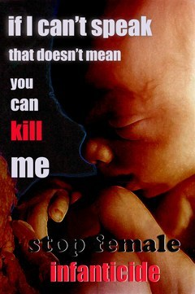

Slide 35


Slide 36


Slide 37


