Slide 1
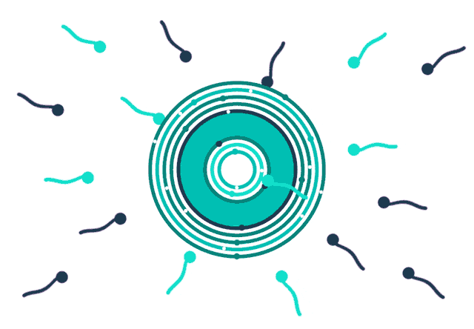
INFERTILITY
School of Health and Allied Sciences
Pokhara Universit

Slide 2
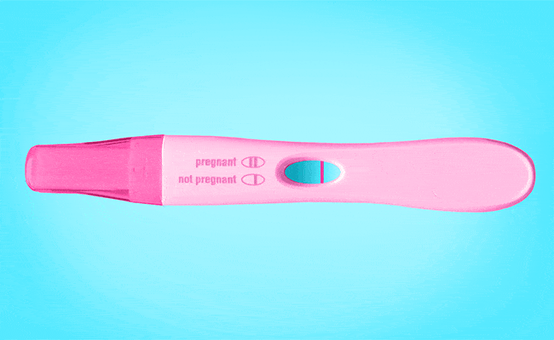
Contents
Introduction
Causes of infertility
Social consequences of infertility

Slide 3


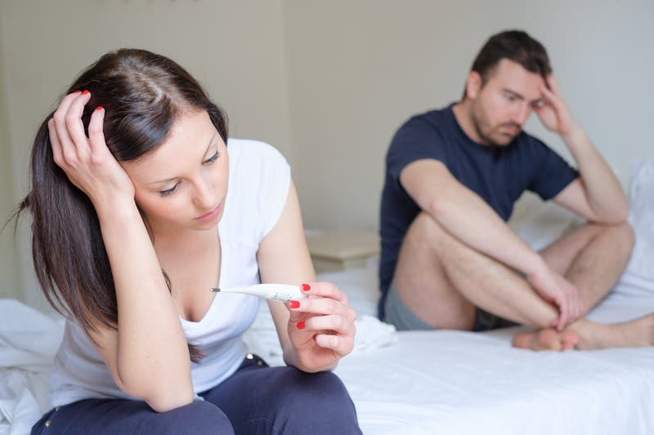

INTRODUCTION
Infertility is “a disease of the reproductive system defined by the failure to achieve a clinical pregnancy after 12 months or more of regular unprotected sexual intercourse.”- WHO
Infertility happens when a couple cannot conceive after having regular unprotected sex.
It may be that one partner cannot contribute to conception, or that a woman is unable to carry a pregnancy to full term. It is often defined as not conceiving after 12 months of regular sexual intercourse without the use of birth control.

Slide 4
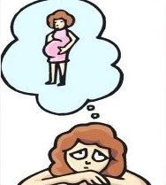
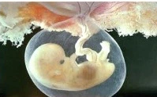
INTRODUCTION
Primary infertility and secondary infertility
Primary infertility is defined as the absence of a live birth for women who desire a child and have been in a union for at least 12 months, during which they have not used any contraceptives. The World Health Organization also adds that 'women whose pregnancy spontaneously miscarries, or whose pregnancy results in a still born child, without ever having had a live birth would present with primarily infertility'.
Secondary infertility is defined as the absence of a live birth for women who desire a child and have been in a union for at least 12 months since their last live birth, during which they did not use any contraceptives.

Slide 5


Causes of infertility
Causes of female infertility
Defective Ovulation
Endocrine disorders
Physical disorders
Ovarian disorders
Endometriosis
Defective Transport
Ovum
Scar tissue after abdominal surgery
Sperm
Cervix
Defective Implantation
Congenital anomaly and fibroids
Causes of male infertility
Defective Spermatogenesis
Defective Transport
Ineffective Delivery

Slide 6
Causes of female infertility
Defective Ovulation
Endocrine disorders: The dysfunction of hypothalamus and pituitary gland can lead to an excess amount of prolactin, this may prevent ovulation. Moreover, other endocrine glands including adrenals and thyroid may also delay ovulation. When the corpus luteum, fails to produce enough progesterone required to thicken the uterine lining, the fertilized egg may not be able to implant, thus leading to infertility.
Physical disorders: Certain physical disorders such as obesity, anorexia nervosa, and excessive exercise may lead to overweight or malnutrition, and later the menstrual cycle, thus make the couple infertile.
Ovarian disorders: Polycystic ovarian disease (PCO) can lead to infertility because of an increased amount of testosterone and LH and decrease uptake of glucose by muscle, fat and liver cells resulting in the production of large amounts of insulin by the pancreas. Low FSH levels also hinder the production of eggs from the ovarian follicles, and lead to form fluid-filled ovarian cysts that eventually cover the whole ovaries and prevent conception.
Endometriosis: This refers to a condition in which sections of the uterine lining implant in the vagina, ovaries, fallopian tubes or pelvis. These implants form fluid- filled cysts that grow with each menstrual cycle, and eventually turn into blisters and scars. These scars then block the passage of the egg and delay pregnancy.

Slide 7
Causes of female infertility
Defective Transport
Ovum: Occurrence of Pelvic Inflammatory Disease (PID), gonorrhea, peritonitis, previous tubal surgery, and fimbrial adhesions can cause tubal obstruction; as a result the egg is not released or trapped, therefore, delaying conception.
Scar tissue after abdominal surgery: After abdominal surgeries, presence of scar tissue may alter the movement of the ovaries, fallopian tubes, and uterus, resulting in infertility.
Sperm: Presence of psychosexual problem such as vaginismus, or dyspareunia may hinder fertilization and make the couple infertile.
Cervix: Trauma, surgery, infection, anti-sperm antibodies in the cervical mucus may also delay pregnancy.

Slide 8
Causes of female infertility
Defective Implantation
Defective implantation can occur because of the following causes:
Congenital anomaly and fibroids: Congenital uterine anomaly such as bicornuate uterus and uterine fibroids near the fallopian tubes or cervix may alter implantation of the zygote and cause infertility.

Slide 9
Causes of male infertility
Defective Spermatogenesis: Presence of endocrine disorders such as diabetes mellitus and hyperthyroidism lead to azospermia or the formation of faulty sperms that are not capable to fertilize the ovum. Moreover, testicular disorder such as undescended testis can also affect fertility.
Defective Transport: Obstruction of the seminal vesicles or absence of the seminal ducts may affect the mobility of the sperms, and thus end up in infertility.
Ineffective Delivery: The psychosexual problems like impotence, ejaculatory dysfunction, physical disability, hypospadias, and epispadias can affect fertility of males.

Slide 10
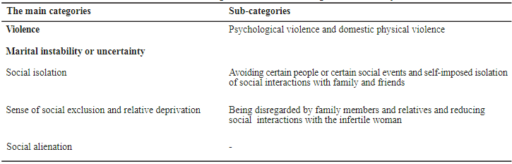
Social consequences of infertility

Slide 11
Social consequences of infertility
Violence
This category includes two sub-categories: psychological violence and domestic physical violence.
The first sub-category, the psychological violence, is usually experienced as the form of stigma.
Stigmatized individuals possess some attribute, or characteristic, that conveys a social identity that is devalued in a particular social context.
Hence, the stigmatized people experience discrimination and loss of status. When people are labeled, set apart, and linked to undesirable characteristics, a rationale is constructed for devaluing, rejecting, excluding and de-authorizing them.
Most infertile people who had experienced stigma felt the loss of dignity and social status by the spouse, significant others, family members and community. They reported experiences of blaming and inattention by others and sense of humiliation for being infertile.

Slide 12

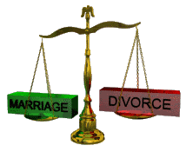

Social consequences of infertility
Marital instability or uncertainty
According to the infertile women, there are some factors contributing to the possibility of divorce among the infertile couples.
These influencing factors are as follows: "the high social pressure for remarriage of husband by the relatives and/ or people around", "husband’s decision to remarry", "repeated treatment related infertility", and "lack of proper understanding by husbands of the social and psychological pressures experienced by their wives.“

Slide 13

Social consequences of infertility
Social isolation
This category also consists of two sub-categories: avoiding certain people or certain social events and self-imposed isolation from social interactions with family and friends.
Majority of infertile women or men chose to avoid dealing with socio-psychological stress of infertility.
This means that they preferred to employ a maladaptive coping mechanism, characterized by the continuous effort to protect them from social and psychological harm.

Slide 14


Social consequences of infertility
Feeling of social exclusion and relative deprivation
This category includes two sub-categories: being disregarded by family members and relatives and reducing social interactions with the infertile woman.
In some conditions, such as the arrival of new baby to family or presence of a newly pregnant woman at family gatherings, were ignored by family or relatives.
Another factor that creates a feeling of relative deprivation and social exclusion for the infertile women is reducing social interactions with the infertile woman by the family members and the friends. The relatives and friends, especially those with children, preferred to socialize with families who had children

Slide 15
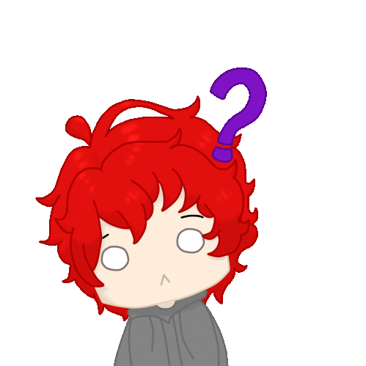
Social consequences of infertility
The social alienation
(Distancing, isolation, unfriendliness)
Alienation is the process whereby individuals become estranged from the society and elements of culture, which then confront them as an independent, objectified force.
In this view, the infertile women or men experiencing alienation suffer from confusion in navigating their social behavior and in adapting certain social norms.
This type of social alienation can be characterized by confusion or uncertain behavior in dealing with children and pregnant women and in joining in social or certain religious ceremonies.

Slide 16
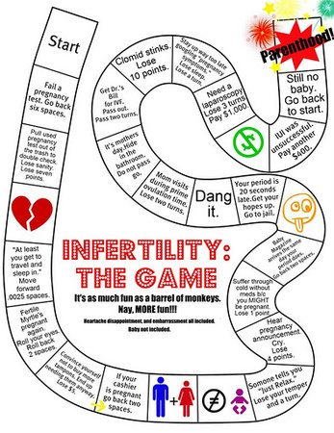

Slide 17
THANK YOU!!!
PRABIN SHARMA
Masters of Public Health
(Public Health Service Management)
Pokhara University, 2017
Contact: +977-9843229635
Email: Prabinsharma9635@gmail.com

