Slide 1
Public Health Problems in Nepal:
Vaccine preventable diseases

Slide 2
Let's start by defining several basic terms:
Immunity: Protection from an infectious disease. If you are immune to a disease, you can be exposed to it without becoming infected.
Vaccine: A product that stimulates a person’s immune system to produce immunity to a specific disease, protecting the person from that disease. Vaccines are usually administered through needle injections, but can also be administered by mouth or sprayed into the nose. The vaccine is capable of stimulating immune response by the host, who is thus rendered resistant to infection.
Vaccination: The act of introducing a vaccine into the body to produce immunity to a specific disease.
Immunization: A process by which a person becomes protected against a disease through vaccination. This term is often used interchangeably with vaccination or inoculation.

Slide 3
Types of Vaccines
Live, attenuated vaccines
Inactivated vaccines
Subunit vaccines
Toxoid vaccines
Conjugate vaccines
DNA vaccines
Recombinant vector vaccines

Slide 4
LIVE, ATTENUATED VACCINES:
contain a version of the living microbe that has been weakened in the lab so it can’t cause disease.
Live, attenuated vaccines are relatively easy to create for certain viruses. Vaccines against measles, mumps, and chickenpox, for example, are made by this method.
Viruses are simple microbes containing a small number of genes, and scientists can therefore more readily control their characteristics. Live, attenuated vaccines are more difficult to create for bacteria. Bacteria have thousands of genes and thus are much harder to control
Fragile – must be stored and handled carefully
INACTIVATED VACCINES(killed antigens)
Inactivated vaccines are not alive and cannot replicate. These vaccines are produced by growing the bacteria or virus in culture media, then inactivating it with heat and/or chemicals (usually formalin).
The entire dose of antigen is administered in the injection. are made from a protein or other small pieces taken from a virus or bacteria. The flu vaccine is an example.

Slide 5
SUBUNIT VACCINES(purified antigens): Instead of the entire microbe, subunit vaccines include only the antigens that best stimulate the immune system.
TOXOID VACCINES(inactivated toxins) :Scentists have found that they can inactivate toxins by treating them with formalin, a solution of formaldehyde and sterilized water. Such “detoxified” toxins, called toxoids, are safe for use in vaccines.
When the immune system receives a vaccine containing a harmless toxoid, it learns how to fight off the natural toxin. The immune system produces antibodies that lock onto and block the toxin. Vaccines against diphtheria and tetanus are examples of toxoid vaccines.
Notes:
scientists do that, however, they can make subunit vaccines in one of two ways:
They can grow the microbe in the laboratory and then use chemicals to break it apart and gather the important antigens.
They can manufacture the antigen molecules from the microbe using recombinant DNA technology. Vaccines produced this way are called “recombinant subunit vaccines.”

Slide 6
CONJUGATE VACCINES
If a bacterium possesses an outer coating of sugar molecules called polysaccharides, as many harmful bacteria do, researchers may try making a conjugate vaccine for it. When making a conjugate vaccine, scientists link antigens or toxoids from a microbe that an infant’s immune system can recognize to the polysaccharides. The linkage helps the immature immune system react to polysaccharide coatings and defend against the disease-causing bacterium.
The vaccine that protects against Haemophilus influenzae type B (Hib) is a conjugate vaccine.
DNA VACCINES
Once the genes from a microbe have been analyzed, scientists could attempt to create a DNA vaccine against it. these vaccines can be administered with a needle and syringe or with a needle-less devic

Slide 7
Vaccine Preventable Diseases
_{Any} diseases that is prevented by administering the vaccine either injectable or oral route.

Slide 8
List of Vaccine-Preventable Diseases
Anthrax Human papilloma virus Cervical cancer (Human papilloma virus) Diphtheria Hepatitis A Hepatitis B Haemophilus influenza type b (Hib) Influenza Japanese Encephalitis Lyme Disease Measles Pneumococcal pneumonia Poliomyelitis | Rabies Rotavirus Rubella (German measles) Shingles (Herpes zoster) Smallpox Tetanus Tuberculosis Typhoid fever Varicella (chickenpox) Yellow fever

Slide 9
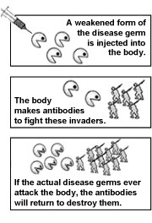
How Do Vaccines Prevent Disease?
Vaccines protect you by preparing your immune system to recognize and fight serious, and sometimes deadly, diseases.
Vaccines contain the same antigens (or parts of antigens) that cause diseases. For example, measles vaccine contains measles virus. But the antigens in vaccines are either killed, or weakened to the point that they don’t cause disease. However, they are strong enough to make the immune system produce antibodies that lead to immunity

Slide 10
VPDs in Nepal

Slide 11
Burden of VPDs in Nepal
In Nepal according to WHO Vaccine preventable diseases monitoring system, 2015 ; number of reported cases of different VPDs are shown in the table below;
Number of reported cases | Year
 | 2014 | 2013 | 2012
Diptheria | 1079 | 103 | 138
JE | 1304 | 118 | 75
Measles | 1279 | 1861 | 3'362
Mumps | 34034 | 29134 | 35'874
Pertusis | 6096 | 3431 | 1'595
Polio (includes indigenous, imported, polio cases caused by vaccine derived polio viruses; excludes vaccine associated paralytic polio, non polio acute flaccid paralysis) | 0 | 0 | 0
Rubella | 704 | 755 | 801
Tetatus (total) | 883 | 377 | 359
Tetanus (neonatal) | 57 | 87 | 32

Slide 12
Prevention of VPDs
Immunization is the key
Immunization prevents illness, disability and death from vaccine-preventable diseases including diphtheria, measles, pertussis, pneumonia, polio, rotavirus diarrhoea, rubella and tetanus.
Immunization currently averts an estimated 2 to 3 million deaths every year.
But an estimated 22.6 million infants worldwide are still missing out on basic vaccines.

Slide 13
National Immunization Program (NIP) in Nepal
P1 program of GoN, runs under Child Health Division .
The accessibility of immunization has reached to the 97%
population and serves equally, successfully to the poor and rich, also does not discriminate child's sex. Currently ten antigens (IPV added in RI in 2014, thus totaling 11) provided through the routine immunization. The contribution of immunization in achieving the MDG 4 goal is immense.
GOAL: To reduce child mortality, morbidity and disability associated with vaccine-preventable diseases.

Slide 14
Nepal has achieved polio free status in 27th March 2014, sustained maternal and neonatal tetanus elimination since 2005, and Japanese encephalitis is in control status and conducting measles case based surveillance to meet the target of elimination by 2019.
The national coverage of BCG is the highest of all antigens indicates that almost 99% mother have access in immunization services, while DPT‐HepB‐Hib and OPV‐ 3 coverage are more than 91%.
Themeasles/rubella vaccine coverage is 88% and Td2+ coverage (Td2 and Td2+) coverage is 75%. The JE
coverage (31 districts) is 75%.

Slide 15
The objectives of NIP are to:
  Achieve and maintain at least 90% vaccination coverage for all antigens at national and district level by 2016
  Ensure access to vaccines of assured quality and with appropriate waste management
  Achieve and maintain polio free status
  Maintain maternal and neonatal tetanus elimination status
  Achieve measles elimination status by 2016
  Accelerate control of vaccine‐preventable diseases through introduction of new and underused vaccines
  Strengthen and expand VPD surveillance
  Continue to expand immunization beyond infancy

Slide 16
TARGET POPULATION
1. Under 1 years of age for BCG, DPT-HepB-Hib, OPV, and Measles/ Rubella vaccine.
2 .12-23 months children for JE vaccine.
3.2 Pregnant women for Tetanus Toxoid containing (Td) vaccine

Slide 17
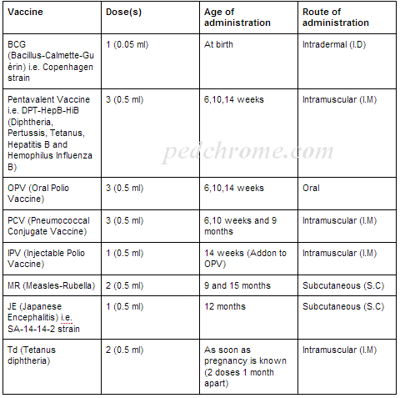
Immunization schedule of Nepal

Slide 18
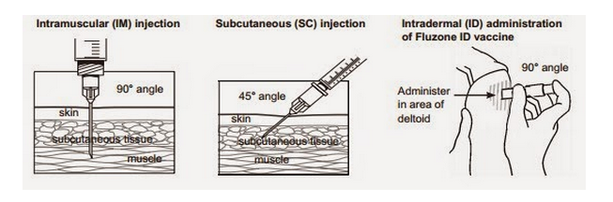

Slide 19
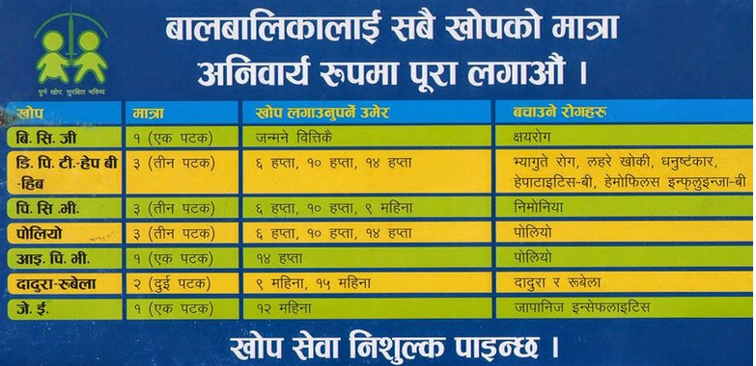
NIP…Schedule

Slide 20
Diseases having goals for eradication or elimination globally and in Nepal
Poliomyelitis eradication: Nepal is polio free since August 2010 but officially SEAR (South East Asian Region) member countries were declared polio free in 2014 after 3 years sustenance of polio free in all member countries.
Measles elimination: Achieve measles incidence of less than one confirmed case per million population per year by 2016 in Nepal (Measles incidence rate was 0.26/1,000,000 in FY 2070/71)
Maternal and neonatal tetanus elimination: Nepal achieved Maternal and Neonatal Tetanus elimination status in 2005. Since then Nepal has sustained MNT elimination status

Slide 21
Brief overview on Common VPDs in Nepal

Slide 22
Diphtheria
Infection of the throat causes severe breathing difficulty which may result in asphyxia.
An acute infectious disease caused by Corynebacterium diphtheriae and characterized by in its typical form by the presence of pseudomembrane in the tonsils.

Slide 23
Diphtheria
Occurrence: World wide but now largely controlled in developed countries.
Organism: Corynebacterium diphtheriae
Reservoir (Source) : Man, case and carrier.
Mode of transmission: Airborne, contact , contaminated milk.
Major Site of involvement: tonsils, pharynx, larynx,

Slide 24
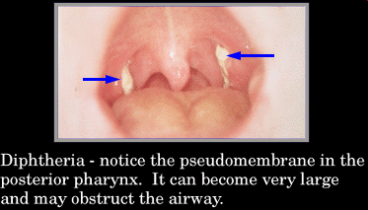
Sign and symptoms: Initial symptoms are mild and includes malaise, headache and loss of appetite,vomiting, sore throat, anorexia, difficulty in swallowing and low-grade fever, Within 2-3 days, small patches of white pseudomembrane on the tonsils are found which later becomes large, thick and greyish (which may result in respiratory obstruction)
If larynx is affected, hoarseness and barking cough may occur .Neck swelling leading to bull neck appearance
Control: Active immunization
Notes:
Malaise:a general feeling of discomfort, illness, or unease whose exact cause is difficult to identify.

Slide 25
Haemophilus influenza type b
Caused by bacteria H. influenzae type b
An important cause of meningitis in young children, and is frequently associated with severe neurological sequelae, even if antibiotics are given promptly.
H. influenzae is also a major cause of pneumonia in children. Other important, but less frequent, manifestations of H. influenzae disease include epiglottitis, osteomyelitis, septic arthritis in young children and septicaemia.

Slide 26
Tuberculosis
TB is a chronic infectious and communicable disease caused by Mycobacterium tuberculosis, which primarily affects lungs and causes pulmonary tuberculosis.
Occurrence: World wide
Organism: Mycobacterium tuberculosis
Reservoir (Source) : Man, cattle.
Mode of transmission: Airborne- droplet, and dust, Milk.

Slide 27
Tuberculosis
Sign and symptoms (pulmonary TB): chest pain fatigue, malaise, breathlessness, weight loss, loss of appetite and a low-grade fever, cough, sputum with blood
Control:
- General improvement in housing, nutrition and personal hygiene.
- Active immunization with BCG
- Case finding and treatment

Slide 28
Whooping Cough (Pertusis) (Lahare khoki in Nepali)
From Latin: Per- intensive and tussic- cough
It is an acute infectious, usually of young children, caused by Bordetella pertusis.
Sign and symptom: begins with minor respiratory symptoms (mild fever, sneezing, and an irritating cough) and, gradually becoming violent with the characteristic “whoop”. The spectrum of disease varies from severe illness to atypical and mild illness without whoop. The Chinese call it “hundred day cough”.

Slide 29
Whooping Cough
Occurrence:- Still worldwide, mainly tropical countries Organism:- Bordetella pertusis-
B. parapertusis causes - only <5%
Mode of transmission: Droplet infection
Direct contact
Control:
- Case- Early diagnosis, isolation and treatment
- Contact- Avoid contact
- Active immunization- DPT

Slide 30
Tetanus
Tetanus is an acute, often fatal disease caused by an exotoxin produced by Clostridium tetani.
It is characterized by muscular rigidity which persists throughout illness punctuated by painful spasm of the voluntary muscles, especially the masseters (trismus or lock jaw), the facial muscles (risus sardonicus), muscles of the back and neck (opisthotonus), and those of the lower limbs and abdomen.

Slide 31
Tetanus
Occurrence: World wide
Organism: Clostridium tetani
Mode of transmission: are introduced through the punctured wound.
Period of communicability: Tetanus is not a contagious from person to person. Vaccine preventable disease that is infectious, but not contagious.
Control: Immunization, specific treatment, notification.

Slide 32
Hepatitis B
Hepatitis B is an acute systemic infection caused by hepatitis B virus (HBV) which is characterised by long incubation period and symptoms similar to that of hepatitis A such as headache, malaise, anorexia, nausea, vomiting and jaundice, but appear to be more severe and life threatening.

Slide 33
Hepatitis B
Occurrence: World wide
Organism: Hepatitis B Virus
Reservoir (Source) : Human (Patients and carriers).
Mode of transmission: Parenteral, infected blood or blood product, sexual contact
Infective material: Blood and blood product, other body fluids such as saliva, semen and vaginal secretion .
Control:
- Improve hygienic practice
- Active immunization
- By transfusing screened blood & their product

Slide 34
Poliomyelitis
An acute viral infection caused by an RNA virus affecting the central nervous system and infrequently resulting in varying degrees of paralysis.
It is characterized by fever, malaise, headache, stiffness of neck and back and increased cells and protein in the CSF.

Slide 35
Poliomyelitis
Occurrence : Worldwide
Organism : Polio virus
Reservoir : Man
Most vulnerable age- 6 Months to 3 Years.
Period of infectivity: 10 days before and after the onset of symptoms.
Transmission : Food, Water, Droplet.
Control :
- Notification. - Isolation.
- Safe disposal of faeces. – Hygiene.
- Immunization.

Slide 36
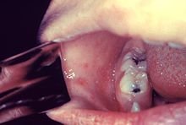
Measles
Measles is a serious disease that causes fever, rash, and other complications. Measles is caused by paramyxovirus and spreads very easily from person to person.
An acute highly infectious disease of childhood
The initial sign of measles is called the early or prodromal symptoms that include high fever, cough, coryza and conjunctivitis (3Cs) followed by a typical rash. Usually bluish-white lesions on the oral mucosa (opposite the lower 1st and 2nd molar) called Koplik’s spot manifest 2-3 days before measles rash occur.
Notes:
Coryza- inflammation of mucous membrane inside nose

Slide 37
Measles
Occurrence : Worldwide
Organism : Measles virus (Paramyxovirus)
Reservoir : Man.
Period of infectivity: From 4 days before until 5 days after the onset of the rash.
Transmission : Droplets, Contact, airborne.
Control :
- Active Immunization with live attenuated virus.
- Improvement of the nutrition of the children.

Slide 38
Common VPDs in Nepal and the burden
According to global burden of disease 2008 as of March 2012, 1.5 million of deaths among children under 5 years were due to diseases that could have been prevented by routine vaccination.
  representing 17% of global total mortality in children 0-59 months of age

Slide 39
Global burden of VPDs
Polio:
Polio cases have decreased by over 99% since 1988, from an estimated 350 000 cases then, to 223 reported cases in 2012.
Nepal is polio free since August 2010 but officially SEAR (South East Asian Region) member countries were declared polio free in 2014 after 3 years sustenance of polio free in all member countries.

Slide 40
Measles:
While global measles deaths have decreased by 78 percent worldwide — from 562 000 deaths in 2000 to 122 000 in 2012 — measles is still common in many developing countries, particularly in parts of Africa and Asia.

Slide 41
Diptheria: In the year 2000, 30 000 cases and 3000 deaths of diphtheria were reported worldwide
Pertusis: WHO estimated that in 2008, about 16 million cases of pertussis occurred worldwide, 95% of which were in developing countries, and that some 195 000 patients died from this disease.
Tetanus: Maternal and Neonatal Tetanus (MNT) 2012 global figure show that 10’011 cases of tetanus and 4’649 cases of neonatal tetanus were reported.

Slide 42
Hepatitis B: An estimated two billion people worldwide have been infected with hepatitis B virus and more than 360 million have chronic (long-term) liver infections. About 620 000 people die every year as a result of hepatitis B virus infection.
Tuberculosis: According to WHO in 2013 up to 80 000 children die from TB each year and children account for over half a million new cases annually. The actual burden of TB in children is likely higher, especially given the challenge in diagnosing childhood TB.

Slide 43
Nepal is one of the countries recognized for the well functioning immunization system. The accessibility of immunization has reached to the 97% population and serves equally, successfully to the poor and
rich, also does not discriminate child's sex.
The contribution of immunization in achieving the MDG 4
goal is immense.

Slide 44
Thank You

