Slide 1
Water Emergency
Water, sanitation, and hygiene (WASH)-related emergency preparedness and outbreak response has become one of the most significant and crucial public health issues in recent history.
Emergencies can include
natural disasters (for example, hurricanes, floods, and droughts),
man-made disasters (for example, chemical spills into waterways), and
outbreaks (for example, infections linked to water exposure after a disaster)

Slide 2
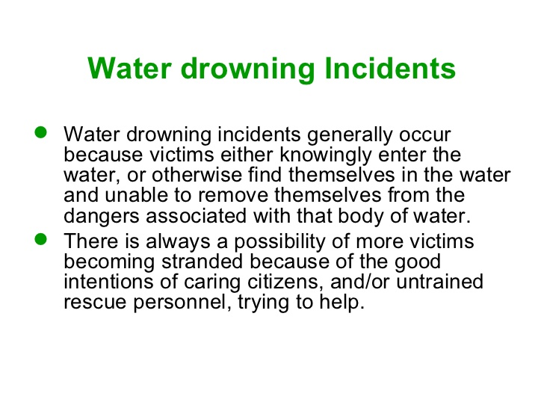

Slide 3
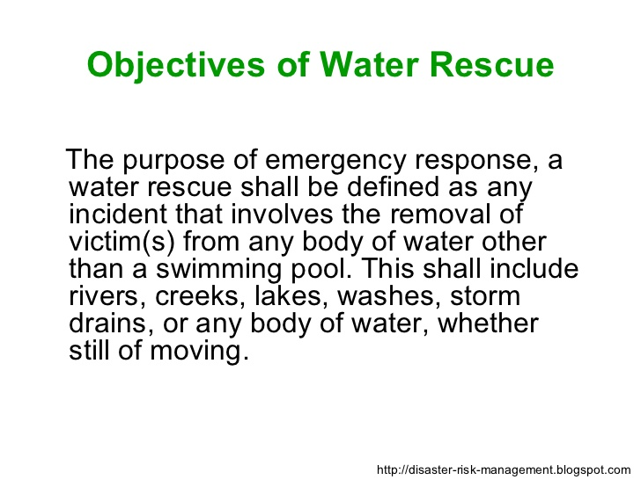

Slide 4
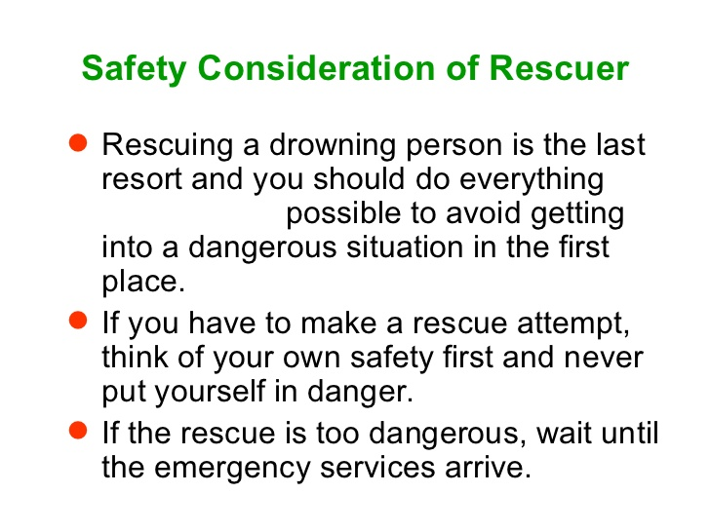

Slide 5
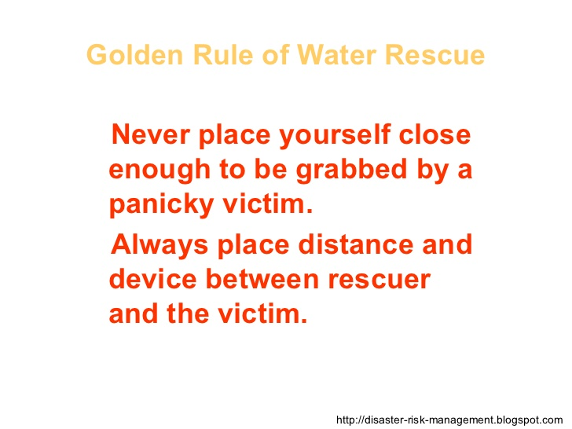

Slide 6
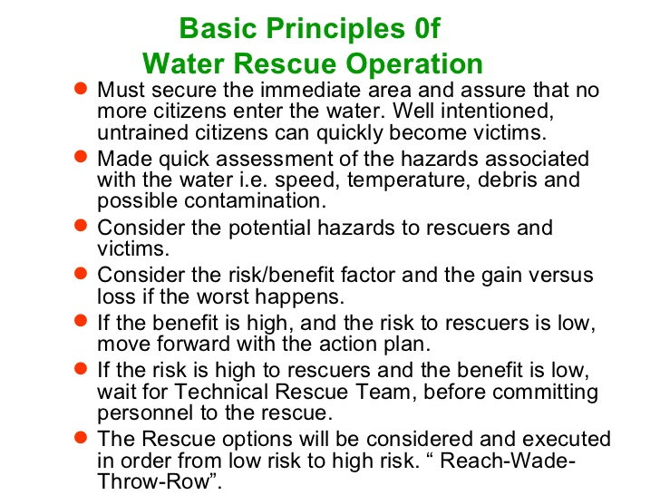

Slide 7
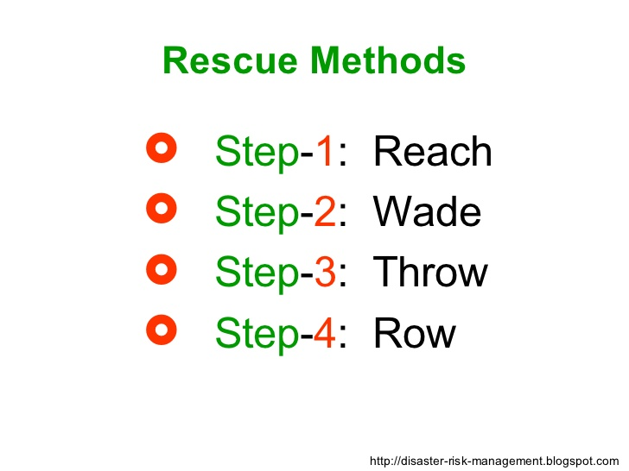

Slide 8


Slide 9
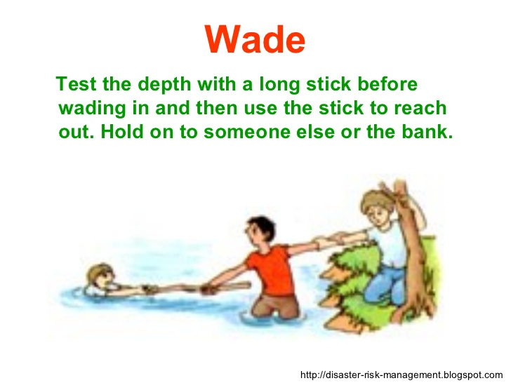

Slide 10
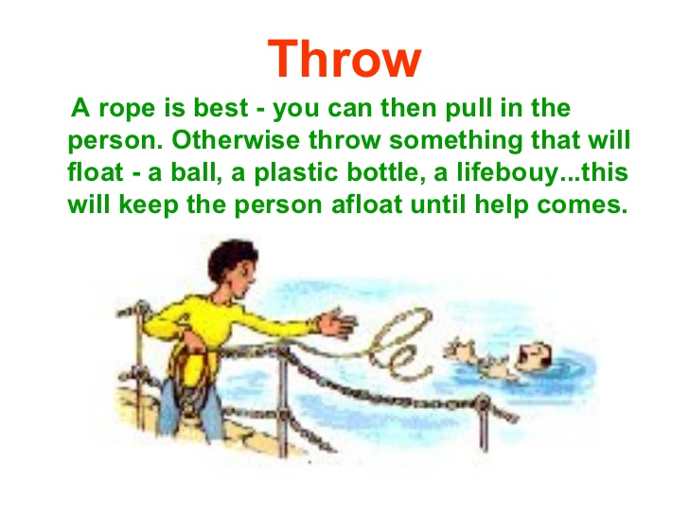

Slide 11
