Slide 1
Introduction
Name: Manu Kumari Lamtari Magar
Roll no : 16
Level : Bachelor
Faculty : Health and Allied Science, Pokhara University
Sector : Bachelor of Public Heath

Slide 2
Biodiversity Conservation

Slide 3
CONSERVATION OF BIODIVERSITY: INSITU AND
EX-SITU
In-situ conservation:
Conservation of a species is best done by protecting
its habitat along with all the other species
that live in it in nature.
Ex-situ conservation:
However, there are situations in which an endangered species is so close to extinction that unless alternate
methods are instituted, the species may be rapidly
driven to extinction.
Restoration of Biodiversity
Imparting Environmental Education
Enacting, strengthening and enforcing Environmental Legislation
Population Control
Reviewing the agriculture practice
Controlling Urbanization
Conservation through Biotechnology

Slide 4
Biodiversity Conservation
In situ
Ex situ
Sacred groves and lakes
Biosphere Reserves
National parks, wildlife sanctuaries
Terrestrial
Marine
Sacred plant home garden
Seed Bank, Gene bank, Cryopreservation
Botanical garden, Zoological garden, Aquaria
Notes:
Cryopreservation or cryoconservation is a process where organelles, cells, tissues, extracellular matrix, organs or any other biological constructs susceptible to damage caused by unregulated chemical kinetics are preserved by cooling to very low temperatures

Slide 5
Biodiversity Conservation in Nepal
Nepal has great diversity of flora and fauna due to unique geographical location with representative of deciduous and coniferous forests of subtropical and temperate regions to the sub-alpine and alpine , pastures and snow capped Himalayan peaks with their cold streams, glaciers and lakes.

Slide 6
Nepal consist more than
5,000 species of flowering plants,
181 species of mammals,
844 species of birds,
185 species of fishes,
635 species of butterflies and
more than 2252 moths.

Slide 7
The concept of bio-diversity conservation was arisen in Rana regime when the central zoo was established in Nepal.
However, the active efforts for the conservation of bio-diversity started about 30 years ago.

Slide 8
The various efforts include protected areas, zoo, different types of law, conventions, non governmental organizations (NGOs), local and national authorities, national and international organizations, etc.

Slide 9
Among them the protected areas is main.
The protected areas conserve the biological things in their original place which is called in situ conservation.

Slide 10
The protected areas has covered 26,695 km. square (18.32%) of the total area of Nepal.
The National Parks and Wildlife Conservation Act 1973 provides the legal basis for the management of protected areas.
The protected areas include nine national parks, three wildlife reserves, one hunting reserve, three conservation areas and six buffer zones.

Slide 11
Rules and Regulation for Biodiversity Conservation
Zoo is important tool for the protection of threatened animals.
The National Zoo of Nepal which is situated in Kathmandu is helping for the conservation of important animals from different ecological zones of the country.
Notable animals are rhino, tiger, crocodile, black bear, Black buck, clouded leopard etc.

Slide 12
For the conservation of biodiversity, many rules (acts) and regulations has been formed by the government of Nepal.
Some of them are:
Aquatic Animals Protection Act (1961): It is concerned for the protection of wetlands and aquatic animals.
National Parks and Wildlife Conservation Act (1973): It is the base for the management of protected areas.

Slide 13
The other important acts which are helping directly and indirectly for the conservation of biodiversity like
Forest Act (1993),
Environmental Protection Act (1996),
Soil and Watershed Conservation Act (1982),
Water Resource Act (1992),
Electricity Act (1992),
Livestock Health and Livestock Service Act (1998).

Slide 14
The regulations includes:
Himalayan National Park Regulations (1979),
Buffer Zone Management Régulations (1996),
Environnemental Protection Régulations (1997) etc.
These regulations are also concerned for the protection of biodiversity.

Slide 15
Similarly,
Environment Protection Council (1992),
Ministry of Forest and Soil Conservation,
Ministry of Agriculture,
Ministry of Population and Environment,
National Planning Commission,
National Agriculture Research Council,
Nepal Academy of Science and Technology,
Department of Botany and Zoology of Tribhuvan University,
Local authorities (Village Development Committee and Dstrict Development Committee) are working for the conservation of biodiversity.

Slide 16
Non government organizations like
Ecological Society (ECOS),
Natural History Society of Nepal (NASHON),
Legal and Environmental Analysis for Development and Research Service (LEADERS)
are also working directly and indirectly for the conservation of biodiversity in Nepal.

Slide 17
The international conventions like the
World Heritage Convention (1992),
Convention on International Trade in Endangered Species of Fauna and Flora (CITES),1993,
Ramsar Convention on Wetlands of International Importance (1971),
Convention on Biological Diversity (1992)
are also related for the conservation of biodiversity.

Slide 18
There are also many international and national organizations which are working on biodiversity research and conservation.
Some of them are followings:
1) International Union for the Conservation of Nature (IUCN)
2) United Nations Environnemental Programme (UNEP).
3) World Wildlife Fund (WWF).
4) Global Environmental Facility (GEF)
5) International Centre for Integrated Mountain Development (ICIMOD)
6) International Plant Genetic Resource Institute (IPGRI)
7) King Mahendra Trust for Nature Conservation (KMTNC).

Slide 19
The Government of Nepal has given legal protection to
27 mammal species,
9 bird species and
3 reptile species
under the National Park and Wildlife Conservation Act 1973.

Slide 20
The Government of Nepal has protected many plant species under the Forest act 1993.
The Bark of tree, Kutki etc, are banned for collection, use, sale and distribution, transportation and export.
The other important medicinal plants like Jatamansi, sarpagandha, Talis patra, Lauth salla, Yarsagumba are banned for export except processed and permission of department of forest.
Similarly, Champ, Khayer, sal, Sakhuwa, Simal, Satisal, Bijayasal etc, are banned for transportation, export and felling for commercial purposes.

Slide 21
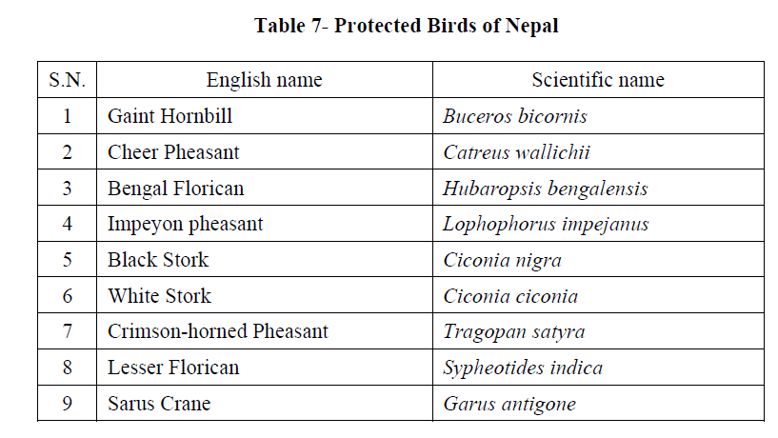

Slide 22
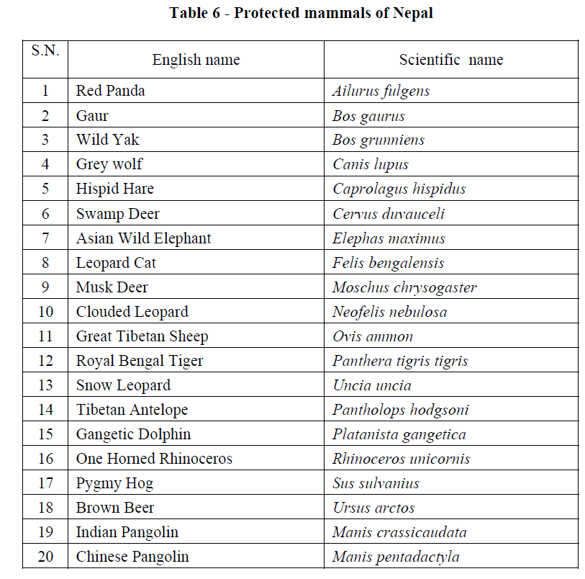

Slide 23
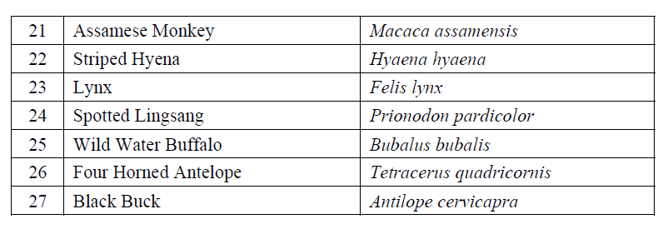

Slide 24
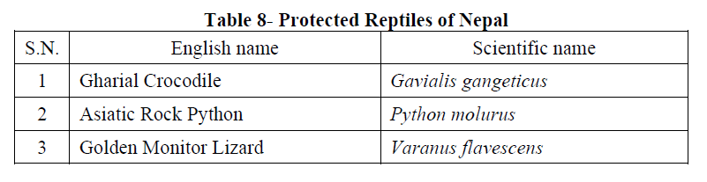

Slide 25
References :
Wikipedia
www.omicsonline.org
www.wwfnepal.org
www.ntnc.org.np

Slide 26


