Slide 2
Measurement Procedure for Head

Slide 3
To measure the baby’s head, the doctor or nurse places a flexible measuring tape where the baby’s head has the largest circumference - just above the eyebrows and ears and around the back where it slopes up prominently from the neck.
The head is the upper portion of the human body which supports the face and is maintained by skull which itself encloses the brain.
The baby’s head is usually between 19-21 inches long, with the circumference of 13.5 inches.

Slide 4
For the measurement of circumference of head, the device that cant be stretched such as flexible metal tape is used.
It is measured from the most prominent part of forehead(1-2 fingers above the eyebrow) around the widest part of back of head.
Brain growth takes place 70% during fetal life, 15% during infancy and 10% during pre-school years.

Slide 5
Steps for measurement
First, start with a measuring tape that cannot be stretched.
Securely wrap the tape around the widest possible circumference of the head and its usually 1-2 widths above eyebrows.
It is recommended to reposition the tape and repeat the measurements 3 times.

Slide 6
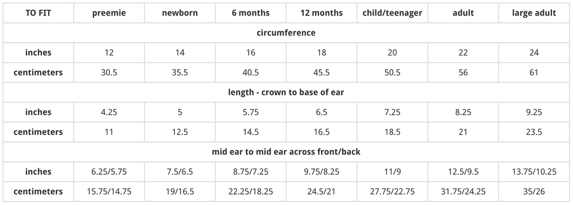
Table showing the measurements

Slide 8
CHEST CIRCUMFERENCE
It is usually measured at the level of nipples, preferably in mid inspiration.
Xiphisternum-lowest part of the sternum (where the ribs meet the sternum)
In children
<= 5years - lying down position
> 5 years - standing position

Slide 9
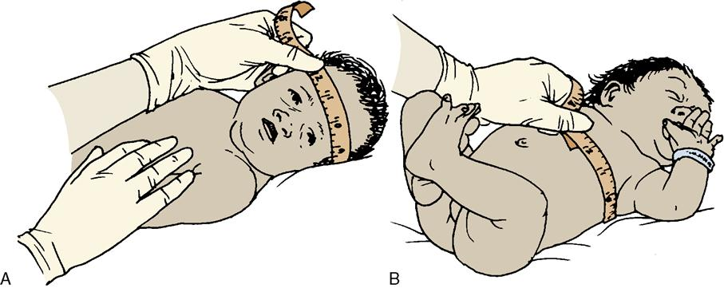
RELATIONSHIP BETWEEN HEAD SIZE AND CHEST CIRCUMFERENCE
At birth: head circumference > chest circumference by upto 3 cms.
At around 9 months to 1 year of age: head circumference = chest circumference,
but thereafter chest grows more rapidly compared to the brain.

Slide 10
In malnourished children, chest size may be significantly smaller than head circumference because growth of brain is less affected by undernutrition.
Therefore there will be considerable delay before chest circumference overtakes head circumference.

Slide 11
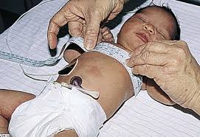

Slide 12
PROCEDURES
Wash your hands and explain the procedure to the child and parent.
Whilst the child is standing, feel for the xiphisternum and mark with a short horizontal line.
Pass the tape around so that the mark is at the upper border of the tape.
Make sure the tape is level. It should rest on the skin but not indenting it/not pulled too tight.
Take the reading at the end of expiration.
Make three measurements of chest circumference.
Record the individual measurement and the mean (average) by adding the values together and dividing by three.

Slide 13
Measurement procedure for arm:
Measurement of arm also called as mid upper arm circumference(MUAC).
MUAC is the circumference of the left upper arm,measured at the mid-point between the tip of the shoulder and the tip of the elbow (olecranon process and the acromium).
It is used for the assessment of nutritional status.

Slide 14
Contd…
Low weight for height reflects child is suffering from malnutrition.
-represents the gain in muscle mass.
MUAC cannot be used before the age of 1 year {hardly varies between the age of 1 year and 5 years (16-17.7 cm between age of 1 year and 5 years)}.
Useful indicator to be used for assessment of nutritional status of communities where accurate age of children <5 years may not be known.

Slide 15
Procedure :
-Bend the left arm,find and mark with a pen the
olecranon process and acromium.
-Mark the midpoint between these two marks.
-With the arm hanging straight down,wrap a
around the arm at the midpoint mark.
-Measure to the nearest 1mm.

Slide 16
Interpretation of MUAC:
MUAC | Status | Color in shakir tape
>13.5cm | Well nourished | Green
>12.5-13.5cm | Moderately nourished | Yellow
<12.5cm | Severly undernourished | Red

Slide 17
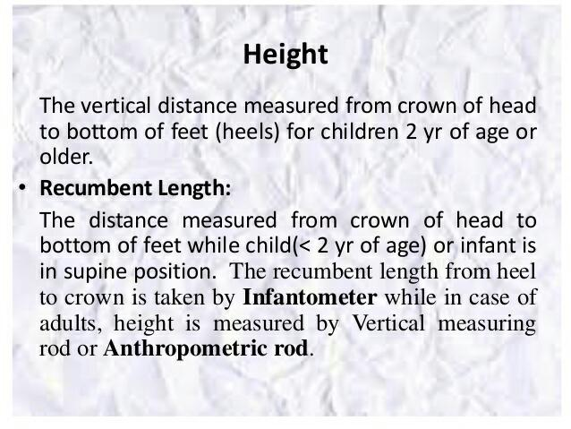

Slide 18
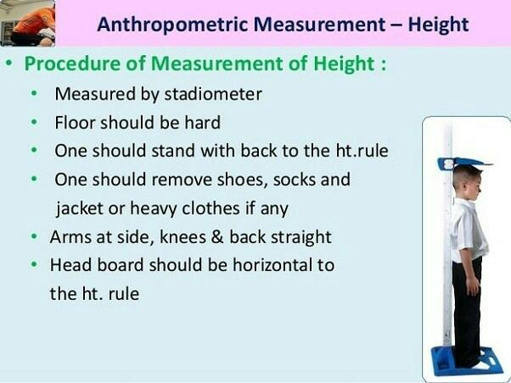

Slide 19
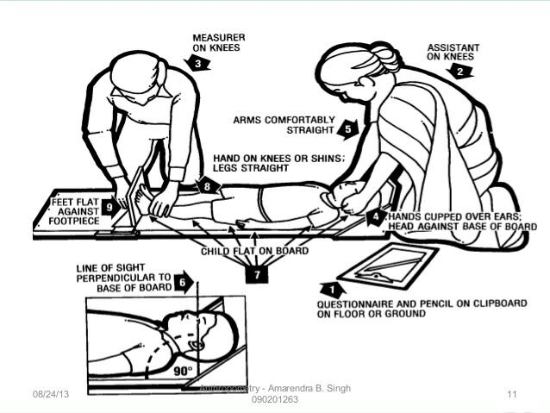

Slide 20
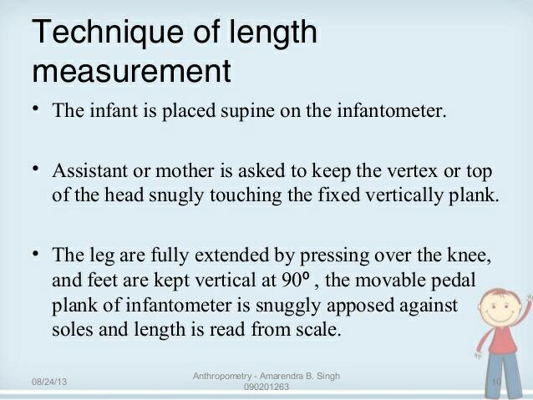
Measurement by infantometer

Slide 21
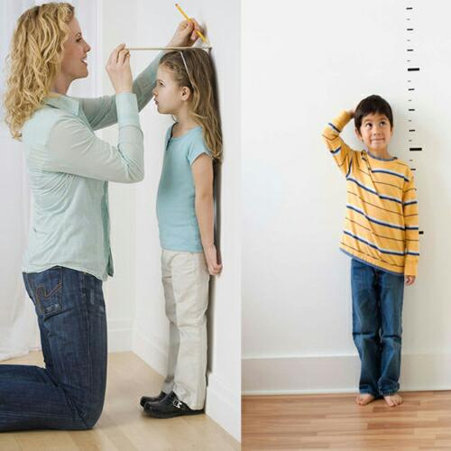

Slide 22
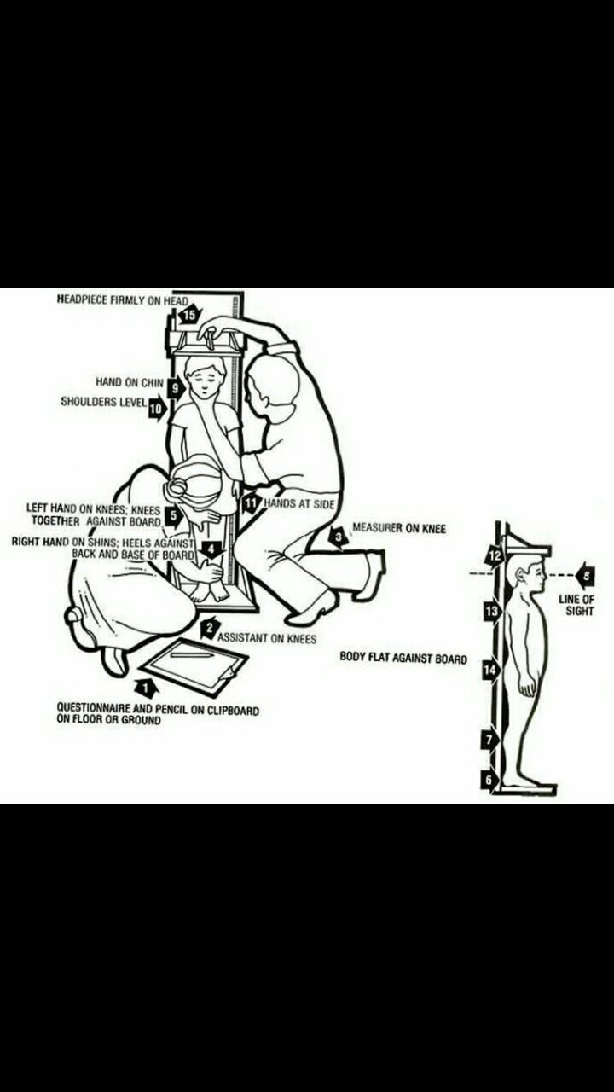

Slide 23
Measurement procedure for Weight
Introduction:
Repeated measurement of weight at intervals ,ideally monthly from birth to one year, every 2 months during second and every 3 months thereafter upto 5 years of age indicates birth trend of weight gain . Healthy babies on an average double their weight by 5-6 months, triple by end of first year and quadriple by the age of 2 year.

Slide 24
Indication
AGE WEIGHT INCREASE
0-5 months 20gm/day
6-12 months 15gm/day
upto 2 years 2.5kg/year
3-5 years 2kg/year

Slide 25
Digital scale is used to measure weight.
Weight is measured in pound or kilogram.
Recommended Equipments:
Scales
.Tanita HD-314 scale
.Tanita HD-351 scale
2. Standard weight for checking accuracy
3. Name tags

Slide 26
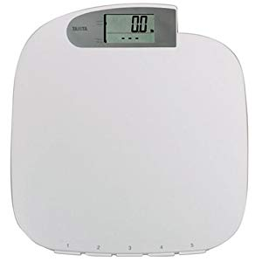
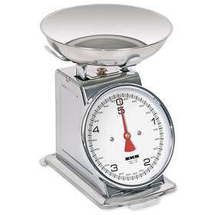
Tanita HD 351 scale
Tanita HD 314 scale

Slide 27
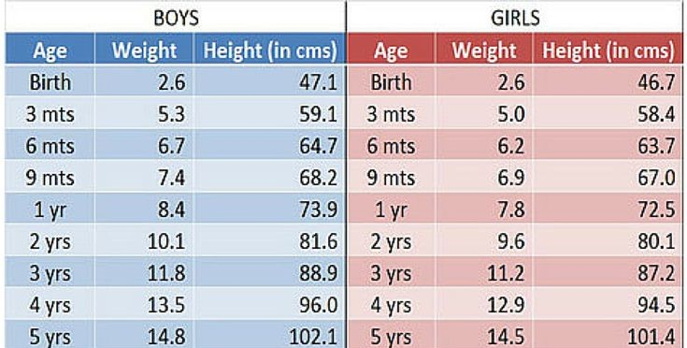

Slide 28
Weight measurement Procedure scale
1. Turn on the scale to “zero” the scale.
2. Place standard weight on the scale to ensure accuracy of the scale.
3. If the readout is more than one-half pound off the standard weight change the battries. Then place the standard weight on the scale again. If it is still off by more than a half-pound, donot use this scale.
4. If the scale is accurate being assessments

Slide 29
5. Ask the child to remove extra layers of clothing, jewelry and any items in his/her pockets.
6. Ask the child to step on the scale backwards .
7. Ensure that the body weight is evenly distributed between both feet.
8. Arms hang freely by the sides of the body, pams towards thighs.
9. Head is up and facing straight ahead.
10. Weight is recorded to nearest 0.2 pounds(or appropriate unit for the scale).

Slide 30
