Slide 1


1

Slide 2


Progress or general course of action of a person in some profession.
Specific jobs that a person performs, the kinds of responsibilities and activities that comprise those jobs, movements and transitions between jobs.
2

Slide 3


A formal approach used by the firms to ensure that people with proper qualifications and experience are available when needed.
Career development benefits both employees as well as organizations.
Organization needs to have career development programme and integrate the function with HR activities.
3

Slide 4
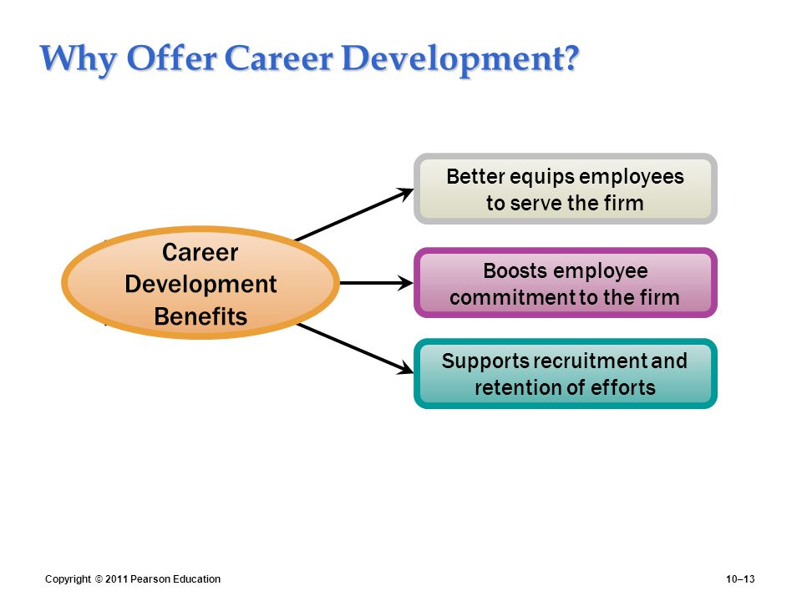

Slide 5

Roles of two parties are crucial in in career development: employer, employee.
Employer’s Role-
Proactive
Encourage
Reward
Enlighten
5

Slide 6
Employee’s Role
Assessing one’s own KSA’s.
Seek out information about career options.
Make use of development opportunities provided in organization
Establish goals and plans.
Accepts that career planning and developments are one’s own responsibility
6

Slide 7

 Career Planning Workshops
Career Counselling
Mentoring
Leave
Personal Development plans
 Career workbooks
6

Slide 8


 Management Participation
Provide top management support
Provide collaboration between line managers and HR managers
Train managerial personnel
Setting Goals
Plan human resources strategy
Changing HR Policies
Provide for job rotation
Provide outplacement service
Announcing Program
Explain its philosophy

Slide 9

 Career Planning Workbooks
 Stimulate thinking about careers, strengths/limitations,
development needs
Career Planning Workshops
Discuss and compare attitudes, concerns, plans
Career Counseling
Discuss job, career interests, goals
Web-based Career Development
Products, services, and confidentiality

Slide 10

Performance
Exposure
Networking
Leveraging
Mentors
Key subordinates
Expandability

Slide 11
Self assessment
Individual counselling
Information services
Employee assessment programs
Employee development programs

Slide 12


Servicing the Career Development Needs
Career Planning Workshops
Career Planning Workbooks
Career Counseling
Development Testing for Employees
Extensive Web-Based Products/Services

Slide 13

Transfers
Promotions and Demotions/Termination
Relocation Services
Outplacement Services
Development Opportunity Announcements

Slide 14

STAGE 1: Preparation for Work
Typical Age Range: 0-25
Major Tasks: Develop occupational self-image, assess alternative occupations, develop initial occupational choice, pursue necessary education.
STAGE 2: Organizational Entry
Typical Age Range: 18-25
Major Tasks: Obtain job offer(s) from desired organization(s), select appropriate job based on accurate info.
STAGE 3: Early Career
Typical Age Range: 25-40
Major Tasks: Learn job, learn organizational rules and norms, fit into chosen occupation and organization, increase competence, pursue goals.

Slide 15
STAGE 4: Mid-career
Typical Age Range: 40-55
Major Tasks: Reappraise early career and early adulthood, reaffirm or modify goals, make choices appropriate to middle adult years, remain productive in work.
STAGE 5: Late Career
Typical Age Range: 55-retirement
Major Tasks: Remain productive in work, maintain self-esteem, prepare for effective retirement.

Slide 16
Career Counseling
Career Pathing
Inventory Skills
Transfers
Training
Job Posting
Promoting
Lateral Development
16

Slide 17
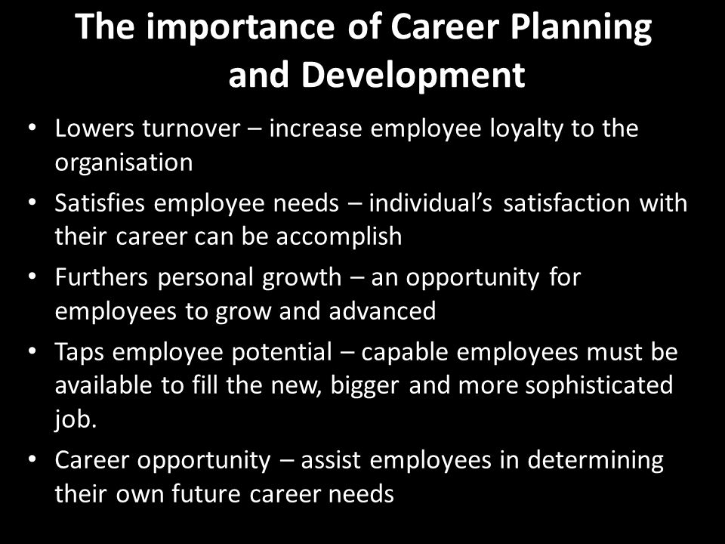

Slide 18


18

