Slide 1
Unit IV: Balanced Diet

Slide 2
Contents
Introduction
Importance
Food group and food pyramid
Uses of food group and pyramid
Balanced diet for different age group

Slide 3
Balanced diet:
A balanced diet is one which contains different types of foods in such quantities and proportions so that the need for calories, proteins, minerals, vitamins and other nutrients is adequately met for maintaining health, vitality and general well-being of an individual.

Slide 4
Purpose of balanced diet
To meet the daily requirements of nutrients
To maintain correct proportion of nutrients in the daily diet
To maintain the desirable body weight
To Promote and preserve the good health

Slide 5
Types of balanced diet
High cost balanced diet:
contains sufficient/liberal amount protein foods of animal origin (milk, meat, fish, egg etc.).
Moderate cost balanced diet:
contains moderate amount protein foods of animal origin.
Low cost balanced diet:
contains small amounts protein foods of animal origin and liberal amount of plant source protein.

Slide 6
General Guidelines/Principles of Balanced Diet:
About 70% of the total energy requirements may be met through the intake of Carbohydrate. While the energy from Carbohydrate should not be less than 40%.
Intake of Fat should be limited to not more than 15% of the calorie requirements in the diet, but it may exceed to 30% for infant and children. Besides this, at least 25% of vegetable oil out of total fat should be incorporated daily.
Saturated fats should be not more than 10% of total energy intake. Unsaturated fats should replace the remaining fats requirements.

Slide 7
General Guidelines/Principles of Balanced Diet:
Protein intake should be at least 15-20% of total energy. 25% of protein required should be desired from animal protein.
Refined carbohydrates should be minimized and be rich in fiber.
Sources rich in fat and alcohol should be avoided.
Vitamins are recommended in terms of Calorie intake, because they are used as coenzyme for metabolism of foods.
Salt intake should not increase more than 5 gm per day.

Slide 8
Food group
Basis of Food Group
    Inclusion of variety
    Requirements of foods i.e. consumption amount
    Composition of foods
Food groups are the systematic classification of foods on the basis of their composition, for the purpose of preparation of balanced diet which gives the verities and quantity of the foods in daily meal that meets the RDA, the foundation of healthy life.
Foods of the same food group share similar nutritional properties.

Slide 9
Balanced diet contd.
Five Food groups for balanced diet preparation
Cereal and products
Protein foods
Protective fruits and vegetables
    Vitamin A rich
    Vitamin C rich
Other fruits and vegetables
Oil, fats and sugar

Slide 10
Nutrient contribution of five food group (ICMR 1991)
Food group | Foods included | Main nutrients
Cereal and their products | Rice, wheat, maize, millets etc. | Energy, protein, iron, thiamin, niacin, fibre
Protein foods | Legumes, pulses, meat fish, egg, poultry | Protein, energy, calcium, iron, B-complex vitamin, fibre, invisible fat, essential amino acids
Protective fruits and vegetables
Vitamin A rich products Vitamin C rich products | All green leafy vegetables, yellow fruits | Carotenoids, iron, calcium, fibre
 | Citrus fruits, vegetables | Vitamin C, fibre,
Other fruits and vegetables | Gourds, beans, potatoes, other fruits. | Vitamins, minerals, fibre
Oil, Fat and Sugar | Oils, ghee, butter, sugar, syrup, | Calorie, fat, essential fatty acids

Slide 11
Food guide for balanced diet (ICMR 1991)
Food group | Foods included | Size of serving | Suggested No. of serving
Cereal and their products | Staple foods, rice wheat, maize and their products | 25 gm | 9-16
Protein foods | Dal, legumes, nuts and oilseeds | 25 gm | 3-5
 | Milk and milk products | 150 gm
 | Eggs | 1 No
 | Fish, poultry, meat | 30 gm
Protective Fruits and Vegetables
 | Vitamin A rich products | 50-75 gm | 1-2
 | Vitamin C rich products | 50-75 gm | 1-2
Other fruits and vegetables | All remaining fruits and vegetables | 50-75 gm | 3 or more
Oil, fat and sugar | Oils, ghee, butter | 5 gm | 2 or more
 | Sugar, jaggary, syrup | 5 gm | -

Slide 12
Guidelines for use of food groups
Select food from each of the five food groups
Select at least minimum number of serving from each group
Make choice within each group
Try to include at least one food from group 2 in each meal
Use seasonal fruits and vegetables

Slide 13
Dietary score card
SN | Food group | Points per serving | Maximum score
1 | Cereals and products | 5 | 45
2 | Protein foods | 5 | 15
3 | Protective fruits and vegetables | 10 | 20
4 | Other fruits and vegetables | 5 | 10
5 | Fats, oil and sugar | 5 | 10

Slide 14
Calculation of dietary score card:
Check if all five groups are included in the meal.
Add up the score for each group.
If the total score for any group is higher than the maximum permissible score, count only the maximum score for that group.
Add the total score and evaluate as follows:
    100…….. excellent
    90………..Good
    Less than 90 Need to include the missing group.

Slide 15
Food Pyramid
Food pyramid ??
Uses ??
Properties/features of food pyramid
Example of food pyramid Nepal

Slide 16
Food pyramid ??
A food guide pyramid is a pyramid shaped guide of healthy foods divided into sections to show the recommended intake for each food group.
Represent it as a table rather than a "pyramid".
The first food pyramid was published in Sweden in 1974.
The most widely known food pyramid was introduced by the United States Department of Agriculture in the year 1992, was updated in 2005, and then replaced in 2011.
Over 25 other countries and organisations have also published food pyramids.

Slide 17
Features of food pyramid
Food pyramid contains food pictures in a pyramid shape.(than tabular or other structures)
Food pyramids are mostly developed in local and simple languages, availability of food.
Foods included at the top of pyramid should be consumed the least, whereas pyramid at the bottom should be consumed the most.

Slide 18
Uses of food pyramid
The important uses of food pyramids are
Nutrition education
  Effective nutrition education due to pictorial presentation, local languages
Promotes food based dietary guidelines

Slide 19
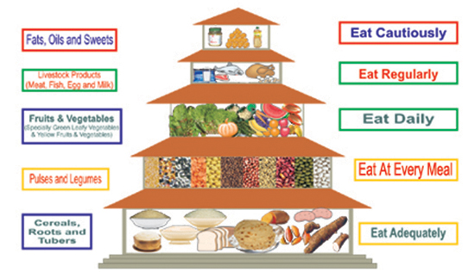
Food Pyramid (DFTQC)

Slide 20
Food Exchange List:
It is a systematic listing of foods in a group having approximately equal amount of carbohydrate, protein and fat in a specific amount of the foods.

Slide 21
Importance of F.E.L.
Food exchange list plays an important role in diet planning.
These list are used in diet planning to make a quick and fairly accurate estimation of nutritive value of diets.

Slide 22
Food group in food exchange list
Milk exchange
Legumes and pulses exchange
Flesh foods or meat exchange
Vegetables A exchange
Vegetables B exchange
Fruit exchange
Cereal exchange
Fat exchange.

Slide 23
Composition of food exchange list
Food group | Weight (ml/gm) | Carbohydrate (gm) | Fat (gm) | Protein (gm) | Energy (Kcal)
Milk |  |  |  | 5 | 100
Legume and pulses | 30 | 15 |  | 6 | 100
Meat | 40 | - |  | 10 | 70
Vegetables A
Vegetable B |  | 10 |  |  | 50
Fruit |  | 10 |  |  | 50
Cereal | 30 | 20 |  | 2 | 100
Fat |  |  | 11 |  | 100

Slide 24
Guidelines for the use of exchange list
Milk exchange: at lease 2 exchange
Legumes and pulse exchange: at least 2 exchange
Meat exchange: at least 1 exchange
Vegetable A exchange: at least 2 exchange.
Vegetable B exchange: at least 2 exchange.
Fruit exchange: at least 2 exchange
Cereal exchange: at least 6-12 exchange
Fat exchange: 3-4 exchange.

Slide 25
Dietary Guidelines
A nutritionally adequate diet should be consumed through a wise choice from a variety of foods.
Additional food and extra care be required during pregnancy and lactation.
Exclusive breast-feeding should be practiced for up to six months. Breast-feeding can be continued up to two years.
Food supplements should be introduced to infants after six months.
Adequate and appropriate diet should be taken by children and adolescents, both in health and disease.

Slide 26
Dietary Guidelines
Green leafy vegetables, other vegetables and fruits should be used in plenty.
Cooking oils and animal foods should be used in moderation, and vanaspati/ghee/butter should be used only sparingly.
Over-eating should be avoided to prevent over-weight and obesity. Proper physical activity is essential to maintain desirable body weight.
Salt should be used in moderation.
Foods consumed should be safe and clean.
Water should be taken in adequate amounts and beverages should be consumed in moderation.
Processed and ready-to-eat foods should be used judiciously. Sugar should be used sparingly.

Slide 27
Dietary Guidelines
Healthy and positive food concepts and cooking practices should be adopted.
The elderly should eat a nutrient-rich diet to keep fit and active.

Slide 28
Food to be reduced
Reduce daily sodium intake to less than 2,300 milligrams (mg) and further reduce intake to 1,500 mg among persons who are 51 and older.
Consume less than 10 percent of calories from saturated fatty acids by replacing them with monounsaturated and polyunsaturated fatty acids.
Consume less than 300 mg per day of dietary cholesterol.
Keep trans fatty acid consumption as low as possible by limiting foods that contain synthetic sources of trans fats, such as partially hydrogenated oils, and by limiting other solid fats.
Reduce the intake of calories from solid fats and added sugars.
Limit the consumption of foods that contain refined grains, especially refined grain foods that contain solid fats, added sugars, and sodium.

Slide 29
Foods to be increased
Increase vegetable and fruit intake.
Eat a variety of vegetables, especially dark-green and red and orange vegetables and beans and peas.
Consume at least half of all grains as whole grains. Increase whole-grain intake by replacing refined grains with whole grains.
Increase intake of fat-free or low-fat milk and milk products, such as milk, yogurt, cheese, or fortified soy beverages.⁶
Choose a variety of protein foods, which include seafood, lean meat and poultry, eggs, beans and peas, soy products, and unsalted nuts and seeds.
Increase the amount and variety of seafood consumed by choosing seafood in place of some meat and poultry.
Use oils to replace solid fats where possible.
Choose foods that provide more potassium, dietary fiber, calcium, and vitamin D. These foods include vegetables, fruits, whole grains, and milk and milk products.

Slide 30
What is a "Healthy Diet"?
The healthy diet may be defined as one that:
Emphasizes fruits, vegetables, whole grains, and fat-free or low-fat milk and milk products;
Includes lean meats, poultry, fish, beans, eggs, and nuts; and
Is low in saturated fats, trans fats, cholesterol, salt (sodium), and added sugars.

Slide 31
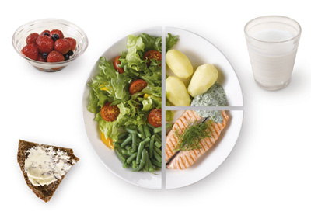
Healthy diet: Plate model

Slide 32
Guidelines for good health
Variety in food
Proportionality
  Some food high
  Some foods low
Moderation
  Saturated fat, trans-fat, added sugar, alcohol, cholesterol, salt
Activity
  Physical activity

Slide 33
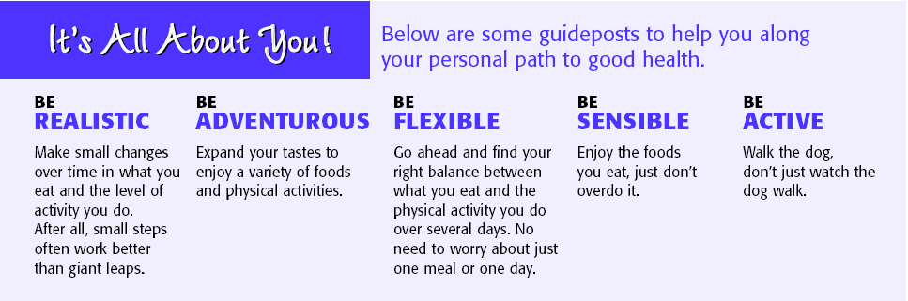
Guidelines for good health contd.

