Slide 1
ENTAMOEBA HISTOLYTICA
ENTAMOEBA HISTOLYTICA

Slide 2
INTRODUCTION
. Kingdom- Protista
.Subkingdom- Protozoa
.Phlum- Sarcomastigophora
.Subphylum- Sarcodina
.Superclass- Rhizopoda
.Class- Lobosea
.Subclass- Gymnamoebia
.Order- Amoebida
.Subclass- Tubulina
.Genus- Entamoeba
.Species- Entamoeba histolytica.

Slide 3
Entamoeba histolytica
Geographical distribution--- Worldwide. More common in the tropics and subtropics than in the temperate zone.
Habitat- Trophozoites of E. histolytica live in the mucous and submucous layers of the large intestine.

Slide 4
MORPHOLOGY
.There are three phases in the life cycle of E. histolytica—
Trophozoite (Growing or feeding stage)—
.shows slow gliding movement .The clear hyaline ectoplasm (pseudopodium) has a jerky movement ,ejected under high pressure, followed by flowing in of the whole granular endoplasm.
.Shape- not fixed.
.Size-ranges from 18- 40 um, average being 20-30 um.
.Cytoplasm- a clear translucent ectoplasm and a granular endoplasm.
Red blood cells, occasionally leucocytes and tissue debris are found inside the endoplasm.
.Nucleus- shape- spherical.
size- 4-6um.
In stained preparation nuclear structure shows
a.)Karyosome- small dot like, central in position, surrounded by a clear halo.
b.)Nuclear membrane-lined with a single layer of uniformly distributed fine chromatic granule s.
c.)Space between the karyosome and the nuclear membrane is traversed by a fine thread of linin network having a spoke like radial arrangement.

Slide 5
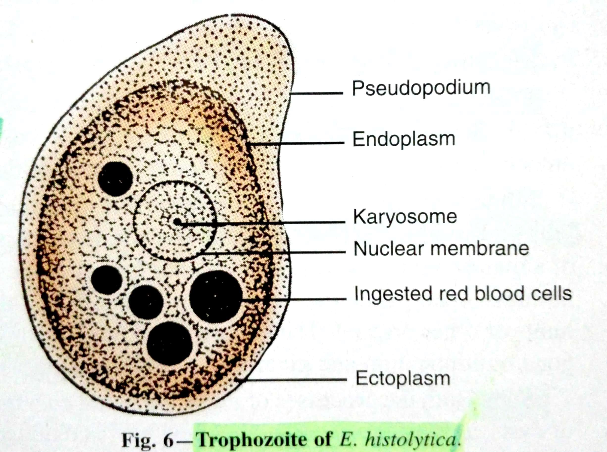
TROPHOZOITE

Slide 6
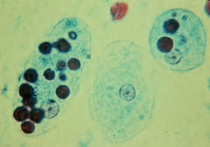
TROPHOZOITE

Slide 7
2.) Pre-cystic stage—
.size- 10-20 um.
.shape- round or slightly ovoid with a blunt pseudopodium projecting from the periphery.
.Endoplasm is free of red blood cells and other food particles.
.Nuclear structure is same as that of trophozoite.

Slide 8
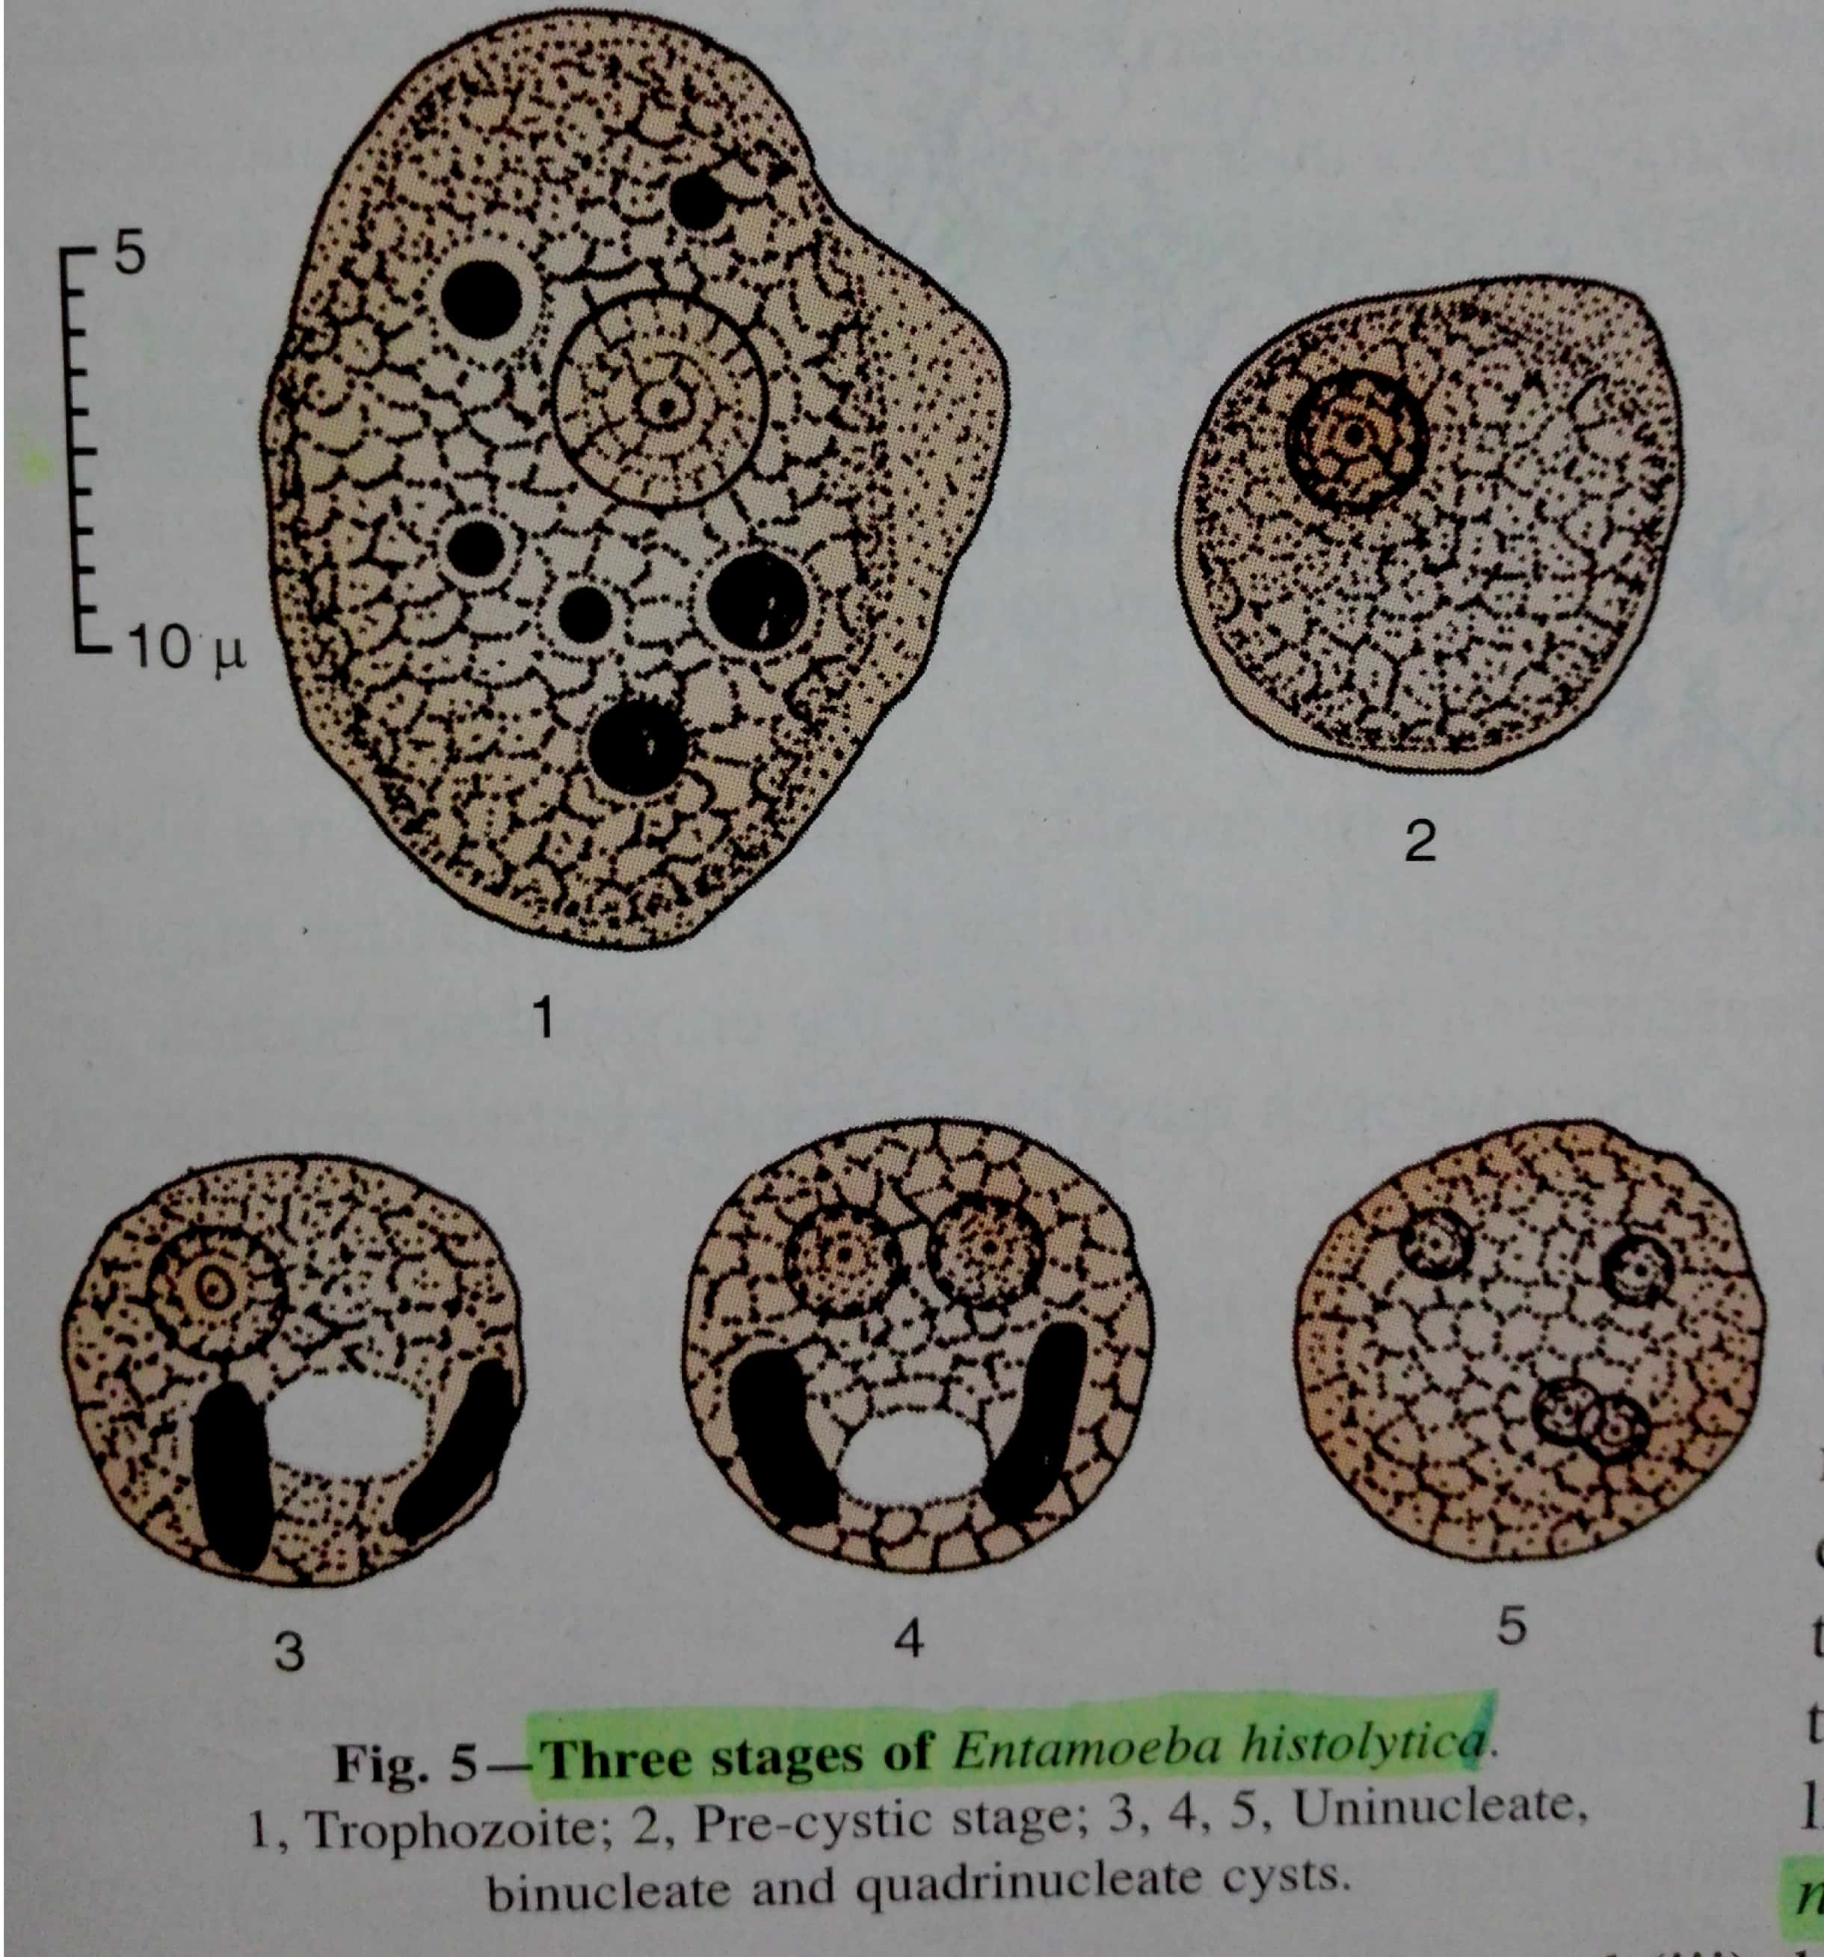

Slide 9
3.) Cystic stage—
.Size- the small race being 6-9 um and the large race 12-15 um.
.during encystment, the parasite becomes rounded and is surrounded by a highly refractile membrane, called the cyst wall.
.cytoplasm is clear and hyaline .In early stage of development,cytoplasm of cyst shows—
a.)Chromatid or Chromidial Bars---seen as refractile oblong bars with rounded ends in preparations with normal saline and black when stained with iron haematoxylin;1-4 in no. and one half –two third the diameter of the cyst.
b.)Glycogen Mass---- stains brown with iodine.
.Nuclear structure is same as that of trophozoite.Mature cyst is quadrinucleate.
.Cyst –uninucleate body---------- binucleate --------quadrinucleate by binary fission.
.during the process of division the nuclei undergo reduction in size becoming 2um in dia.

Slide 10
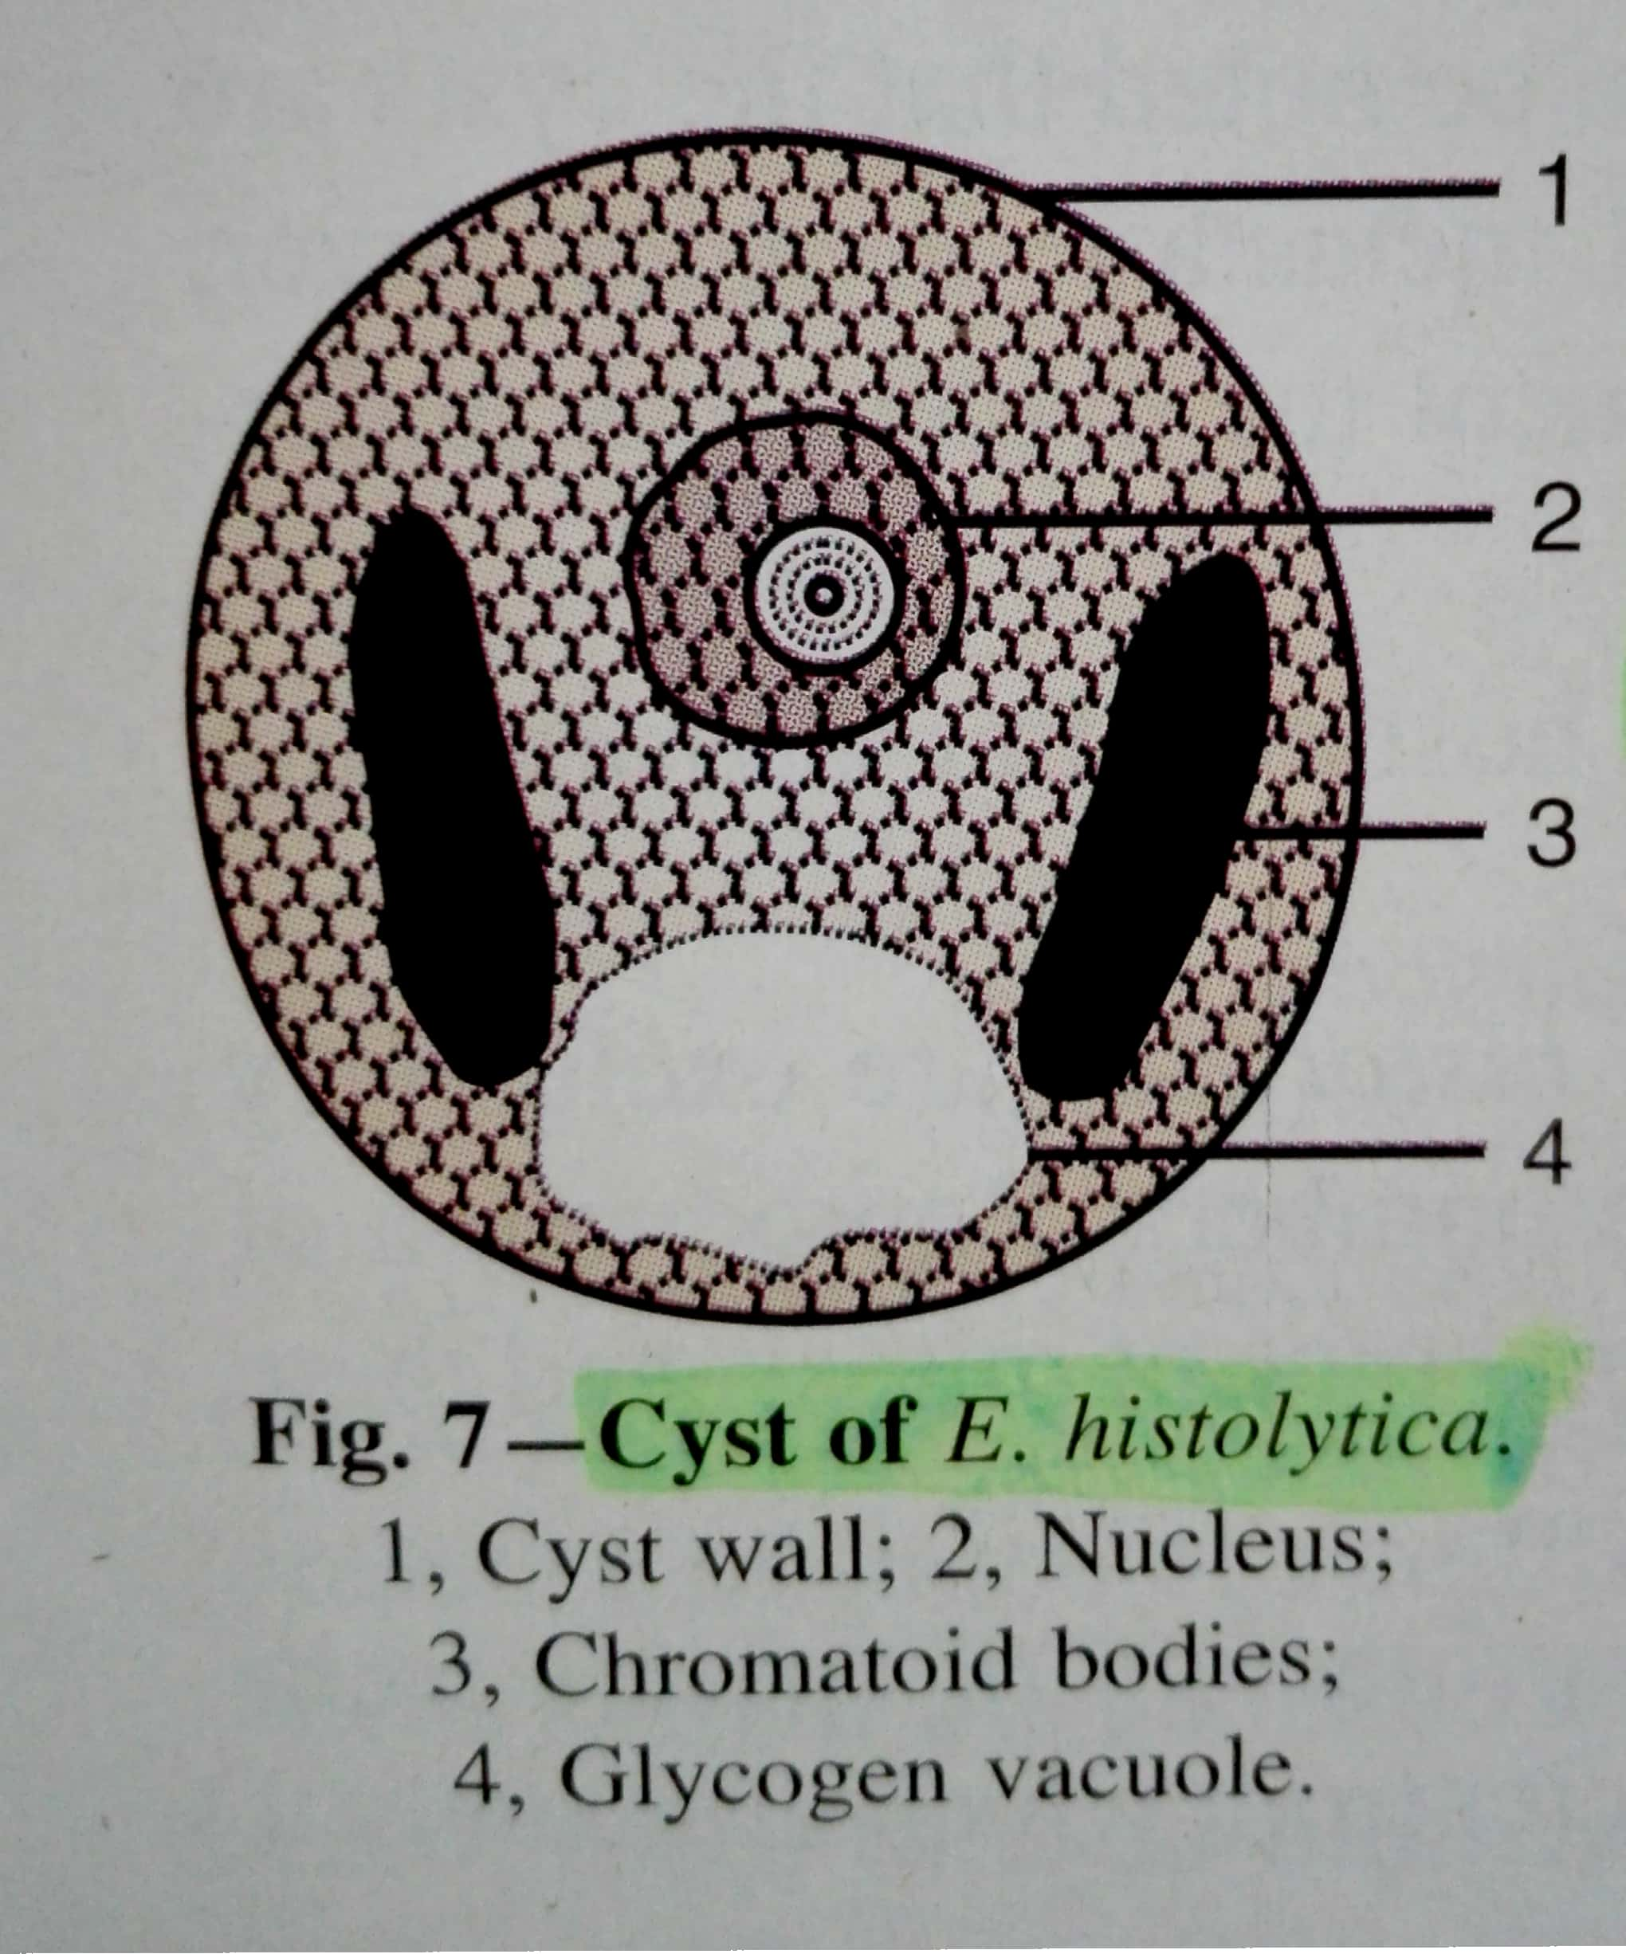

Slide 11
METHOD OF REPRODUCTION
.EXCYSTATION
.ENCYSTATION
.MULTIPLICATION

Slide 12
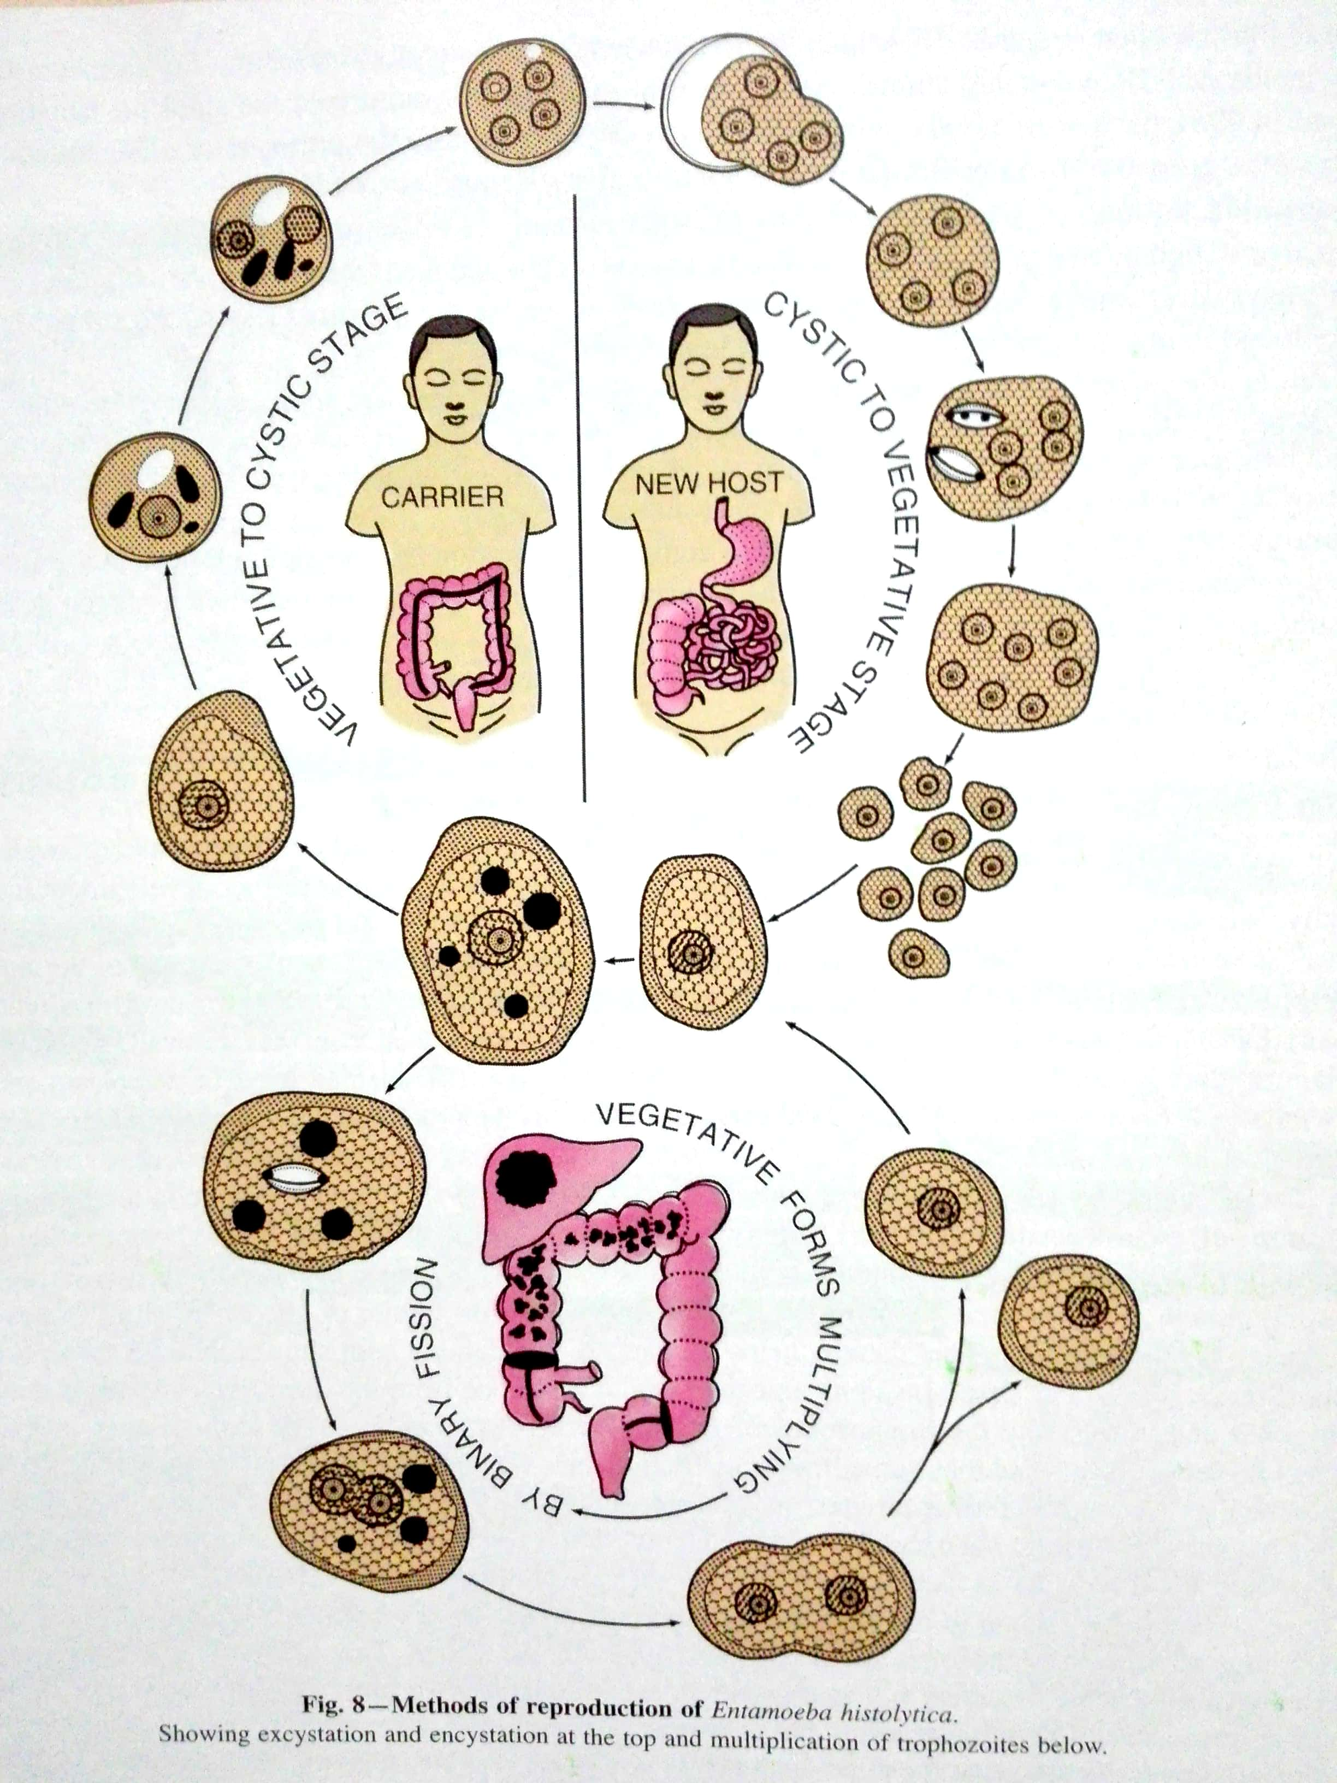
METHOD OF REPRODUCTION

Slide 13
LIFE CYCLE
E.histolytica passes its life cycle only in one host , man.
Quadrinucleate cysts are the infective forms of the parasite
Trophozoite phase of the parasite is responsible for producing the characteristic lesions of amoebiasis.

Slide 14
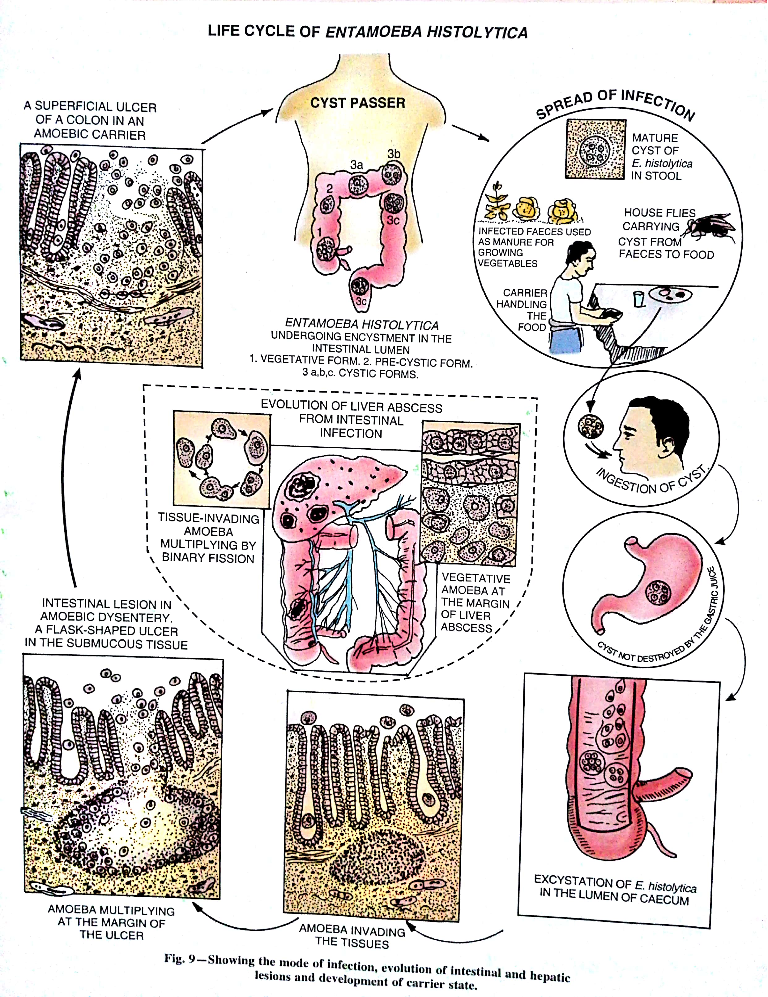

Slide 15
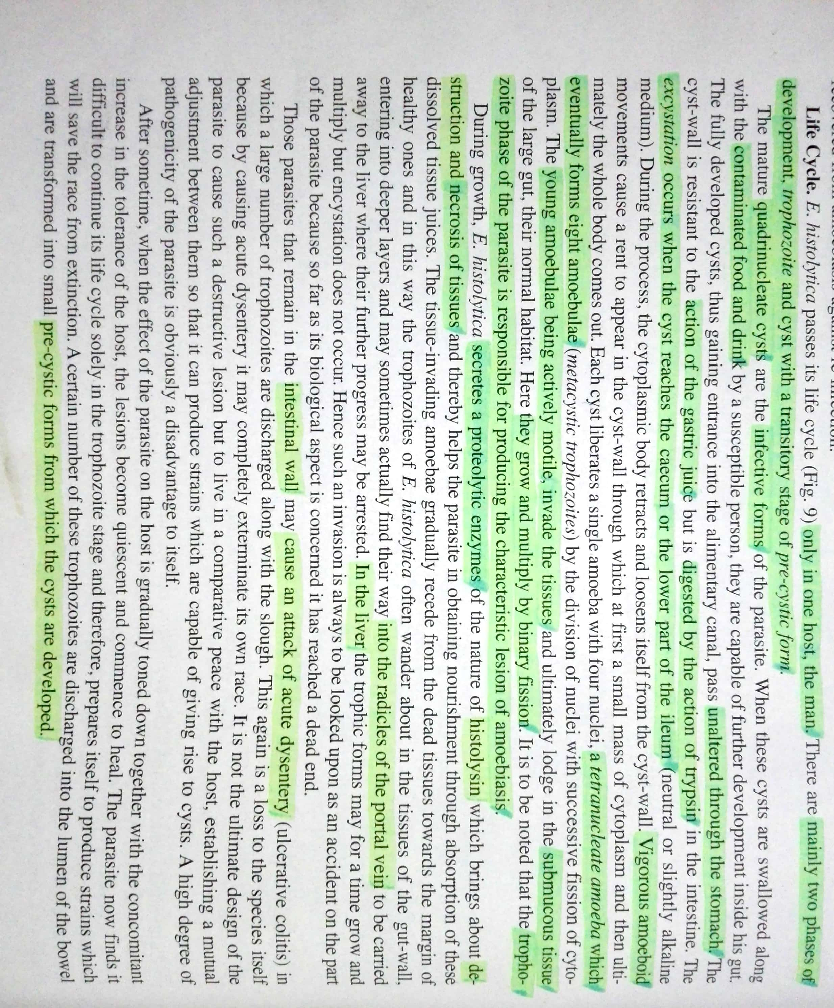

Slide 16
PATHOGENICITY
Incubation period- 4-5 days.
Symptomatology-term AMOEBIASIS is used to denote all those conditions which are produced in the human host by infection with E.histolytica at different areas of its invasion.
AMOEBIC DYSENTERY is a condition in which the infection is confined to the intestinal canal and is characterized by the passage of blood and mucus in the stool.
Dysentery is a symptom characteristic of extensive intestinal ulcerations representing only a part of the clinical picture of intestinal amoebiasis.
Clinical picture vary from acute colitis to chronic colitis and asymptomatic carrier state.

Slide 17
PATHOGENIC LESIONS
1.)Primary or intestinal Lesions—The infection is limited entirely to the large intestine, the initial site of location of the parasite.
2.)Secondary or Metastatic Lesions—The extra colonic areas where the trophozoites of E.histolytica can migrate and produce lesions include liver ,lungs, and brain.

Slide 18
INTESTINAL LESIONS
GENESIS----
. The metastatic trophozoite liberated after excystation enter through the crypts of lieberkuhn .
.By their amoebiod movement they penetrate directly through the columnar epithelium of the mucus membrane.
.By the proteolytic ferment (histolysin) they secrete, they dissolve the intestinal epithelial cells.
.By continuous lysis of tissue cells they reach the submucous coat.
.The amoeba rapidly multiply and increase in no. , form colonies, destroy the tissues in their vicinity and utilize the cytolysed material as their food.

Slide 19
. A considerable area of the submucosa is destroyed, undermining the mucous membrane above.
.The invasion of the tissues by this protozoal parasite leads to coagulative necrosis and the formation of abscess which finally breaks down, leading to the development of ulcers.

Slide 20
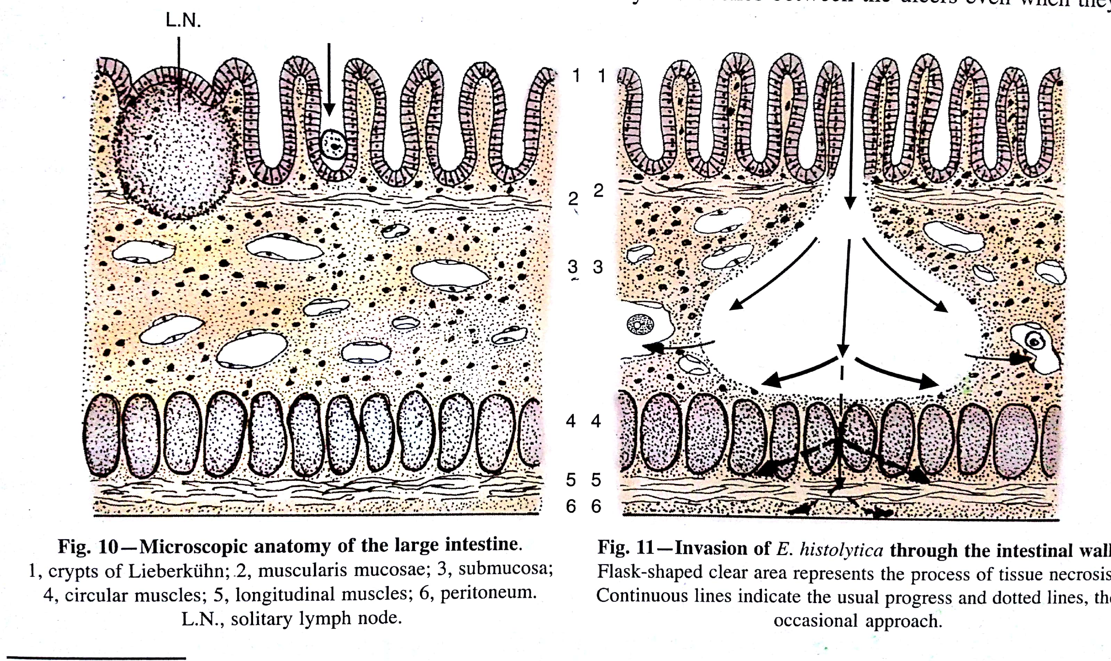

Slide 21
Character of ulcers---- A typical amoebic ulcer has the following peculiarities :
a.)Size– Pin’s head to one inch or more in dia..
b.)Shape- Round or oval.
c.)Margin—On vertical section, has the appearance of a flask (flask- shaped ulcer).
d.)Base-formed by the muscular coat and filled up by the necrotic material , yellowish or blackish slough.

Slide 22
AMOEBIC DYSENTRY AND BACILLARY DYSENTRY
Clinically amoebic dysentry presents with a feature of slow onset with localised abdominal tenderness.
Bacillary dysentry clinically presents with acute onset, associated with fever, generalised abdominal tenderness and tenesmus.

Slide 23
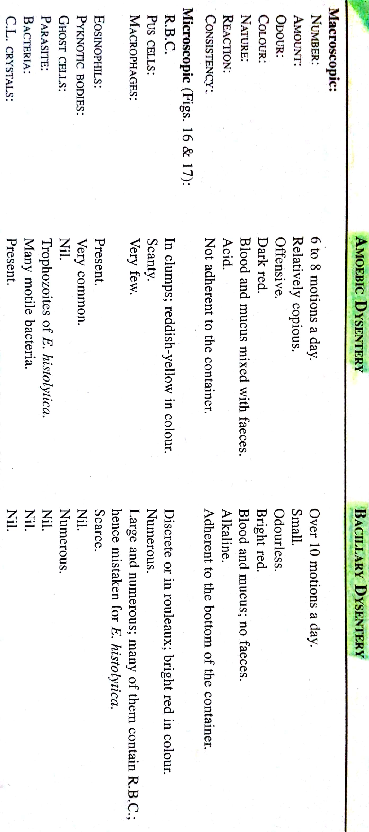
Difference between

Slide 24
Lab. diagnosis
Diagnosis in Intestinal Amoebiasis:
- Macroscopic examination shows offensive dark brown semi solid stool, acid in reaction, mixed with blood and mucous and much faecal matter.
- Microscopic examination shows cysts and trophozoites.
Diagnosis in Heaptic Amoebiasis:
- Diagnostic Aspiration and liver biopsy shows the trophozoites and cysts.
- Examination of blood shows leucocytosis.
Diagnosis in pulmonary amoebiasis:
- Demonstration of trophozoites in sputum.

Slide 25
Treatment:
Metronidazole.
Prophylaxis:
- Boiled drinking water.
- Protection of food and drink from contamination.
- Avoidance of use of raw fruits and vegetables.
- Personal cleanliness.
- Sanitary disposal of faeces.
- Detection and isolation of carriers.

Slide 26
Thank You

