Slide 1

First Aid
SUNITA SHARMA
LECTURER
POKHARA UNIVERSITY

Slide 2
First Aid
Is the immediate assistance or service given to someone before the arrival of medical staff /ambulance.
Measures to be taken immediately after the accident not with an idea to cure but in order to prevent further harm being done. It uses the available human and material resources at the side of accident to provide initial care to the victim of injury or sudden illness until more advance care is provided.
Assistance given to any suffering a sudden illness or injury with care to preserve life,prevent the condition from worsening and promote recovery.

Slide 3
Temporary assistance until the arrival of competent medical care.
First aid is the immediate treatment given to the victim of trauma or sudden illness before arrival or available of expert medical help.

Slide 4
AIMS/OBJECTIVES
To preserve/sustain the life
To prevent suffering
To prevent secondary complications
To promote speedy recovery
To make medical care available at the earliest

Slide 5
3 p’s of first aid
Preserve life-stop the person from injury
Prevent further injury-stop the person from being injured even more.
Promote recovery-try to help the person heal his injuries.
The purpose of first aid is not to cure but to help the victim.
Uses available human resources and material resources available on site.

Slide 6
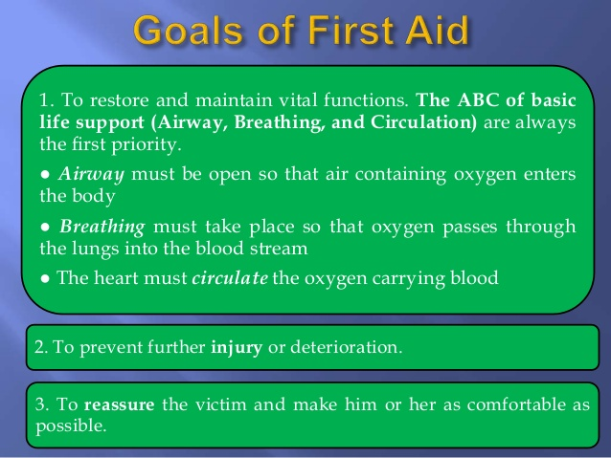

Slide 7
5.To relieve pain
6. To make comfort
7. To promote recovery
8.To provide reassurance to the casualty
9. To preserve life
10. To prevent from complication.
11. To arrange for transportation of the casualty to the nearest hospital if required.

Slide 8
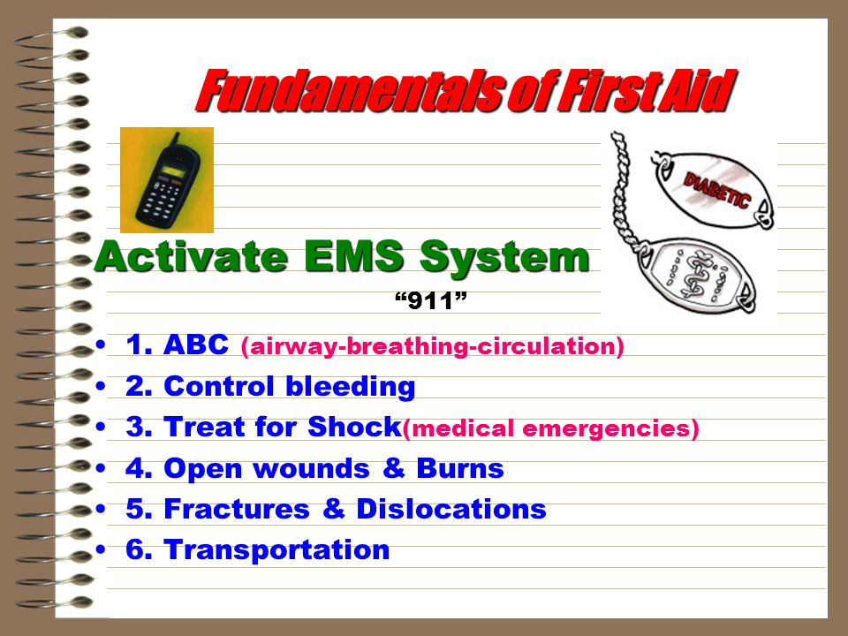

Slide 9
Scope of first aid
The scope of first aid are:
Diagnosis-The first aid must first know how the accident occurred(history) watch for the symptoms
treatment-cause of condition should be removed
For quick referral-casualty/victim should either be taken to hospital or medical attention as soon as possible

Slide 10
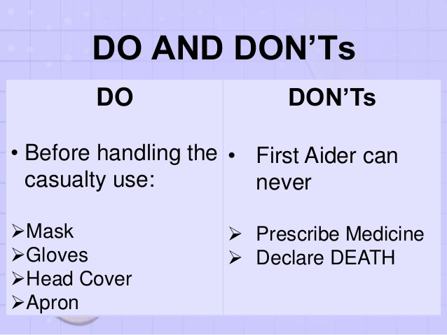

Slide 11
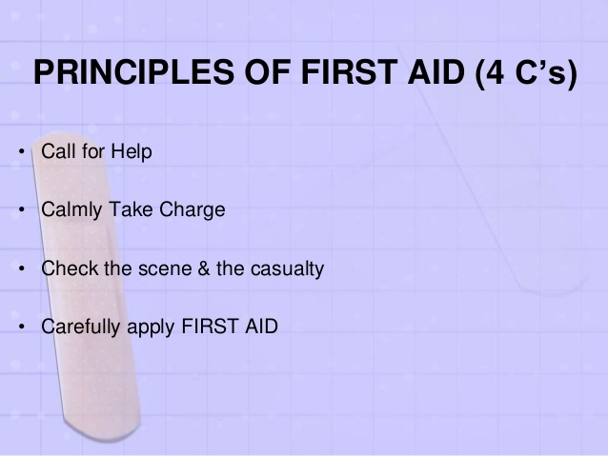

Slide 12
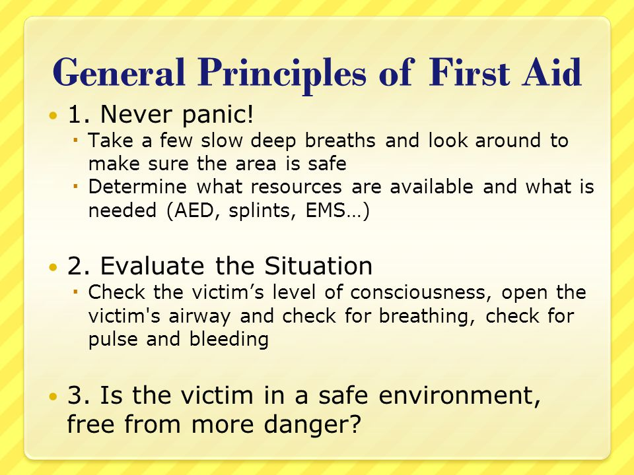

Slide 13
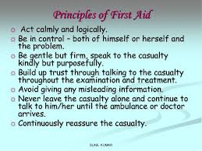

Slide 14
Principles
1.First do no harm
First aid is not an exact science and is open to error
First aid is about putting the first things first.(what is an emergency)
Safety is very important

Slide 15
Principles
Reach the site of accident as early as posssible
Don’t waste time asking unnecessary questions
Find out the cause of the injury
Separation of the causative agent from the patient or the patient from the agent e.g. fire,electrical wire,poisonous insects

Slide 16
Find out whether the patient is dead or alive,conscious or uncoscious
Determine the priority of first aid measures to be adopted. E.g.restoration of breathing,stop bleeding from the site of injury etc.
Arrange for medical aid.

Slide 17
Basic principles of first aid include:
Safe response to emergencies for the benefit of casualties, bystanders and rescuers
Securing the emergency site to reduce further harm to the casualty
Using appropriate first aid procedures and techniques
Safely moving the casualty, minimizing pain and helping stabilize the condition
Providing reassurance and guidance to the casualty
Communication with bystanders and emergency services personnel
Acting in accord with first aid protocol and workplace guidelines

Slide 18
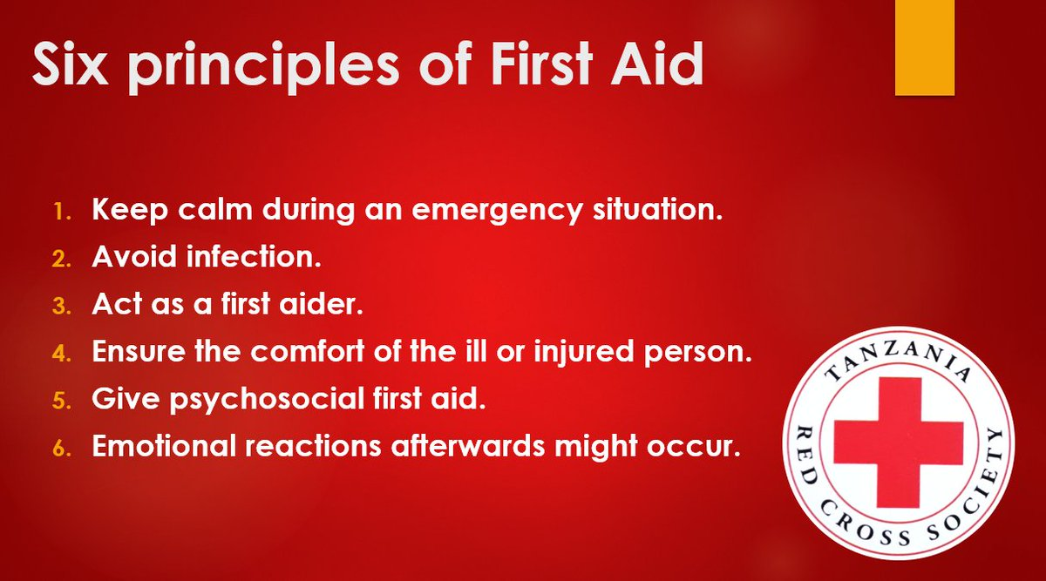

Slide 19
1)

Slide 20
Qualities That Make a Good First Aider
1) Prompt and Quick in Action. First aiders are required to face a variety of emergency situations and this call for immediate action and wise thinking. ...
2) Self- confident and able to remain calm under stress-Ideal first aiders don't panic in emergency situation. ...
3) Excellent Decision Makers. ...
4) Skillful. ...
5) Good Communication Skills. ...
6) Kind and Comforting.
7)Sympathetic and reassuring
8)Ability to work as a team

Slide 21
Qualities Contd…
A good observer
Able to lead to control crowd and take help from onlookers
Knowledgeable enough to recognize injuries, which need to be treated first
Tactful enough to deal with anxious relatives, able to understand his own limitations and avoid assuring the relatives or declaring the patient dead, if so.

Slide 22
First aid kit
First aid kit is a collection of supplies and equipments that is used to give medical treatment. However there is wide variation.
As well as knowing some basic first aid techniques, it is important that households and workplaces have a first aid kit that meets their needs and is well organised, fully stocked and readily available at all times.
The contents should be appropriate to cope with a range of emergency situations, depending on the setting. It’s a good idea to have a number of kits handy in different places, such as in the home, car or office.

Slide 23

The international standard for first aid kit is that they should be identified with ISO graphical symbol for first aid which is an equal white cross on green background.
First aid kits can be assembled in almost any type of container, and this will depend on whether they are commercially produced or assembled by an individual. Standard kits often come in durable plastic boxes, fabric pouches or in wall mounted cabinets. The type of container will vary depending on the purpose, and they range in size from wallet-sized through to large box.

Slide 24
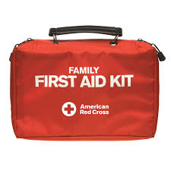
It is recommended that all kits are in a clean, waterproof container to keep the contents safe and aseptic. Kits should also be checked regularly and restocked if any items are damaged or are out of date.
Format
Appearance-International organization for standardization (ISO)sets –green with a white cross.

Slide 25
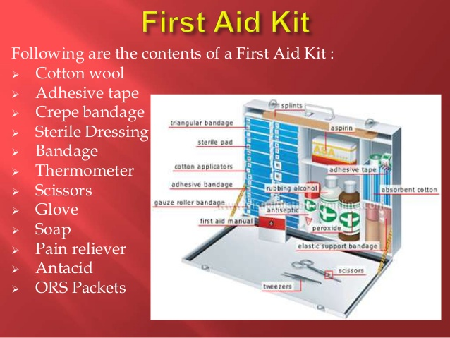

Slide 26
Contents of first aid kit
Medicines (acetaminophen, Ibuprofen, antacid,antibiotic ointment)
alcohol wipes
antiseptic hand cleanser
adhesive tape
sterile dressing (gauze)
Crepe bandages
several sizes of adhesive bandages
thermometer
scissors
triangular bandages
instant cold packs

Slide 27
Gloves,goggles apron,mask
soap
Torch light and extra batteries
Tweezers
Splint
ORS solution

Slide 28
Types of first aid
Emergency first aid is the first response to a life-threatening (or limb-threatening) medical emergency, either an illness or an injury. It's often called first responder training. More advanced medical care will happen after first aid in this case. This type of first aid includes CPR, clearing an airway obstruction, splinting a broken bone, and severe bleeding control.
Non-emergency first aid is the treatment we initiate ourselves for minor medical needs. We may or may not seek more advanced medical care after the initial response. This includes taking over-the-counter medications for minor pain or allergies, cleaning and bandaging cuts or abrasions, and minor bleeding control.

Slide 29
Basic First Aid – It includes the content for Basic First Aid involving life threatening injuries. Focus is on Airway, Breathing and Circulatory emergencies and prevention of such. This course comes with CPR A (Adult skills) or CPR C (Adult, Child and Infant skills).
Standard First Aid- Standard First Aid incorporates all of Emergency First Aid and is designed for those who require a more in-depth understanding of first aid including: legal implications of first aid treatment, spinal injuries, heat or cold injuries,wound care, head neck and spine injuries bone and joint injuries, chest injuries poisoning, and other medical emergencies. This course comes with CPR A (Adult skills) or CPR C (Adult, Child and Infant skills).

Slide 30
Aquatic/Marine first aid is usually practiced by professionals such as lifeguards, professional mariners or in diver rescue, and covers the specific problems which may be faced in water after.
Battlefield first aid takes into account the specific needs of treating wounded combatants and non-combatants during armed conflict.
Child Care First Aid – meant for Dayhome/Daycare Providers. Covers the content for Standard First Aid plus additional content for Childhood Illnesses and Safety. Comes with a level B CPR (Adult, Child and Infant skills).

Slide 31
Mental Health First Aid is a treatment which is given to someone experiencing a mental health problem.It’s training program teaches members of the public how to help a person developing a mental health problem (including a substance use problem), experiencing a worsening of an existing mental health problem or in a mental health crisis.

Slide 32
What is personal protective equipment?
Personal protective equipment, commonly referred to as "PPE", is equipment worn to minimize exposure to hazards that cause serious workplace injuries and illnesses. These injuries and illnesses may result from contact with chemical, radiological, physical, electrical, mechanical, or other workplace hazards. In health it is used for infection protection .

Slide 33
Employers have duties concerning the provision and use of personal protective equipment (PPE) at work.
PPE is equipment that will protect the user against health or safety risks at work. It can include items such as mask, head cap apron, gown, gloves, eye protection(goggles),boot etc.

Slide 34
What can be done to ensure proper use of personal protective equipment?
All personal protective equipment should be safely designed and constructed, and should be maintained in a clean and reliable fashion. It should fit comfortably, encouraging worker use. If the personal protective equipment does not fit properly, it can make the difference between being safely covered or dangerously exposed.

Slide 35
Employers are also required to train each worker required to use personal protective equipment to know:
When it is necessary
What kind is necessary
How to properly put it on, adjust, wear and take it off
The limitations of the equipment
Proper care, maintenance, useful life, and disposal of the equipment
If PPE is to be used, a PPE program should be implemented. This program should address the hazards present; the selection, maintenance, and use of PPE; the training of employees; and monitoring of the program to ensure its ongoing effectiveness.

Slide 36
Legal aspect of providing first aid
In an emergency situation, some people may be reluctant to put their first aid skills into practice due to concerns relating to legal issues and fear of being sued.
The 4 main basic legal issues of first aid are:
Duty of care (obligation): In general, community first aiders need not fear legal litigation if care is made in good faith, and they try to avoid further harm using actions that are not reckless and within their skills and limitations.
Workplace first aiders must act within the scope of their activity of their organisation and according to instruction of the organisation. They must also perform their tasks to the standard expected of a reasonable competent person.
Notes:
Litigation- the process of taking legal action

Slide 37
Negligence: Not fulfilling, or breaking a duty of care could leave the first aider open to questions of negligence. Although unlikely to be sued as a first aider, it is important that first aider confine their activities to their level of training and do not carry out any medical procedures that you have not been trained in.

Slide 38
Consent: If the patient is awake,first aider must gain consent from them before treatment; if they are unconscious you may proceed with care, as consent is considered to be implied. For persons under 18, consent should be obtained from parents/guardians where possible.

Slide 39
Recording: Whether providing first aid in the community or the workplace you will be required to provide details of the incident. This might be to a supervisor, parent or carer, ambulance officer, medical professional or someone else. It is good practice to take notes during or soon after providing first aid. Workplace first aid officers will be required to record the first aid incident, and any care or treatment administered on the relevant workplace form.

Slide 40
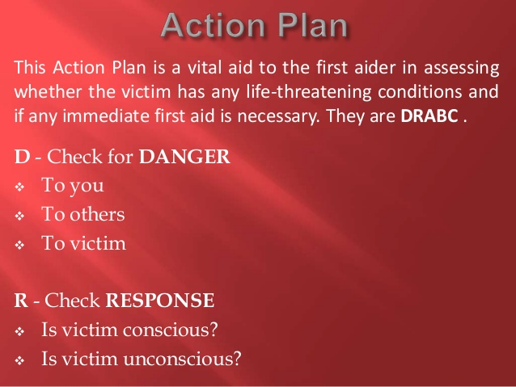

Slide 41
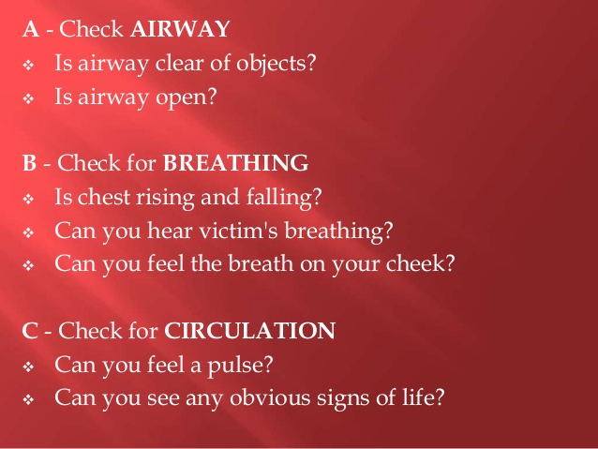

Slide 42
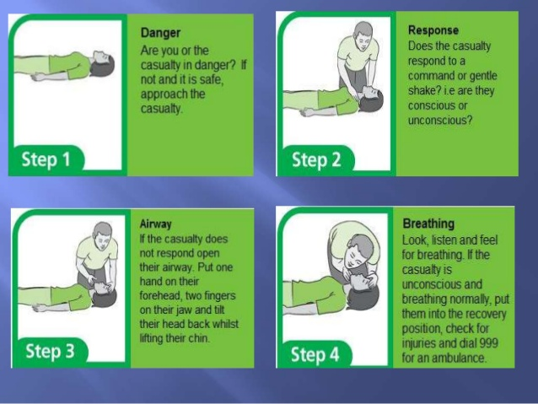

Slide 43
Role of first Aider
The role of first aid provider is to give first aid,making sure that anyone else involved are safe and they don’t make the situation worse
a. Assess the situation quickly and calmly
safety: Are you or they in any danger?
Scene: what caused the accident or situation? How many casualties are there?
Situation :what is happened? What do you think the major injuries could be?
b. Protect yourself and them from any danger
Always protect yourself first, never put yourself at risk.
Only move them safety if leaving them would cause them more harm.
If you can’t make an area safe, call for emergency help.

Slide 44
Prevent infection between you and them
Wash your hands properly
Wear disposable gloves
Don’t touch an open wound without gloves
Don’t breathe,cough or sneeze over the wound of the casualty.
d. Provide comfort and reassure
Stay calmly and take charge of situation
Introduce yourself to them
Explain what is happening.

Slide 45
e. Give first aid treatment: Assess the casualty,
prioritize the situation
f. Arrange for the right kind of help
Call 911/112 for ambulance
Stay with them until you can leave them in right care.
Refer to hospital if situation is likely to worsen

Slide 46
Responsibilities of first aider
To access a situation quickly and safely and provide appropriate help
To protect casualties and others at the site from possible danger.
To identify as far as possible,the injury or nature of illness affecting a casualty.
To give each casualty early and appropriate treatment,treating the most serious case first.
To arrange for referall of casualty to hospital or to his or her home.
To remain with the casualty until appropriate care is available.
To report your observation to those taking over care of the casualties and to give further assistance as required.

Slide 47
Duties
Ensure your current first aid certificate information updated.
Be familiar with the first aid procedure.
The victim should be given services where he/she lies.
In certain circumstances,injured person must be moved to prevent from further injury from fire and explosion etc.
Respond quickly to provide an emergency service for illness/ injury as needed.
Render appropriate first aid service and CPR until referral/transportation of casualty to medical facilities.
Arrange prompt and suitable referral as needed.

Slide 48
Record all the treatment on the first aid form.
Preserve first aid facilities,including first aid equipment,checking and restocking first aid kits as necessary.
Report any need of first aid equipments to concerned authorities or official.

Slide 49
Different Terms of Infection prevention
Infection-It is the invasion of the body by pathogens that reproduce and cause disease
Local infection-limited to specific part of the body where the microorganism remain.
Systemic infection-Microorganism spread and damage different parts of the body.
Sepsis-A combination form meaning pertaining to decay or infection.

Slide 50
Asepsis-The process by which environment of the patient is protected from contact with infective organism.
Asepsis or Aseptic technique-Aseptic techniques are general term used in health care setting to describe the combination of efforts made to prevent the entry of micro-organisms into any area of the body where they are likely to cause infection.
Antisepsis-It is the prevention of infection by killing or inhibiting microorganism on skin and other body tissue,by using a chemical agent.

Slide 51
Cleaning-It is the process that physically removes all visible blood, body fluids or any other foreign materials such as dust or dirt from skin or inanimate objects.
Disinfectant-It is a germicidal chemical substance used on inanimate objects to kill pathogenic microorganisms but not necessarily all others.
Disinfection-It is the process that eliminates most but not all disease causing microorganisms .High level disinfection (HLD) by boiling or the use of chemicals eliminate all microorganisms except bacterial endospores.

Slide 52
Decontamination-It is the process that makes objects safer to be handled by the staff, especially cleaning personnel,before cleaning.Such objects include large surface e.g.(operation table),surgical instruments and gloves

Slide 53
Disinfection-Procedure and treatment that eliminates many or all pathogenic microorganism with the exception of bacterial spores.
Sterilization-Process of killing all microorganism including spores.
Method of sterilization
1.Autoclave
2.Dry heat
3.Chemical

Slide 54
High level disinfection
HLD eliminates most but not all disease causing microrganisms except bacterial endospores. Kills hepatitis B,C and HIV virus.95% effective against microorganisms.
Boiling-heating to 100 degree or more kills vegetative forms of bacterial pathogens,almost all viruses and fungi within 2 minutes.Endospores and some viruses are not destroyed so quickly.Hepatitis virus can survive up to 30 minutes of boiling.
Chemical method- chemicals used are:
Formaldehyde: for 20 mins
Gluteraldehyde :for 20 mins
0.1% chlorine solution for 20 mins

Slide 55
Autoclave-Sterilization is done by steam under pressure.
Most widely used method.
Used with 15-20 pound pressure for 15-45 minutes at a temperature of 121 degree centigrade.
Kills spores.
Forceps,scalpel,scissors,needles syringe, linen,gauze etc. are used.

Slide 56
Dry heat-High temperature and long exposure times are required for hot air oven. Itis done at a temperature of 170 degree centigrade for 2 hours.Glass, ,eye instruments and delicate instruments are sterilized in this method.
Chemical-Chemicals used are:
Formaldehyde-commonly used as formalin,8% for 24 hours.
Gluteraldehyde-More effective than formaldehyde.A 2% solution of gluteraldehyde (cidex) is bactericidal tuberculocidal, and varicidal used for 8-10 hrs.

Slide 57
Difference between antiseptic and disinfectant
Antiseptics and disinfectants both are antimicrobials that kill microorganisms, and many people use the terms interchangeably. Antiseptics are sometimes called skin disinfectants.
But there’s a big difference between antiseptics and disinfectants. An antiseptic is applied to the body, while disinfectants are applied to nonliving surfaces, such as floors, walls, chairs, handrails. In a surgical setting, for example, a doctor will apply an antiseptic to the surgical site on a person’s body and use a disinfectant to sterilize the operating table.

Slide 58
antiseptic and disinfectant
An antiseptic is a substance that stops or slows down the growth of microorganisms. They’re frequently used in hospitals and other medical settings to reduce the risk of infection during surgery and other procedures.
Different types of antiseptics are used in medical settings. These include hand rubs, hand washes, and skin preparations. Some are also available over the counter (OTC) for home use.

Slide 59
Both antiseptics and disinfectants contain chemical agents that are sometimes called biocides. Hydrogen peroxide is an example of a common ingredient in both antiseptics and disinfectants. However, antiseptics usually contain lower concentrations of biocides than disinfectants do.

Slide 60
Uses of antiseptics
Hand washing. Medical professionals use antiseptics for hand scrubs and rubs in hospitals.
Disinfecting mucous membranes. Antiseptics can be applied to the urethra, bladder, or vagina to clean the area before inserting a catheter. They can also help to treat an infection in these areas.
Cleaning skin before an operation. Antiseptics are applied to the skin before any kind of surgery to protect against any harmful microorganisms that might be on the skin.

Slide 61
Treating skin infections. We can buy OTC antiseptics to reduce the risk of infection in minor cuts, burns, and wounds. Examples include hydrogen peroxide.
Treating throat and mouth infections. Some throat lozenges contain antiseptics to help with sore throats due to a bacterial infection.

Slide 62
Common disinfectants include alcohols, quarternary ammonium salts, formaldehyde and glutaraldehyde, bleach, chloramine, chlorine dioxide, ozone, silver dihydrogen citrate, and thymol. One non-chemical disinfectant is UV light.
glutaraldehyde (Cidex)- glutaraldehyde 2% solution, kills all pathogens.It is bactericidal,tuberuculocidal,varicidal,fingicidal
Complete disinfection is 10 min,sporicidal within 4 hrs.
Hydrogen peroxide-Highly disinfectant,6% solution required for the equipment to get disinfected in less than 30 min. After immersion the instruments must be rinsed with sterile water.

Slide 63
Phenolic compound
Phenol –It is dark in color and strong irritant.Pure form may cause skin burns.
Composition-0.5-1% of carbolic acid
Disinfection of sharp instruments in 100% solution,should be immersed for 2-3 hrs and in 20% solution for 24 hrs.
Diluted solution is used for disinfection of dog bite wounds

Slide 64
Lysol-Dark brown colour,irritant chemical and cause burn when itcomes in contact with the skin.
30 min for 100% solution
Needles ,knives, scissors are used
Chloroxylenol (dettol)
2.5% for thermometers (disinfects in 5 min)
5% for instruments and plastic equipment (disinfects in 5-15 min)

Slide 65
Some antiseptics are: hydrogen peroxide, iodine, polyhexanide, and povidone-iodine, alcohol, boric acid, and benzalkonium chloride.
Spirit
Alcohol,(optimum concentration of 70% alcohol is highly effective
Used for disinfection of skin before IM/IV injections.
Used along with other disinfectants,for painting the parts before operation.
Savlon-Cleansing agent having disinfectant properties as well.Widely used in 1% solution for cleaning the skin before cleansing of wound.Germicide and detergent properties.

Slide 66
COMMON ANTISEPTICS
Chlorhexidine. ...
Povidone-Iodine. ...
Chloroxylenol. ...
Isopropyl Alcohol. ...
Hexachlorophene. ...
Benzalkonium Chloride. ...
Hydrogen Peroxide

Slide 67
Fumigation-It is disinfection by exposure to the fumes of vaporized disinfectant or use of fumes or gases to destroy organisms.
Fumigation with sulphur
Fumigation with formalin

Slide 68
Chlorhexidine, is a disinfectant and antiseptic that is used for skin disinfection before surgery and to sterilize surgical instruments. It may be used both to disinfect the skin of the patient and the hands of the healthcare providers.

