Slide 1
UNIT II
FOOD FORTIFICATION
BY:
Laxmi Adhikari
Nutritional science
2nd sem

Slide 2
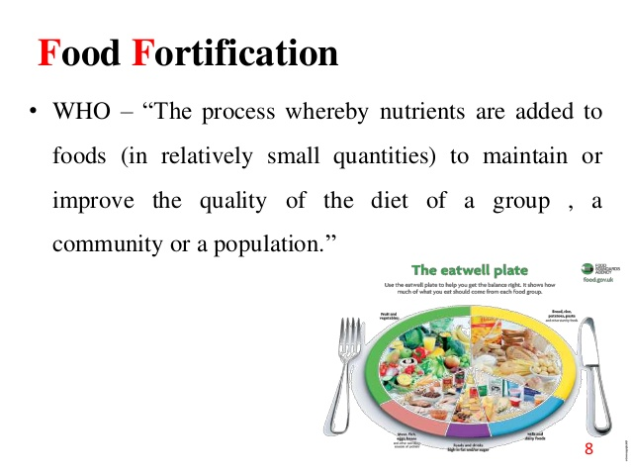

Slide 3
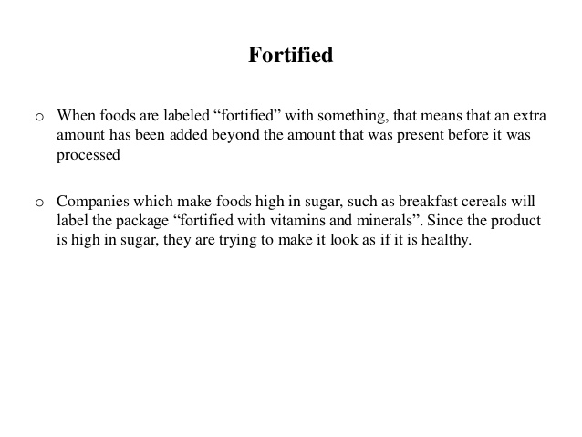

Slide 4
As defined by the World Health Organization (WHO) and the Food and Agricultural Organization of the United Nations (FAO), fortification refers to "the practice of deliberately increasing the content of an essential micronutrient, ie. vitamins and minerals (including trace elements) in a food, so as to improve the nutritional quality of the food supply and to provide a public health benefit with minimal risk to health", whereas enrichment is defined as "synonymous with fortification and refers to the addition of micronutrients to a food which are lost during processing".

Slide 5
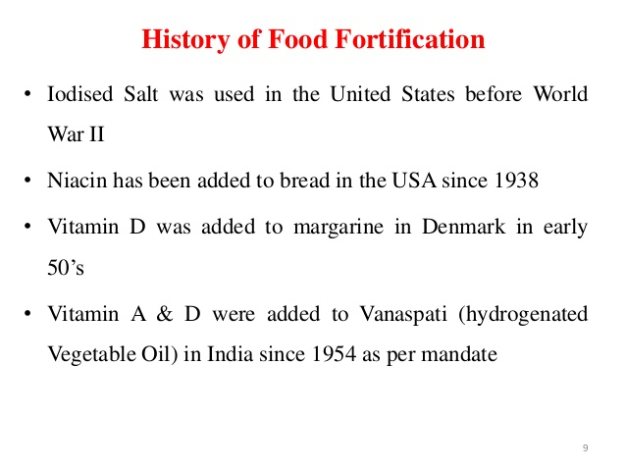

Slide 6

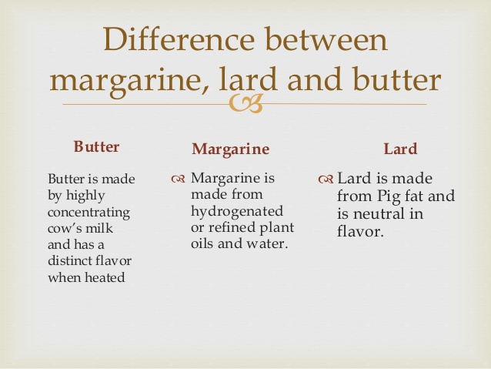

Slide 7
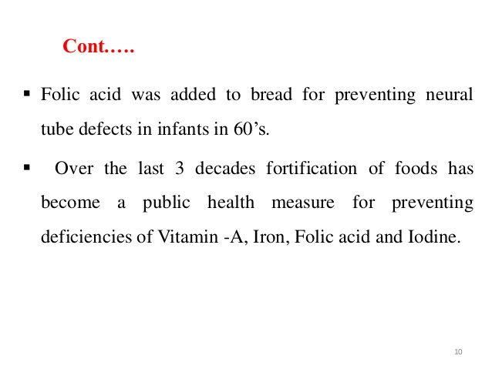

Slide 8
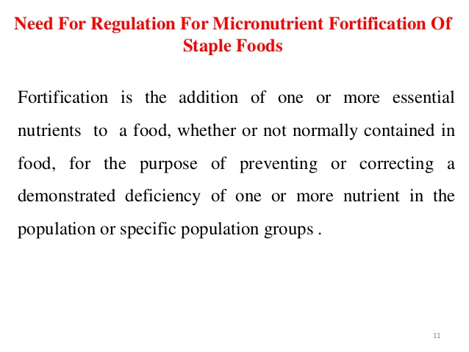

Slide 9
The original purpose of food fortification was to decrease the occurrence of nutrient deficiencies, particularly in populations that lack access to sufficient amounts of essential nutrients.
Food fortification helps people living in developed countries as well as those in underdeveloped countries, where a variety of foods are not always available.
Fortified foods help to fill in the nutritional gaps in our diet.
They can deliver vitamins and minerals to large portions of the population without requiring large changes in our behaviour or diet

Slide 10
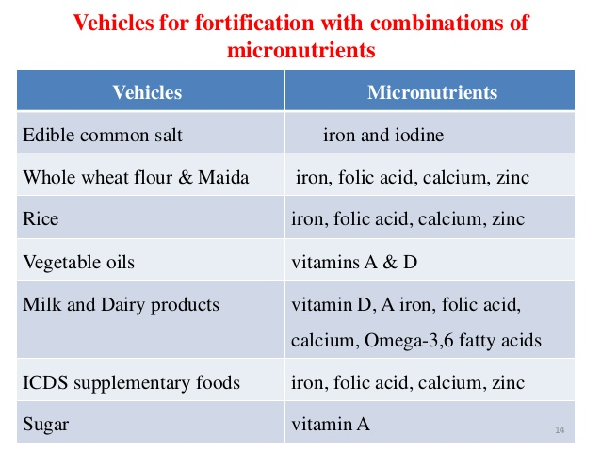

Slide 11
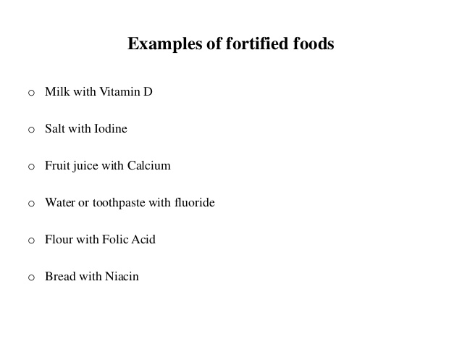

Slide 12
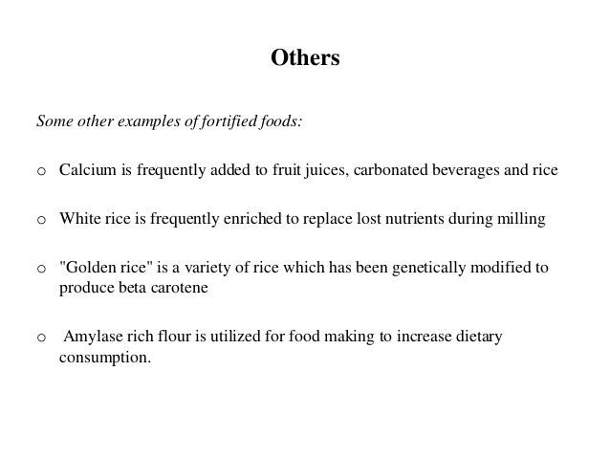

Slide 13
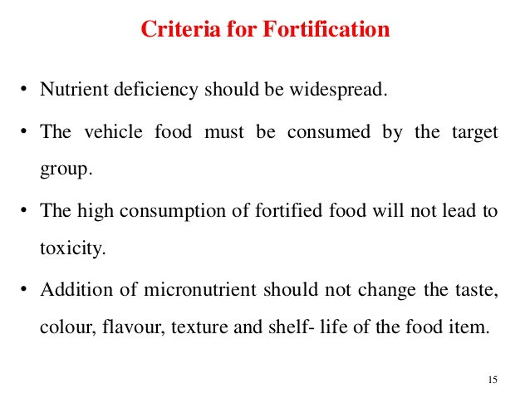

Slide 14
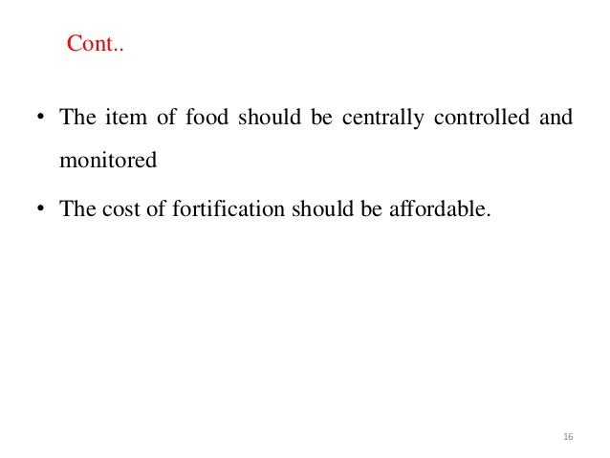

Slide 15
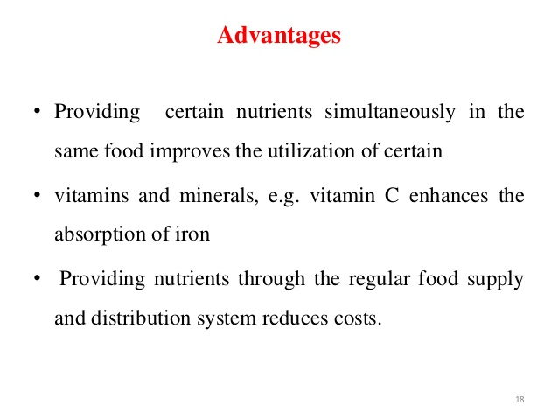

Slide 16
Fortification is one of the most cost effective strategies that can be implemented on a larger scale since the cost of fortification is generally less than other techniques to address nutrition deficiencies.
Fortified foods are considered to be better at lowering the risk of multiple deficiencies that can result from seasonal deficits in the food supply or a poor quality diet.
Fortification does not require any behaviour modification or compliance that is expected in supplementation. It does not require a change in the individual food habits and consumption pattern.

Slide 17
The quantity of micronutrients added to the food product is small and well regulated, and so the likelihood of an overdose of nutrients is unlikely.
Fortification is planned in such a way that the intrinsic characteristics of the food are not altered, such as the taste, the appearance and the texture.
The food fortification process can be initiated quickly after formulating a set of regulations and standards. This means that the objective of improving the health of needy communities can be attained in a short period of time

Slide 18
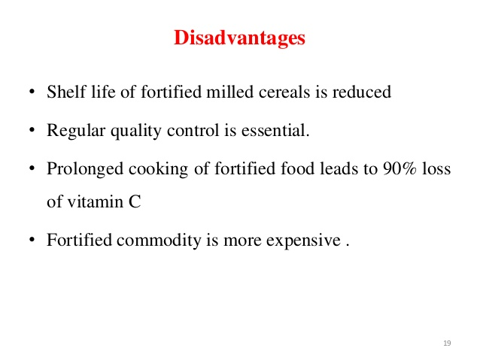

Slide 19
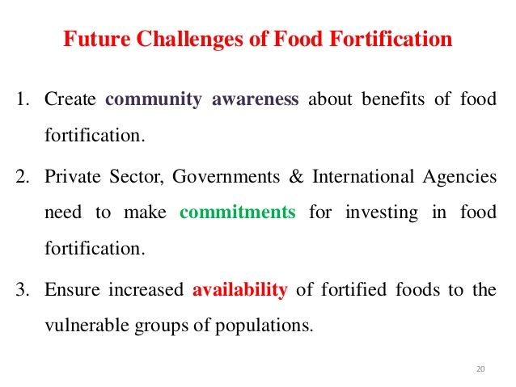

Slide 20
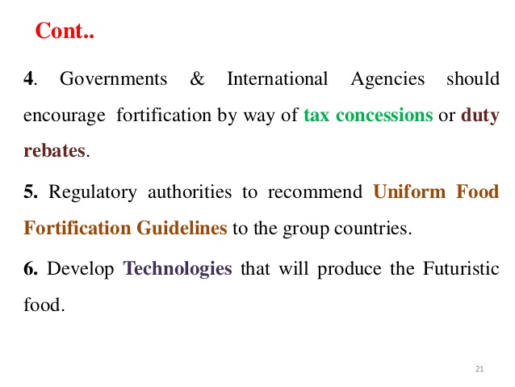

Slide 21
Types of food fortification
Main methods of food fortification:
Commercial and industrial fortification (wheat flour, corn meal, cooking oils)
Biofortification (breeding crops to increase their nutritional value, which can include both conventional selective breeding, and genetic engineering). Biofortification differs from ordinary fortification because it focuses on making plant foods more nutritious as the plants are growing, rather than having nutrients added to the foods when they are being processed
Home fortification (example: vitamin D drops , MNP)

Slide 22


