Slide 1
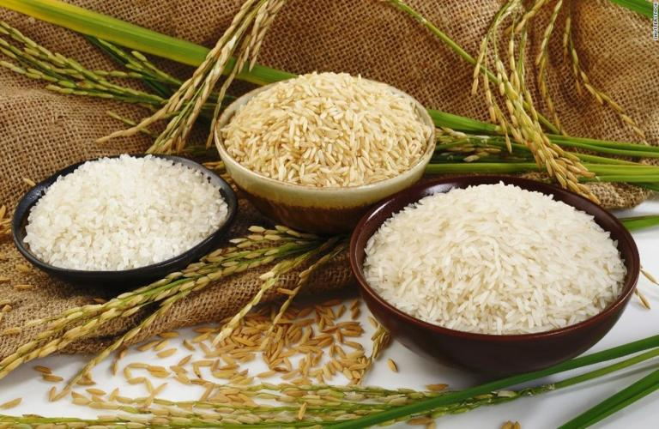
Food fortification, introduction, importance, advantages, types, WHO/FAO guideline

Slide 2


Slide 3


Slide 4


Slide 5
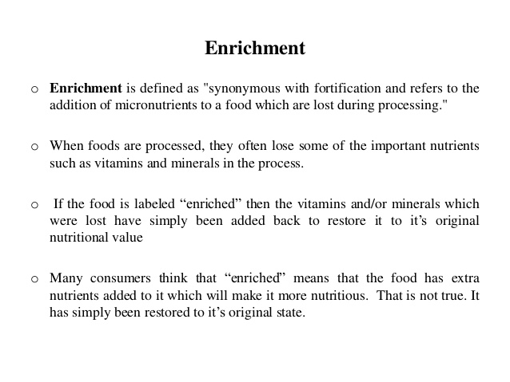

Slide 6
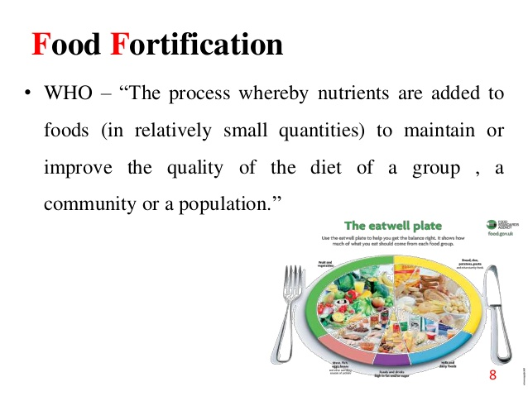

Slide 7
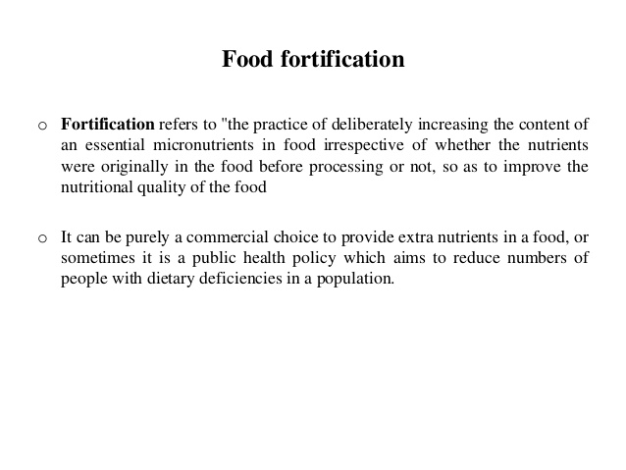

Slide 8
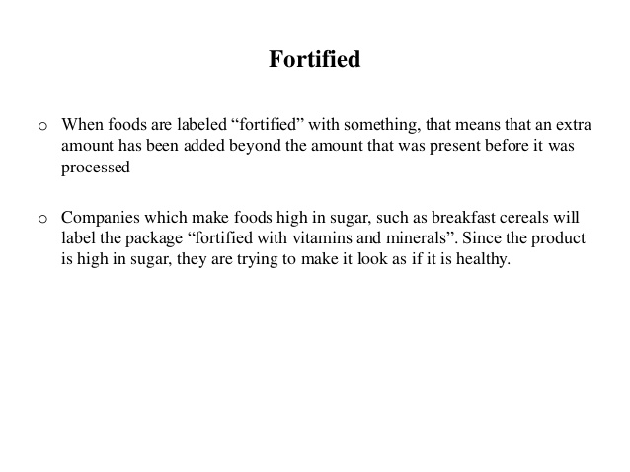

Slide 9
Types of food fortification
Food fortification can take several forms
Mass fortification-It is possible to fortify foods that are widely consumed by the general population
Targeted fortification-to fortify foods designed for specific population subgroups, such as complementary foods for young children or rations for displaced populations
Market-driven fortification-to allow food manufacturers to voluntarily fortify foods available in the market place

Slide 10
Types of food fortification
Generally speaking, Mass fortification is nearly always mandatory, targeted fortification can be either mandatory or voluntary depending on the public health significance of the problem it is seeking to address,
Market-driven fortification is always voluntary, but governed by regulatory limits
The choice between mandatory or voluntary food fortification usually depends on national circumstances.

Slide 11
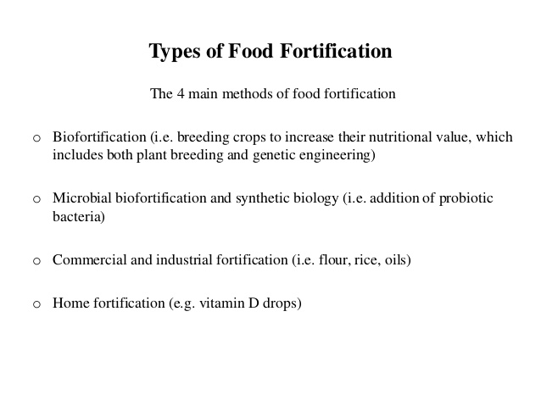
Other types of food fortification

Slide 12
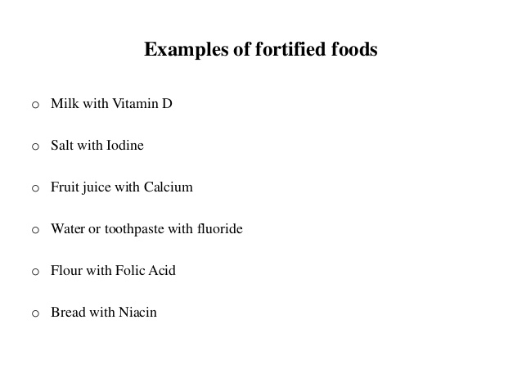

Slide 13
Advantage of food fortification
If consumed on a regular and frequent basis, fortified foods will maintain body stores of nutrients more efficiently and more effectively than will intermittent supplements.
Fortified foods are also better at lowering the risk of the multiple deficiencies that can result from seasonal deficits in the food supply or a poor quality diet. This is an important advantage to growing children who need a sustained supply of micronutrients for growth and development, and to women of fertile age who need to enter periods of pre lactation with adequate nutrient stores.
Fortification can be an excellent way of increasing the content of vitamins in breast milk and thus reducing the need for supplementation in postpartum women and infants.

Slide 14
Advantage of food fortification
Fortification generally aims to supply micronutrients in amounts that approximate to those provided by a good, well-balanced diet. Consequently, fortified staple foods will contain “natural” or near natural levels of micronutrients, which may not necessarily be the case with supplements.
Fortification of widely distributed and widely consumed foods has the potential to improve the nutritional status of a large proportion of the population, both poor and wealthy.
Multiple micronutrient deficiencies often coexist in a population that has a poor diet. It follows that multiple micronutrient fortification is frequently desirable. In most cases, it is feasible to fortify foods with several micronutrients simultaneously.

Slide 15
Advantage of food fortification
It is usually possible to add one or several micronutrients without adding substantially to the total cost of the food product at the point of manufacture.
When properly regulated, fortification carries a minimal risk of chronic toxicity.
Fortification is often more cost-effective than other strategies, especially if the technology already exists and if an appropriate food distribution system is in place

Slide 16
Limitation of food fortification
While fortified foods contain increased amounts of selected micronutrients, they are not a substitute for a good quality diet that supplies adequate amounts of energy, protein, essential fats and other food constituents required for optimal health.
A specific fortified foodstuff might not be consumed by all members of a target population. Conversely, everyone in the population is exposed to increased levels of micronutrients in food, irrespective of whether or not they will benefit from fortification
Very low-income population groups are known to have coexisting multiple micronutrient deficiencies, as a result of inadequate intakes of the traditional diet. Although multiple micronutrient fortification is technically possible, the reality is that the poor will be unable to obtain recommended intakes of all micronutrients from fortified foods alone.

Slide 17
Importance of food fortification
Improve the nutritional status of target populations and minimal risk to health.
Improve the nutritional quality & value of the food
Address population-wide nutrient deficiencies
Reduce the risk of neural tube birth defects,
Food fortification provides a practical and inexpensive alternative of diseases such as goiter, rickets, beriberi and pellagra were once common health problems
Provide certain technological function in food processing
Cost effective approach
Increase productivity
Increase economic progress

Slide 18
Scope of food science and nutrition in public health
Food Science is a vast field. Off late it has been booming tremendously. Food is a basic necessity for humans.
Food science, there are two major divisions. One is the Food Science and Nutrition, and the other Food Science in the Food Industry. Both the fields are expanding in India and abroad, but both are equally demanding.
Food choices and lifestyles have changed over time. Diseases and Disorders have spread rapidly. Weight loss and Healthy Body goal are gaining popularity.
Nutritionist can help the vast amount of people and can cater to their needs. The Food Industry is another sector closely related to the Nutritional Sector as they deal with Nutritional Value of the Products sold in Markets.

Slide 19
