Slide 1
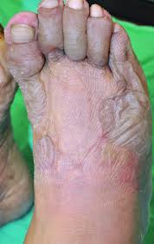
Frostbite

Slide 2
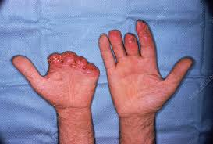
Definition
Frostbite is an injury caused by freezing of the skin and underlying tissue.
Mainly caused by exposure of body parts below freezing point like fingers, toes, feet ,tip of ear , nose etc.

Slide 3
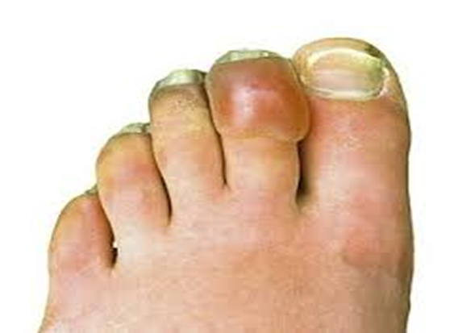
Sign and symptoms
The person experience burning, numbness, tingling, itching, or cold sensations in the affected areas.
The regions appear white and frozen.

Slide 4
Contd…
In severe condition, there is an initial decrease in sensation that is eventually completely lost.
Swelling and blood-filled blisters are noted over white or yellowish skin that looks waxy and turns a purplish blue as it rewarms.
Loss of sensation, has no resistance when pressed on, and may even appear blackened and dead.

Slide 5
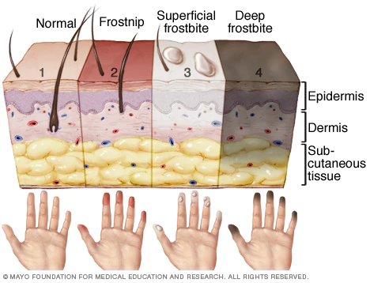
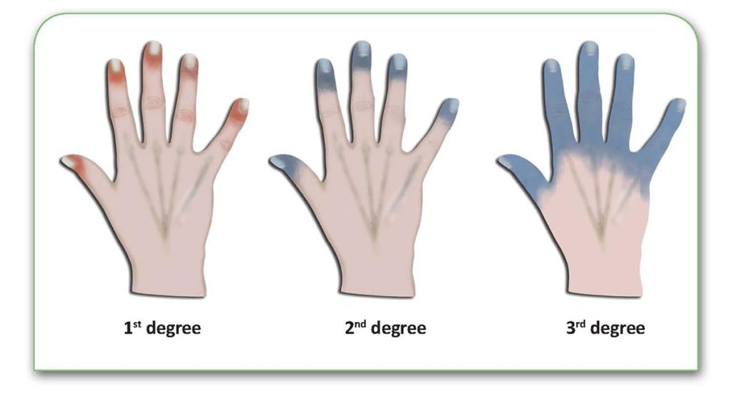
Stages of frost bite

Slide 6
Stages of frost bite
Frostnip : Frostnip is a mild form of frostbite. Continued exposure leads to numbness in the affected area. The skin is warms, victim may feel pain and tingling. Frostnip doesn't permanently damage the skin.

Slide 7
2. Superficial frostbite : Superficial frostbite appears as reddened skin that turns white or pale. The skin may begin to feel warm — a sign of serious skin involvement. If you treat frostbite with rewarming at this stage, the surface of skin may appear mottled. And you may notice stinging, burning and swelling. A fluid-filled blister may appear 12 to 36 hours after rewarming the skin.

Slide 8
3. Deep (severe) frostbite : As frostbite progresses, it affects all layers of the skin, including the tissues that lie below. The skin turns white or bluish gray and victim may experience numbness, losing all sensation of cold, pain or discomfort in the affected area. Joints or muscles may no longer work. Large blisters form 24 to 48 hours after rewarming. Afterward, the area turns black and hard as the tissue dies.

Slide 9
Treatment (first aid):
Check for hypothermia:
Get emergency medical help if you suspect hypothermia. symptoms include : intense shivering, drowsiness, muscle weakness, dizziness, and nausea
Protect skin from further damage

Slide 10
Warm frostbitten parts.
Protect face ,nose ,or ears by covering with either mask or ears by thick cap or by dry gloved hands.
Don’t rub the affected area and don’t walk on frostbitten feet or toes if possible.

Slide 11
Get out of cold:
Remove wet clothes and wrap up in a warm blanket. Take care not to break any blisters
Gently rewarm frostbitten area:
Soak the frostbitten area in warm water -99 to 104 F for about 30 min.
Stop rewarming if skin color becomes normal or looses numbness.
Don’t rewarm frostbitten skin with direct heat such as stove, heat lamp ,fireplace or heating pad .this can cause burn.

Slide 12
Drink warm liquids:
Tea coffee or soup can help to warm from inside, don’t let to drink alcohol .
Consider pain medicine:
OTC drugs for reliving pain can be given.

Slide 13
