Slide 1

Mental Health Program in Nepal
Presented by:
Menaka Paudel (Roll no: 17)
Sujita Subedi (Roll no: 36)
BPH 7th Semester
Presented to :
Asso.Professor
Dr.Hari Prasad Kaphle

Slide 2
Introduction
Mental health problems constitute of 18% of the total NCDs and is the 4th leading cause of disability.
10% of the adult population had some mental disorder in their lifetime and 4.3% currently had some mental disorder.
The prevalence of suicidality was 7.2%, current suicidality was 6.5%, lifetime suicidal attempts were1.1%, and future suicidal attempts was 0.3%.
There is increased risk among the vulnerable.
Notes:
Data according to mental health survey 2020(2077)…. Examples: poor, hard to reach population, homeless, conflict affected, survivors of violence, minority groups, non-binary gender, prisoners, people in humanitarian settings etc.

Slide 3
Background
History of mental health services in Nepal roots back to 2018(1961) as an out-patient service from Bir hospital.
The Government of Nepal has strengthened its political commitment to mental health by establishing an NCDs and Mental Health Section under EDCD.
Mental health care has been included in the list of basic health services in subsection 4(e) of section 3 of the public health service act , 2075.
The public health service regulations have expanded the type of mental health services to be included in basic health services and emergency Health service packages.
The National health policy 2019, section 6.17.5, has a strategy to expand mental health services integrated into overall health systems.

Slide 4
Background cont.
There is no standalone mental health policy in Nepal.
The National Mental Health Strategy and action plan 2020(2077B.S.) provides a more comprehensive description of Nepal’s plan for mental health care.
This strategic action plan describes the provision of free primary care mental health services for all parts of the country.
Key components incorporated with this strategic action plan are:
-Integration of Mental Health at Primary Health care level.
-Strengthening mental health at Secondary Health Care level.
-Service user engagement in policy development and planning.

Slide 5
Milestone of Mental Health Program in Nepal
1961: Psychiatric Outpatient services started at Bir Hospital, Kathmandu
1965: Psychiatric In-patient services initiated at Bir Hospital
1985: Patan Mental Hospital (Lagan Khel, Lalitpur) established
(First specialized mental health hospital)
1996/97: National Mental Health Policy adopted
2017: Community Mental Health Care Package developed
(Integration of mental health services into Primary Health Care)

Slide 6
Milestone of Mental Health Program in Nepal
2020: National Mental Health Strategy & Action Plan endorsed
2021: Mental health integrated under EDCD (NCD & Mental Health Section)
Nepal joined WHO Special Initiative for Mental Health
2022: National Mental Healthcare Program adopted
(Nationwide expansion, community care & suicide prevention

Slide 7
National Mental Health Care Programme Nepal 2022 (2079/80)
It provides a framework for the delivery of PHC-oriented mental health services.
It guides programme managers on implementing the Public Health Service Act 2018, Public Health Service Regulation 2020, and the National Mental Health Strategy and Action Plan 2020.
It prioritizes practical, equitable, and need based mental health care, considering the current health system capacity, infrastructure and community needs.
It emphasizes people-centered care, community participation, and enhanced access to mental health services.
It aims to provide basic mental health services at the primary healthcare level and focused care at secondary health facilities.
Notes:
Programme managers of all levels

Slide 8
Context
The Constitution of Nepal mandates free basic health services and equal access to health services for every citizen.
Mental health care has been included in the list of basic health services in Subsection 4 (e) of Section 3 of the Public Health Services Act, 2075 (2018).
Mental health services have also been included as basic and emergency health services under the Public Health Regulations 2077 (2020),
And Chapter 7 of the Act Relating to Rights of Persons with Disabilities, 2074 (2017) guarantees citizens’ rights to health, rehabilitation, and social security.
Sections 35 and 36 of the Act also ensure additional service facilities for people with mental or psychosocial disabilities.
Notes:
Mental health services have also been included in the “basic and emergency health services” in Schedules 1 and 2of the Public Health Regulations 2077 (2020), and service arrangements to be made for mental health at the federal, provincial and local levels. Chapter 7 of the Act Relating to Rights of Persons with Disabilities, 2074 (2017) confers all citizens with the rights to health, rehabilitation, social security and recreation

Slide 9
Guiding Principles of Mental Health Care Program
Strengthen primary health care capacity to deliver mental health care services;
Strengthen people-centred, culturally sensitive, gender-appropriate mental health services;
Build connected services along the continuum of care, with strong PHC linkage to improve access to care;
Respect the rights of people living with mental health conditions and provide rights-based care;
Focus on equity so that the poor and deprived are covered while pursuing mental health care for all;
Recognize the roles service users, their caregivers and the wider community in promoting mental health and well-being; and
Ensure collaboration and partnership between the government, NGOs and the private sector.
Notes:
service users=persons with mental health conditions

Slide 10
Vision and Objectives
Vision:
“Enabling all Nepalese to lead a productive and quality life by improving their mental health and psychosocial well-being”.
Objective:
To deliver the basic package of mental health services at the PHC level and focused mental health care at secondary health facilities.
Notes:
This would be achieved in collaboration with academic institutions, NGOs and communities through a PHC-oriented model of service delivery

Slide 11
Specific Objectives:
Strengthen health care system to allow for the integration of mental health services, on a priority basis, into BHSCs, basic hospitals and general hospitals;
Follow an integrated people-centered model of care characterized by team-based practices, strive for result-oriented care, and ensure coordination of care and continuity of services across all levels of care;
Improve staffing, including the creation of a dedicated cadre to deliver the specified mental health services in district-level general hospitals;
Develop strategic linkages with communities for the promotion of mental health, reduction of stigma and improvement in help-seeking behavior; and
Strengthen data system to measure and monitor the progress of mental health services.

Slide 12
Five Strategies of National Mental Health Strategy and Action Plan 2020 (2077)
Ensure easy availability, affordability, and equitable access in mental health services.
Manage resources, human resources and institutionalize mental health and psychosocial services.
Promote mental health and increase awareness to eliminate superstitions, myths related to mental health.
Protect human right of people with mental health problem and psychosocial disability.
Integrate mental health services information with existing health information system and promote research.

Slide 13
Key Programs |Activities for mental health
Scaling of Suicide prevention with a multi prong collaborative action
Suicide prevention orientation workshop.
Developing national suicide prevention action plan led by National Planning Commission.
Nepal has band on 26 pesticide since 2019.
NHEICC has developed National reporting guide for media persons on suicide and trained 293 journalists.
24 /7 suicide helpline supported by WHO and local NGOs.

Slide 14
Nepal Suicide Prevention Helpline
S.N | Organization name | Service time | Phone number
1 | National Suicide Prevention Helpline | 8 am to 8 pm | 1166
2 | TUTH | 24 | 16600121600
3 | Mental health helpline Nepal | 8 am to 8 pm | 16600133666
4 | Nepal emergency hotline | 24hrs | 110|112
5 | Patan hospital suicide hotline | 24 hrs | 9813476123
6 | TPO Nepal | 24hrs | 16600102005

Slide 15
2. Child and Adolescent Mental Health(CAMH) services
Integration of child and adolescent mental health(CAMH) services at the primary care level.
In Karnali 46,864 adolescents were reached with Socio-Emotional Learning (SEL) under the WHO-UNICEF helping adolescents thrive (HAT) initiative.
The Government of Nepal, with support from NORAD,has established two specialized child mental health facilities in Kanti Children Hospital and Mental Hospital.
3. Psychotropic Medications
Health facilities across Nepal provide various psychotropic medications free of costs including antipsychotics, anti-depressants, anxiolytics, mood stabilizers, and anti-epileptics ( Amitriptylline, Fluoxetine, Carbamazepine, Phenobarbitone, Sodium Valproate, Riseperidone, Diazepam, etc.).

Slide 16
4. Integrating Mental Health into maternal health services
FWD and EDCD with support from WHO has started prioritizing maternal mental healthcare.
Paropakar Maternity and Women’s Hospital (PMWH),Nepal’s only government tertiary maternity hospital, has been a key player, providing psychosocial counseling.
5. Multi-sectoral Mental Health and Psychosocial Support (MHPSS) Preparedness during Emergences
Strengthening mental health systems and services for emergency preparedness in Sudurpaschim and Karnali Provinces.
Providing mental health and psychological support services to earthquake affected children and adolescent in Jajarkot and Rukum west through UNICEF along with Karnali subcluster.

Slide 17
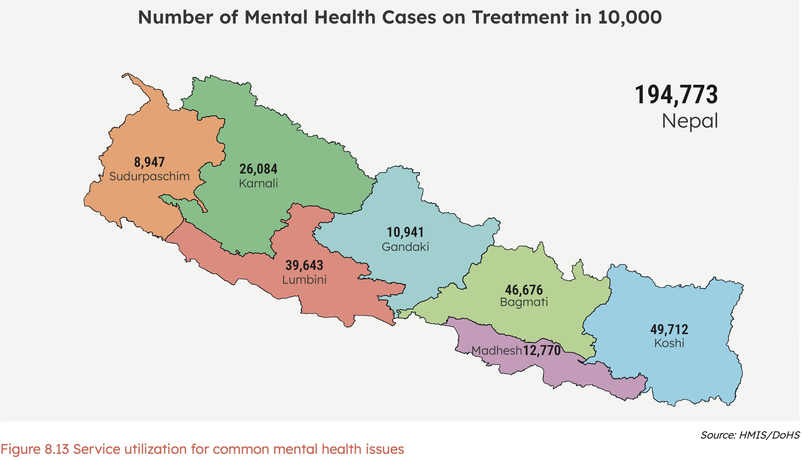
Service Utilization for Mental Health Issues

Slide 18
SWOT Analysis
Strengths
Expansion of mental health programme at grassroot level.
Prioritized capacity building activities including private sector with database for training.
Immediate planning to address issues of provincial and national review.
Effective communication and collaboration among supporting partners.
Increased participation of NGO, INGOs working in Mental health in the national programme.
Regular meetings of steering, coordination and technical committees.

Slide 19
Weaknesses
Inadequate institutional set up and human resources.
Insufficient training for newly recruited health workers.
Low priority for mental health programme at sub-national level.
Inadequate supply for medicine and equipment.
Access and quality of services in rural and underserved areas is not regulated.

Slide 20
Opportunities
Evidence based planning aligned with the national mental health strategy and action plan 2020
Resource mobilization, partnerships, and collaboration with local Government and new partners
Increased collaboration and coordination among all three tiers of Government
Public private partnership initiatives
Threats
Poor motivation of health workers
Retaining trained human resources
Stigma and discrimination related to mental health

Slide 21
Suggestions
Strengthen integration of mental health services into primary health care to improve access and early detection.
Ensure adequate and continuous availability of essential psychotropic medicines at all levels of health facilities.
Increase recruitment and retention of specialized mental health professionals, including psychiatrists, psychologists, and mental health nurses.
Promote community engagement and awareness programs to reduce stigma and improve help-seeking behavior.
Support community-based outreach, home visits, and peer support groups, especially for vulnerable populations.

Slide 22
References
https://nhrc.gov.np/wp-content/uploads/2022/10/National-Mental-Health-Survey-Report2020.pdf
https://publichealthupdate.com/national-mental-health-strategy-action-plan-2077/#google_vignette
https://psychiatrynepal.org.np/wp-content/uploads/2024/03/National-Mental-Health-Care-Programme-Nepal-2022-1.pdf
https://hmis.gov.np/posts/single/the-public-health-service-act-2075-2018
https://hokapilvastu.lumbini.gov.np/en/policies/10
https://publichealthupdate.com/national-health-policy-2019-nepal/#google_vignette
https://hmis.gov.np/posts/single/annual-health-report-208081

Slide 23


