Slide 1

NATIONAL NUTRITION PROGRAMME
PRESENTED BY
Aashma Upadhaya
Rajani Bhandari Chhetri

Slide 2
Background
After restructuring of DOHS in federal context, Nutrition section is under Family Welfare Division FWD
The Constitution of Nepal (2015) ensures the right to food, health and nutrition to all citizens.
The Scaling-Up-Nutrition (SUN) initiative calls for multi-sectoral action improved nutrition during the first 1,000 days of life.
The Government of Nepal (GoN) as an early members of SUN, adopted the Multi-Sector Nutrition Plan(MSNP) in 2012 to reduce chronic nutrition.
The UN General Assembly declared the 2016-2025 period as the Decade of Action on Nutrition.

Slide 3
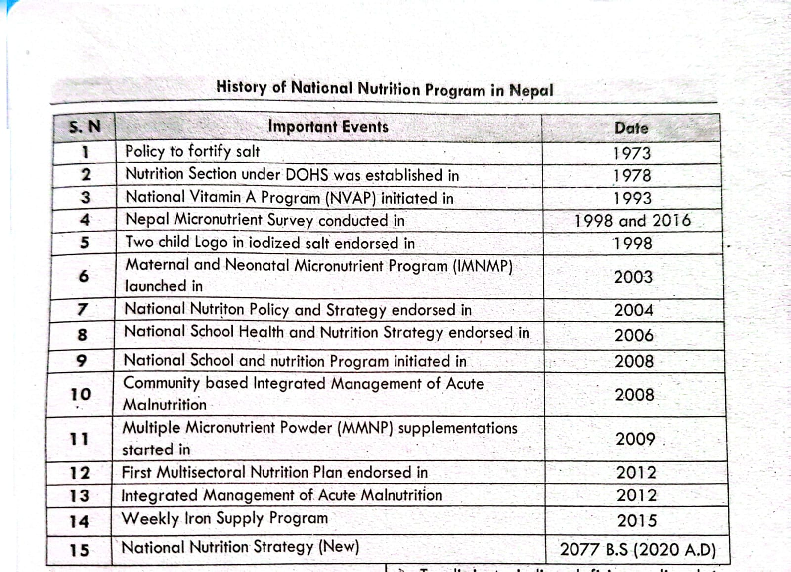

Slide 4
Phases of implementation of different nutrition program/services
Nationwide programme
Growth Monitoring and Promotion
Maternal, Infant and Young Child Nutrition (MIYCN)
Micro-Nutrient Powder (MNP) supplementation Program
Biannual distribution of Vitamin A and Albendazole
Control and Prevention of Iodine Deficiency Disorders (IDD)
School Health and Nutrition Program
Integrated Management of Acute Malnutrition (IMAM)

Slide 5
Scale up programme
Mother Baby Friendly Hospital Initiative (MBFHI)
Nutrition Rehabilitation Center (NRC)
Comprehensive Lactation Management Center (CLMC)
Lactation Management Unit (LMU)
Pilot programme
Model Nutrition Specific Program

Slide 6
VISION, MISSION AND GOAL
Vision
To prepare well-nourished, healthy, happy and capable citizens.
Mission
To build a nutrition friendly society.
Goal
To reduce the current problem of malnutrition in line with the Sustainable Development Goals by 2030.

Slide 7
OBJECTIVES
Improving the nutritional status of newborns, children, adolescents and women by increasing their access to nutritionally specific and nutrition-sensitive services
Enhancing the quality of nutrition specific and nutrition sensitive services and enhancing the capacity of service providers to provide nutrition services
Increase the demand for nutrition specific and sensitive services by raising public awareness at the community level, promote positive behaviors related to nutrition and eliminate negative habits.
To increase the scope of nutrition services in accordance with time.

Slide 8
Global nutrition Target for 2025 determined by World Health Assembly
Nepal was also signatory nation.
Reduce the global number of <5 children who are stunted by 40%.
Reduce anaemia in women of reproductive age by 50%.
Reduce low birth weight by 30%.
Zero increase in childhood overweight.
Increase the rate of exclusive breastfeeding in the first six months up to at least 50%.
Reduce and maintain childhood wasting to less than 5%.

Slide 9
TARGET OF MSNP III
By the end of the plan period,
  The stunting rate among children under five years of age will be reduced from 25 percent to less than 15 percent,
  The wasting rate from 8 percent to 4 percent,
  The underweight rate from 19 percent to 9 percent
  The overweight/obesity rate among children under five years of age will be reduced to less than 1 percent.
  Similarly, the underweight birth rate will be reduced from 12 percent to ≤1.4 percent.
  The overweight/obesity rate among children under five years of age will be reduced to less than 1 percent,
  Anemia among children aged five years and above will decrease from 43 percent to 10 percent, while anemia among women aged 15 to 49 years will decrease from 34 percent to 10 percent.
  Similarly, chronic energy deficiency among women of reproductive age will decrease from 10 percent to 15 percent.

Slide 10
Key Strategies of National Nutrition Program
Update and expand multi-sectoral nutrition programs
Promoting domestic production by encouraging the consumption of nutritious and healthy food
Adopt short-term, medium-term and long-term measures to improve micro nutrition
Key
Strategies
Strengthening and development of school health program and nutrition education

Slide 11
Strategies
1. Update and expand multi-sectoral nutrition programs
Strategy 1.1: To continue, strengthen and expand the life cycle-based nutrition service
Strategy 1.2: To continue coordination and support to improve the quality of nutrition sensitive services
Strategy 1.3: To increase the capacity of nutrition service providers to provide nutrition services
Strategy 1.4: To make institutional arrangements and strengthen in accordance with the federal structure for the implementation of the programs and activities decided by the Multisector Nutrition Plan.
Strategy 1.5: To strengthen multi-sectoral coordination and cooperation

Slide 12
Strategies
Strategy 1.6: To integrate nutrition services with other health sector programs
Strategy 1.7: To strengthen and promote nutrition related information and communication
Strategy 1.8: To conduct special nutrition programs for the inaccessible classes, communities and regions
Strategy 1.9: To promote nutrition research
Strategy 1.10: To make the monitoring and evaluation of nutrition services effective
Strategy 1.11: To take appropriate initiatives to address the nutritional needs of senior citizens.

Slide 13
Strategies
2. Adopt short-term, medium-term and long-term measures to improve micro nutrition
Strategy 2.1: Supplementation to prevent, control and treat micronutrient deficiencies (Short term strategy)
Strategy 2.2: To fortify various micronutrients in food to prevent micronutrient deficiency in women, adolescents and children (Midterm Strategy).
Strategy 2.3: To conduct programs for social behavior change to prevent micronutrient deficiency in women, adolescents and children (Long term strategy).

Slide 14
Strategies
3. Strengthening and development of school health program and nutrition education
Strategy 3.1: To strengthen and expand the school health and nutrition program
4. Promoting domestic production by encouraging the consumption of nutritious and healthy food
Strategy 4.1: To promote domestic food production by encouraging consumption of various nutritious and healthy foods.

Slide 15
Activities
Screening of under-five children by FCHVs.
Baal vita community promotion program.
Iron Folic Acid distribution during pregnancy and to postpartum and adolescent's girls.
Vitamin A and deworming tablet mass campaign.
Identification of barriers and expansion of integrated management of acute malnutrition.
Seminar on progress review of national nutrition programs, nutritional rehabilitation center and formulation of action plan.
Training on comprehensive nutrition specific interventions (CNSI) package for health workers.
Nutrition related days celebration (like- breastfeeding week, school health and nutrition week, iodine month).
Onsite coaching for nutrition program.

Slide 16
Activities
National workshop on adolescent, maternal and child nutrition.
Nutrition in emergency.
Review of mother baby friendly hospital initiative.
Facilitating the implementation of model nutrition special programs at the local level.
Capacity building (onsite training) program for doctors, nurses working for establishment or strengthening of services in inpatient treatment centers.
Nepal micronutrient status survey program preparatory workshop.
Formulation of strategies to reduce excess use of salt.
Promotion of school health and nutrition.
Procurement of nutritional commodities (vitamin a, rutf, mnp, f-75, f-100, resomal, height board, weighing machine, muac, super cereal etc)

Slide 17
CURRENT ACHIEVEMENTS

Slide 18
S.N. | INDICATORS | STATUS | SOURCE
1. | Stunted | 25% | NDHS 2022
2. | Underweight | 19% | NDHS 2022
3. | Wasted | 8% | NDHS 2022
4. | Overweight | 1% | NDHS 2022
5. | Exclusive Breastfeeding | 56% | NDHS 2022
6. | Anemia among children age 6-59 months | 43% | NDHS 2022
7. | Children aged 0-23 months registered for growth monitoring | 68.3% | HMIS/DoHS 2080/81
8. | Average number of growth monitoring visits per child | 8.9% | HMIS/DoHS 2080/81
9. | Underweight children registered for growth monitoring | 2.1% | HMIS/DoHS 2080/81
10. | Early initiation of breast feeding | 84.61% | HMIS/DoHS 2080/81

Slide 19
S.N. | INDICATORS | STATUS | SOURCE
11. | Women who received a 180-day supply of IFA during pregnancy | 65.5% | HMIS/DoHS 2080/81
12. | Postpartum mother who received 45-day supply IFA | 81.9% | HMIS/DoHS 2080/81
13. | IFA distribution to adolescent girls For 13 weeks For 26 weeks | 54.5% 41.6% | HMIS/DoHS 2080/81
14. | Households using adequately iodized salt | 98% | NDHS 2022
15. | Children aged 6–11 months who received vitamin A In Kartik 2080 In Baishakh 2081 | 132.68% 120.81% | HMIS/DoHS 2080/81
16. | Coverage of deworming tablets for children aged 12 to 59 months In Kartik 2080 In Baishakh 2081 | 114.2% 90% | HMIS/DoHS 2080/81

Slide 20
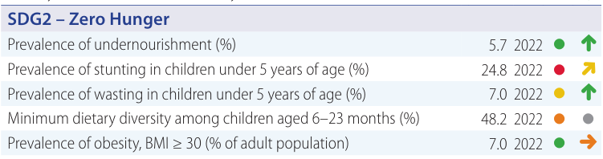
Achievement on SGD Goals by Nepal
Value Year Rating Trend

Slide 21
SWOT Analysis of Nutrition Programs
Strengths
Reduction in stunting, wasting, and underweight among under five children.
Constitutional Support: Right to food, health, and nutrition ensured by the Constitution of Nepal, 2015.
Government Priority: Recognized as a Priority One program by the Government of Nepal.
Service Delivery: Growth monitoring, nutrition counseling, and distribution of iron-folic acid tablets at various healthcare levels.
Training on comprehensive nutrition specific interventions (CNSI) package for health workers.
26 NRCs functioning in different parts of the country for management of SAM cases.
Conduction of logistic management analysis and orientation.
Supplementation Programs: Mass Vitamin A supplementation for children aged 6-59 months.

Slide 22
Weaknesses
GMP, IMAM, MNP, and Adolescent IFA interventions have poor coverage, compliance, and service quality.
Early initiation and exclusive breastfeeding trends are decreasing, while the trend of bottle feeding is increasing.
Recording and reporting of nutrition program indicators in HMIS is incomplete and untimely.
Procurement and supply of nutrition commodities (RUTF, MNP, IFA) is not timely. Transportation and storage at local levels are unsatisfactory.
Limited allocation of financial resources and delay in disbursement
There’s a lack of a Stadiometer and weight machine in OTC
Frequent transfer of staffs and lack of knowledge retention.

Slide 23
Opportunities
Integrating and coordinating with the Education sector for School Health and Nutrition is key to addressing malnutrition in adolescents.
Policy Framework: Supported by robust policies like the National Nutrition Strategy (2077), Multisector Nutrition Plan (2023–2030), and National Health Policy.
Scaling up of comprehensive nutrition services at all levels
Program Integration: Opportunities to link with EPI, PHC, and outreach clinics.
External Support: Backed by external development partners (EDPs).
Need to ensure sustainable financing from the local and provincial levels.

Slide 24
Threats
Deep-rooted misconceptions, taboos, and harmful socio-cultural practices related to food and nutrition persist.
Emerging issues of the triple burden of malnutrition (undernutrition, overweight/ obesity, and micronutrient deficiencies) are noted.
Political Instability: Governance and program continuity risks.
Geographical Constraints: Challenging terrain hampers service delivery.
Natural Disasters: Vulnerability to disasters disrupts program implementation.

Slide 26
Suggestions
Improvements in complementary feeding, exclusive breastfeeding and maternal diet to reducing stunting/anemia.
Strengthen maternal nutrition interventions (iron–folic acid, calcium, diversified diet) during pregnancy and lactation to address intergenerational malnutrition.
Scale up community-based nutrition education focusing on appropriate infant and young child feeding (IYCF), dietary diversity, and meal frequency.
Improve early identification and management of acute malnutrition through regular screening and timely referral from growth monitoring sessions.

Slide 27
Strengthen behavior change communication (BCC) to reduce poor feeding practices contributing to anemia.
Promote workplace-friendly breastfeeding policies and community support groups to sustain exclusive breastfeeding for six months.
Improve quality of GMP sessions, ensuring counseling, follow-up, and referral—not just measurement.
Enhance coordination among health, education, agriculture, and WASH sectors under the Multisectoral Nutrition Plan (MSNP) to address underlying causes of malnutrition.

Slide 28
References
NDHS 2022 report
Annual Health Report 2080/81
Annual Health Report 2078/79
National nutrition strategy 2077
Nepal Health Fact Sheets 2025
National nutritional policy
Sustainable Development Report 2025

Slide 29
THANK YOU

