Slide 1
How to overcome stage fear and class room practice.
Presented by
Mr. T.P.

Slide 2

Most People Feel Anxiety
What people fear most...
  Snakes
  Public speaking
  Death

Slide 3

Public speaking
Snakes
Death

Slide 4
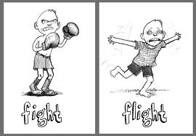

Slide 5
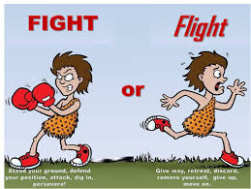

Slide 6
Five Steps to Overcome Fear
Be well prepared
Practice
Have a backup
Reduce fear of your audience
Relax yourself

Slide 7
1. Be Well Prepared
Leave nothing to chance
  Lay out your strategy
  Ensure all material is ready
  Make contingency plans

Slide 8
Cont’d
Know your material
  know exactly what you are going to talk about
  have a good outline of facts and information

Slide 9
Cont’d
Know the Conditions
  Check out the lectern and microphone
  Visualize how you will be doing things
Going through this process will relax you & give you more confidence

Slide 10
2. Practice Your Speech
Practice alone
many times
speak out loud
speak looking into a mirror
stand in the corner
record your practice

Slide 11
Cont’d
Practice before friends
Gets you closer to the "real world" of speaking to a group
Even one person is good for this type of practice
Proper preparation and rehearsal can help to reduce fear by about 75%.

Slide 12
3. Have A Backup
Have a backup, in case you forget what you want to say.

Slide 13
Cont’d
Prepare a "safety net"
Outline your speech
  use paper or cards
  Referring to notes is generally acceptable, as long as you are not reading your speech.
You may never even use your notes, but they can reduce the “butterflies”.

Slide 14
4. Reduce Fear of Audience
The more important the audience or the occasion,
the greater your fear can be.
Negative approach
visualize the audience as not being all that important.
old trick: imagine audience is naked, or in clown suits -- the ridiculous image will make them seem less important.
Problem: the negative image may be reflected in your speech.

Slide 15
Positive approach
the audience is usually on your side
  they want to hear what you have to say
  it is just like talking to your friends

Slide 16
5. Relax
Relax yourself just
before you speak.
Sit comfortably with your back straight.
Breathe in slowly, hold your breath for 4 to 5 seconds, and then slowly exhale.
To relax your facial muscles, open your mouth wide and eyes wide, and then close them tightly. Pause and open them again.

Slide 17
Cont’d
Take two breaths to settle you before you get out of your chair.
thank the person who introduced you.
count to 5 before you start speaking.
This will allow the audience to get settled and ready to hear you.
It is also a way to show that you are now in control.

Slide 18
Cont’d
Stress-Control Breathing
Centered in your abdomen, not your chest.
Stage One
  Inhale air and let your abdomen go out.
  Exhale air and let your abdomen go in.
Stage Two
  As you inhale, use a soothing word such as "calm" or "relax”.

Slide 19
Proper breathing techniques can further reduce this fear by 15%.
&
Your mental state accounts for the remaining 10%.

Slide 20
Practice takes you from this..

Slide 21
To this….

Slide 22
Thank You

Slide 23
What is stage fear? What are the steps to overcome? Explain in detail.

