Slide 1
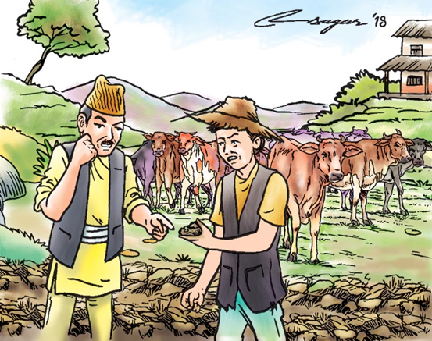
Soil Erosion
Name: Aman K.C.
Roll Number: 3
2nd Semester, BPH
Pokhara University

Slide 2
Description of Content
Definition of Soil Erosion
Causes of Soil Erosion
Effects of Soil Erosion
Problems caused by soil erosion in Nepal
Control Method of Soil Erosion
Reference

Slide 3
Definition of Soil Erosion
Soil erosion is the displacement of the upper layer of soil.
Soil erosion is a naturally occurring process that affects all landforms.
In agriculture, soil erosion refers to the wearing away of a field’s topsoil by the natural physical forces of water and wind or through forces associated with farming activities such as tillage.

Slide 4
CAUSES OF SOIL eROSION
Farming : Agriculture is the most significant activity that accelerates soil erosion because of the amount of land that is farmed and how much farming practices disturb the ground.(Farmers remove native vegetation and then plow the land to plant new seeds. Because most crops grow only in spring and summer, the land lies fallow during the winter. Of course, winter is also the stormy season in many locations, so wind and rain are available to wash soil away. Tractor tires make deep grooves, which are natural pathways for water. Fine soil is blown away by wind.

Slide 5
Grazing: Grazing animals wander over large areas of pasture or natural grasslands eating grasses and shrubs. Grazers expose soil by removing the plant covering an area. If too many animals graze the same land area, the animals’ hooves pull plants out by their roots. A land is overgrazed if too many animals are living there.
Deforestation: It is one of the major factors responsible for Soil erosion. Removal of forest cover which function as a binder of the top layer of the soil with increasing land demand have resulted in enhancing extent of soil erosion.

Slide 6
Amount of rainfall : Soil erosion depends on the amount of rainfall. If there is heavy rainfall, there will be more soil erosion.
Ground slopes: Stepper slope ground erodes more than the grounds having mild slope due to increased speed of run off than infiltration.
Climate change: Climate change causes more heavy rainfall due to which soil erosion takes place. Soil erosion rates are expected to be increased in response to the change in climate.

Slide 7
Effects of soil erosion
Loss of topsoil:. Topsoil is so fertile, if it is removed, this can cause serious harm to farmer’s crops or the ability to effectively work their land.
Soil compaction: When soil under the topsoil becomes compacted and stiff, it reduces the ability for water to infiltrate these deeper levels, keeping runoff at greater levels, which increases the risk of more serious erosion.

Slide 8
Soil acidity levels: When the structure of the soil becomes compromised, and organic matter is greatly reduced, there is a higher chance of increased soil acidity, which will significantly impact the ability for plants and crops to grow.
Long term erosion: If an area is prone to erosion or has a history of it, it becomes even harder to protect it in the future. The process has already reduced the soil structure and organic matter of the area, meaning that it will be harder to recover in the long run.

Slide 9
Reduced organic and fertile matter: Removing topsoil that is heavy with organic matter will reduce the ability for the land to regenerate new crops. When new crops or plants can’t be placed successfully in the area, this continues a cycle of reduced levels of organic nutrients.
Water pollution: A major problem with runoff from soils particularly those used for agricultural processes is that sediment and contamination like the use of fertilizer or pesticide. This can have significant damage on fish and water quality.

Slide 10
Problems caused by soil erosion in Nepal
In Nepal, the situation is worse because two-thirds of the country’s total area is geologically fragile where soil erosion is exceedingly high. Topsoil loss has been reported as high as 87 tones per hectare per year on sloping terraces. When the top soil is lost, the land is degraded.
Poor land management in Nepal has caused soil erosion each year with impacts not just on food production but also on biodiversity loss, carbon loss and disaster. Forecasts on land in South Asia indicate that countries like Nepal will have to face the greatest challenges if better land regulation and improved farming technologies are not put in place.

Slide 11
Unscientific farming in the hills (steep slope) is one of the causes of soil erosion in Nepal. Shifting cultivation and unnecessary tillage practices also lead to land degradation and damage the ground vegetation and natural ecosystems. Cultivation on the steep slope without taking improved farming practices such as terracing, selection of appropriate crops and use of organic manures into consideration have contributed to increased soil erosion. Furthermore, agricultural intensification produces certain by-products and side effects that are unfriendly to the environment.

Slide 12
Control methods of Soil erosion
Planting herbs and shrubs
Adding rocks on the sloppy areas
Building retaining walls on the sloppy areas
By improving the drainage
Reducing the water if possible
Avoiding people, animals and machines to travel through the fertile soil
Planting trees to prevent the landslide
Reducing tillage

Slide 13
By covering the soil through out the year by vegetation
By turning the hill into terraces
By stopping the animals to graze in fertile land
By stopping the construction work and recreational activities in the fertile soil.

Slide 14
References
https://en.wikipedia.org/wiki/Soil_erosion
http://www.omafra.gov.on.ca/english/engineer/facts/12-053.htm
https://courses.lumenlearning.com/geo/chapter/reading-causes-of-soil-erosion/
http://www.yourarticlelibrary.com/soil/soil-erosion-6-main-causes-of-soil-erosion/12326
http://www.yourarticlelibrary.com/soil/soil-erosion-6-main-causes-of-soil-erosion/12326
https://thehimalayantimes.com/opinion/losing-the-land-soil-erosion-and-degradation/
https://www.wikihow.com/Prevent-Soil-Erosion

Slide 15


