Slide 1
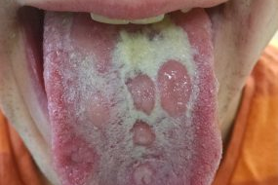
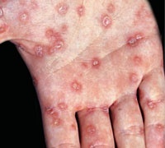
Syphilis
People who are sexually active can get syphilis, a curable sexually transmitted disease (STD)

Slide 2
Introduction
Syphilis is a preventable and curable bacterial sexually transmitted infection (STI). If untreated, it can cause serious health issues. (WHO)
Many people with syphilis do not have symptoms or do not notice them.
Syphilis is transmitted during oral, vaginal and anal sex, in pregnancy and through blood transfusion. Syphilis in pregnancy may lead to stillbirth, newborn death and babies born with syphilis (congenital syphilis).

Slide 3
Syphilis is a highly contagious disease and bacterial infection that’s mostly spread through sexual activity, including oral and anal sex.
Syphilis is a sexually transmitted disease (STD) that can have serious complications when left untreated, but it is simple to cure with the right treatment.
The infected person often doesn’t know that they have the disease and passes it on to their sexual partner.

Slide 4
Prevalence of the syphilis in the Nepalese context
The prevalence of syphilis in the general population in Nepal has not been investigated before.
As expected the prevalence of syphilis among the rural women in this study (0.2%) was much lower than in a previous study of high-risk populations in Kathmandu and nearby cities, where 0.7% of female sex workers had active syphilis, and 2.5% a previous infection .
The estimated prevalence for women in Southeast Asia is 0.37% .
Notes:
https://www.hindawi.com/journals/idog/2018/4980396/ (2018) Global estimates of the prevalence and incidence of four curable sexually transmitted infections in 2012 based on systematic review and global reporting,” PLoS ONE, vol. 10, no. 12, Article ID e0143304, 2015.

Slide 5
Cause and factors
Syphilis is caused by spiral shaped bacterium called Treponema pallidum.
The most common route of transmission is through contact with an infected person’s sore during sexual activity.
Syphilis is contagious during its primary and secondary stages, and sometimes in the early latent period.
Syphilis may spread through direct unprotected close contact with an lesion(such as during kissing) or through infected mothers to their babies during pregnancy or childbirth (congenital syphilis).

Slide 6
Causes
Syphilis is transmitted from syphilis infected persons to healthy ones through genital, oral or anal sex or from infected mother to fetus during pregnancy or to new-born baby while giving birth.
Syphilis is caused by spiral shaped bacterium Treponema pallidum where the spiral shape allows it to burrow into mucous membranes or enter through minute breaks in the skin.
Syphilis doesn’t pass through toilet seats, shared utensils or casual contact. Less commonly, syphilis can be passed through kisssing if broken skin comes into contact.

Slide 7
Risk factors
The factors that can increase a person’s risk of infection can be listed as below :
  Unprotected sex
  Multiple sex partners
  HIV infection
  Man who makes sexual relationship with men.

Slide 8
Symptoms
Syphilis symptoms can be hard to notice. The best way to know if you have syphilis is to tested.
Syphilis can be kind of confusing because there are a few different stages and they can overlap or happen around the same time.
Symptoms can vary with each stage, and they might not always happen in the same order for every one.
Stages are primary stage, secondary stage and late stage .

Slide 9
Primary syphilis (first stage)
About 10 days to 3 months after infection we may find a painless sore (chancre).
Chancres are usually firm, round, and painless, or sometimes open and wet.
It is usually occurs on the penis or vagina, in the mouth or around the bottom.
Chancre usually heals within two to six weeks.
If the infection is not treated, it will move to the second stage.
Notes:
Primary stage : After Treponema pallidum infection, the primary symptom will manifest with a chancre, usually within 21 days. They look like small circular sores which are painless, called chancre. Such chancres maybe seen inside lips too. Being these chancres usually painless and internal, they can be easily missed by both patients and doctors. Without treatment, a chancre will heal in anywhere from three to six weeks. The chancre contains the infectious bacteria, this stage is highly contagious. Any contact with the chancre can spread the infection.

Slide 10
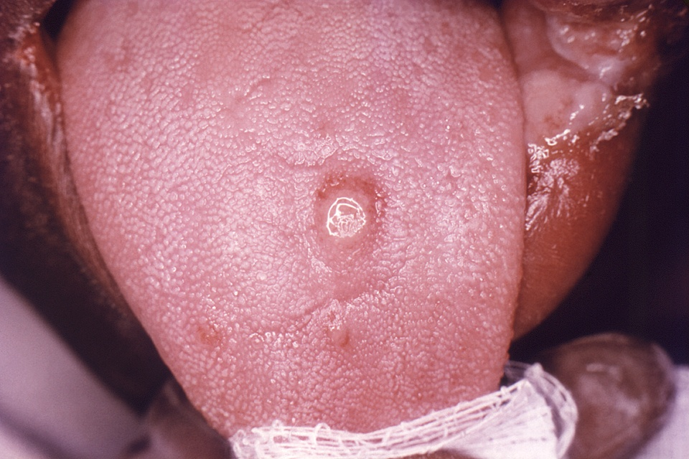
Chancre on the surface of a tongue:

Slide 11
Secondary Syphilis (Second stage)
A few weeks after the sore disappears , rashes are appear in a body, often on the palms of hands or soles of feet.
Symptoms like: fever, a sore throat, swollen lymph nodes, patchy hair loss, headaches, un explained weight loss and fatigue.
These symptoms may resolve a few weeks after they first appear . They might also return several times over a longer period.
If the infection is not treated secondary syphilis can progress to the late stage.
Notes:
Secondary stage : If primary syphilis is left untreated, secondary stage of syphilis may develop. It occurs within 4 to 10 weeks of a primary infection. This stage is characterized by a skin rash on almost any part of the body, including sores inside the mouth, vagina or anus. The copper colored rashes of secondary syphilis is often found on the palms of the hands and the soles of the feet. Fever, enlarged lymph nodes, fatigue, weight loss, hair loss, headaches, joint aches and muscle aches have been reported in the secondary stage of syphilis. If this secondary stage of the infection is not treated, the infection can progress to tertiary stage of syphilis which is very complicated and severe. But sometimes, syphilis will show no symptoms at all, which is called latent syphilis.

Slide 12
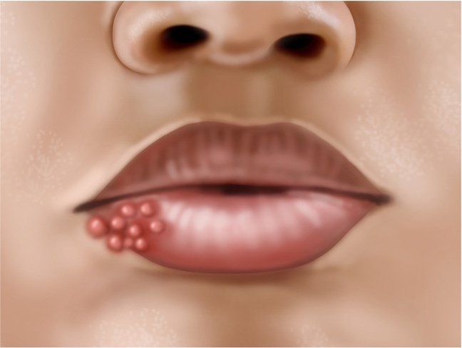
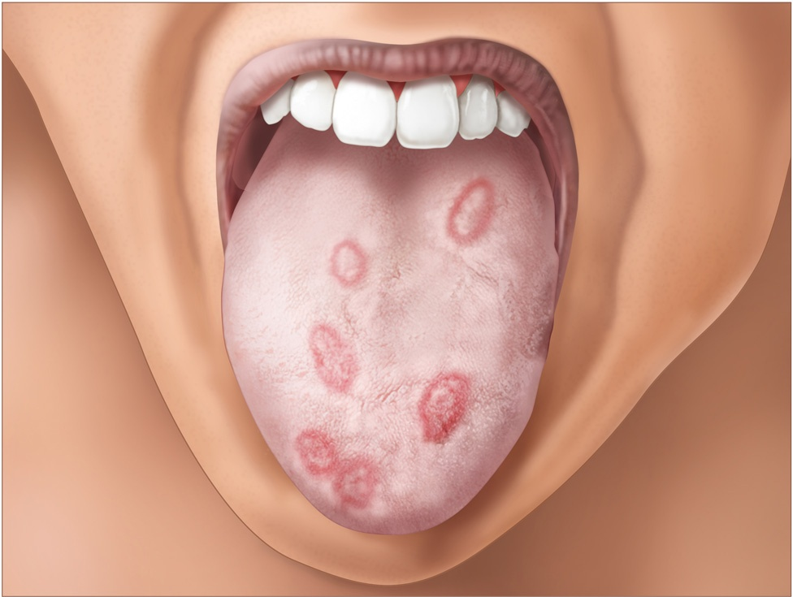

Slide 13
Tertiary Stage (Late syphilis)
It can occur 10-30 years after the onset of the infection, usually after a period of latency during which there are no symptoms.
At this stage, syphilis damages the following organs and systems:
Heart
Blood vessels
Liver
Bones
Joints
Organs damage means that it can often lead to death.
Notes:
he last stage of infection is known as tertiary syphilis. It is the most serious stage of infection. It’s characterized by major diseases of the skin, bones, heart, liver, and other organs. Neurosyphilis, arguably the most severe complication, affects the brain and is, by far, the most difficult to treat. This stage can be life-threatening. Few symptoms of tertiary syphilis are:blindness
deafness
mental illness
memory loss
destruction of soft tissue and bone
neurological disorders
meningitis
heart disease
neurosyphilis

Slide 14
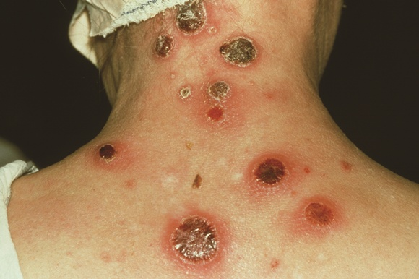

Slide 15
Mode of transmission
Syphilis is transmitted from person to person by direct contact with a syphilitic sore, known as a chancre.
In most cases, syphilis are transmitted during vaginal, anal or oral sex.
It can transmitted through infected blood transfusion.
In addition, pregnant woman with syphilis can transmit the infection to their unborn child.

Slide 16
Medicine used for treatment based on National protocol
Penicillin IM is the drug of choice to treat syphilis.
Doxycycline is the alternative for treating early and late latent syphilis.
Diagnosed for primary, secondary or early latent syphilis , the recommended treatment is a single injection of penicillin.
Syphilis for longer than a year, additional doses is need.
People who are allergic to penicillin will likely be treated with a different antibiotics such as:
doxycycline
azithromycin
ceftriaxone
Notes:
yphilis can be treated with antibiotics. Penicillin IM is considered the drug of choice, but other antibiotics like doxycycline, tetracycline, azithromycin, should be used for a person who is allergic to penicillin.
Actually, penicillin is the treatment of choice for syphilis in all stages. Treatment with penicillin is safe during pregnancy too. Treatment kills the bacteria and prevents further organ damage, but will not reverse damage to the organs that has already occurred.

Slide 17
Prevention and controlling measures
Use condoms during any type of sexual contact.
Avoid sharing sex toys.
Avoids sharing needles if using injected drugs
Get screened for STIs and talk to your partners about their results.
Avoid sex with someone infected with syphilis or who has symptoms of syphilis until they have finished treatment.
Notes:
There is no vaccine available to prevent syphilis. Safe-sex practices, including condom use, can only prevent syphilis. But if the infectious chancre is located in a body are unprotected by a condom then only condom will not work. Washing or cleansing after sexual activity cannot prevent the infection. Neonatal syphilis is preventable by treating the mother early in her pregnancy.

Slide 18
Gonorrhoea

Slide 19
Introduction
Gonorrhoea is a preventable and curable sexually transmitted infection caused by the bacterium Neisseria gonorrhoeae, which is primarily transmitted through vaginal, oral and anal sex.
In 2020 there were an estimated 82.4 million new infections among adults globally.
Most women with gonorrhoea do not have symptoms, and when they do, vaginal discharge is common, while most men present with discharge from their penis.

Slide 20
If left untreated, gonorrhoea can lead to infertility in both men and women and other sexual and reproductive health complications. It also increases the risk of HIV infection.
Gonorrhea bacteria can infect the urethra, rectum, female reproductive tract, mouth, throat or eyes.

Slide 21
Global Scenerio
In 2020, WHO estimated 82.4 million new infections with N. gonorrhoeae among adults aged 15 to 49 years. Prevalence of gonorrhoea is highest among vulnerable populations such as men who have sex with men, sex workers, transgender women and adolescents and young people in high burden countries.
Gonorrhea is treatable and can be cured with some antibiotics.
WHO, fact sheet

Slide 22
National Scenerio
In 2010, study conducted in Western Nepal; Manipal Hospital ; A total of 119 patients were tested for gonococcal infections. Forty-eight patients were diagnosed as having gonococcal infections, of which 40 cases were culture positive.
https://nepjol.info/index.php/NJMS/article/view/6603/5392#:~:text=1%2C2%20According%20to%20Family,the%20treatment%20expensive%20and%20prolonged.

Slide 23
Mode of transmission of Neisseria gonorrhoeae
The primary mode of transmission for gonorrhea is through sexual contact with an infected person. The bacterium can be present in the discharge from the penis or vagina of an infected individual.
The most common modes of transmission include:
Unprotected Sexual Intercourse: Gonorrhea is primarily transmitted through vaginal, anal, or oral sex with an infected partner. If one partner is infected, the bacterium can be easily transmitted to the other.
Vertical Transmission: Infected mothers can pass gonorrhea to their newborns during childbirth. This can lead to eye infections (conjunctivitis) in the newborn.
It's important to note that gonorrhea can be present in the genital, rectal, and throat areas, so unprotected sexual contact involving any of these areas can result in transmission.

Slide 24
Symptoms
Male symptoms of gonorrhea infection include:
Painful urination.
Pus-like discharge from the tip of the penis.
Pain or swelling in one testicle.

Slide 25
Female symptoms of gonorrhea infection include:
Increased vaginal discharge.
Painful urination.
Vaginal bleeding between periods, such as after vaginal intercourse.
Abdominal or pelvic pain.

Slide 26
Gonorrhea at other sites in the body
Gonorrhea also can affect these parts of the body:
Rectum. Symptoms include anal itching, pus-like discharge from the rectum, spots of bright red blood on toilet tissue and having to strain during bowel movements.
Eyes. Gonorrhea that affects the eyes can cause eye pain, sensitivity to light, and pus-like discharge from one or both eyes.
Throat. Symptoms of a throat infection might include a sore throat and swollen lymph nodes in the neck.
Joints. If one or more joints become infected by the affected joints might be warm, red, swollen and extremely painful, especially during movement. This condition is known as septic arthritis.

Slide 27
Risk factors
A younger age (sexually active people under 25 are at greatest risk)
Multiple sex partners
Inconsistent condom use
Had a past gonorrheal infection
Had other STDs in the past

Slide 28
Diagnosis
Molecular tests are the gold standard for diagnosing N. gonorrhoeae which can be performed in the lab or at the point of care. Rapid diagnostic tests are currently under development.
Gram stain microscopy –less sensitive in women with vaginal/cervical discharge as well as for throat and anal infections.
In primary health care settings, where diagnostic capacity for detecting N. gonorrhoeae is not available, a syndromic approach for case management is recommended.

Slide 29
Prevention
Consistent and correct condom use in every sexual encounter
People with gonorrhoea should notify current and recent sexual partners to help prevent the spread of the disease.
Antibiotic eye ointment is recommended for newborns to prevent gonococcal eye infection.
There are no specific vaccines for the prevention of gonorrhoea.
However, studies are showing promising results with the use of a meningococcal type B vaccine (4CMenB) that seems to offer cross-protection against gonorrhea.

Slide 30
WHO has recognized gonorrhoea as a significant public health problem and has set ambitious targets to reduce the global burden through prevention, diagnosis, and treatment strategies. The Global Health Sector Strategies on HIV, viral hepatitis and STIs 2022–2030 aims to reduce the incidence of N. gonorrhoeae infection by 90% by 2030, compared to 2020 baseline.
WHO is working with countries and partners to improve people-centered case management approaches, ensure appropriate treatment recommendations and effective testing and partner services strategies, support the development of new easy to use and affordable diagnostics and treatment, vaccine development and improve surveillance.

Slide 31
WHO also works with countries and partners to improve antimicrobial resistance stewardship through the Enhanced Gonorrhoea Antimicrobial Surveillance Program (EGASP), which includes the implementation and use of better surveillance systems to detect antimicrobial resistance in N. gonorrhoeae and to inform locally appropriate treatment.

Slide 32
Primary prevention:
Abstinence
Promotion of safer sexual behaviour including consistent and correct use of condoms.
Provision of condoms at affordable prices
Making the condom accessible
Reducing rates of partner change by being faithful to only one sexual partner.

Slide 33
2. Secondary prevention
Promotion of health care seeking behaviour directed particularly towards those at increased risk of acquiring STIs including HIV infection.
The provision of accessible, effective and acceptable services which offer diagnosis and effective treatment for both symptomatic and asymptomatic patients with STIs and their partners.

Slide 34
Prevention and Control
Prevention methods include practicing safe sex by using condoms, being in a mutually monogamous relationship with an uninfected partner, and regular testing for STIs, especially if there is a change in sexual partners or if symptoms of infection are present. If you suspect you have gonorrhea or any other STI, it is crucial to seek medical advice promptly for diagnosis and appropriate treatment.

Slide 35
Treatment
People with gonorrhoea should be treated as soon as possible.
Gonorrhoea is treated with antibiotics called cephalosporins. These include:
ceftriaxone, usually given by injection and is the preferred treatment
cefixime, usually given orally with another antibiotic, azithromycin, but only when ceftriaxone is not feasible.
People should wait 7 days after taking the medicine before having sex. They should notify their sexual partner(s) to get tested or treated.

Slide 36


