Slide 1

Toxoplasma gondii

Slide 2
Toxoplasma gondii
Worldwide
Zoonotic parasite; Toxoplasma is an opportunistic pathogen.
Infects animals, cattle, birds, rodents, pigs, and sheep.
and humans.
Causes the disease Toxoplasmosis.
Toxoplasmosis is leading cause of abortion in sheep and goats.
Intracellular parasite.
Final host (Felidae family, cat)
Intermediate host (mammals )
Toxoplasmosis
All parasite stages are infectious.
Risking group: Pregnant women, meat handlers (food preparation) or anyone who eats the raw meat

Slide 3
Morphology:
Three morphological forms
Asexual forms | Tachyzoite
 | Bradyzoite (Tissue cyst)
Sexual form | oocyst

Slide 4
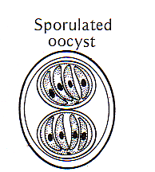
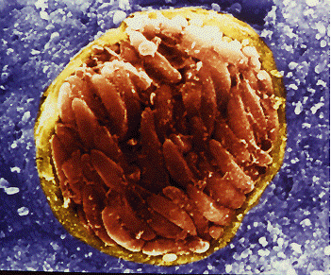
Toxoplasma gondii exists in three forms
All parasite stages are infectious.
Tachyzoites
TACHYZOITES
TISSUE CYSTS
BRADYZOIT
OOCYSTS
Bradyzoites
TISSUE CYSTS
Oocysts

Slide 5
TACHYZOITE
Actively multiplying form
Crescent shaped
Seen in acute infection
Infect all the nucleated mammalian cells
Inside the host cell, the tachyzoites are surrounded by a vacuole → asexual multiplication occurs → rosettes
Host cell → distends → pseudocyst

Slide 6
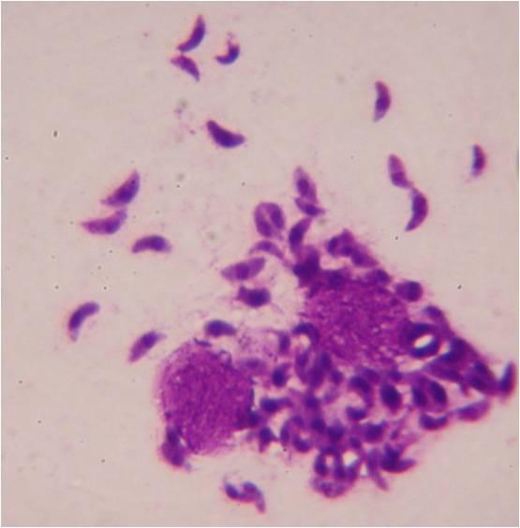
Image of a tachyzoite

Slide 7
Bradyzoites
Are slow-growing stage inside the tissue cysts.
Bradyzoites mark the chronic phase of infection.
Bradyzoites are resistant to low pH and digestive enzymes during stomach passage.
Protective cyst wall is finally dissolved and bradyzoites infect tissue and transform into tachyzoites.
Bradyzoites are released in the intestine and are highly infective if ingested.

Slide 8
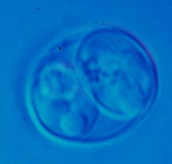
Oocysts in the feces of cat
Cat ingests tissue cysts containing bradyzoites.
Gametocytes develop in the small intestine.
Sexual cycle produces the oocyst which is excreted in the feces.
Oocysts appear in the cat’s feces 3-5 days after infection by cysts.
Oocysts require oxygen and they sporulate in 1- 5 days.

Slide 9

Life cycle
Definitive host

Slide 10

Intermediate host:

Slide 11
Life cycle – two phases:
Enteric cycle or sexual cycle
Exo enteric cycle or asexual cycle

Slide 12
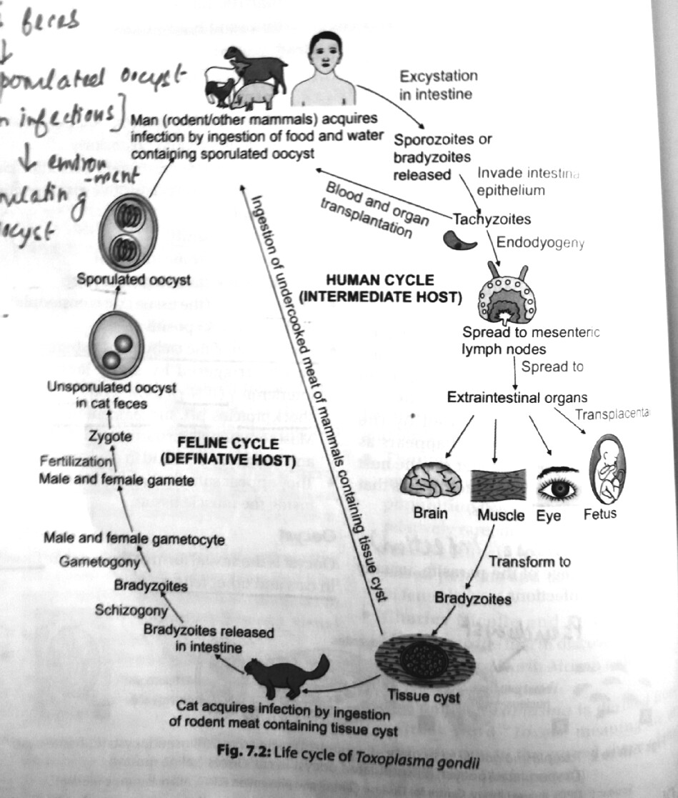

Slide 13
Transmission to man:
Ingestion of sporulated oocysts from contaminated soil, food or water
Ingestion of tissue cyst containing bradyzoites from undercooked meat
By blood transfusion, needle stick injuries, organ transplantation
Transplacentral transmission
Laboratory accidents
( Tachyzoites are the infective form in blood)

Slide 14
Disease: Toxoplasmosis
Acquired toxoplasmosis
  Mild lymphatic inflammation
Congenital toxoplasmosis

Slide 15
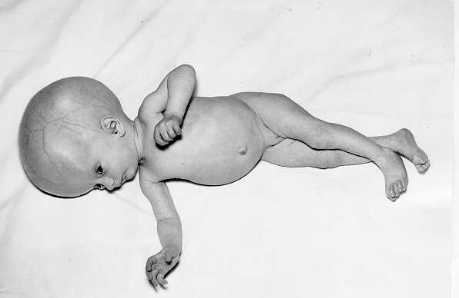
Congenital Toxoplasmosis
Intracerebral calcification.
Chorioretinitis . Ocular toxoplasmosis
Hydrocephaly.
Microcephaly .
Convulsions.
Mental retardation .
Cardiomegaly .
toxoplasmic encephalitis
Congenital disease

Slide 16
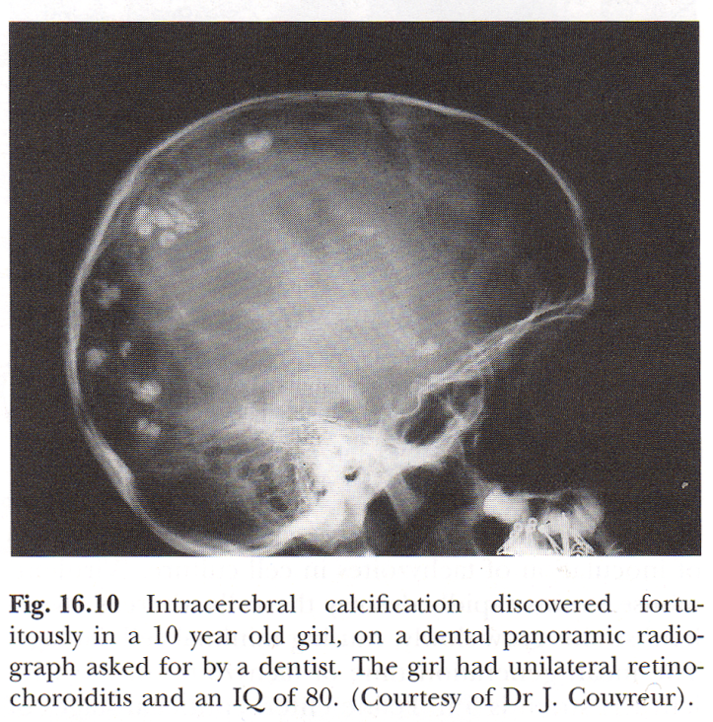
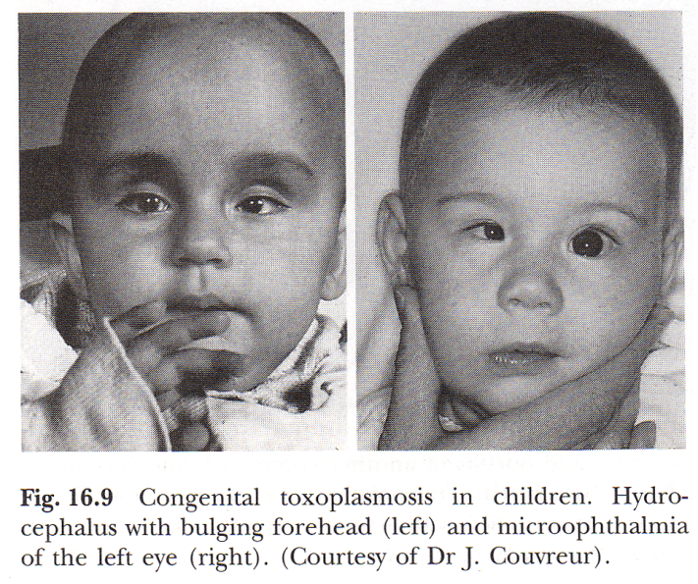
Congenital toxoplasmosis is a problem in 1-5/1000 pregnancies
* Intracerebral calcification.
If a woman is infected for the first time during pregnancy the parasite can cross the placenta and cause fetal disease.
Both the* probability and severity of the disease depend on when the infection takes place during pregnancy.
Early: low transmission, but severe disease
Late: high transmission, more benign symptoms.
Hydrocephaly.

Slide 17
Lab Diagnosis of Toxoplasmosis:
The demonstration of the Toxoplasma gondii organism in blood, body fluids, or tissue.
Detection of Toxoplasma gondii antigen in blood or body fluids by enzyme-linked immunosorbent assay (ELISA) technique.
The Sabin-Feldman dye test: is a sensitive and specific neutralization test. It measures IgG antibody and is the standard reference test for toxoplasmosis. High titers suggest acute disease.
Serologically: IgM fluorescent antibody test detects IgM antibodies within the first week of infection, but titers fall within a few months.
Polymerase Chain Reaction on body fluids, including CSF, amniotic fluid, and blood.
Skin test results showing delayed skin hypersensitivity to Toxoplasma gondii antigens.
Antibody levels in aqueous humor or CSF may reflect local antibody production and infection.
Animal inoculation: inoculation of suspected infected tissues into experimental animals.
Culture: inoculation of suspected infected tissues into tissue culture.

Slide 18
Sabin Feldman dye test
Gold standard antibody detection test
Done only in reference laboratories
Complement mediated neutralization test that requires live tachyzoites
Live tachyzoites are incubated with complement and test serum
Alkaline methylene blue dye is added and reincubated

Slide 19
Toxoplasma antibodies in the serum bind to the antigens in the live tachyzoites → killed due to complement mediated lysis
Killed tachyzoites → thin, distorted and colourless
The dilution of the test serum at which 50% of the tachyzoites are killed → antibody titer of the test serum

Slide 20
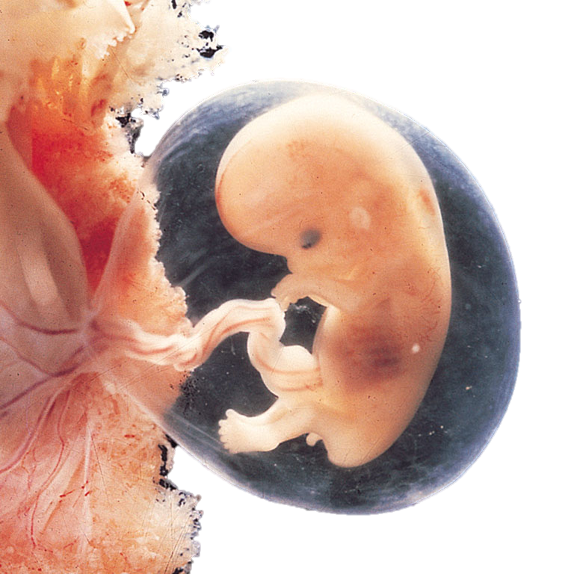
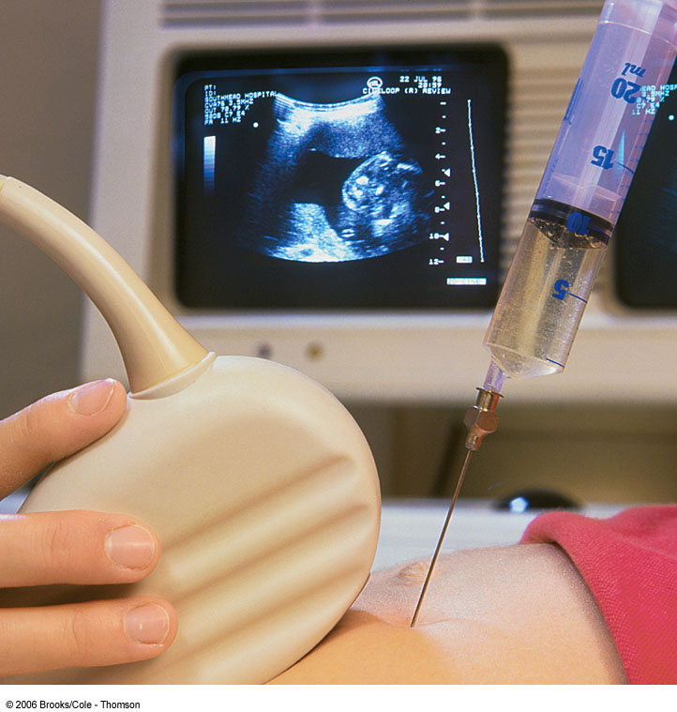
Amniocentesis
Done around 16th week of pregnancy
A long needle is inserted into the Amniotic sac and amniotic fluid is drawn.

Slide 21
Indication for Amniocentesis
Fetal cells are pulled from the Amniotic sac / fluid and are grown in a laboratory culture for chromosomal analysis.
The age and sex of the unborn child can be determined as well as any genetic or metabolic problems. Other kinds of birth defects can be discovered.
Parasitological diagnosis: examination of amniotic fluid e.g., for presence of Toxoplasma gondii .

Slide 22

Congenital toxoplasmosis

Slide 23
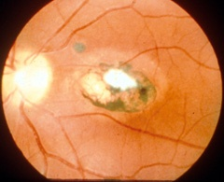
Ocular toxoplasmosis:

Slide 24
Treatment:
Congenital toxoplasmosis:
oral pyrimethamine (1mg/kg) and sulfadiazine ( 100mg/kg) with folinic acid daily for one year

Slide 25
Prevention
Consumption of cooked meat
Hand hygiene
Prenatal and antenatal screening to detect Toxoplasma infection in women of child bearing age
Proper handling of pet cats
Screening of blood donors and organ donors

Slide 26

THANK YOU……

