Slide 1
Steps in formulation of Training Objectives with its significance and illustrations

Slide 2
Training Objectives
You cannot start to design a great workshop if you're unclear about what learners will be able to do as a result of training.
Training objectives are the intended measurable outcome that your learners will achieve once they've finished a course.
Training objectives must be specific and measurable.

Slide 3
Training Objectives
Bring about change
Acquire knowledge
Acquire skills
Develop confidence
Develop good judgement

Slide 4
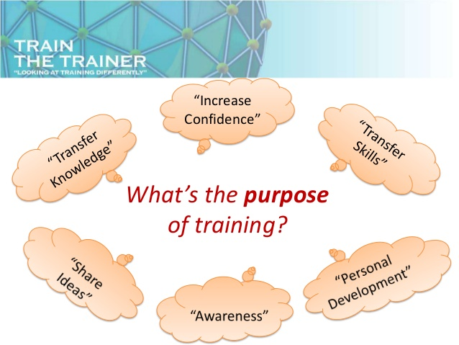

Slide 5
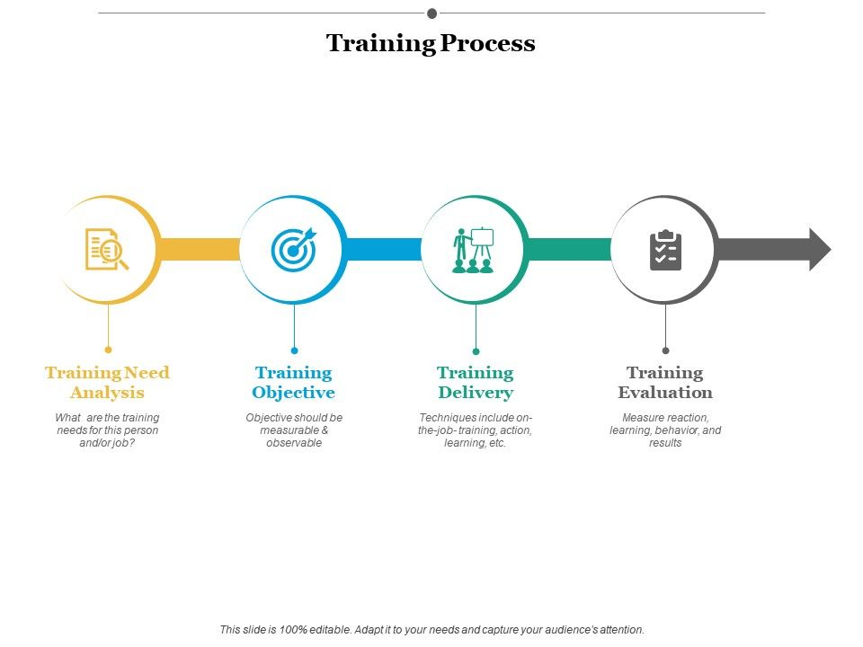

Slide 6
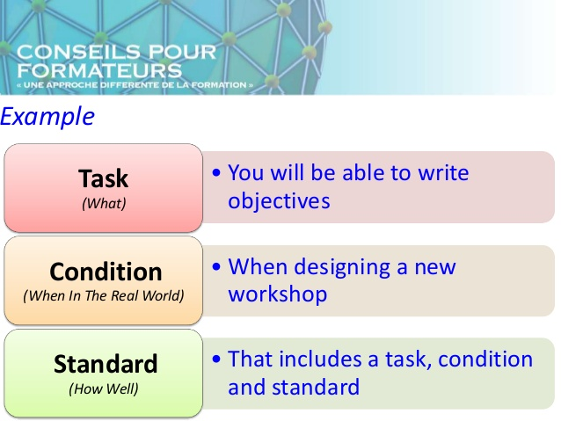
Steps in formulation of training objectives

Slide 7
Contd...
Before writing objectives need analysis must be undertaken against the goal.
On the basis of need, specify a measurable outcome under defined operational conditions that meet the need would be the concept of writing objective.
Always remember that Objective is NOT how to do it, but what will be the outcome or result after the activities completed
Use right verb to write objectives

Slide 8
S | Specific | It has a specific outcome to be accomplished. The outcome is stated in a clearly defined manner
M | Measurable | Objective should be measurable. If it cannot be measured it will be difficult to assess
A | Achievable | Possibility to achieve the objective to be ensured in a given market conditions, time period, resources allocated etc
R | Relevant | It should be appropriate with the situation describe. It should meet the long-term activities of the organization
T | Time bound | This means clearly stating when the objective will be achieved?

Slide 9
Significance/Benefits of Objectives setting
It sets specific targets for the employee to achieve which are linked to Development Plan
It states how the performance of the employee is to be measured to assess progress
It provides direction and guidance for the employee
It allows progress, targets and successes to be monitored and measured.
It motivates and inspires the employees.

Slide 10
Significance/Benefits of Objectives setting
It helps build working relationships between the employee & the manager, and improves overall communication
Helps to focus on a specific task
Enhanced knowledge and skills of employee

Slide 11
References
https://techspective.net/2016/09/06/importance-of-setting-objectives/
https://www.slideshare.net/DavidGibsonEureka/how-to-write-training-objectives?qid=6f56374c-168f-4189-a603-647999f66b48&v=&b=&from_search=2
https://www.google.com/search?q=training+objective&oq=trainin&aqs=chrome.0.69i59j69i57j0l6.4179j0j8&sourceid=chrome&ie=UTF-8

Slide 12
THANK YOU!!!

