Slide 1

Concept of biodiversity

Slide 2
Basic concept of biodiversity
“biodiversity” is short form of biological diversity.
Biological diversity refers to varieties within the living world.
biodiversity is used to describe the number, variety, & variability of life forms, levels and combinations existing within the living world.
In a broader sense biodiversity is a synonym of all life on the earth.

Slide 3
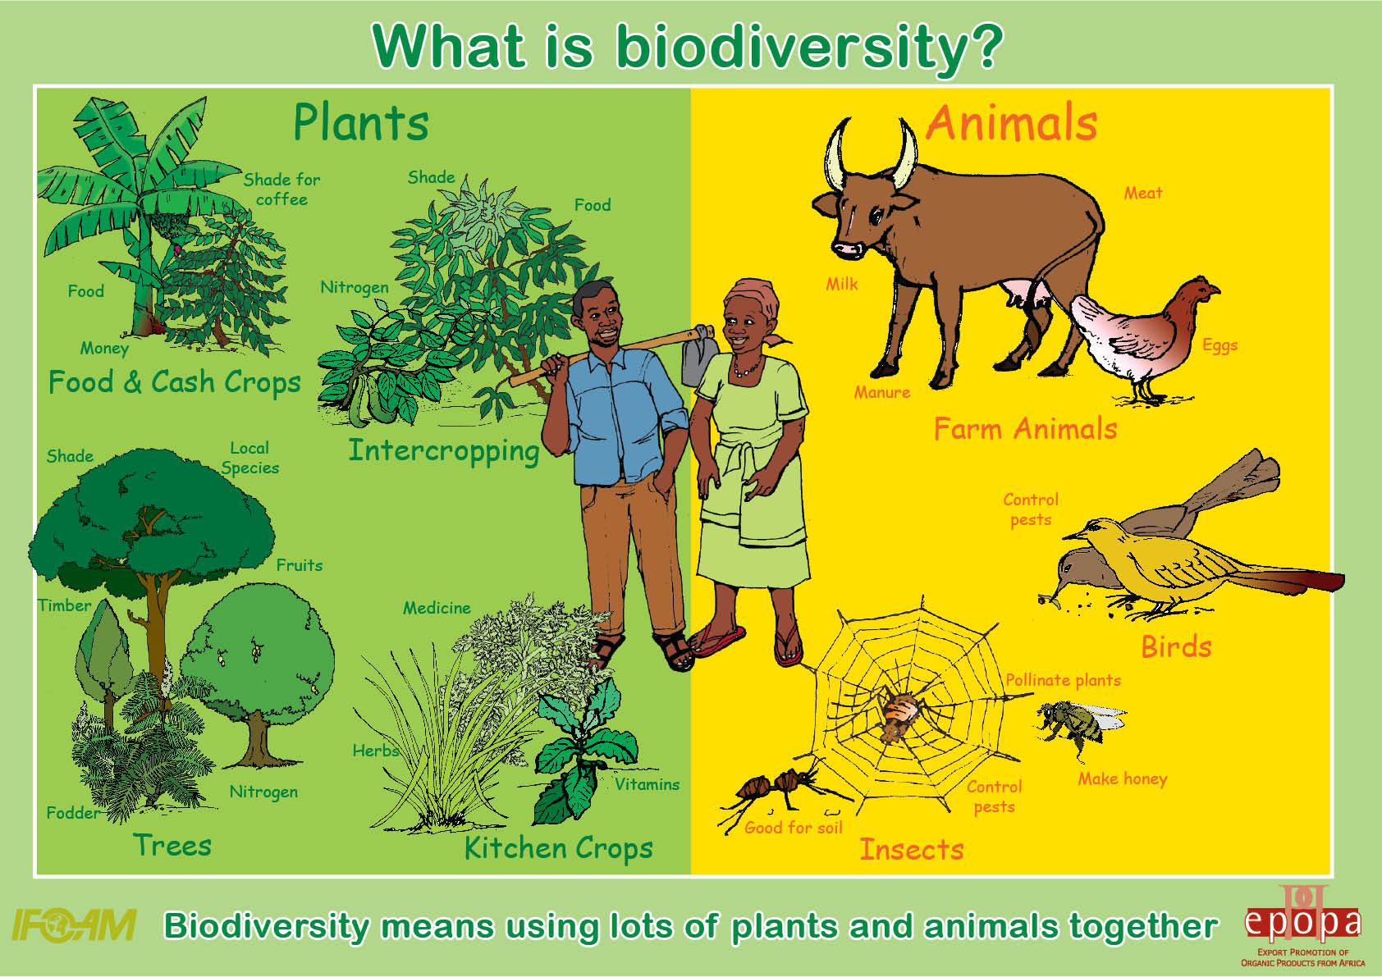

Slide 4
Definition
The number and variety of organisms found within a specified geographic region.
The variability among living organisms on the earth, including the variability within and between species and within and between ecosystems.
Biodiversity underpins life on Earth, and refers to the variety found in biota from genetic make up of plants an animals to cultural diversity.

Slide 5
According to the definition of the UN conference on environment and development 1992, biodiversity includes all of its manifestations.
Therefore in addition to terrestrial biodiversity, it also covers marine and other aquatic biodiversity as well.
As such biodiversity means the richness and on the variety of living thing from all sources including terrestrial, marine and fresh water ecosystem & ecological complex of which they are part, this includes within species, between species and ecosystem.

Slide 6
"Biological diversity" means the variability among living organisms from all sources including, inter alia, terrestrial, marine and other aquatic ecosystems and the ecological complexes of which they are part: this includes diversity within species, between species and of ecosystems. (definition from CBD)

Slide 7
Biodiversity is an attribute of life and differs from biological resources.
Biological resources is defined as the resources which are originated from biological diversity and their potential use or value to humans, such as a seed or a gene, rhinos or their horns, maize growing in field etc.

Slide 8
3 types
1) Genetic diversity
  Genes are the fundamental units of heredity which are passed from an organism to its offspring.
  Genes, either individually or in groups contribute many different attributes to an organism such as its physical appearance (brown eyes or dark hair), its ability to resist certain insects, or survive drought.
  Genetic diversity refers to variation of genes and genomes within living organisms, i.e., the genetic differences among population of a single species and among individuals within a population.

Slide 9
  It also covers distinct populations of the same species such as hundreds of traditional rice variety in Nepal
  Since the study of genetic diversity requires much sophisticated techniques & instruments, very little and fragmentary work has been done so far in Nepal.
  Study of genetic diversity is important for production of antibiotic, micronutrients, production of resist crops to specific disease, production of anti-cancer agents, hormones, insulin, muscle relaxants, vaccines etc.
  But it also has some disadvantages: e.g., resistance has been developed by mosquito & other vectors and bacteria to climate, pesticides and antibiotic.

Slide 10
2) Species diversity
A group of organisms that are sufficiently similar morphologically, physiologically & genetically are grouped together to form a species.
Species diversity refers to the frequency and variety of species within a geographical area.
The total number of species in the world has been estimated to range from 5 to 30 million, out of which approximately 1.7 million have been described.
Species are principle agent in governing biological diversity.

Slide 11
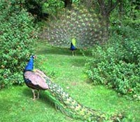

Slide 12
There are different way to describe species diversity
  One often used way to measure species diversity is “species richness”, which gives the total number of species within a particular area or geographical area.
Species diversity in natural habitants is high in areas of high rainfall and lower in drier areas.
The richest areas are tropical rain forest, which cover about 7% of the world’s land area & contain 90% of all species.

Slide 13
3) Ecosystem diversity
An ecosystem comprise a dynamic complex of plant animal and microorganism communities and their interaction to non-living environment, which interact as a functional unit.
Ecosystem diversity refers to the variety of habitat, dynamic complexes of plant, animal and microorganisms communities & their non living environment which interact as functional unit and their change over time.
Ecologists have identified 118 types of ecosystems in Nepal.

Slide 14
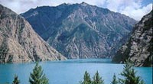
This may involve assessment of the relative abundance of different species as well as consideration of the types of species.
Examples of these ecosystem are : terrestrial ecosystem, marine ecosystem, aquatic ecosystem, ecosystem in forest, land and diversity of all ecosystem in biosphere.

Slide 15
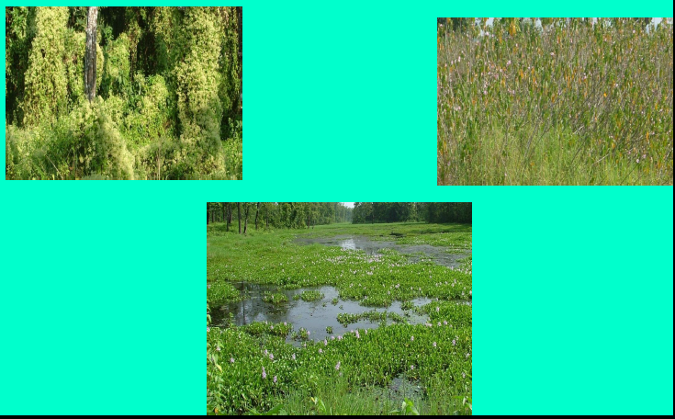

Slide 16
Biodiversity in Nepal
Nepal’s biodiversity is a reflection of its unique geographical position & altitudinal & climatic variation.
Those ecosystem, species & biological resources which are indigenous as well as endemic & which together give Nepal its distinct & unique ecological character are paramount in the protection and management of Nepal's biodiversity.

Slide 17
Biodiversity in Nepal
The country’s unique geography, with dramatic changes in elevation along the relatively short (150-250 kilometers) north south transect, and associated variability in the physiographic and climatic conditions have resulted in and extremely rich diversity of flora and fauna in Nepal.
Other important climatic factors such as rainfall, winter snowfall, temperature, and aspect also have influence on biodiversity.
Besides these local factors, the country’s standing at the crossroads of two major biogeographic regions of the world (Indo-Malayan to the south and Palearctic to the north) has made Nepal a mixing place of species originating in both the regions (Stainton, 1972).

Slide 18
Biodiversity in Nepal
Ecosystem Diversity
The original study to identify and classify the country’s ecosystems was carried out by Dobremez and his colleagues in the late 1960s.
The classification was based on altitude, climatic variations and vegetation types (Dobremez, 1970; 1976).
The Biodiversity Profiles Project (1995), which built upon Dobremez’s work and reports 118 ecosystems with 75 vegetation types, is the most widely used categorization of ecosystems and vegetation since its creation.
Most of the ecosystems are found in the Middle Mountains and High Mountains

Slide 19
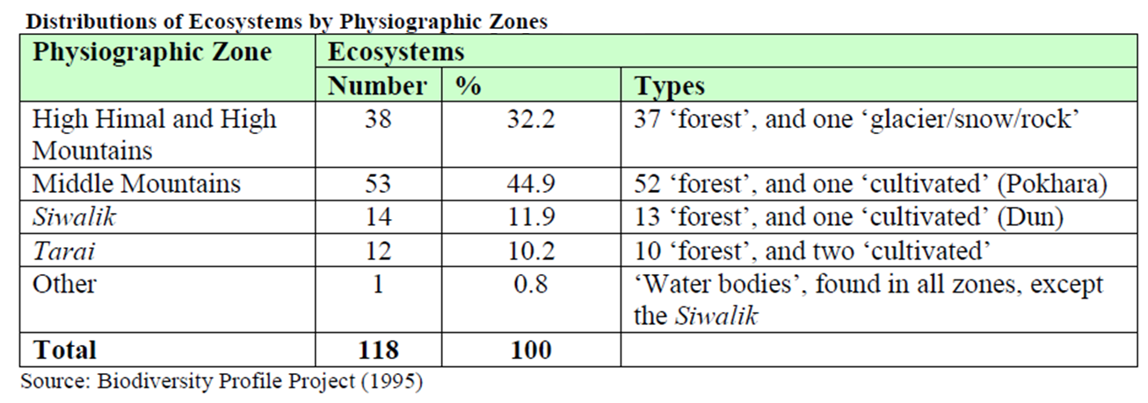

Slide 20
Forest Ecosystems of Nepal
Stainton (1972) delineated phyto-geographic boundaries based on climate, vegetation and floristic composition and classified the country’s forests into 35 types.

Slide 21
These types are often categorized into 10 major groups:
(i) tropical,
(ii) subtropical broadleaved,
(iii) subtropical conifer,
(iv) lower temperate broadleaved,
(v) lower temperate mixed broadleaved,
(vi) upper temperate broadleaved,
(vii) upper temperate mixed broadleaved,
(viii) temperate coniferous,
(ix) sub-alpine, and
(x) alpine scrub.

Slide 22
(B) Rangeland Ecosystems
Rangeland ecosystems in Nepal are comprised of
grasslands,
pastures and
shrub lands
that cover about 1.7 million hectares or nearly 12 percent of country’s land area.

Slide 23
About 79 % of the rangelands are located in the High Mountains and High Himalaya areas,
17 % in Middle Mountains and
the remaining 4% in the Siwalik and Tarai

Slide 24
A temperate rangeland and associatedmixed forest in Jumla
Photo ©: Rabindra Maharjan

Slide 25
(C) Wetland Ecosystems
Wetland ecosystems of Nepal fall into two broad categories:
natural wetlands, comprising of lakes and ponds, riverine floodplains, swamps and marshes, and
man-made wetlands, including water reservoirs, ponds and deep-water paddy fields. Irrigated paddy fields cover the largest area followed by rivers

Slide 26
Nearly half (45%) of the wetlands are in High Himalaya . This is due mainly to the large number of glaciers and glacial lakes in the Himalayan region.
Among the major river basins, Karnali houses the highest number (36%) of wetlands, followed by Koshi (Bhandari, 2009).
Nine of the country’s wetlands are listed as Ramsar sites.
Rupa Lake in Lekhnath Municipality, Pokhara
Photo ©: Kapil Khanal

Slide 27
Nepalese wetlands have very high ecological significance, as they harbor many threatened species of flora and fauna and serve as resting places for many migratory and globally threatened birds.
The wetland ecosystems offer excellent habitats to at least 230 indigenous species of fish belonging to 104 genera of high economic, environmental and academic value (Rajbanshi, 2013).

Slide 28
The wetlands also have high cultural and economic significance.
Many ethnic groups are dependent on wetlands for their livelihoods.
The wide variety of plants and animals that the wetlands support provide a wide range of goods and services as well as income-generating opportunities for the local people.
Loss and degradation of these vital natural resources during the last few decades has severely affected these relationships.

Slide 29
(D) Agro-ecosystems
The diverse climatic and topographic conditions have favored for maximum diversity of agricultural crops, their wild relatives, and animal species in Nepal.
Crops, livestock and forests are the three major components of the country’s complex farming systems.

Slide 30
A Middle Mountain farming system in central Nepal
Photo ©: Sagar Kumar Rimal
(D) Agro-ecosystems
Traditional farming systems, which use local knowledge and experiences and vary across the country, are assumed to have great role in maintaining the agricultural diversity.
Forests are integral components of such systems.

Slide 31
Species Diversity
Nepal harbors around three percent and one percent of the world’s flora and fauna, respectively.
This includes
  over three percent of Angiosperms,
  five percent of Gymnosperms,
  six percent of Bryophytes, and
  nearly five percent of Pteridophytes.
  The country also holds proportionately high number of faunal species, including
    208 species (5.2% of the world’s total) mammals, and
    873 species (9.5%) of birds

Slide 32
Species Diversity

Slide 33
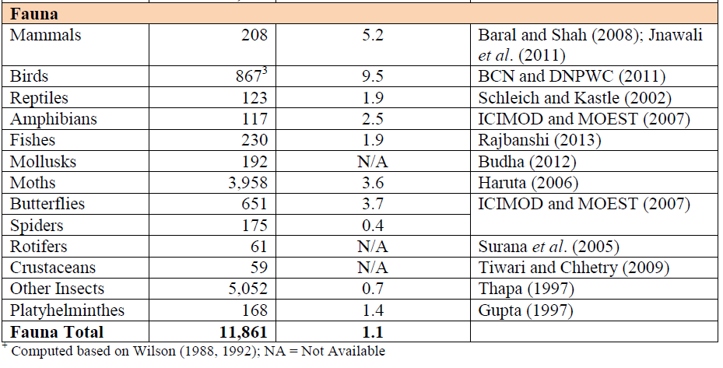

Slide 34
Genetic Diversity

Slide 35
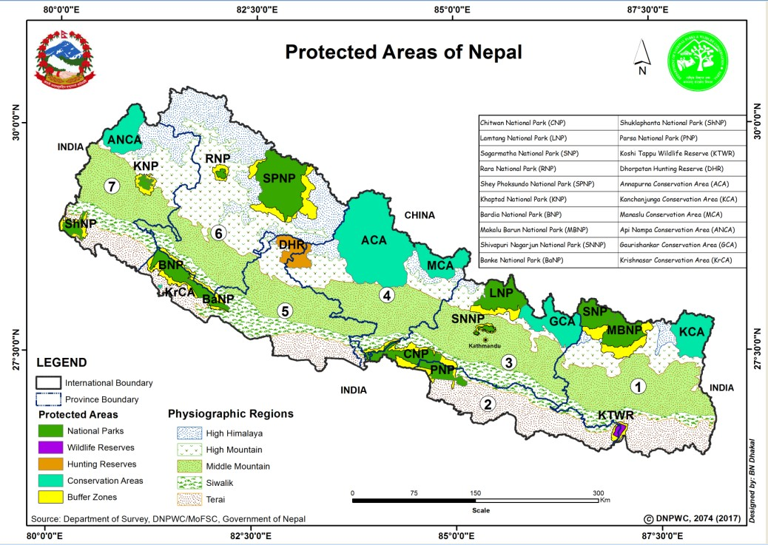
Concept of biodiversity

Slide 36
Global Biodiversity

Slide 37
Global Biodiversity
More than 99 percent of all species that ever lived on Earth are estimated to be extinct. Estimates on the number of Earth's current species range from 2 million to 10¹²of which about 1.6 million have been databased thus far and over 80 percent have not yet been described.

Slide 38
Global Biodiversity
More recently, in May 2016, scientists reported that 1 trillion species are estimated to be on Earth

Slide 39
Global Biodiversity (Described)
Bryophyta 16,236
Gymnosperm | ~1,021
Angiosperm | 22000
Lichen | 17,000
Algae | 12,272
Fungi | 98,998 (incl. Lichens 17,000)
Insects | ~1,000,000 (965,431–1,015,897)
Pisces | 31,153
Ambhibians | 6,515
Reptile | 8,734
Aves | 9990
Mammals | 5487

Slide 40
Importance of biodiversity
The value of biodiversity can be grouped as the following categories
1) Resource value
  It provides the material basis for life such as food, fiber, medicine & raw material for industry.
  It also provide genes for breeding improved varieties .
  Similarly local cultivators of crop & local bread of animals also provide genes better suited to local environmental condition.

Slide 41
The air we breathe is a product of photosynthesis by green plants. Insects, worms, bacteria, and other tiny organisms break down wastes and aid in the decomposition of dead plants and animals to enrich soils. More than 90 percent of the calories consumed by people worldwide are produced from 80 plant species. Almost 30 percent of medicines are developed from plants and animals, and many more are derived from these sources.

Slide 42
2) Functional use
  It plays important role in the maintenance of biosphere which is a state supportive to human life.
  It provides many ecosystem services to human being such as water shed regulation & stabilization of soil, recycling of important elements like carbon, hydrogen, nitrogen, oxygen.
  It also regulate the chemistry of the atmosphere, global climate, water cycle and soil quality.

Slide 43
3) Aesthetic & ethical value
  Biodiversity is used for appealing beauty, cultural, religious or moral faith is an aspect of non-material value.
  It also help to increase the economical development of country from tourism by bring in foreign currency, e.g., national parks, conservation areas wild life reserve etc.
  Aesthetic values concerns with the mental pleasure and satisfaction to the sense or mind.
  Ethical values are more related to cultural, religious and moral senses ultimately based on the view that all living creature on the earth are inter related to each other directly or indirectly & all of them have a right of existence.

Slide 44
4) Study and research
  The study and research of various aspect of biodiversity is to be carried out for the economic and social development of human race.
  The accumulated knowledge & skill will help in the conservation & promotion of creatures of the earth.
  Biodiversity is a large area for research of creatures.

Slide 45
Major threats or challenges to biodiversity
3 major levels
The threat of ecosystem loss
The threat of species loss
The threat of loss of genetic loss

Slide 46
The threat of ecosystem loss
Ecosystem loss can be the result of direct or indirect impact of human activities.
Direct cause include conversion of natural environment (forest, grassland, hill, mountain) to agriculture, horticulture, residential forest or industrial development, road, dams or other physical infrastructure.

Slide 47
The greatest threat comes from the need of subsistence farmers to extend their agriculture activity & perception that is best achieved through the conversion of forest & other virgin land
Ecosystem loss has been appear due to following cause:
  Habitat loss due to deforestation
  Threat of rangeland biodiversity: due to increased grazing animals.
  Fire
  Threats to protected areas : e.g., grazing, poaching, illegal timber harvesting.
  Threat to wetland biodiversity
    Industrial pollution, agricultural runoff water, solid waste pollution.

Slide 48
The threat of species loss
Species loss can be the result of over exploitation of biological resources.
Uncontrolled use of forest resources for subsistence like fuel material, timber, shelter, medicine, food etc.
Over 75% of the energy resources & over 40% fodder needs are meet through forest resources.
A threat to this biological resources is also a threat to social and economical wellbeing of the people
Threat to forest diversity.

Slide 49
Threats to forest biodiversity
The Nepal Conservation Strategy raised the alarm that if Nepal were to lose its remaining humid tropical forests, an estimated ten species of highly valuable timber trees, six species of fibre trees, six species of edible fruit trees, four species of medicinal herbs and fifty species of other trees and shrubs would be lost forever.
In addition, the habitats for 200 species of birds, ten species of mammals and twenty species of reptiles and amphibians would be severely affected.
Shrestha et al. (1998) reported that 68% of plant species were lost when 41% of the density and 50% of the tree biomass were lost in Riyale, Kabhrepalanchowk.
Similarly, Shrestha et al. (2000) reported that a 78.2% plant species loss occurred when 83.1% of the density and 80.1% of the tree biomass were lost in the degraded forests of Chitrepani, Makwanpur district, as compared to natural forests.

Slide 50
Threats to endangered plants and animals are increasing due to the high commercial values in local and international markets for specific plants and animal parts.
In Nepal, 56 mammal, 226 bird, 25 reptile, nine amphibian, 35 fish, and 142 butterfly species are threatened with extinction locally.

Slide 51
Threats to Non-Timber Forest Products (NTFPs)
The most critical threats to all NTFPs are deforestation, habitat degradation, and unsustainable harvesting.
The most common NTFPs that are traded on a large scale (over 100 tonnes/year) are Pine resin (khoto), Sal seed, Ritha, Timur, Dalchini and Tejpat, Sabai grass (or Babiyo), Lokta, Satawari (or Kurilo), Chirayito, Jatamansi, (Malla et al. 1993).

Slide 52
The threat of loss of genetic resources
The genetic resources of Nepal are in a state of depletion which is primarily due to the destruction of natural habitat, over-grazing, land fragmentation, commercialisation of agriculture and the expansion of high-yielding crop varieties, indiscriminate use of pesticides, population growth and urbanisation, changes in farmers’ priorities, and lack of awareness among policy makers and planners about the importance of biodiversity.

Slide 53
Threats to protected areas
There are still many conflicts and threats that affect the entire Protected Areas System in Nepal. A few examples are discussed below:
Grazing is a year-round threat to many of the protected areas in the Terai, whereas it is usually only a seasonal threat to the high elevation pastures of the Himalayas.
Poaching for high value products for international markets, such as rhino horn, elephant tail hair are fundamentally different in scope and in degree from the occasional poaching of wild animals to supplement rural diets.

Slide 54
PRELIMINARY CAUSAL CHAIN ANALYSIS
Root causes of the threats to ecosystem loss
Low level of public information and participation
Increase population and incidence of poverty
Weak institutional capacity
Lack of integrated land and water use planning

Slide 55
INTERMEDIATE CAUSES
Limited land available for the growing human population
Inefficient or over-use of land
Lack of environmental sensitivity and awareness
Ineffective solid and liquid waste management

Slide 56
IMMEDIATE CAUSES
Grazing, grass-cutting and other illegal activities
Conversion of forests and wetlands to agriculture
Haphazard Fire
Pollution and environmental degradation
Soil erosion
THREAT OF ECOSYSTEM LOSS

Slide 57
THREAT OF SPECIES LOSS
ROOT CAUSES
Weak in administrative, planning and management capacity
Inadequate data and information management
High incidence of poverty
Low level of public information and participation
IMMEDIATE CAUSES
Poaching, hunting and other illegal activities
Over-collection of medicinal and other plants
Replacement of indigenous races with exotic varieties
No recovery/rehabilitation plans
Competition and other impacts of alien species
Destruction of habitat
INTERMEDIATE CAUSES
Inadequate active management
Inadequate implementation of legislation
Subsistence and income needs
Lack of environmental awareness and sensitivity
THREAT OF
SPECIES LOSS

Slide 58
Root causes of the threats to Genetic loss
IMMEDIATE CAUSES
Alien species promoted over indigenous species
Unsustainable agricultural practices
Hybridisation with alien species
INTERMEDIATE CAUSES
Absence of an integrated/co-ordinated approach to management of biological resources
Lack of environmental awareness and sensitivity
Pressing need for subsistence and/or income generation
ROOT CAUSES
Lack of policies or strategies for biodiversity conservation
Low level of public information and participation
High incidence of poverty
THREAT OF LOSS OF GENETIC RESOURCES

Slide 59
Though the above causal chain analysis is very preliminary, the results obtained above are very indicative of some of the origins of the threats to biodiversity in Nepal. These can be summarised as follows:
  Low level of public awareness and participation
  High population pressures and incidence of poverty
  Weak institutional, administrative, planning and management capacities
  Lack of integrated land and water use planning
  Inadequate data and information management
  Lack of policies or strategies for biodiversity conservation

Slide 60
Challanges
Lack of Creating ownership among people
Governance: Biodiversity vs. livelihood and local participation
Illiteracy
Tenure Right: Indigenous, forest dependent communities (Chepang, Raute). Both BD and these in trouble
Benefit Sharing mechanism ( Government, local community)
Payment of Environmental Services

Slide 61
Pollution
Capacity Building: Aware why to protect, monitoring skills and documentation system
Policy Formulation Process: Trickle down, no involvement of community and stakeholders. Thus may be unreliable policy, low ownership.
Global climate change
Ignore role of staskeholder and local manager
Over-harvesting
Lack of coordination and Partnership

Slide 62
Biodiversity conservation measures
Ex-situ Conservation
In-situ Conservation

Slide 63
Ex-situ Conservation
Ex situ conservation literally means, "off-site conservation". It is the process of protecting an endangered species, variety or breed, of plant or animal outside its natural habitat; for example, by removing part of the population from a threatened habitat and placing it in a new location, which may be a wild area or within the care of humans.

Slide 64
Ex-situ Conservation
The degree to which humans control or modify the natural dynamics of the managed population varies widely, and this may include alteration of living environments, reproductive patterns, access to resources, and protection from predation and mortality.

Slide 65
Botanical gardens, zoos, and aquariums
Botanical gardens, and zoos are the most conventional methods of Ex situ conservation and also In situ conservation, all of which house whole, protected specimens for breeding and reintroduction into the wild when necessary and possible. These facilities provide not only housing and care for specimens of endangered species, but also have an educational value. They inform the public of the threatened status of endangered species and of those factors which cause the threat, with the hope of creating public interest in stopping and reversing those factors which jeopardize a species' survival in the first place.

Slide 66
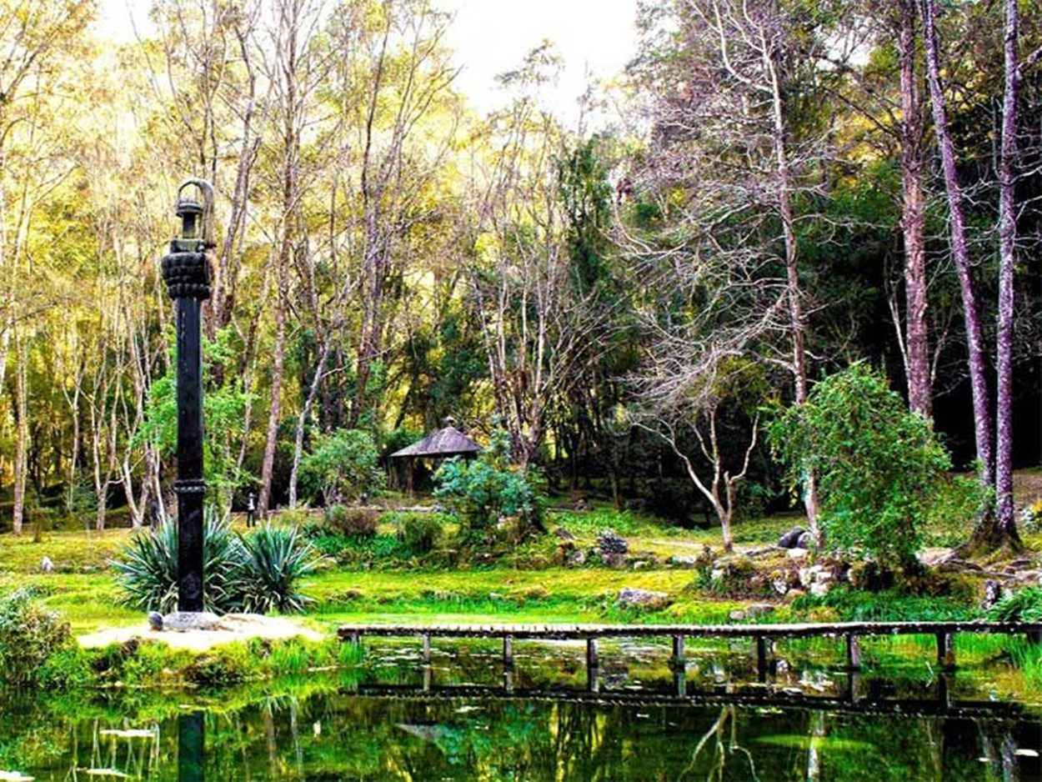

Slide 67
Botanical gardens, zoos, and aquariums
National Botanical Garden,Godawari
Dhitachaur Botanical Garden, Jumla
Mulpani Botanical Garden, Kapurkot, Salyan
Dhakeri Botanical Garden, Banke
Tistung Botanical Garden, Tistung
Daman Botanical Garden, Daman
Brindawan Botanical Garden, Hetuda
Dhanusha Botanical Garden, Dhanusha
Maipokhari Botanical Garden, Ilam
Dewariya Botanical Garden KailaliI

Slide 68
National Botanical Garden, Godavari
National Botanical Garden is a Government institution holding documented collections of living plants for the purpose of scientific research, conservation, display and education.
Daman Botanical Garden, Daman
Situated at (2320 m.) and at about 75 km (road distance) from Kathmandu and lies on southwestern part of it . The total land area covered by the garden is 15 Ha (300 Ropani). Principal objective of the garden is to conserve the garden with shade house germplasm of the plants occurring in the garden and its surrounding locality. Further, it is also aimed to represent different plant species having similar bioclimatic condition from other parts.

Slide 69
National Botanical Garden, Godavari
National Botanical Garden is a Government institution holding documented collections of living plants for the purpose of scientific research, conservation, display and education.
Daman Botanical Garden, Daman
Situated at (2320 m.) and at about 75 km (road distance) from Kathmandu and lies on southwestern part of it . The total land area covered by the garden is 15 Ha (300 Ropani). Principal objective of the garden is to conserve the garden with shade house germplasm of the plants occurring in the garden and its surrounding locality. Further, it is also aimed to represent different plant species having similar bioclimatic condition from other parts.

Slide 70
Zoo
A zoo (short for zoological garden or zoological park and also called an animal park or menagerie) is a facility in which all animals are housed within enclosures, displayed to the public, and in which they may also breed.
Established basically as the private zoo by late Prime Minister Juddha Sumsher J.B. Rana in 1932, The Central Zoo is the only zoo in Nepal. The Government of Nepal finally opened the zoo to the public in 1956. The Zoo remained under the management of various Departments of the Government for various years. It was only when the zoo was managed meeting the standards when it was handed over to The National Trust for Nature Conservation (NTNC) in December 1995. The Trust has developed plans and policies to maintain the zoo and improve the living conditions of animals.

Slide 71
Cryopreservation
The storage of seeds, pollen, tissue, or embryos in liquid nitrogen. This method can be used for virtually indefinite storage of material without deterioration over a much greater time-period relative to all other methods of ex situ conservation.
Cryopreservation is also used for the conservation of livestock genetics through Cryoconservation of animal genetic resources. Technical limitations prevent the cryopreservation of many species, but cryobiology is a field of active research, and many studies concerning plants are underway.

Slide 72
Seed bank
The storage of seeds in a temperature and moisture controlled environment. This technique is used for taxa with orthodox seeds that tolerate desiccation. Seed bank facilities vary from sealed boxes to climate controlled walk-in freezers or vaults. Taxa with recalcitrant seeds that do not tolerate desiccation are typically not held in seed banks for extended periods of time.

Slide 73
Tissue culture (storage and propagation)
Somatic tissue can be stored in vitro for short periods of time. This is done in a light and temperature controlled environment that regulates the growth of cells. As a ex situ conservation technique tissue culture is primary used for clonal propagation of vegetative tissue or immature seeds. This allows for the proliferation of clonal plants from a relatively small amount of parent tissue.

Slide 74
Field gene banking
An extensive open-air planting used maintain genetic diversity of wild, agricultural, or forestry species. Typically species that are either difficult or impossible to conserve in seed banks are conserved in field gene banks. Field gene banks may also be used grow and select progeny of species stored by other ex situ techniques.

Slide 75
Cultivation collections
Plants under horticultural care in a constructed landscape, typically a botanic garden or arboreta. This technique is similar to a field gene bank in that plants are maintained in the ambient environment, but the collections are typically not as genetically diverse or extensive. These collections are susceptible to hybridization, artificial selection, genetic drift, and disease transmission. Species that cannot be conserved by other ex situ techniques are often included in cultivated collections.

Slide 76
In-Situ Conservation
In-situ conservation is the on-site conservation or the conservation of genetic resources in natural populations of plant or animal species. It is the process of protecting an endangered plant or animal species in its natural habitat, either by protecting or restoring the habitat itself, or by defending the species from predators.

Slide 77
National Park
National Park is a reserve of natural, semi-natural, or developed land that a sovereign state declares or owns. Although individual nations designate their own national parks differently, there is a common idea: the conservation of 'wild nature' for posterity and as a symbol of national pride.

Slide 78
National Park
12 National parks in Nepal
Bardia National park
Banke National Park
Chitwan National Park
Khaptad National Park
Langtang National Park
Makalu Barun National Park
Parsa National Park
Rara National Park
Sagarmatha National Park
Shey-Phoksundo National Park
Shivapuri Nagarjun National Park
Shuklaphanta National Park

Slide 79
Wildlife reserves
The Koshi Tappu Wildlife Reserve is a protected area in the Terai of eastern Nepal covering 175 km² of wetlands in the Sunsari, Saptari and Udayapur Districts. It comprises extensive mudflats, reed beds, and freshwater marshes in the floodplain of the Sapta Kosi River, and ranges in altitude from 75 to 81 m (246 to 266 ft). It was established in 1976 and designated as a Ramsar site in December 1987

Slide 80
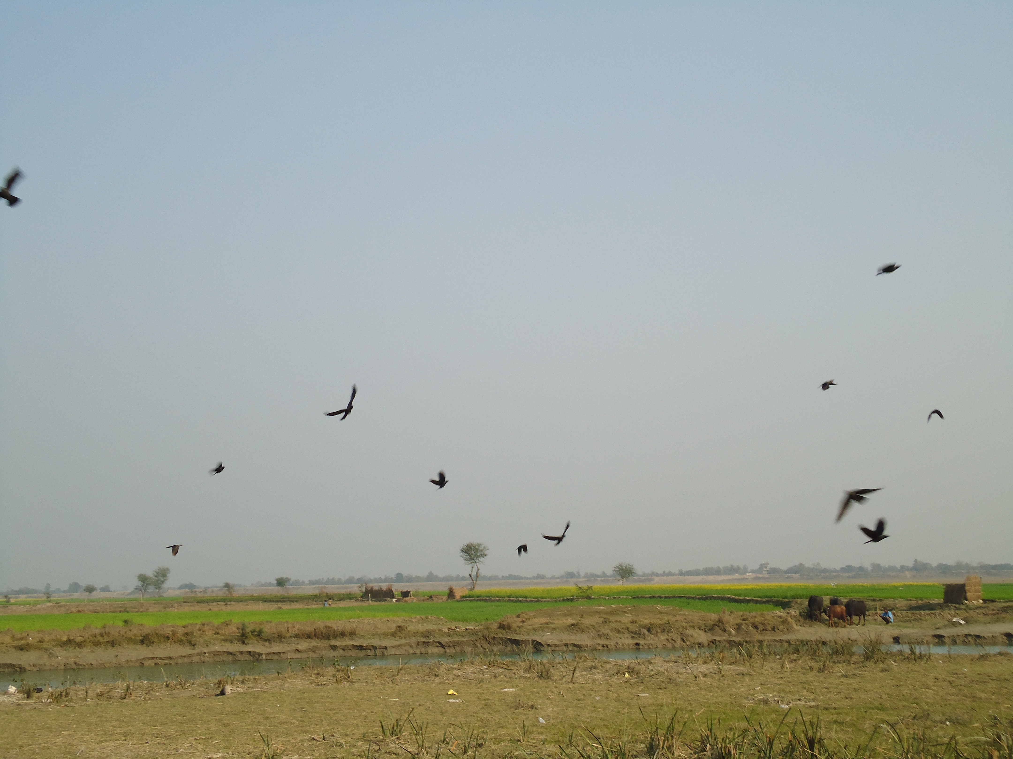

Slide 81
Conservation areas
Annapurna Conservation Area
Kanchenjunga Conservation Area
Manaslu Conservation Area
Blackbuck Conservation Area
Api Nampa Conservation Area
Gaurishankar Conservation Area

Slide 82
Hunting Reserve
Dhorpatan Hunting Reserve

Slide 84
Ramsar Sites
The following Ramsar sites were declared between 1988 and 2008
Bishazari Tal – 3,200 ha (12 sq mi)
Ghodaghodi Tal – 2,563 ha (9.90 sq mi)
Gokyo Lake Complex – 7,770 ha (30.0 sq mi)
Gosaikunda – 13.8 ha (34 acres)
Jagdishpur Reservoir – 225 ha (0.87 sq mi)
Kosi Tappu Wildlife Reserve – 17,500 ha (68 sq mi)
Mai Pokhari – 90 ha (220 acres)
Phoksundo Lake – 494 ha (1.91 sq mi)
Rara Lake – 1,583 ha (6.11 sq mi)
Lake Cluster of Pokhara Valley[8] – 178.5 km2 (68.9 sq mi)

Slide 85
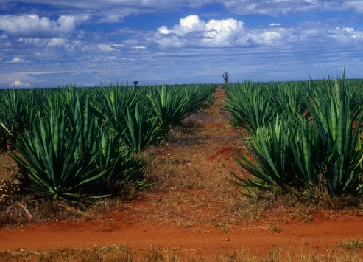
Thank you

