Slide 1

Concept of climate and weather
Weather of an area is the total physical conditions of the lower atmosphere over the area for hours or days as can be measured as temperature, precipitation, humidity, direction and speed of wind, cloud cover, sunshine and others.

Slide 2
Concept of climate and weather
Climate is a region’s general pattern of atmospheric or weather conditions over a long time ( decades or centuries) as analyzed by data measured for past years (generally 30 years and more).

Slide 3
Concept of climate and weather
Climate is a region’s general pattern of atmospheric or weather conditions over a long time ( decades or centuries) as analyzed by data measured for past years (generally 30 years and more).

Slide 4
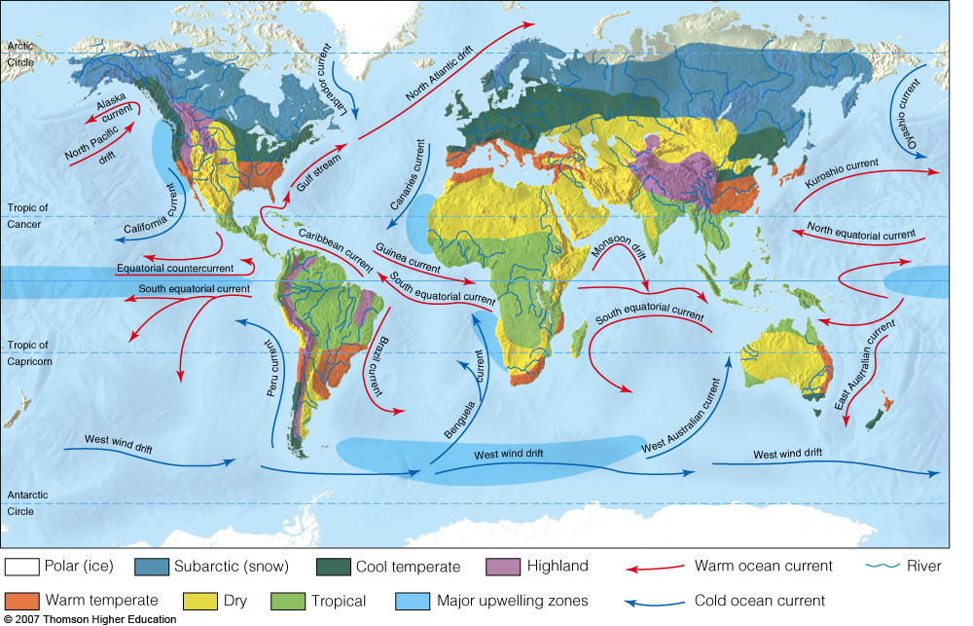
Earth’s Current Climate Zones

Slide 5
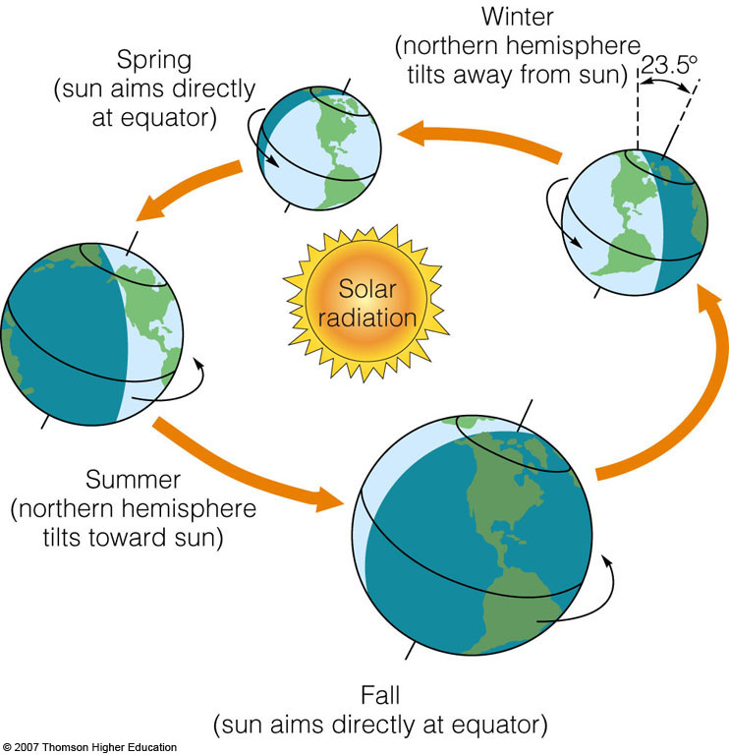
Solar Energy and Global Air Circulation: Distributing Heat
Global air circulation is affected by the uneven heating of the earth’s surface by solar energy, seasonal changes in temperature and precipitation.

Slide 6
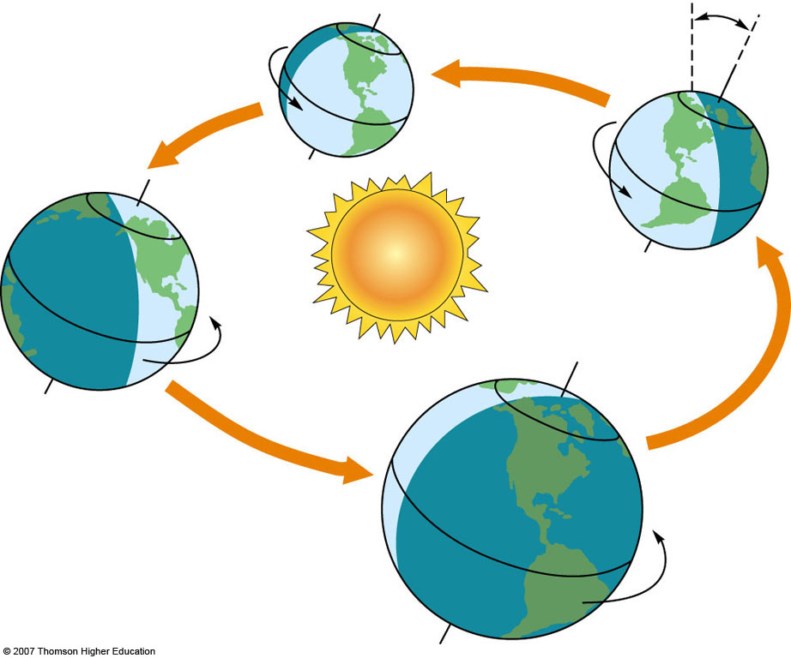
Winter
(northern hemisphere
tilts away from sun)
Spring
(sun aims directly
at equator)
23.5 °
Solar
radiation
Summer
(northern hemisphere
tilts toward sun)
Fall
(sun aims directly at equator)
Notes:
Figure 5.3
Natural capital: as the planet makes its annual revolution around the sun on an axis tilted about 23.5°, various regions are tipped toward or away from the sun. The resulting variations in the amount of solar energy reaching the earth create the seasons in the northern and southern hemispheres.

Slide 7
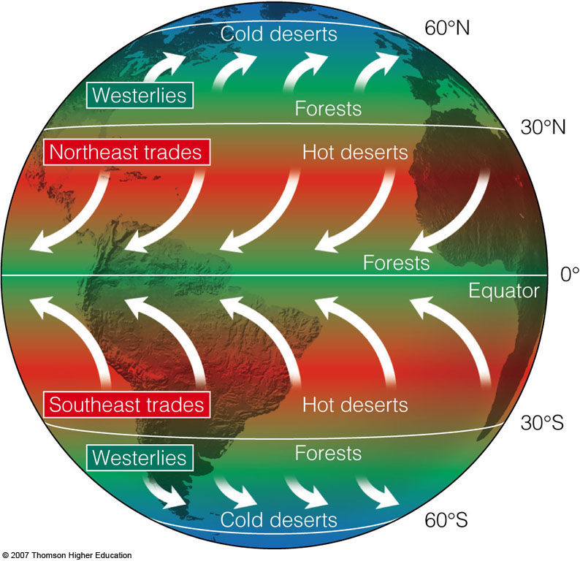
Coriolis Effect
Global air circulation is affected by the rotation of the earth on its axis.

Slide 8
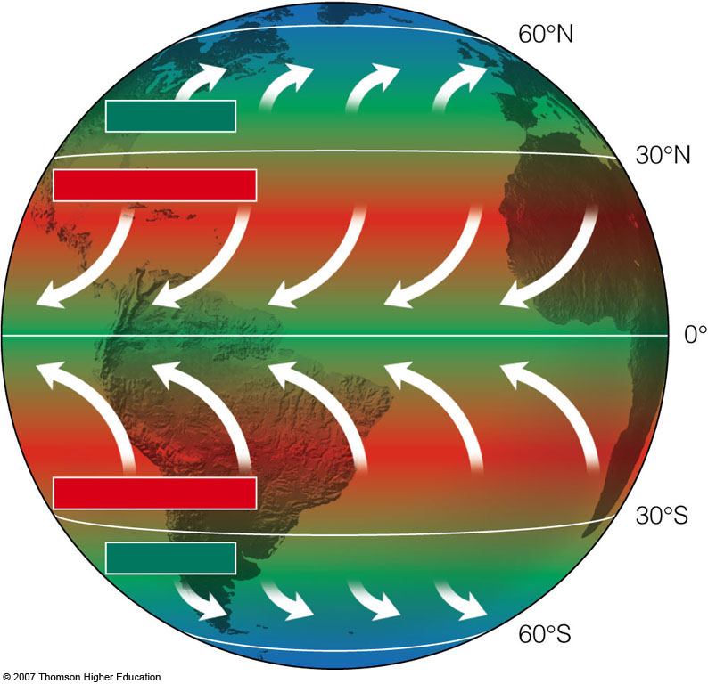
Cold deserts
Westerlies
Forests
Northeast trades
Hot deserts
Forests
Equator
Southeast trades
Hot deserts
Westerlies
Forests
Cold deserts
Notes:
Figure 5.4
Natural capital: because of the Coriolis effect the earth’s rotation deflects the movement of the air over different parts of the earth, creating global patterns of prevailing winds that help distribute heat and moisture in the troposphere.

Slide 9
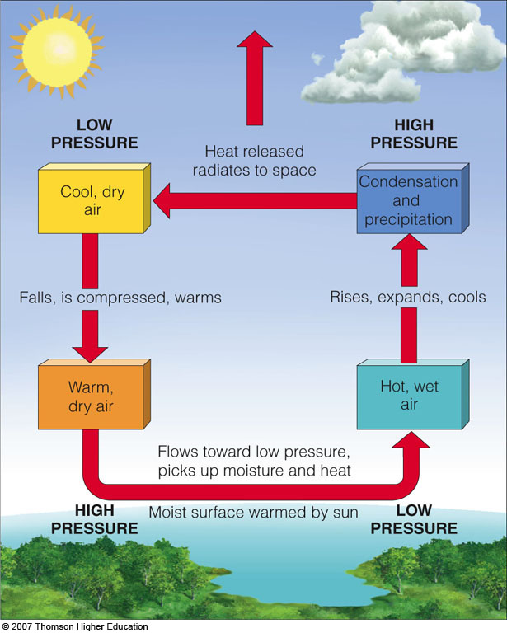
Convection Currents
Global air circulation is affected by the properties of air water, and land.

Slide 10
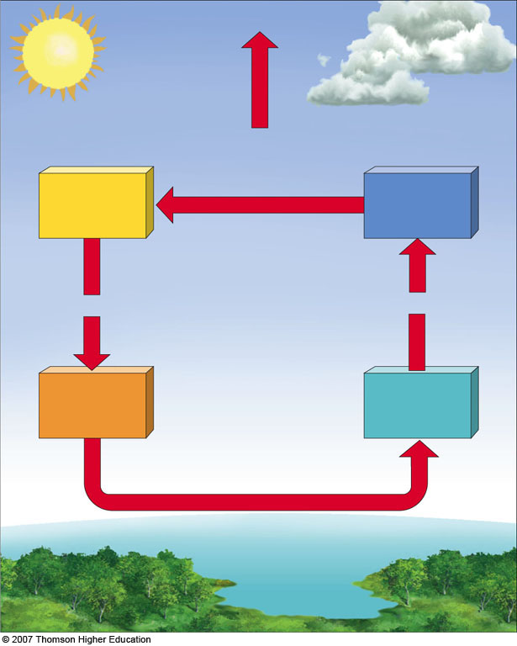
LOW
PRESSURE
HIGH
PRESSURE
Heat released
radiates to space
Cool, dry
air
Condensation
and
precipitation
Falls, is compressed, warms
Rises, expands, cools
Warm,
dry air
Hot, wet
air
Flows toward low pressure,
picks up moisture and heat
HIGH
PRESSURE
Moist surface warmed by sun
LOW
PRESSURE
Notes:
Figure 5.5
Natural capital: transfer of energy by convection in the troposphere. Convection occurs when hot and wet warm air rises, cools, and releases moisture as precipitation and heat (right side). Then the more dense cool and dry air sinks, gets warmer, and picks up moisture as it flows across the earth’s surface to begin the cycle again.

Slide 11
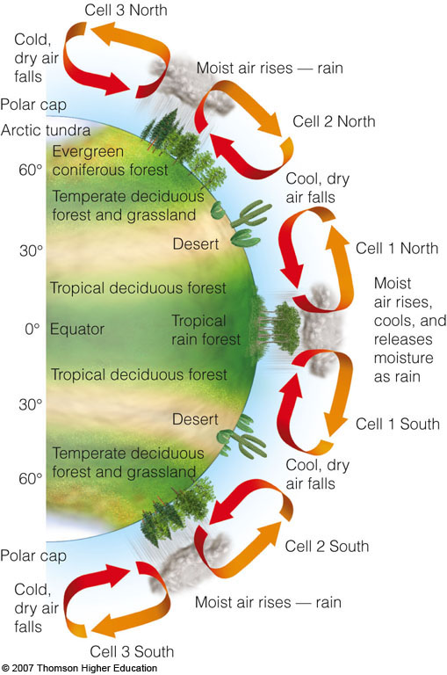
Convection Cells
Heat and moisture are distributed over the earth’s surface by vertical currents, which form six giant convection cells at different latitudes.

Slide 12
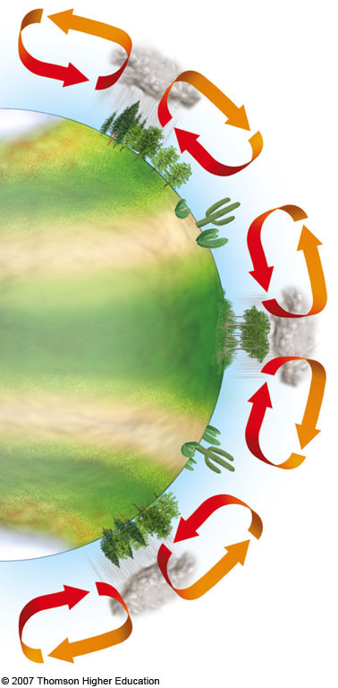
Cold,
dry air
falls
Cell 3 North
Moist air rises — rain
Polar cap
Arctic tundra
Cell 2 North
60°
Evergreen
coniferous forest
Cool, dry
air falls
Temperate deciduous
forest and grassland
30°
Desert
Cell 1 North
Tropical deciduous forest
Moist air rises,
cools, and releases
Moisture as rain
0°
Equator
Tropical
rain forest
Tropical deciduous forest
30°
Desert
Temperate deciduous
forest and grassland
Cell 1 South
60°
Cool, dry
air falls
Polar cap
Cell 2 South
Cold,
dry air
falls
Moist air rises — rain
Cell 3 South
Notes:
Figure 5.6
Natural capital: global air circulation and biomes. Heat and moisture are distributed over the earth’s surface by vertical currents, which form six giant convection cells at different latitudes. The resulting uneven distribution of heat and moisture over the planet’s surface leads to the forests, grasslands, and deserts that make up the earth’s biomes.

Slide 13
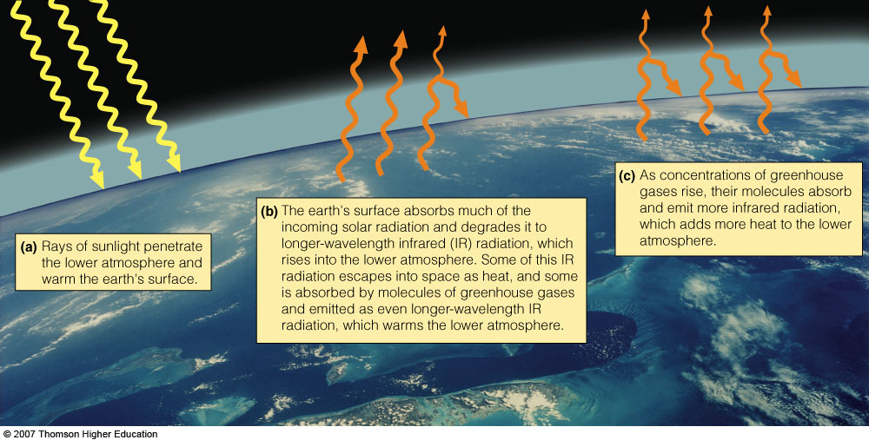
Ocean Currents:
Distributing Heat and Nutrients
Ocean currents influence climate by distributing heat from place to place and mixing and distributing nutrients.

Slide 14
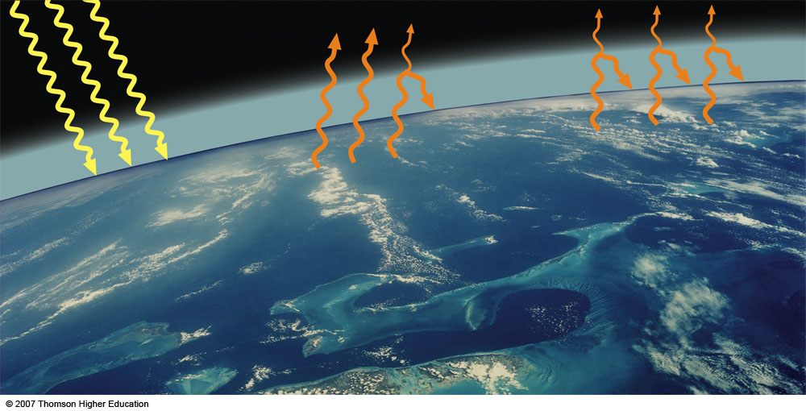
(a) Rays of sunlight
penetrate the lower
atmosphere and
warm the earth's
surface.
(b) The earth's surface absorbs
much of the incoming solar radiation
and degrades it to longer-wavelength
infrared (IR) radiation, which rises
into the lower atmosphere. Some of this
IR radiation escapes into space as heat,
and some is absorbed by molecules of
greenhouse gases and emitted as even
longer-wavelength IR radiation, which
warms the lower atmosphere.
(c) As concentrations of
greenhouse gases rise,
their molecules absorb
and emit more infrared
radiation, which adds
more heat to the lower
atmosphere.
Notes:
Figure 5.7
Natural capital: the natural greenhouse effect. When concentrations of greenhouse gases in the atmosphere rise, the average temperature of the troposphere rises. (Modified by permission from Cecie Starr, Biology: Concepts and Applications, 4th ed., Pacific Grove, Calif.: Brooks/Cole, 2000)

Slide 15
Ocean Currents:
Distributing Heat and Nutrients
Global warming:
  Considerable scientific evidence and climate models indicate that large inputs of greenhouse gases from anthropogenic activities into the troposphere can enhance the natural greenhouse effect and change the earth’s climate in your lifetime.

Slide 16
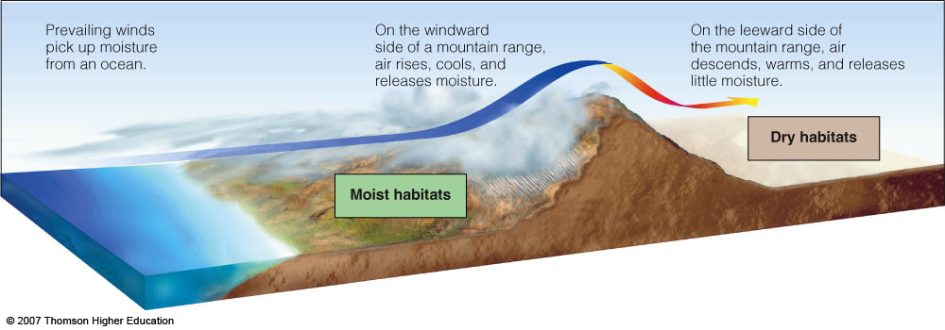
Topography and Local Climate:
Land Matters
Interactions between land and oceans and disruptions of airflows by mountains and cities affect local climates.

Slide 17
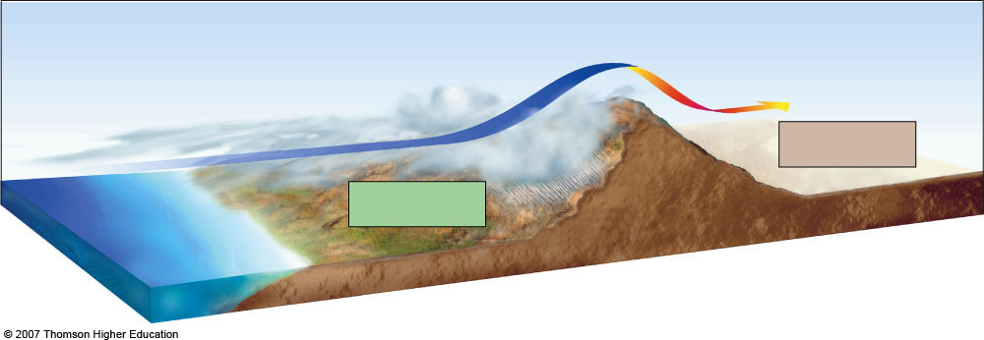
Prevailing winds
pick up moisture
from an ocean.
On the windward
side of a mountain range,
air rises, cools, and
releases moisture.
On the leeward side of
the mountain range, air
descends, warms, and
Releases little moisture.
Dry habitats
Moist habitats
Notes:
Figure 5.8
Natural capital: The rain shadow effect is a reduction of rainfall on the sides of mountains facing away from prevailing surface winds. Warm, moist air in prevailing onshore winds loses most of its moisture as rain and snow on the windward (wind-facing) slopes of a mountain range. This leads to semiarid and arid conditions on the leeward side of the mountain range and the land beyond. The Mojave Desert in the U.S. state of California and Asia’s Gobi Desert were both created by this effect.

Slide 18
Earth’s Current Climate Zones

Slide 19
Solar Energy and Global Air Circulation: Distributing Heat
Global air circulation is affected by the uneven heating of the earth’s surface by solar energy, seasonal changes in temperature and precipitation.

Slide 20
Winter
(northern hemisphere
tilts away from sun)
Spring
(sun aims directly
at equator)
23.5 °
Solar
radiation
Summer
(northern hemisphere
tilts toward sun)
Fall
(sun aims directly at equator)
Notes:
Figure 5.3
Natural capital: as the planet makes its annual revolution around the sun on an axis tilted about 23.5°, various regions are tipped toward or away from the sun. The resulting variations in the amount of solar energy reaching the earth create the seasons in the northern and southern hemispheres.

Slide 21
Greenhouse gases and its global scenario
A greenhouse gas is a gas in an atmosphere that absorbs and emits radiant energy within the thermal infrared range. Greenhouse gases are those that absorb and emit infrared radiation in the wavelength range emitted by Earth.
This process is the fundamental cause of the greenhouse effect. The primary greenhouse gases in Earth's atmosphere are water vapor, carbon dioxide, methane, nitrous oxide, and ozone. Without greenhouse gases, the average temperature of Earth's surface would be about −18 °C rather than the present average of 15 °C.

Slide 22
Greenhouse gases and its global scenario
Human activities since the beginning of the Industrial Revolution (around 1750) have produced a 40% increase in the atmospheric concentration of carbon dioxide (CO2), from 280 ppm in 1750 to 406 ppm in early 2017

Slide 23
Greenhouse gases and its global scenario
This increase has occurred despite the uptake of more than half of the emissions by various natural "sinks" involved in the carbon cycle. The vast majority of anthropogenic carbon dioxide emissions (i.e., emissions produced by human activities) come from combustion of fossil fuels, principally coal, oil, and natural gas, with comparatively modest additional contributions coming from deforestation, changes in land use, soil erosion, and agriculture.

Slide 24
Greenhouse gases and its global scenario
Atmospheric concentrations of greenhouse gases are determined by the balance between sources (emissions of the gas from human activities and natural systems) and sinks (the removal of the gas from the atmosphere by conversion to a different chemical compound). The proportion of an emission remaining in the atmosphere after a specified time is the "airborne fraction" (AF). The annual airborne fraction is the ratio of the atmospheric increase in a given year to that year's total emissions. As of 2006 the annual airborne fraction for CO2 was about 0.45.

Slide 25
Greenhouse gases and its global scenario
In order, the most abundant greenhouse gases in Earth's atmosphere are:
Water vapor (H2O)
Carbon dioxide (CO2)
Methane (CH4)
Nitrous oxide (N2O)
Ozone (O3)
Chlorofluorocarbons (CFCs)
Hydrochlofluorocarbons (HCFCs) and
Hydrofluorocarbons (HFCs)

Slide 26
Greenhouse gases and its global scenario
Atmospheric concentrations of greenhouse gases are determined by the balance between sources (emissions of the gas from human activities and natural systems) and sinks (the removal of the gas from the atmosphere by conversion to a different chemical compound).The proportion of an emission remaining in the atmosphere after a specified time is the "airborne fraction" (AF). The annual airborne fraction is the ratio of the atmospheric increase in a given year to that year's total emissions. As of 2006 the annual airborne fraction for CO2 was about 0.45. The annual airborne fraction increased at a rate of 0.25 ± 0.21% per year over the period 1959–2006.

Slide 27
Greenhouse gases and its global scenario
Water vapour, carbon dioxide, methane and nitrous oxide are the four major greenhouse gases in the troposphere. These gases have been present in varying concentrations in the troposphere during most of the earth’s long history. Fluctuations in the troposphere concentrations of these gases, especially carbon dioxide and methane, plus changes in solar output are the major factors causing the changes in the average temperature of the troposphere over the past 400,000 years.

Slide 28
Greenhouse gases and its global scenario
For more than 275 years, since the beginning of the Industrial Revolution, human actions have led to significant increases in the troposphere concentration of three greenhouse gases carbon dioxide, methane and nitrous oxide. These increases result mostly from burning fossil fuels (which adds co2 and CH4), clearing and burning forests (which add CO2 and N2O), and planting rice and using inorganic fertilizers (which releases CH4 and N2O). .

Slide 29
Greenhouse gases and its global scenario
In 2004, the US was the world’s largest emitter of greenhouse gases, with 22% of global emissions, followed by China (14%), The European Union (13%), Russia (6%), Japan (5%), and India (4%). But between 1990 and 2004, China’s emissions increased by 88% while those of the US rose by 19%. China’s emissions are expected to surpass U.S. emissions by 2025. The United States and Canada have some of the world’s highest greenhouse gas emissions per person. Each American, on average, releases about 10 times more CO2 than the average Chinese. In 2005, each person in the United States emitted, on average, 9 kilograms of CO2 to produce half of the country’s electricity and nearly 40% of its CO2

Slide 30
Greenhouse gases and its global scenario

Slide 31
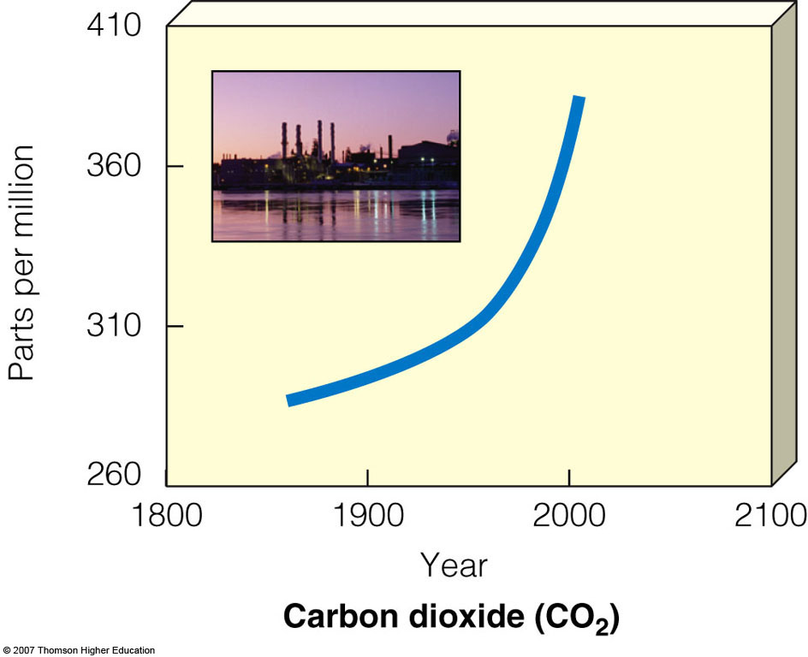
Fig. 20-5a, p. 467
Notes:
Figure 20.5
Science: increases in average concentrations of three greenhouse gases—carbon dioxide, methane, and nitrous oxide—in the troposphere between 1860 and 2005, mostly because of fossil fuel burning, deforestation, and agriculture. The fluctuations in the CO₂ curve (top) reflect seasonal changes in photosynthetic activity, which cause small differences between summer and winter concentrations of CO₂. (Data from Intergovernmental Panel on Climate Change, National Center for Atmospheric Research, and World Resources Institute)

Slide 32
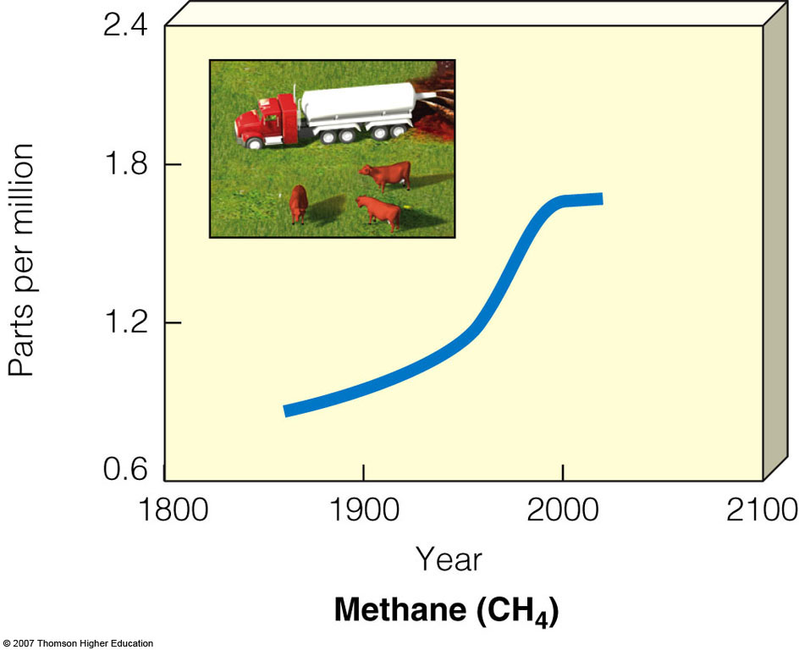
Fig. 20-5b, p. 467
Notes:
Figure 20.5
Science: increases in average concentrations of three greenhouse gases—carbon dioxide, methane, and nitrous oxide—in the troposphere between 1860 and 2005, mostly because of fossil fuel burning, deforestation, and agriculture. The fluctuations in the CO₂ curve (top) reflect seasonal changes in photosynthetic activity, which cause small differences between summer and winter concentrations of CO₂. (Data from Intergovernmental Panel on Climate Change, National Center for Atmospheric Research, and World Resources Institute)

Slide 33
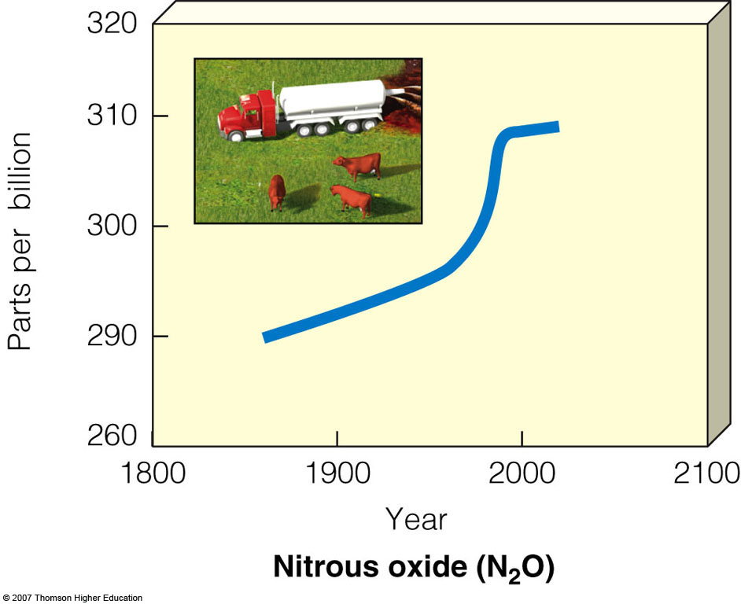
Fig. 20-5c, p. 467
Notes:
Figure 20.5
Science: increases in average concentrations of three greenhouse gases—carbon dioxide, methane, and nitrous oxide—in the troposphere between 1860 and 2005, mostly because of fossil fuel burning, deforestation, and agriculture. The fluctuations in the CO₂ curve (top) reflect seasonal changes in photosynthetic activity, which cause small differences between summer and winter concentrations of CO₂. (Data from Intergovernmental Panel on Climate Change, National Center for Atmospheric Research, and World Resources Institute)

Slide 34
4.3 Greenhouse effect and global warming
Three major factors shape the earth’s climate.
1. The sun: without solar energy the earth would be a dark and frigid planet with no life
2. Natural greenhouse effect: the natural process warming the earth’s lower troposphere and surface because of several gases known as greenhouse gases.
3. The ocean: that cover most of the planet surface and influence climate by storing carbon dioxide and heat, evaporating and receiving water as part of the hydrologic cycle, and moving stored heat from one place to another in currents. Natural cooling process also takes place at earth’s surface. Large quantities of heat are absorbed by the evaporation of surface water, most of it from the ocean. As these water vapour molecules rise, they condense to form droplets in clouds and release their stored heat higher in the troposphere. Because of the impact of this natural heating and cooling, the earth’s average surface temperature is about 15oC.

Slide 35
4.3 Greenhouse effect and global warming
Global warming refers to temperature increases in the troposphere, which in turn can cause climate change. Natural changes, human activities or both can cause such warming. Global climate change is a broader term that refers to changes in any aspects of the earth’s climate, including temperature, precipitation, and storm intensity and patterns.

Slide 36
Why Should We Be Concerned about a Warmer Earth?
A rapid increase in the temperature of the troposphere during this century would give us little time to deal with its harmful effects.
As a prevention strategy scientists urge to cut global CO₂ emissions in half over the next 50 years.
  This could prevent changes in the earth’s climate system that would last for tens of thousands of years.

Slide 38
4.5 Climate change scenario in Nepal
Nepal is among the least developed countries (LDCs) in South Asia covering area of 147181 square kilometers and with great topographical variation extending from 60 meters from mean sea level to 8848 meter from mean sea level. At the time of population census in 2011 there were 26,494,504 people residing in the country. Studies on climate change in Nepal reveals that 10 million people are exposed to increasing risks of climate change.

Slide 39
Ministry of Environment Nepal (MOE) states that the temperature rise rate for Nepal is 0.06 % (MOE Climate Change Policy 2011). Others claim that average temperatures across the country is different (i.e. higher in the mountains and the Himalayas: 0.08°C as compared to Terai: 0.04°C.) (Gautam and Pokhrel 2010). Extreme climatic conditions increase vulnerability to erosion, landslides, avalanches, flooding, loss of flora and fauna and decreased agricultural production (Nepal and Chipeniuk 2005).

Slide 40
Rice, Wheat and Maize are grown as major crops in Nepal. Nepal Agricultural Research Council (NARC) showed that the change in temperature has had a positive effect on the yield of rice and wheat in all regions but also showed a negative impact on the yield of maize, particularly in the plains land of Nepal, otherwise known as Nepal’s bread basket.

Slide 41
There are 2323 glacial lakes in Nepal covering 75 sq. kms. Geoscientists have recorded that the number and volume of Glacier Lake Outburst Flooding (GLOF) hazards are increasing in Nepal. Rate of retreat of some glaciers is estimated to be as high as 20 m/year. Evidence in the Main Rongbuk glacier (in Mount Everest): lost 330 feet of vertical ice, at a rate of more than 4ft/yr, between 1921 and 2007. Snow and glacier melt might increase water in Nepal's river system 5.7% till 2030, decrease by 28% by the end of this century. Crop failure and loss of livestock: threaten livelihoods of mountain farmers who are already vulnerable and food-insecure. Changes in snow patterns: affect tourism industry, cause enormous economic losses. Tourism is one of the major contributor in Nepalese economy. (Source: Devkota Dinesh, former VC, NPC) Impacts

Slide 42
Of 2,323 glacial lakes in Nepal, 20 have been found to be potentially dangerous with respect to glacial lake outburst floods (GLOFs). An example of such event occurred in 1985, when a GLOFs caused a 10-15 meters high surge of water and debris to flood down the BhoteKoshi and DudhKoshi rivers for 90 km, destroying the Namche Small Hydro Project. As a response to Nepal’s vulnerability to climate change, numerous adaptation options for various sectors have been proposed and many already implemented. One major project that focuses on GLOFs mitigation has been undertaken in the Tsho Rolpa glacial lake area.

Slide 43
With Dutch support, the Nepalese government undertook a project to drain and reduce the depth of the Tsho Rolpa glacial lake by 3 meters. This reduced the risk of a GLOFs by 20 percent. A major aspect of the design was that a channel was cut into the moraine, and a gate was constructed to allow water to be released as necessary. In addition, an early warning system was simultaneously established in 19 villages downstream of the Rolwaling river. Local villagers were actively involved in the design of this system to ensure that they feel safe from potential flood events and are also made aware about the potential damages. Source: Raut 2005 Draining potentially dangerous glacial lakes in Nepal

Slide 44
Mosquitoes and other vector insects are spreading to the newer places of higher altitude. The subtropical and warm temperature regions are predicted to be particularly vulnerable to malaria and kalaazar. There will be higher risk of water-borne diseases due to poor sanitation and higher rainfall intensities. Increased flooding could damage municipal treatment facilities or land-fills, increasing the risk of contamination.

Slide 45
By directly eroding the resources that Poor People depend on for their livelihoods, climate change makes it easier for people to fall into poverty and harder for the poorest to escape from it:
Physical resources. Shelter and infrastructure will be damaged or destroyed by an increased frequency of flooding, storms and climate-related disasters.
Human resources. Malnutrition and the incidents of infectious diseases are predicted to rise with changing weather patterns.

Slide 46
Social resources. Reduced livelihood security and prolonged or more frequent droughts and floods will lead to the displacement of communities
Natural resources. Ecosystems are directly threatened by climate change. Change to the natural environment undermines the poor who depend on local ecosystems for a variety of goods and services, and rely on the productivity of their environment to support agriculture. Changes in local ecosystems may require changes to agricultural systems and practices.

Slide 47
Financial resources. The repeated failure of crops or loss of infrastructure and homes leads to increased household costs, decline in income, slower economic development and lower livelihood security.

Slide 48
In Nepal, Flood is mainly restricted to Terai region. It has 6000 rives with 4 mega basin (perennial, fed by snow melt) and 6 smaller basins.
Rivers exhibit great variation in their dry and wet season flows. Not only small rivers but also the larger ones exhibit seasonal variations of more than 100 %. Intense cloudbursts in the catchments result in devastating flood.
Floods in Terai occur regularly and causes considerable damage. In case of sudden release by GLOFs, damage caused by cascading water and associated debris can be catastrophic.

Slide 49
4.6 Solution/mitigation of climate change
Countries like Bangladesh, Bhutan and Nepal are very low on emission as per capita basis and on an overall basis. . Other countries, such as India, have higher and fast-rising greenhouse gas emissions. As such, efforts at mitigation are different in different countries.

Slide 50
Mitigation Efforts Required in Nepal.
In Nepal, the emission level by itself is low. However, the country is sandwiched between India and China, and winds get drifted from the neighboring countries which might have cascading effect in the country. Therefore Adaptation measures should be focused on.
The country is yet to see industrial development. The use of clean energy and carbon free technology should be used.

Slide 51
The country is yet to see industrial development. The use of clean energy and carbon free technology should be used.
Vehicular emission poses dangerous threat, therefore electric vehicle should be promoted.
Serious efforts should be made to lower the individual carbon foot print.
The government should also invest in improvising the transport sector so that people use public transport more than the private vehicles.

Slide 52
To really tackle climate change, action is needed on a global level and the global community should continue to work towards agreeing and implementing measures to keep emissions such that the temperature rise does not exceed 2 degrees. Moreover, South Asia is yet to see a huge infrastructural and other developments. So, all countries should focus on clean energy, energy efficiency, protection of carbon sinks, clean transport and other measures that keep emissions low, especially when these can be achieved with little or no additional costs.

Slide 53
Agriculture is the most important contributor in the economy, therefore, adaptation for this sector should be rightly promulgated.
Smart Agriculture system by Rain Water harvesting and use of right nutrients. Drought and flood proofing measures, promoting crop diversification, Integrated watershed management program, etc. should be used.
Proper management of water resources system, promotion of indigenous and sustainable technologies, etc. Adaptation Required in Nepal

Slide 54
Act Now
Building Adaptive capacity
Reducing Vulnerability
Stringent national adaptation plans such as NAPAs

Slide 55
Act Together
Reduce emission level and individual carbon footprint (at the local level)
Promote sustainable transport system and lower the use of fossil fuels (at national level)
Abide by the Global rules and regulations as initiated in Climate Change forums (at international level)

Slide 56
Act Differently
Use of Smart Technology in Agriculture, Innovative approach to adapt to consequences of climate change
Use of Carbon free technology for further industrial development and restructuring of industries with larger emission by providing subsidies to promote low carbon technology
Promotion of Renewable Energies.

Slide 57
4.8 Climate change adaptation: general concept of NAPA to LAPA, adaptive capacity and its determinants
Climate change adaptation is a response to global warming and climate change, that seeks to reduce the vulnerability of social and biological systems to relatively sudden change and thus offset the effects of global warming. Even if emissions are stabilized relatively soon, global warming and its effects should last many years, and adaptation would be necessary to the resulting changes in climate.

Slide 58
Adaptation is especially important in developing countries since those countries are predicted to bear the brunt of the effects of global warming. That is, the capacity and potential for humans to adapt (called adaptive capacity) is unevenly distributed across different regions and populations, and developing countries generally have less capacity to adapt. Furthermore, the degree of adaptation correlates to the situational focus on environmental issues. Therefore, adaptation requires the situational assessment of sensitivity and vulnerability to environmental impacts

Slide 59
A National Adaptation Programme of Action (NAPA) is a type of plan submitted to the United Nations Framework Convention on Climate Change (UNFCCC) by Least Developed Countries, to describe the country's perception of its most "urgent and immediate needs to adapt to climate change". NAPAs are not supposed to include original research, but use existing information and include profiles of priority projects that are intended to address those needs that have been identified.

Slide 60
The UNFCCC maintains a database of NAPAs, and of country priorities that have been identified within NAPAs.
The Least Developed Country Fund (LDCF) was established to finance the preparation of NAPAs and to implement the projects that they propose.

Slide 61
Local Adaptation Plans of Action (LAPAs) are community-based approaches that take a "vulnerability first" approach to climate change adaptation. LAPAs contrast with National Adaptation Programme of Action (NAPAs) in their bottom-up, local approach, but in some cases are funded under the similar development assistance schemes. LAPAs are often prepared at local government level, although community-based LAPAs are also in place. The practice was initiated in Nepal under the guidance of the Ministry of Population and Environment, the national focal point to United Nations Framework Convention on Climate Change.

Slide 71
EFFECTS OF GLOBAL WARMING
A warmer climate would have beneficial and harmful effects but poor nations in the tropics would suffer the most.
Some of the world’s floating ice and land-based glaciers are slowly melting and are helping warm the troposphere by reflecting less sunlight back into space.

Slide 72
Why Should We Be Concerned about a Warmer Earth?
A rapid increase in the temperature of the troposphere during this century would give us little time to deal with its harmful effects.
As a prevention strategy scientists urge to cut global CO₂ emissions in half over the next 50 years.
  This could prevent changes in the earth’s climate system that would last for tens of thousands of years.

Slide 73
FACTORS AFFECTING THE EARTH’S TEMPERATURE
Some factors can amplify (positive feedback) and some can dampen (negative feedback) projected global warming.
There is uncertainty about how much CO₂ and heat the oceans can remove from the troposphere and how long the heat and CO₂ might remain there.
Warmer temperatures create more clouds that could warm or cool the troposphere.

Slide 74
Effects of Higher
CO₂ Levels on Photosynthesis
Increased CO₂ in the troposphere can increase plant photosynthesis (PS) but:
  The increase in PS would slow as the plants reach maturity.
  Carbon stored by the plants would be returned to the atmosphere as CO₂ when the plants die.
  Increased PS decreases the amount of carbon stored in the soil.
  Tree growth may temporarily slow CO₂ emissions in the S. Hemisphere but is likely to increase CO₂ emissions in the N. Hemisphere.

Slide 75
FACTORS AFFECTING THE EARTH’S TEMPERATURE
Aerosol and soot pollutants produced by human activities can warm or cool the atmosphere, but such effects will decrease with any decline in outdoor air pollution.
Warmer air can release methane gas stored in bogs, wetlands, and tundra soils and accelerate global warming.

Slide 76
EFFECTS OF GLOBAL WARMING
A warmer climate would have beneficial and harmful effects but poor nations in the tropics would suffer the most.
Some of the world’s floating ice and land-based glaciers are slowly melting and are helping warm the troposphere by reflecting less sunlight back into space.

Slide 77
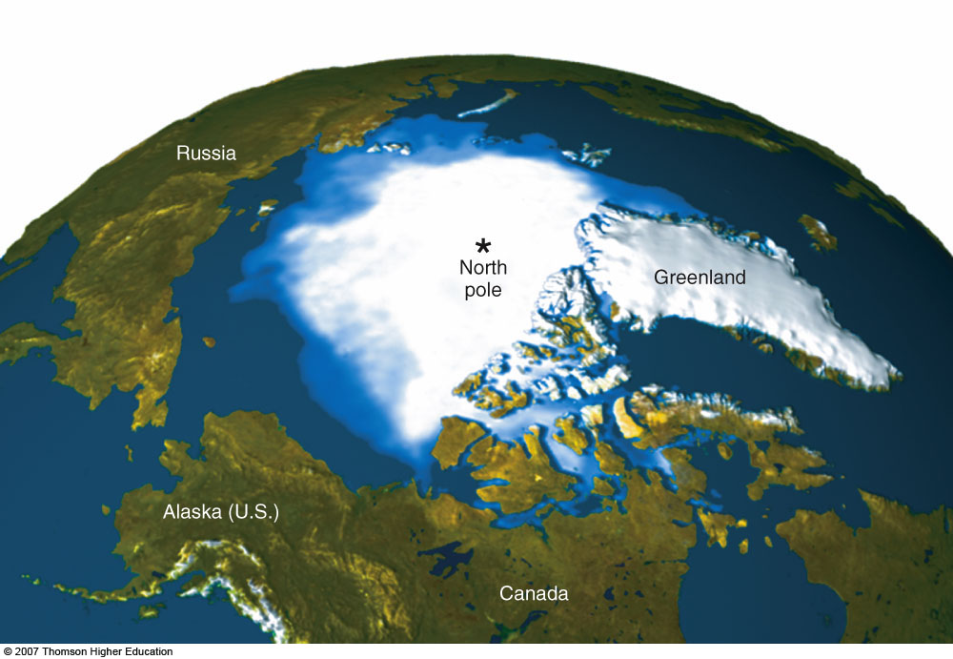
EFFECTS OF GLOBAL WARMING
Between 1979 and 2005, average Arctic sea ice dropped 20% (as shown in blue hues above).
Figure 20-8

Slide 78
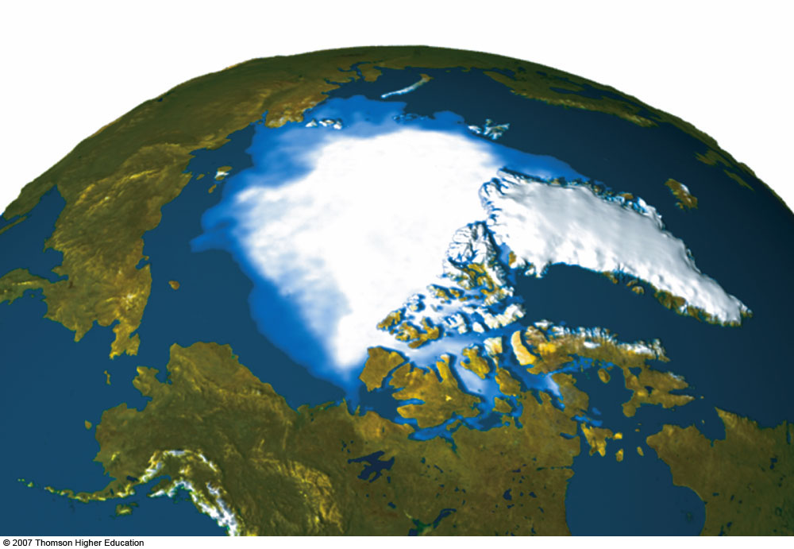
Russia
*
North
pole
Greenland
Alaska (U.S.)
Canada
Fig. 20-8, p. 474
Notes:
Figure 20.8
Science: satellite data showing Arctic sea ice between 1979 and 2005. The white area shows a moving average of Arctic sea ice between 2003 and 2005. The darker blue surrounding the white area is the moving average for the sea ice between 1979 and 1981. Between 1979 and 2005, average Arctic sea ice dropped 20%—a loss in area about the size of the U.S. state of Texas. The decrease in light-colored ice reflects less incoming solar energy back into space and can heat the troposphere. This in turn can cause more ice to melt and raise temperatures more in a runaway positive feedback cycle. QUESTION: List three impacts that this and continued melting of Arctic sea ice might have on your lifestyle. (Goddard Space Flight Center, NASA)

Slide 79
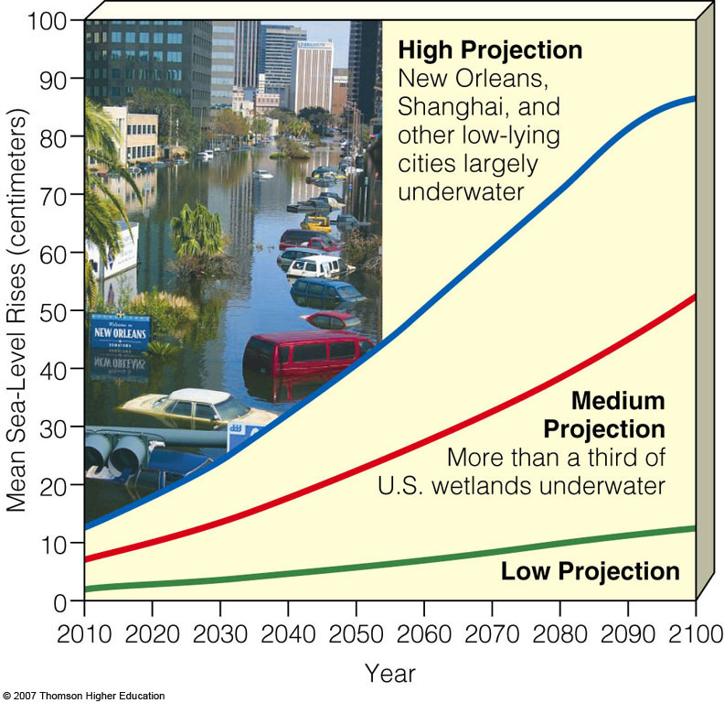
Rising Sea Levels
During this century rising seas levels are projected to flood low-lying urban areas, coastal estuaries, wetlands, coral reefs, and barrier islands and beaches.
Figure 20-10

Slide 80
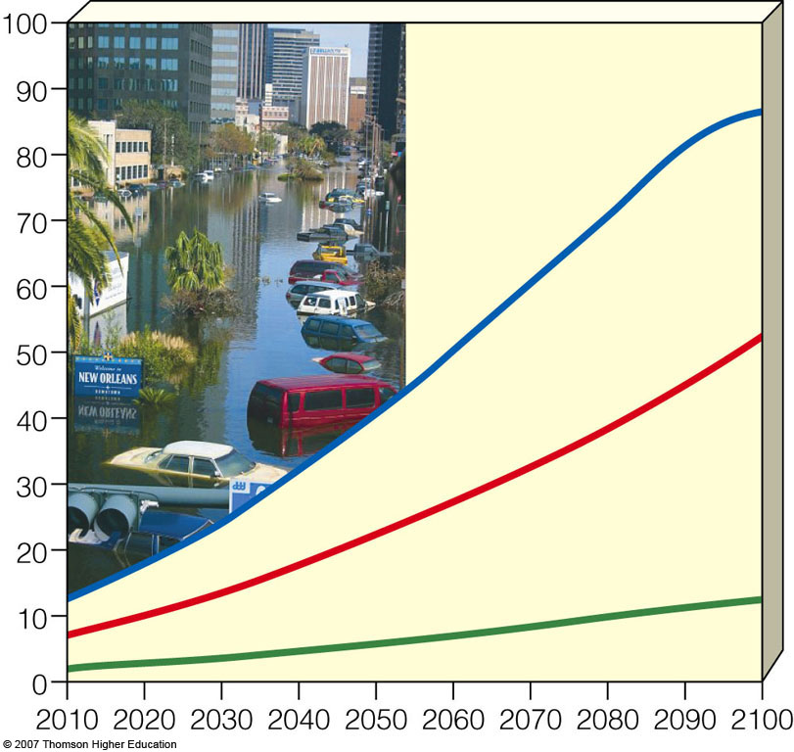
High Projection
New Orleans,
Shanghai, and
other low-lying
cities largely
underwater
Mean Sea-Level Rises (centimeters)
Medium
Projection
More than a third of
U.S. wetlands underwater
Low Projection
Year
Fig. 20-10, p. 475
Notes:
Figure 20.10
Natural capital degradation: projected rise in global sea levels during this century. With such a rise, flooding and coastal erosion would be especially severe in heavily populated coastal areas of the tropics and warm temperate regions. Thirteen of the world’s largest 20 cities are located at sea level. QUESTION: List three ways that this projected rise in sea level could affect your lifestyle. (Data from Intergovernmental Panel on Climate Change, 2000)

Slide 81
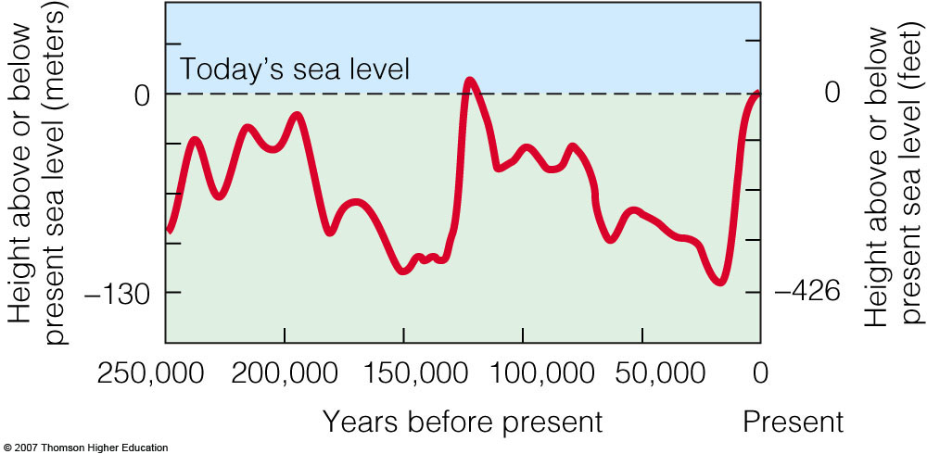
Rising Sea Levels
Changes in average sea level over the past 250,000 years based on data from ocean cores.
Figure 20-9

Slide 82
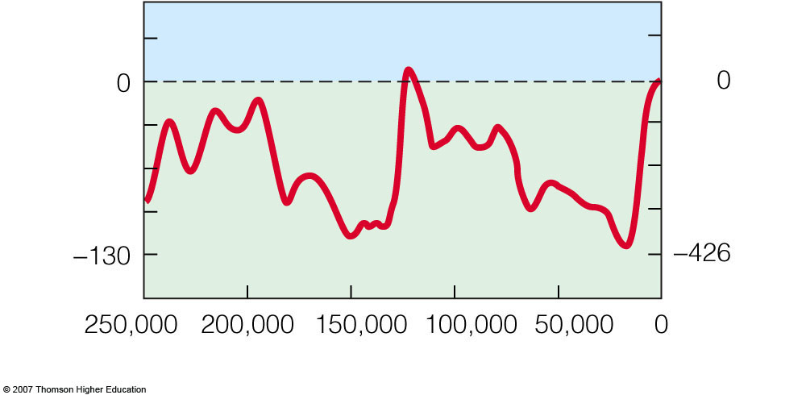
Today’s sea level
Height above or below
present sea level (meters)
Height above or below present sea level (feet)
Years before present
Present
Fig. 20-9, p. 475
Notes:
Figure 20.9
Changes in average sea level over the past 250,000 years based on data from cores removed from the ocean bottom. The coming and going of glacial periods (ice ages) largely determine the rise and fall of sea level. As glaciers melted and retreated since the peak of the last glacial period about 18,000 years ago (Figure 4-6, p. 89), the earth’s average sea level has risen about 125 meters (410 feet). (Adapted from Tom Garrison, Oceanography: An Invitation to Marine Science, 3/E, © 1998. Brooks/Cole)

Slide 83
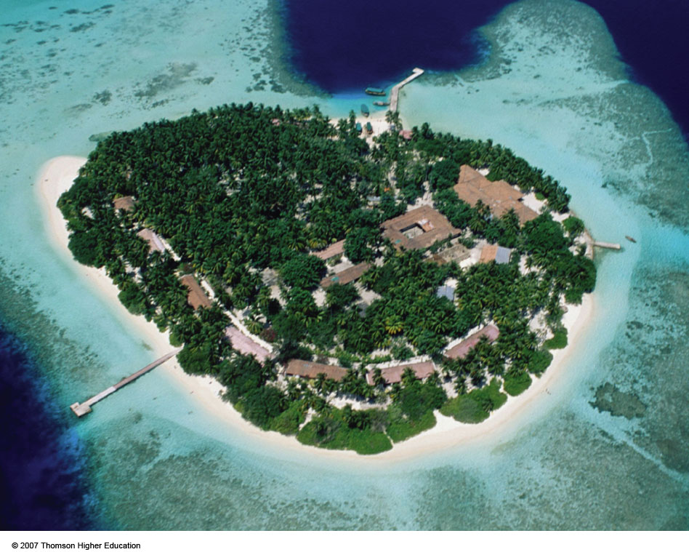
Rising Sea Levels
If seas levels rise by 9-88cm during this century, most of the Maldives islands and their coral reefs will be flooded.
Figure 20-11

Slide 84
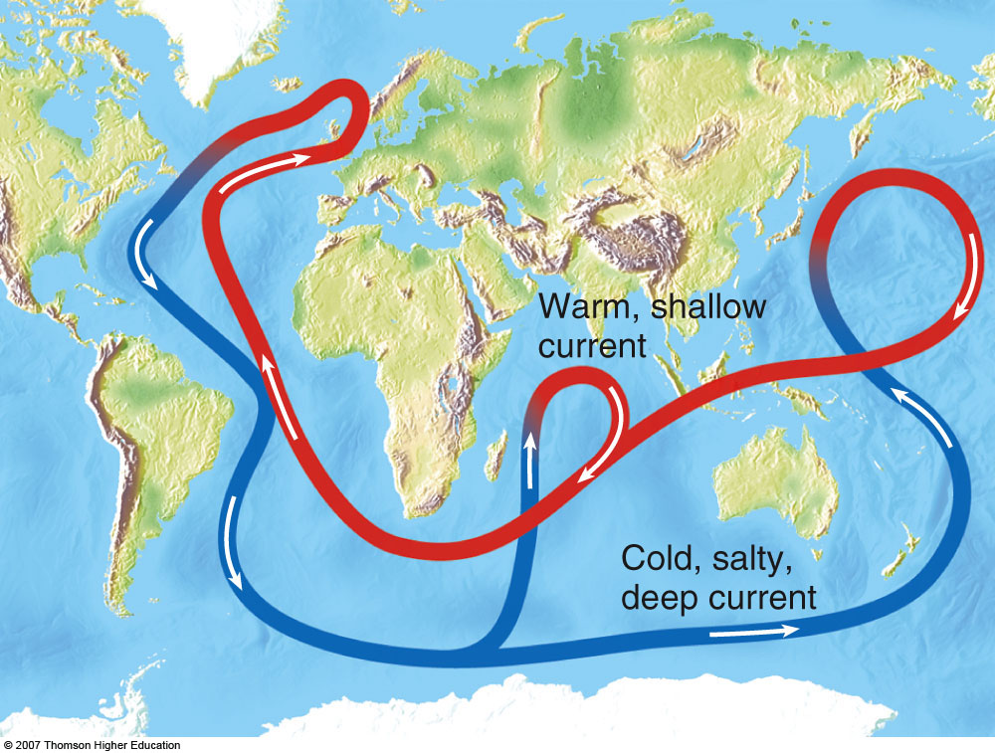
Changing Ocean Currents
Global warming could alter ocean currents and cause both excessive warming and severe cooling.
Figure 20-12

Slide 85
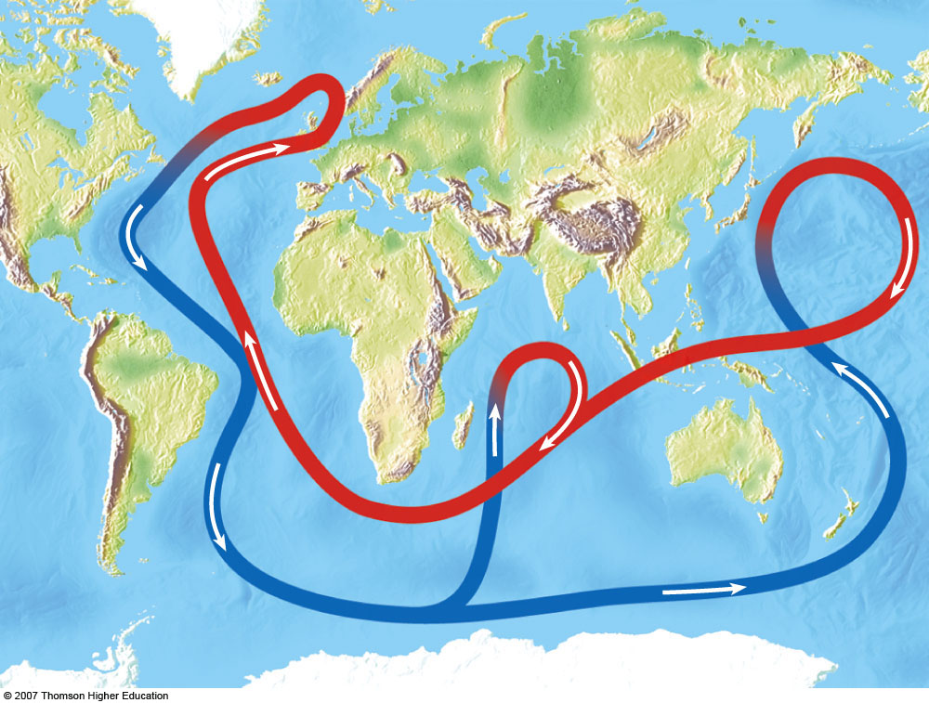
Warm, shallow
current
Cold, salty,
deep current
Fig. 20-12, p. 476
Notes:
Figure 20.12
Natural capital: a connected loop of shallow and deep ocean currents stores CO₂ in the deep sea and transports warm and cool water to various parts of the earth. This loop results when ocean water in the North Atlantic near Iceland is dense enough (because of its salt content and cold temperature) to sink to the ocean bottom, flow southward, and then move eastward to well up in the warmer Pacific. A shallower return current aided by winds then brings warmer and less salty—and thus less dense—water to the Atlantic. This water can cool and sink to begin the cycle again. A warmer planet would be a rainier one, which, coupled with melting glaciers, would increase the amount of freshwater flowing into the North Atlantic. This could slow or even jam this loop by diluting the saltwater and making it more buoyant (less dense) and less prone to sinking. Historical evidence suggests that such shifts in ocean currents have sometimes taken place in a matter of years or decades. QUESTION: How might your lifestyle be affected if this loop slows down in your lifetime?

Slide 86
EFFECTS OF GLOBAL WARMING
A warmer troposphere can decrease the ability of the ocean to remove and store CO₂ by decreasing the nutrient supply for phytoplankton and increasing the acidity of ocean water.
Global warming will lead to prolonged heat waves and droughts in some areas and prolonged heavy rains and increased flooding in other areas.

Slide 87
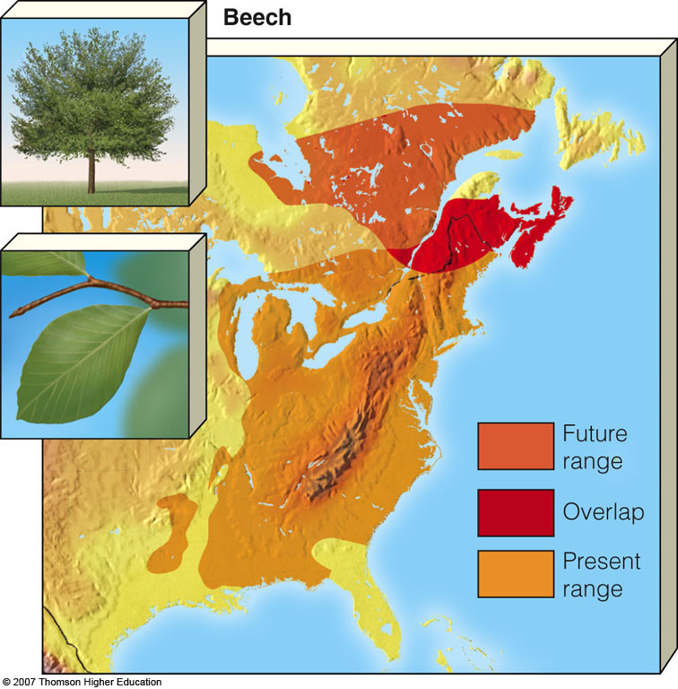
Effects on Biodiversity:
Winners and Losers
Possible effects of global warming on the geographic range of beech trees based on ecological evidence and computer models.
Figure 20-13

Slide 88
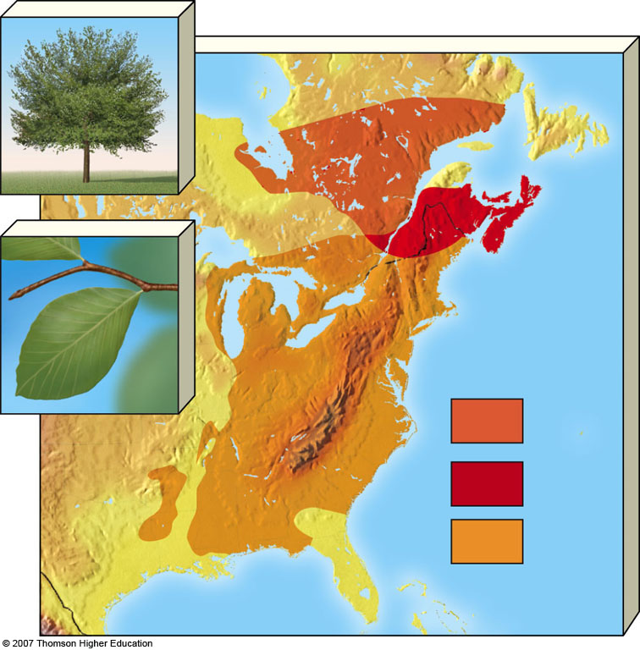
Beech
Future
range
Overlap
Present
range
Fig. 20-13, p. 478
Notes:
Figure 20.13
Natural capital degradation: possible effects of global warming on the geographic range of beech trees based on ecological evidence and computer models. According to one projection, if CO₂ emissions doubled between 1990 and 2050, beech trees (now common throughout the eastern United States) would survive only in a greatly reduced range in northern Maine and southeastern Canada. Similarly, native sugar maples would likely disappear in the northeastern United States. QUESTION: What difference does it make if the range of beech trees changes? (Data from Margaret B. Davis and Catherine Zabinski, University of Minnesota)

Slide 89
EFFECTS OF GLOBAL WARMING
In a warmer world, agricultural productivity may increase in some areas and decrease in others.
Crop and fish production in some areas could be reduced by rising sea levels that would flood river deltas.
Global warming will increase deaths from:
  Heat and disruption of food supply.
  Spread of tropical diseases to temperate regions.
  Increase the number of environmental refugees.

