Slide 1

Unit V: Sustainable Development:
meeting the needs of the present without compromising the ability of future generations to meet theirs
1

Slide 2
Goals of Sustainable Development
-Millinium Development Goals
-Sustainable Development Goals
2

Slide 3
The Sustainable Development Goals (SDGs) were born at the United Nations Conference on Sustainable Development in Rio de Janeiro in 2012. The objective was to produce a set of universal goals challenges that meet the urgent environmental, political and economic facing our world.
3

Slide 4
The SDGs replace the Millennium Development Goals (MDGs), which started a global effort in 2000 to tackle the indignity of poverty. The MDGs established measurable, universally-agreed objectives for tackling extreme poverty and hunger, preventing deadly diseases, and expanding primary education to all children, among other development priorities
4

Slide 5
The Sustainable Development Goals (SDGs), otherwise known as the Global Goals, are a universal call to action to end poverty, protect the planet and ensure that all people enjoy peace and prosperity.
5

Slide 6
These 17 Goals build on the successes of the Millennium Development Goals, while including new areas such as climate change, economic inequality, innovation, sustainable consumption, peace and justice, among other priorities. The goals are interconnected – often the key to success on one will involve tackling issues more commonly associated with another.
6

Slide 7
The SDGs work in the spirit of partnership and pragmatism to make the right choices now to improve life, in a sustainable way, for future generations. They provide clear guidelines and targets for all countries to adopt in accordance with their own priorities and the environmental challenges of the world at large.
7

Slide 8
The SDGs are an inclusive agenda. They tackle the root causes of poverty and unite us together to make a positive change for both people and planet. “Poverty eradication is at the heart of the 2030 Agenda, and so is the commitment to leave no-one behind,” UNDP Administrator Achim Steiner said. “The Agenda offers a unique opportunity to put the whole world on a more prosperous and sustainable development path. In many ways, it reflects what UNDP was created for.”
8

Slide 9
Goal 1: No Poverty "End poverty in all its forms everywhere
Goal 2: Zero Hunger : “End hunger, achieve food security and improved nutrition, and promote sustainable agriculture”
Goal 3: Good Health and Well-Being for People "Ensure healthy lives and promote well-being for all at all ages."
9

Slide 10
Goal 4: Quality Education "Ensure inclusive and equitable quality education and promote lifelong learning opportunities for all."
Goal 5: Gender Equality "Achieve gender equality and empower all women and girls."
Goal 6: Clean Water and Sanitation "Ensure availability and sustainable management of water and sanitation for all."
10

Slide 11
Goal 7: Affordable and Clean Energy "Ensure access to affordable, reliable, sustainable and modern energy for all."
Goal 8: Decent Work and Economic Growth "Promote sustained, inclusive and sustainable economic growth, full and productive employment and decent work for all."
Goal 9: Industry, Innovation, and Infrastructure "Build resilient infrastructure, promote inclusive and sustainable industrialization, and foster innovation"
11

Slide 12
Goal 10: Reducing Inequalities "Reduce income inequality within and among countries."
Goal 11: Sustainable Cities and Communities "Make cities and human settlements inclusive, safe, resilient, and sustainable."
Goal 12: Responsible Consumption and Production "Ensure sustainable consumption and production patterns."
12

Slide 13
Goal 13: Climate Action "Take urgent action to combat climate change and its impacts by regulating emissions and promoting developments in renewable energy."
Goal 14: Life Below Water "Conserve and sustainably use the oceans, seas and marine resources for sustainable development."
Goal 15: Life on Land "Protect, restore and promote sustainable use of terrestrial ecosystems, sustainably manage forests, combat desertification, and halt and reverse land degradation and halt biodiversity loss."
13

Slide 14
Goal 16: Peace, Justice and Strong Institutions "Promote peaceful and inclusive societies for sustainable development, provide access to justice for all and build effective, accountable and inclusive institutions at all levels."
Goal 17: Partnerships for the Goals "Strengthen the means of implementation and revitalize the global partnership for sustainable development"
14

Slide 15
15

Slide 16
Principles of Sustainable Development
16

Slide 17
The basic principles of sustainable development make it possible to harmonise the various sectoral and development strategies with the horizontal strategy on sustainable development (hereinafter: Strategy) and they also provide a general type of guidance for determining the Strategy’s priorities, more specifically defined goals and tasks, the frameworks and means of implementation, in a coordinated and harmonised way.
17

Slide 18
The basic principles have been formulated, clarified, and adopted at the highest levels by the relevant bodies of both the UN and the EU. On account of their national relevance the following should be highlighted from the complete set of principles:
18

Slide 19
The principle of holistic approach:
Things must be viewed as a system of inter-related elements, the elements themselves also being systems interacting with one another. Any intervention may trigger ripple effects even in remote systems. So local challenges can be adequately addressed relying on the knowledge of the wider environment and global trends alike.
19

Slide 20
Principle of intra-generational and inter-generational solidarity. The interests of sustainable development are focused on people. The development and environmental needs of present generations must be addressed without compromising the ability of future generations to meet their own needs.
20

Slide 21
The principle of social justice. The right to adequate conditions for living must be recognised and fundamental human rights must be guaranteed for all. All people should have equal opportunities for acquiring knowledge and skills required to become worthy members of society.
21

Slide 22
The principle of sustainable management of resources. Sustainable management of resources with a view to the limitations of the carrying capacity of the environment; by using natural resources in a prudent and thrifty way it preserves resources required for future development. Biodiversity is also a natural resource and we attach high priority to its conservation.
22

Slide 23
The principle of integration. In the course of elaborating, evaluating, and implementing sectoral policies, plans, and programmes, economic, social, and environmental considerations and their relationships must also be taken into account to ensure that they can mutually reinforce each other. Local, regional, and national activities must be coordinated.
23

Slide 24
The principle of utilising local resources. Efforts should be made to supply the needs of communities on a local level, from local resources. Local features and diversity should be preserved. Preservation and sustainable utilisation of the man-made environment and cultural heritage are also very important tasks.
24

Slide 25
The principle of public participation. Adequate access to information affecting social/economic life and the environment, to information on decision making processes must be provided for all. People’s knowledge about sustainable development, its social/economic and environmental implications, and about sustainable solutions and approaches must be clarified and enhanced. Public participation in decision making should be strengthened.
25

Slide 26
The principle of social responsibility. To enable sustainable development and to make a higher quality of life possible, unsustainable patterns of production and consumption must be changed. Businesses’ social responsibility must be strengthened, along with cooperation between the private and the public sector.
26

Slide 27
The principle of precaution and prevention. The precautionary approach means that wherever the possibility of severe or irreversible damage is perceived, a lack of complete scientific certainty may not be used as an excuse for delaying effective action to prevent damage to the environment or endangering human health; i.e. action must be taken in view of the gravity of the perceived threat.
27

Slide 28
Human activities must be planned and carried out in line with this precautionary principle and activities damaging or polluting the environment endangering natural systems and human health must be prevented and - where it is not possible – reduced, and finally, damages must be restored to their original state as far as possible.
28

Slide 29
The polluter pays principle. Prices must reflect the real costs paid by society for activities involved in consumption and production as well as for their impacts, including the costs of using natural resources. Those engaged in activities damaging/polluting the environment must pay for damage caused to human health or the environment.
29

Slide 30
30

Slide 31
31

Slide 32
32

Slide 33
33

Slide 34
34

Slide 35
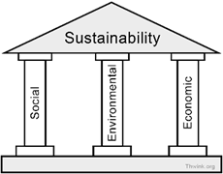
Pillars of Sustainable Development
35

Slide 36
Sustainability is most often defined as meeting the needs of the present without compromising the ability of future generations to meet theirs. It has three main pillars: economic, environmental, and social. These three pillars are informally referred to as people, planet and profits. The three-sphere framework was initially proposed by the economist René Passet in 1979. It has also been worded as "economic, environmental and social" or "ecology, economy and equity”.
36

Slide 37
The core of mainstream sustainability thinking has become the idea of three dimensions, environmental, social and economic sustainability. These have been drawn in a variety of ways, as ‘pillars’ (Figure A), as concentric circles (Figure B), or as interlocking circles (Figure C). The IUCN uses the interlocking circles model to demonstrate that the three objectives need to be better integrated, with action to redress the balance between dimensions of sustainability
37

Slide 38
Evolution of sustainable development
Throughout the evolution of the concept of “sustainable development” there was consensus on the fact that it does not focus solely on environmental issues. The three interdependent and mutually reinforcing pillars are: economic development, social development, and environmental protection. Indigenous peoples have argued that the fourth pillar of sustainable development is also cultural diversity.
38

Slide 39
The idea of sustainability dates back to the early 20th century in the era of industrial revolution when two opposing factions had emerged within the environmental movement: the conservationists and the preservationists. The conservationists focused on the proper use of nature, whereas the preservationists sought the protection of nature from use. Conservation sought to regulate human use while preservation sought to eliminate human impact altogether.
39

Slide 40
As the first evidences of an environmental crisis began to appear, several reactions took place. The International Union for Conservation of Nature (IUCN) was founded in October 1948 following an international conference in Fontainebleau, France. Its promoter’s sought to ensure that any use of natural resources is equitable and ecologically sustainable.
40

Slide 41
The Club of Rome, a think tank composed of a small international group of people from the fields of academia, civil society, diplomacy, and industry, raised considerable public attention in 1972 with its report The Limits to Growth that predicted that economic growth could not continue indefinitely because of the limited availability of natural resources, particularly oil.
41

Slide 42
Sustainable development was a key theme of the United Nations Conference on the Human Environment in Stockholm in 1972. The concept was coined explicitly to suggest that it was possible to achieve economic growth and industrialization without environmental damage.
42

Slide 43
In the ensuing decades, mainstream sustainable development thinking was progressively developed through the World Conservation Strategy (1980), the Brundtland Report (1987), and the United Nations Conference on Environment and Development in Rio (1992), as well as in national government planning and wider engagement from business leaders and non-governmental organisations of all kinds.
43

Slide 44
Over these decades, the definition of sustainable development evolved. The Brundtland Report defined sustainable as ‘development that meets the needs of the present without compromising the ability of future generations to meet their own needs’. This definition was vague, but it cleverly captured two fundamental issues, the problem of the environmental degradation that so commonly accompanies economic growth and yet the need for such growth to alleviate poverty.
44

Slide 45
The core of mainstream sustainability thinking has become the idea of three dimensions, environmental, social and economic sustainability.
Governments, communities and businesses have all responded to the challenge of sustainability to some extent.
45

Slide 46
Almost every national government in the United Nations now has a minister and a department tasked with policy on the environment, and many regional and local governments have also developed this capacity. Since the Rio Earth Summit in 1992 the volume and quality of environmental legislation (international, national and local) has expanded hugely, and international agreements (such as the Kyoto protocol) have not only raised the profile of environmental change but also begun to drive global policy change.
46

Slide 47
Agenda 21 is a non-binding programme of action, which was adopted by more than 178 Governments at the 'Earth Summit' in 1992. Although the Agenda lacks the force of international law, the adoption of the texts carries with it a strong moral obligation to ensure implementation of the strategies. The central belief of this "global partnership" is that all countries can protect the environment while simultaneously experiencing growth.
47

Slide 48
Regarding climate change, there is increasing recognition that the impacts are being felt disproportionately by poor people who already live under precarious conditions. Climate change, with its many facets, further exacerbates existing inequalities faced by these vulnerable groups.
48

Slide 49
It threatens to undermine the realization of fundamental rights for many people and to reverse progress made towards the achievement of the internationally agreed development goals, including the Millennium Development Goals (MDGs). It is a global justice concern that those who suffer most from climate change have done the least to cause it.
49

Slide 50
The concept of climate justice acknowledges that because the world’s richest countries have contributed most to the problem, they have a greater obligation to take action and to do so more quickly. However, many fear that whatever international agreement is reached between governments, it will compound the already unjust burden on the poor and vulnerable.
50

Slide 51
A rapidly growing number of social movements and civil society organizations across the world are mobilizing around this climate justice agenda. Citizens from both the South and the North are drawn to this concept, in part, because many are already experiencing the impacts of climate change and they worry about the fate of their families, homes and livelihoods.
51

Slide 52
The ‘greening’ of business has grown to be a central issue in corporate social responsibility for many global companies, although for many it is still a boutique concern within wider relationship management, rather than something that drives structural change in the nature or scale of core business.
52

Slide 53
Since the Earth Summit in Rio de Janeiro in 1992 and the World Summit on Sustainable Development in Johannesburg in 2002, the subject of sustainable development has moved up on the political agenda. However, action is still not matching the many challenges such as climate change, poverty alleviation and biodiversity loss.
53

Slide 54
Inequality is growing in the world, and the multiple global crises make it all the harder to advance the sustainability agenda effectively and to secure genuine global co-operation and partnership on the key issues.
54

Slide 55
Environmental ethics and global view on sustainable-earth
55

Slide 56
People disagree about how serious our environmental problems are and what we should do about them. These conflicts arise mostly out of differing environmental world views. Environmental worldviews are how people think the world works, what they believe their role in the world should be, and what is their environmental ethics. People with widely differing environmental worldviews can take the same data, be logically consistent, and arrive at quite different conclusions because they start with different assumptions and values.
56

Slide 57
Environmental ethics of people is what they believe is right and wrong environmental behavior. Environmental ethics is the part of environmental philosophy which considers extending the traditional boundaries of ethics from solely including humans to including the non-human world.
There are many different environmental worldviews. Some are human centered; others are life-centered, which puts the primary focus on individual species or on sustaining the earth’s natural life forms (biodiversity and life-support systems (biosphere) for the benefit of humans and other forms of life.
57

Slide 58
HUMAN-CENTERED AND LIFE-CENTERED ENVIRONMENTAL WORLDVIEWS
The major difference among environmental worldviews is the emphasis they put on the role of humans dealing with environmental problems.
Some view that humans are the planet’s most important species and should become managers or stewards of the earth.
58

Slide 59
Human – centered environmental worldview
Some people have a planetary management worldview. According to this worldview, we are the planet’s most important and dominant species, and we can and should manage the earth mostly for our own benefit. Other species and parts of nature are seen as having only instrumental value based on the how useful they are to us.
“The view of the world – that nature belongs to us rather than we to nature- is powerful and pervasive- and it has led to much mischief”
59

Slide 60
Here are three variations of this environmental worldview:
1. The no – problem school: We can solve the environmental, population, or resource problems we face with more economic growth and development, better management, and better technology.
2. The free – market school: The best way to manage the planet for human benefit is through a free – market global economy with minimal government interference and regulations. All public property resources should be converted to private property resources and the global marketplace, governed by the free market competition, should decide essentially everything.
60

Slide 61
3. The spaceship – earth school: The earth is like a spaceship, a complex machine that we can understand, dominate, change, and manage to prevent environmental overload and provide a good life for everyone. This view developed as a result of photographs taken from space showing the earth as a finite planet, or an island in space. This led many people to see that the earth is our only home and we had better treat it with care.
61

Slide 62
Another human - centered environmental worldview is the stewardship worldview. It assumes that we have an ethical responsibility to be caring and responsible managers, or stewards, of the earth. According to the stewardship vies, as we use the earth's natural capital, we are borrowing from the earth and from future generations, especiall because studies indicate that humanity's ecological footprint is about 39% greater than the earth's overall ecological capacity. As a result, we have an ethical responsibility to pay the ecological debt we have run up by leaving the earth in a condition treat is at least as good as we now enjoy.
62

Slide 63
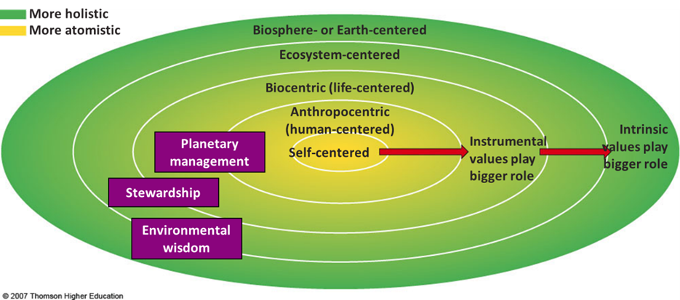
63

Slide 64
Some people believe any human – centered worldview will eventually fail vecause it wrongly assumes we now have or can gain enough knowledge to vecome effective mlanagers or stewards of the earth. To biologist a;nd environmental philosopher Rene Dubos, “ The belief that we can manage the earth and improve on nature is probably the ultimate expression of human conceit, but it has deep roots in the past and is almost universal.”
64

Slide 65
According to some critics of human centered worldviews, the unregulated gloal free-market approach will not work because it is based on increased losses or degradation of the earth’s natural capital and focuses on short term economic benefits regardless of the harmful long term environmental and social consequences.
65

Slide 66
The image of the earth as an island or spaceship in space has played an important role in raising global environmental awareness. But critics argue that thinking of the earth as a spaceship that we can manage is an oversimplified, arrogant, misleading way to view an incredibly complex and ever changing planet. Theis criticism was supported by the failure of Biosphere 2.
66

Slide 67
Critics of human cintered worldviews point out that we donot even how many species live on the earth, much less what their roles are and how mthey interact with one another and their nonliving environment. We have only an inkling of what goes on in a handful of sil, a meadow, or any other part of the earth.
67

Slide 68
Life centered and Earth – centered environmental worldviews
Critics of human – centred environmental views argue that the should be expanded to recognize the inherent or intrinsic value of all forms of life, regardless of their potiential or actual use to humans. Many of the world’s religions have such an inherent respect for life.
68

Slide 69
But there is disagreement over how far we should exten our ethical concerns for various forms or levels of life. Most people with a life centered world view believe we hav an ethical responsibliit to avoid causing the prematured extinction of species through our activities, for two reasons. First, each species is a unique storehouse of genetic information that should be respected and protected simply because it exists ( intrinsic value). Second, each species is a potential economic good for human use ( instrumental value).
69

Slide 70
Trying to decide whether all or only some species should be protected from premature extinction resulting from human activities is a difficult and controversial ethical problem. It is hard to know where to draw the line in order to be ethically consistent.
70

Slide 71
Here are three of the issues involved; first, should all species be protected from premature extinction because of their intrinsic value, or should only certain ones be preserved because of their known or potential instrumental value to us or to their ecosystems?
Second, should all insect and bacterial species be protected, or should we attempt to exterminate those that eat our crops, harm us , or transmit disease organism?
Third, should we emphasize protection of keystone and foundation species over other species that play lesser roles in ecosystems?
71

Slide 72
Some people think we should go beyond focusing mostly on species. They believe we have an ethical responsibility to prevent degradation of the earth’s ecosystems, biodiversity, and biosphere for this and future generations of humans and other species. This earth- centered world view is called the wisdom world view. IN many respect, it is the opposite of the planetary management worldview. According to this worldview, we are part of not apart from the community of life and the ecological processes that sustain all life. Therefore, we should work with the earth instead of trying to conquer and mange it mostly for ourselves.
72

Slide 73
This worldview is based on the ethic that we should strive to care for all species and all humanity. It also suggests that the earth does not need us managing it in order to go on, whereas we need the earth in order to survive. We cannot save the earth because it does not need saving. What we need to save is the existence of our own species and other species that may become extinct because of our activities.
73

Slide 74
Deep ecology environmental worldview
Another earth centred environmental worldview is the deep ecology worldview. It consists of eight premises developed in 1972. By Norgwegian philosopher Arne Naess, in conjunction with philosopher George Sessions and Sociologist Bill Deball.
74

Slide 75
First, each nonhuman for of life on the earth has inherent value independent of its value to humans.
Second, the fundamental interdependence and diversity of life forms contribute to the flourishing of human and nonhuman life on earth.
Third, humans have no right to reduce this interdependence and diversity except to satisfy vital needs.
Fourth, present human interference with the nonhumans world is excessive, and the situation is worsening rapidly.
75

Slide 76
Fifth, because of the damage caused by this interference, it would be better for humans, and much better for nonhumans, if there were a substantial decrease in the human population.
Sixth, basic economic and technological policies must therefore be changed.
Seventh, the predominant ideology must change such that measurements of the quality focus on the overall health of the environment and all living things, rather than on the material wealth of human individual and societies.
Eighth, those who subscribe to these points have an obligation directly or indirectly to try to implement the necessary changes.
76

Slide 77
Ecofeminist Environmental world view
French writer Franqoise d’Eaubornne coined the term ecofeminism in 1974. It includes a spectrum of views on the relationships of women to the earth and to male-dominated societies (patriarches) . Most ecofemenists agree that we need a life centered or earth centered environmental worldview. However, they believe a main cause of our environmental problems is not just human cenreeredness, but specifically male centeredness (androcentrism).
77

Slide 78
Many ecofeminists argue that the rise of male dominated societies and environmental world views since the advent of agriculture, when land and water became important resources to protect (mostly by males), is primarily responsible for our violence against nature and for the oppression of women and minorities as well.
To such ecofenists, our shift from hunter gatherer to agricultural and industrial societies changed our view to nature from that of a nurturing mother to that of a foe to be conquered
78

Slide 79
Ecofeminists note that women earn less than 10% of all wages, own less than 1% of all property, and in most societies have far fewer rights than men. Some ecofeminists suggest that oppression by men has driven women closer to nature and made them more compassionate and nurturing. As oppressed members of society, they argue, many women have more experience in dealing with interpersonal conflicts, bringing people together, acting as caregivers, and identifying emotionally with injustice, pain, and suffering.
79

Slide 80
To these analysts, women with such qualities are in a better position to help lead as we struggle to develop more environmentally sustainable and socially just societies. Such societies should be based on cooperation, rather than confrontation and domination and on finding win- win solutions to our environmenental and human problems instead of win-lose solutions often associated with our current male dominated societies.
Ecofeminists argue that women should be treated as equal partners with men. They do not want to be given token roles or co-opted into the male power game. They want to work with men to bake an entirely new economic and environmental pie. The hope to heal and rift between humans and nature and end oppression based on sex, race, class, age, and cultural and religious beliefs.
80

Slide 81
Ecofeminists are not alone in calling for us to encourage the rise of life centred people who emphasize the best human characteristics; gentleness caring, compassion nonviolence, cooperation and love.
81

Slide 82
Ethical guideline for earth
1. Ecosphere and ecosystem
a. We should try to understand nature.
b. When we must alter nature, first we should do our best to avoid environmental harm
82

Slide 83
2. Species and cultures
a. We shoud work to preserve genetic diversity.
b. We may do what we must to stay alive, but we shoud do what it takes t avoid premature extinction of other species.
c. We ;must protect ecosystems to save species
d. No numan culture should become extince because of present actions
83

Slide 84
3. Individual responsibility
a. We should not cause any suffereing to our food sources
b. We should leave the earth better rhan we found it
c. We shold use only what we have
d. We should heal the wounds we have already caused
84

Slide 85
4. Earth Education
a. We should teach our children about our earth:
i. Respect life
ii. Understand earth
iii. Understand interactions of humans and the earth
iv. Seek wisdom
v. Evaluate personal worldviews
vi. Evaluate conswquences of lifestyles and professions
vii. Use critical thinking skills
viii. Want to help the earth
85

Slide 86
5. Learning to work with earth
a. Listen to ouir children, who favour saving the earth
b. Learn to make our own area sustainanle
c. Have fun saving the earth
86

Slide 87
6. Learning to live simple:
a. Voluntary simplicity- does and enjoys things more with less.
b. The earth provides enough, and we should us the minimal amounts of everything.
c. This is not eht same as forced simplicity that plagues those that cannot afford to have possessions
d. Law of progressive simplification – we must transfer wnergy form material to nonmaterial
87

Slide 88
7. Moving on
a. We need to stop blaming and start taking responsibility
b. We must avoid the common mental traps that lead to denial, indifference and inaction:
i. Gloom and doom pessimism: feeling it’s over
ii. Blind technological optimism: science will save us
iii. Fatalism- we have no control of the future
iv. Extrapolation to infinity: if there’s no quick fix, why bother?
c. We must realize no one can do it all.
d. Hope is vital
e. There is more than one possible solution.
88

Slide 89
8. Components of the earth-wisdom revolution
a. Efficiency revolution to make the most of the earth
b. Pollution prevention
c. sufficiency revolution being sure that everyone has his or her basic needs
d. Demographic revolution balance population growth
e. Seeing the world as a flow of matter and energy
89

Slide 90
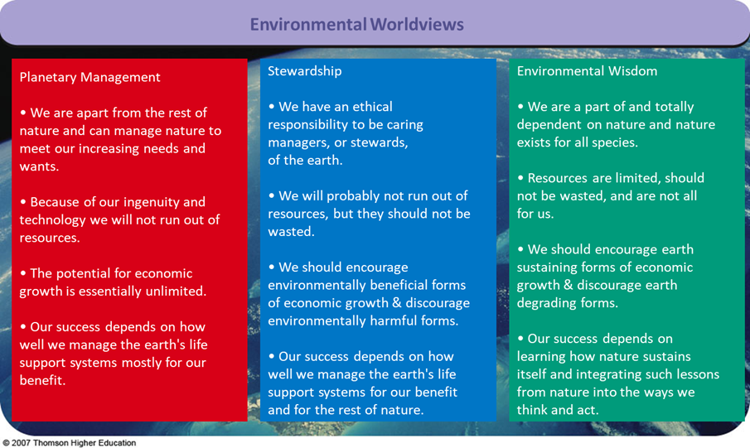
90

