Slide 1

Environmental Impact Assessment

Slide 2
Concept and application of environmental impact assessment
Environmental Assessment (EA) is an amalgamation of arts and science of identifying/predicting and evaluating the results of interactions between environmental variables and human activities in nature. It is a management tool. It ensures compliance of proposed project with the policy and legal provisions and influences decision making processes. Among EA, environmental impact assessment (EIA) and initial environmental examination (IEE) are currently in practice in Nepal.

Slide 3
EIA is a systematic, reproducible and interdisciplinary evaluation activity which identifies, predicts, interprets and communicate information about the proposed projects and find and suggest alternatives to enhance positive impacts and to mitigate negative impacts from the project.

Slide 4
In EIA, environment comprises of bio-physical environment, natural environment, manipulated environment social and economic environment cultural environment. Impact covers adverse impact or beneficial impact, Direct impact or indirect impact, short term- medium term or long term impact, reversible or irreversible impacts, site specific, local regional or national level impacts. Assessment is termed for quantification, prediction, evaluation, monitoring and auditing.

Slide 5
Principles of EIA
1. Participation: All interested parties have appropriate and timely access to the process,
2. Transparency: all assessment decisions and their basis are open and accessible,
3. Certainly: the process ans timing of the assessment are agreed upon in advanced and adhered to by all participants,
4. Accountability: decision makers are responsible to all parties for thir actions and decisions under the assessment process,

Slide 6
5. Credibility: assessment is carried out with professionalism and objectivity,
6. Cost effectiveness: the assessment process and its outcomes ensure environmental protection at the least cost to society,
7. Flexibility: the assessment process is able to adapt so that it can deal efficiently with any sort of proposal and any decision making situation, and
8. Practicality: the information and outputs provided by the assessment process are readily usable in decision making and planning.

Slide 7
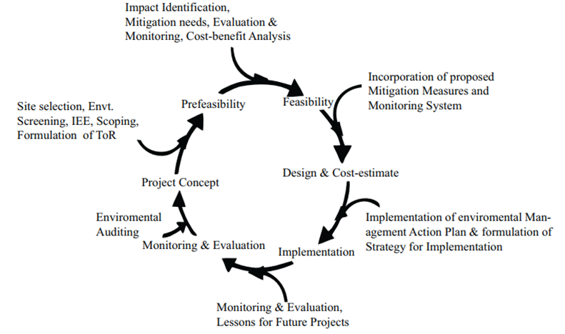
Relevant EIA activities in each stages of project cycle

Slide 8
General steps of EIA
1. Project screening: determines if the project requires an EIA or not.
2. Scoping: identifies potentially significant impacts and provides alternatives to the project as well as a basis for developing terms of reference
3. Project description and consideration of alternatives: seeks to describe all reasonable alternatives, including preferred and ‘no action’ options (project location, scale, process, layout, and operating conditions)
4. Prediction of impacts: identifies and predicts impacts as quantitatively as possible in terms of characteristics such as magnitude, extent, and duration
5. Evaluation of impacts: determines the significance or importance of the predicted impacts
6. Mitigation measures: designs systems and/or processes to avoid, reduce, and minimize adverse impacts to enhance beneficial outcomes
7. Stakeholders’ involvement: ensures that stakeholders’ views as well as issues of quality, comprehensiveness, and effectiveness are adequately addressed in the decision-making process and that these ideas are shared throughout the EIA process with those involved
8. Monitoring and auditing measures: identifies impacts that require monitoring or auditing
9. EIA report: summarizes all the information obtained, analyses, interpreted, and compiled into a report format, which should contain a non-technical summary as well as sections on the methodologies, results, analysis, and conclusions

Slide 9
8.2 Project screening
It is important to establish a mechanism for identifying the projects which require EIA and which do not. The process of selecting projects for EIA is known as screening.
Screening classifies project proposals into following three categories.
1. Projects clearly requiring an EIA,
2. Project not requiring an EIA, and
3. Projects which may or may not require an EIA and should consider conducting an IEE to see if an EIA is needed.

Slide 10
8.2 Project screening
It is important to establish a mechanism for identifying the projects which require EIA and which do not. The process of selecting projects for EIA is known as screening.
Screening classifies project proposals into following three categories.
1. Projects clearly requiring an EIA,
2. Project not requiring an EIA, and
3. Projects which may or may not require an EIA and should consider conducting an IEE to see if an EIA is needed.

Slide 11
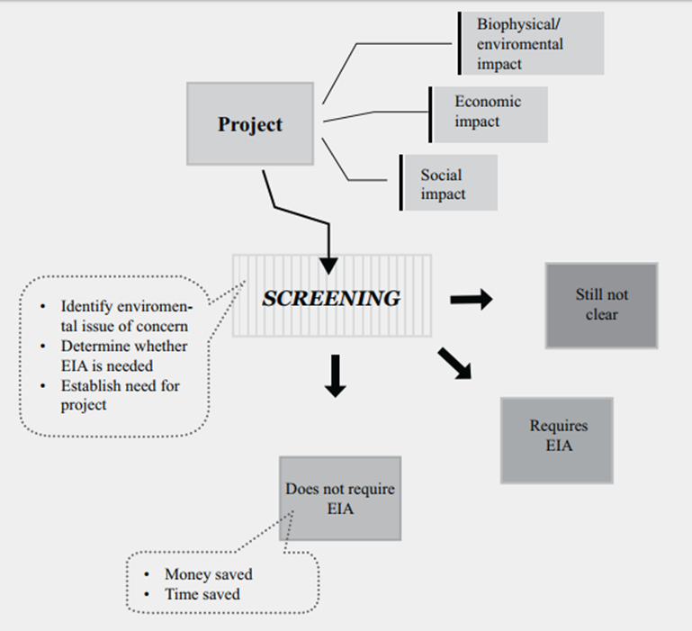

Slide 12
Screening Criteria in Nepal:
All projects in Nepal are screened based on three categories:
• Nature of the project (Type Criteria),
• Size of the project (Threshold Criteria); and
• Location of the project (Sensitive Area Criteria)

Slide 13
Screening Procedure in Nepal:
All projects in Nepal are divided into three categories:
Projects requiring IEE are listed in Schedule 1 of EPR 1997 (amendment 1999)
Projects requiring EIA are listed in Schedule 2 of EPR 1997; and Projects not listed in Schedule 1 and 2:
  with a cost of NRs. 10 million to 100 million require IEE.
  with a cost of NRs. more than 100 million require EIA.

Slide 14
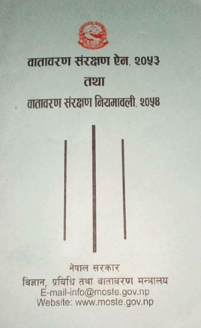
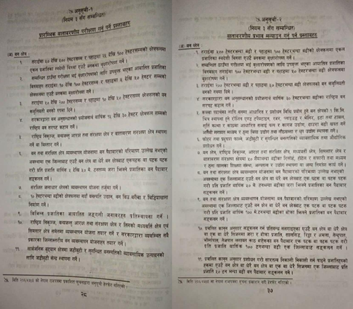

Slide 15
IEE is conducted if there is no definite solution in screening
How IEE should be conducted?
It is necessary to understand the following components of the project activities:
Project activities to be implemented, setting of project, resources’ demands and the waste produced, policies, regulations and guidelines to be known of IEE, and resources and environment are likely to be impacted.
IEE process identifies:
Most likely significant impacts (positive/negative) from proposed actions,
Mitigation measures for adverse impacts not expected to be significant,
Mechanisms for enhancing beneficial impacts, and
Residual uncertainties not possible to be resolved in the screening
A simple matrix/checklist could be used for IEE

Slide 16
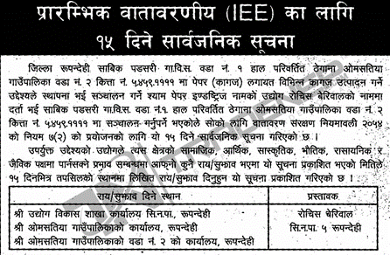

Slide 17
8.3 Scoping
Scoping is defined as a procedure for determining the extent of and the approach to an EIA. Scoping document is not required for an IEE
Scoping involves the following tasks:
a) The involvement of relevant authorities, interested parties and affected groups;
b) The identification of relevant or significant issues to be examined;
c) The identification and selection of alternatives; and
d) The determination of the Terms of Reference (TOR) for further study.

Slide 18
The main objectives of Scoping are:
a) to provide an opportunity for the proponents, consultants, relevant authorities and interested and affected parties to exchange information and express their views and concerns regarding a proposal before an EIA is undertaken; and
b) to focus the study on reasonable alternatives and relevant issues, to ensure that the resulting EIA is useful to the decision -maker and addresses the concerns of interested and affected parties, as well as to facilitate an efficient EIA process that saves time and resources while reducing the risk of costly delays.

Slide 19
Scoping is required to help:
• Identify concerns and issues for consideration in an EIA,
• Enable those responsible for an EIA study to properly brief the study team on the alternatives and on impacts to be considered at different levels of analysis
• Determine the assessment methods to be used,
• Identify all affected interests,
• Provide an opportunity to the public involved in determining the factors to be assessed,
• Facilitate an early agreement on contentious issues,
• Save time and money, and
• Establish terms of reference (TOR) for EIA study

Slide 20
Mechanism of Scoping:
1. Open Scoping: public meetings, workshops, seminars, etc.
2. Closed Scoping: letters, interviews, discussion, etc.
Lists of Participants for Scoping:
1. Proponent (with/without consultants)
2. Review agency
3. Licensing agency
4. Other relevant agencies
5. NGOs
6. Public

Slide 21
Scoping Approach:
1. Planning for Public Involvement
2. Collecting existing information
3. Information distribution
4. Issues of public concern
5. Analysis of significance
6. Establishing and addressing priority issues
7. Agencies responsible and appropriate timing to conduct scoping and involvement of concerned agencies and groups

Slide 22
Methods used in Scoping:
• Literature review
• Map interpretation
• Public Notice
• Planning for public involvement
• Field study
• PRA/RRA
• Data processing
• Impact identification (checklists, matrices, and networks)
• Issues prioritization
• Identification of a strategy for addressing priority issues
• Report preparation

Slide 23
Scoping Requirement in Nepal
1. The proponent publishes a notice in national daily to ask the stakeholders of suggestions within 15 days
2. The suggestions are sent to the proponent within the 15 days of first publication of notice
3. The proponent, along with the received concerns and suggestions sends an application to the concerned authority for scope determination
4. The concerned authority carries out the investigation and sends to MOFE
5. MOFE carries out the investigation on the documents and determines the scope as proposed or suggested

Slide 24
Format of a Scoping document
1. Introduction: Background, the proponent, project description, relevant policies, laws, standards, guidelines and manuals
2. Scoping Methodology: Literature review, map interpretation, public notice, reconnaissance survey, issues prioritization methods, report preparation
3. Existing environmental conditions and likely impacts: Physical, biological socioeconomic, cultural, potential environmental impacts
4. Environmental issues identified and raised: issues identified, issues raised, issues discarded (if any)
5. Issues prioritized for EIA study:
6. Work schedule
7. References
8. Annexes

Slide 25
8.4 Preparation of terms of reference (TOR)
Terms of References (TOR) are prepared following Scoping to provide specific guidelines for the EIA study.
TOR assists in
• Identifying and describing the impacts/issues to be investigated,
• Systematizing the working procedure
• Delineating the specific activities to be implemented,
• Fitting the EIA study into the context of existing policies, rules and administrative procedures, and
• Accomplishing the work within a specified time frame

Slide 26
Main TOR Components:
The TOR should specify the following,
1. The project proposal and its reasonable and practical alternatives (including the ‘no action’ option);
2. The environmental components which need detailed or further study, the indicators for each listed components to be measured or assessed;
3. The likely significant impacts which should be investigated;
4. The need to identify actions required to be minimized as far as possible;

Slide 27
5. Adverse impacts (relocation, increased taxes, compensation, etc.) and enhance benefits;
6. Implementation of an economic evaluation of environmental impacts (to the extent possible);
7. Identification of a monitoring program for impacts of concern during the project’s operation and beyond;
8. Aspects of EIA such as; work tasks, study schedule, review sessions and study team;
9. Provision of a conclusion on whether the project should be implemented or whether it poses an unacceptable risks;
10. The time required for the EIA report with an estimated budget; and
11. The completion date

Slide 28
Format of TOR for Nepal (Schedule 4 of EPR 1997)
Cover page with title and name of the proponent
Executive summary
Table of contents
Acronyms
1. Project description (Background, project description with salient features, objectives of EIA, methodology, description of the study area and study limitations)
2. Review of policy, laws, guidelines and institutions
3. Existing environmental conditions

Slide 29
4. Alternative Analysis
5. Environmental Impacts and Protection Measures (construction and operational phases)
6. Environmental Monitoring and Auditing (types, parameters, methods and schedule)
7. Environmental Management Plan
8. Conclusion and Recommendations
References
Appendices- maps, tables, graphs, drawing and designs, photographs, checklists and questionnaires issues raised , recommendation letters of VDCs, municipalities etc.

